Slide 1
Unit 8:
What subjects do you have today?
Lesson 1: Part 1, 2 page 52
Teacher: Nguyen Thi Thuy Linh

Slide 2
CHECK UP

Slide 3
INTEREVIEW
You have to ask your partner some questions about:
1. What your name?
2. Where are you from?
3. What nationality are you?
4. When’s your birthday?
5. What can you do?
6. What do you like doing?

Slide 4
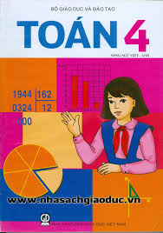

Slide 5
Wednesday, November 23rd , 2016
Unit 8: What subjects do you have today?
Lesson 1: Part 1, 2 page 52
1. Look, listen and repeat:
a. New words:
- subject:
môn học
- Maths:
môn Toán
- Vietnamese:
môn Tiếng Việt
- Science:
môn Khoa học
- Art:
môn Mĩ thuật
- IT = Information Technology:
môn Tin học
- Music:
môn Âm nhạc

Slide 6
MATCHING
Vietnamese
Maths
Art
IT
Music
Science

Slide 7
NAM
TOM

Slide 8
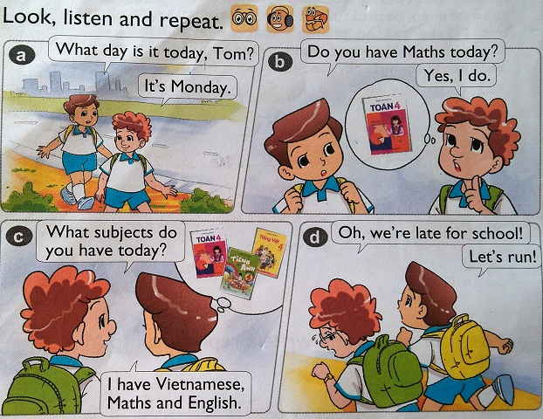
b. Dialogue:

Slide 9
2. Point and say:
S1: What subjects do you have today?
Science.
S2: I have
Vietnamese.
Maths.
Maths.
IT(Information Technology .
Art.
Music.

