Slide 1
Welcome to our English class .
Class: 3 C
Teacher: Nguyen Thi Ly Va

Slide 2
Tuesday, November 12th 2019
Unit 6: Stand up!
Lesson 1: Part 4-5-6/ Page 41

Slide 3
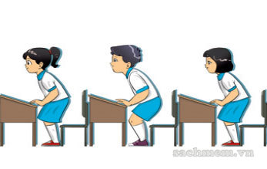
4. Listen and tick
1
a
b
c

Slide 4
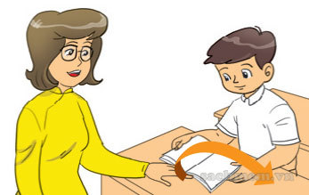
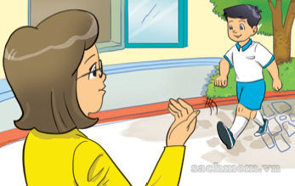
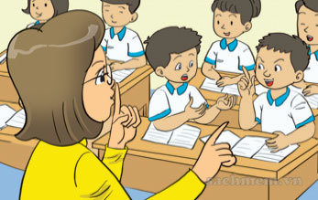
2
a
c
b

Slide 5
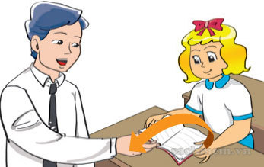
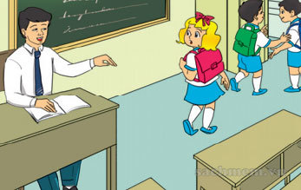
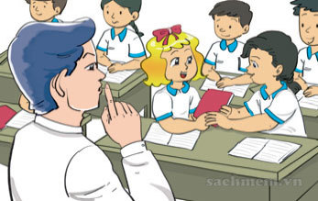
3
a
b
c

Slide 6
v
v
v

Slide 7
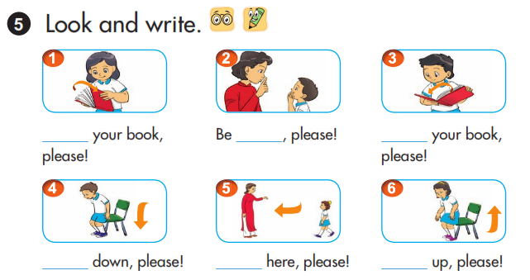
Open
quiet
Close
Sit
Come
Stand

Slide 8
Let's play
Who's a millionaire?

Slide 9
Reorder the words
your/ book / ! / open
Open your book!

Slide 10
SsSt_ nd
A. o
B. e
C. a
D. u
C. a

Slide 11
Sit ……….
A. you.
B. down
B. down
C. up
D. nice

Slide 12
………...your book!
A. open
A. open
B. yours
C. your
D. A and D

Slide 13
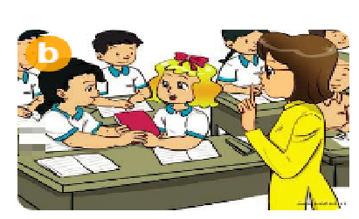
Don’t……….
A. say
B. talk
B. talk
C. look
D. repeat

Slide 14
You are a millionaire.
L
F

