Slide 1
Welcome to our English class .
Class: 3 C
Teacher: Nguyen Thi Ly Va

Slide 2
Wednesday, November 13th 2019
Unit 6: Stand up!
Lesson 2: Part 4-5-6/ Page 43

Slide 3
4/43. Listen and number
4
1
2
3

Slide 4
ask a question

Slide 6
6/43. Let’s write.
come in
sit down
close the book?
open the book?

Slide 7
Let's play
Who's a millionaire?

Slide 8
Reorder the words
your/ book / ! / open
Open your book!

Slide 9
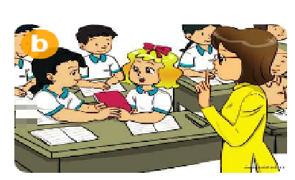
Don’t……….
A. say
B. talk
B. talk
C. look
D. repeat

Slide 10
Reorder the words
come/ in/ May/ I/?
May I come in?

Slide 11
Reorder the words
go/ out/ May/ I/?
May I go out ?

Slide 12
Reorder the words
Yes/ can/ you/./,/
Yes, you can.

Slide 13
Reorder the words
No/ can’t/ you/./,/
No, you can’t.

Slide 14
You are a millionaire.
L
F

