Slide 1


Hua Tao Primary School
Teacher: Nguyen Thi Ly Va
Welcome to
our class 3B

Slide 2
Wednesday, October 16th, 2019
Unit 4:Lesson 2: 1,2,3

Slide 3
Listen to the number song
Pay attention to pronounce the numbers 1-10.

Slide 4


Slide 5
Numbers : số đếm
1 one
6 six
2 two
7 seven
8 eight
3 three
9 nine
4 four
5 five
10 ten

Slide 6

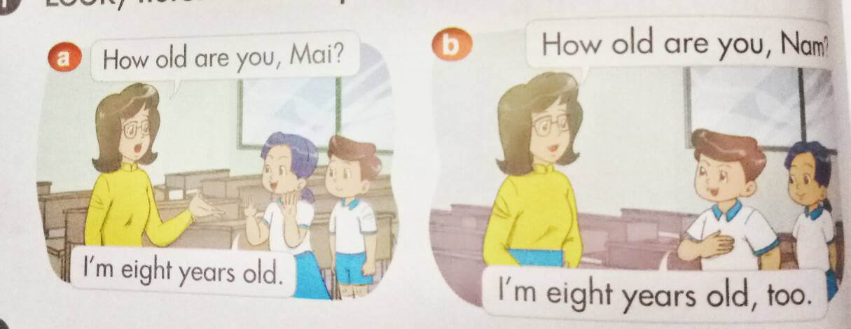
1.Look, listen and repeat:

Slide 7
1.Look, listen and repeat:
How old are you, Mai?
I’m eight years old.
How old are you, Nam?
I’m eight years old, too.

Slide 8
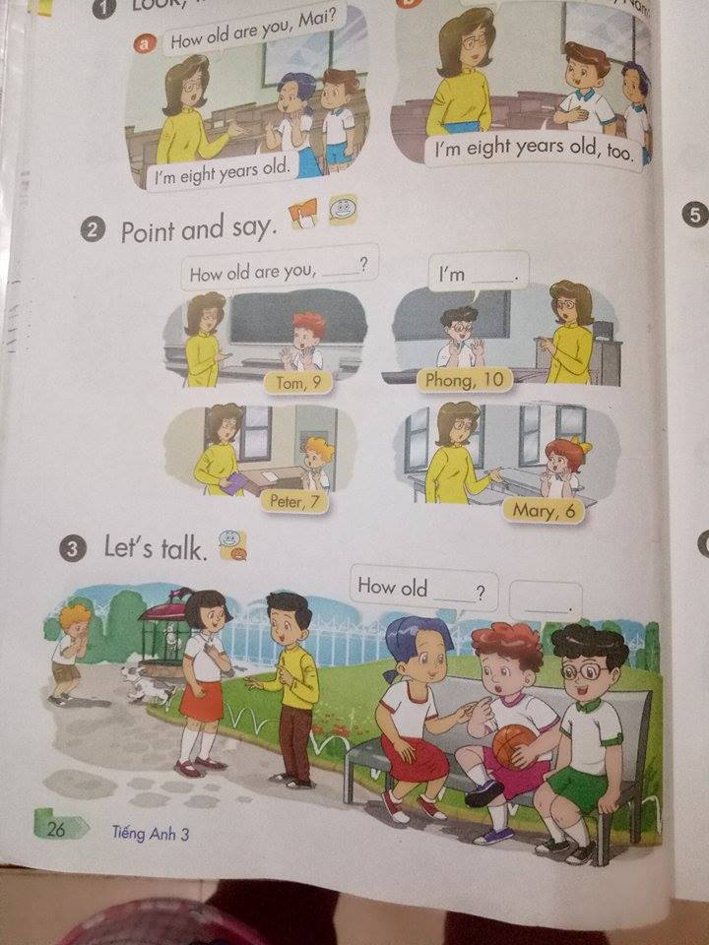
2. Point and say:

Slide 9
Muốn hỏi bạn bao nhiêu tuổi?
A: How old are you?
B: I’m eight years old.
C: I’m eight years old, too.
I’m = I am

Slide 10
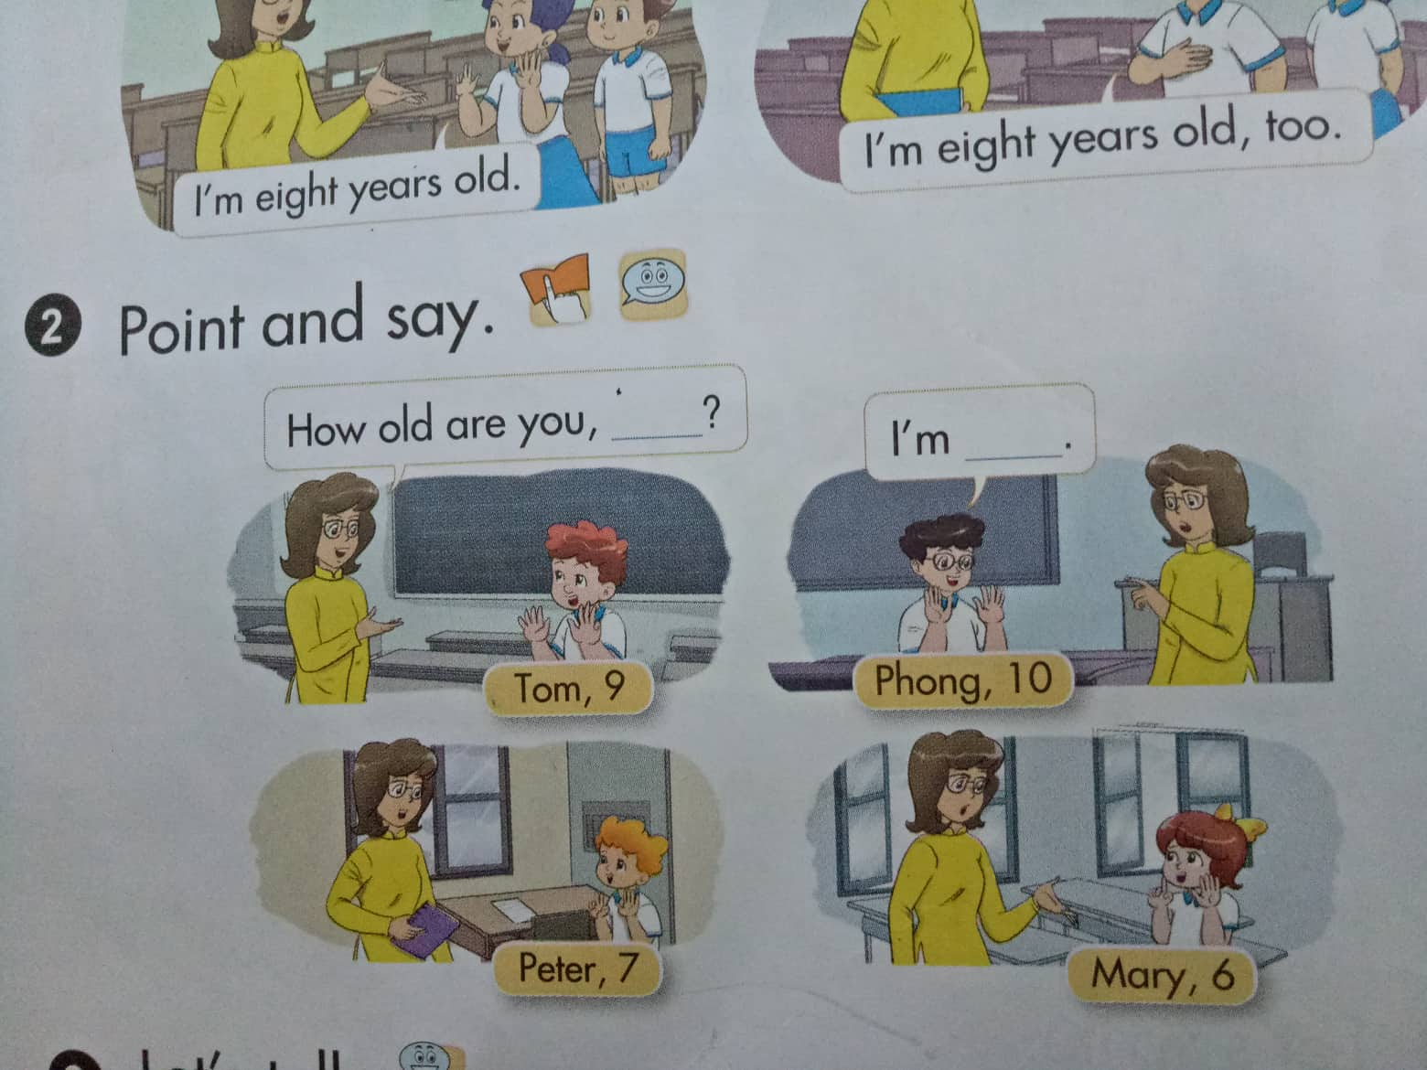
2.Point and say
Tom, 9 How old are you, Tom? I’m nine years old.
Phong, 10 How old are you, Phong ? I’m ten years old.
Peter, 7 How old are you, Peter? I’m seven years old.
Mary, 6 How old are you, Mary? I’m six years old.

Slide 11
3.Let’s talk:
S1: Hello. What’s your name?
S2: My name’s __________
S1: How old are you,.....?
S2: I’m __________

Slide 12
Review: Reoder
1. How/ are/old/you?
1. How old are you?
2. I’m / nine/ old/ years.
2. I’m nine years old.
3. I’m / nine/ old/ years/, /too.
3. I’m nine years old, too.

Slide 13
Best wishes to all of you.
Good bye. See you soon.

Slide 14
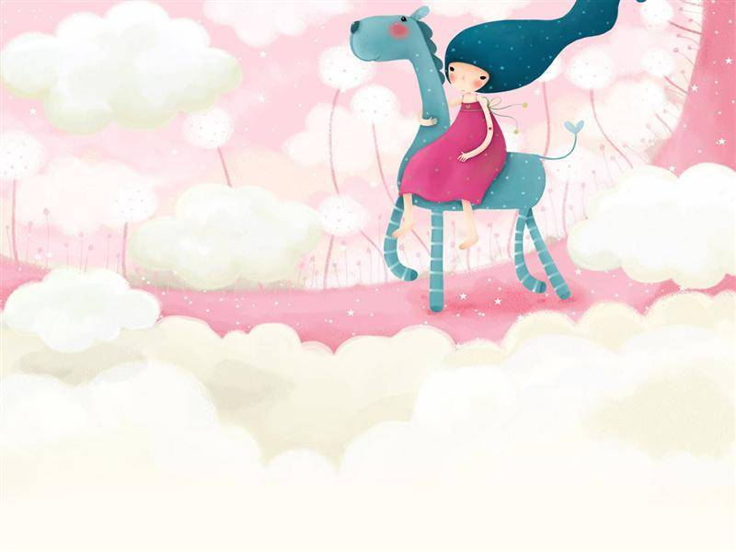
Thanks for
your attention

