Slide 1
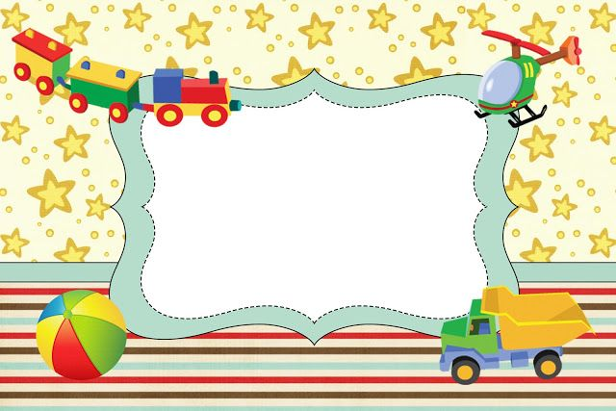
Welcome to class 3

Slide 2
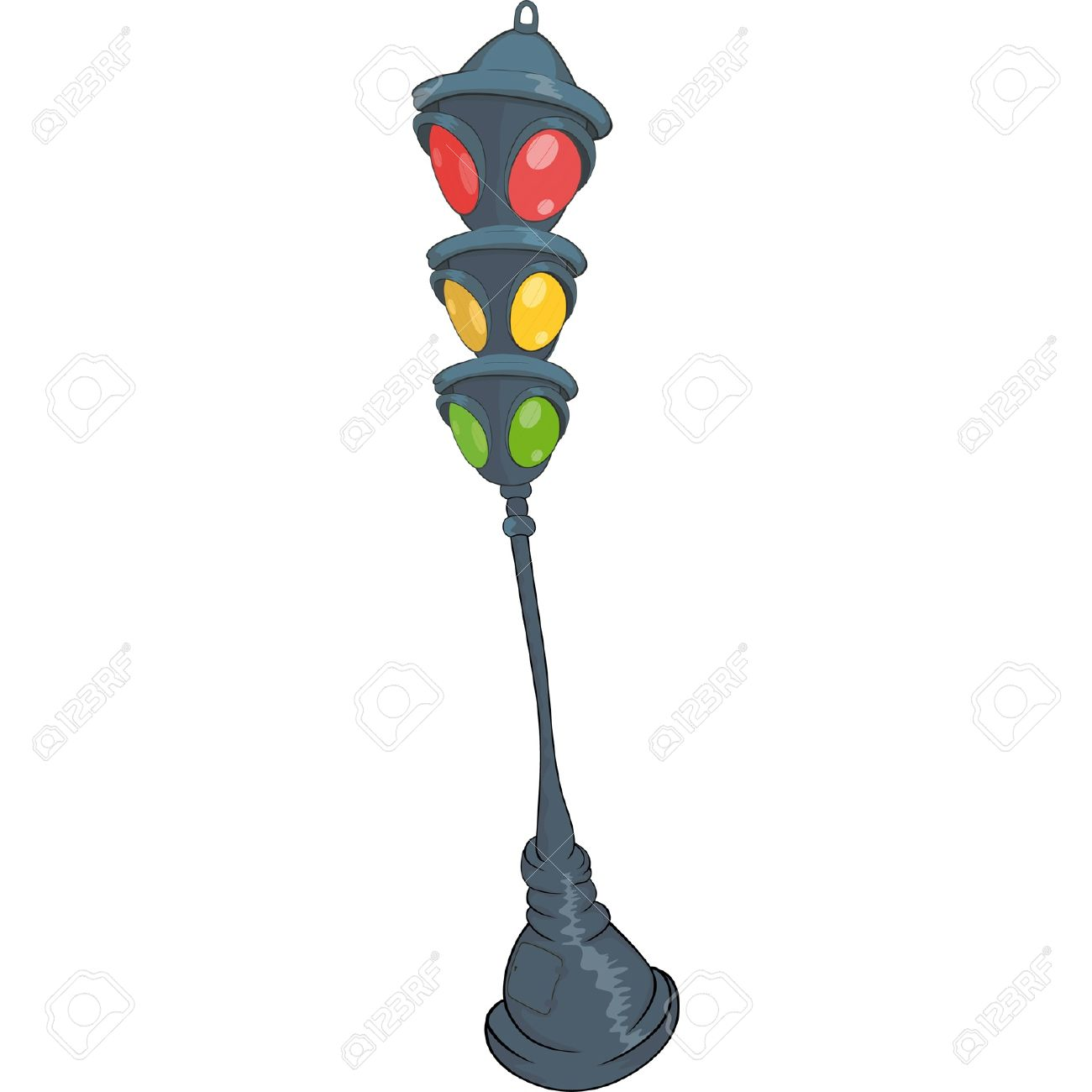
Play game
The Bus

Slide 3
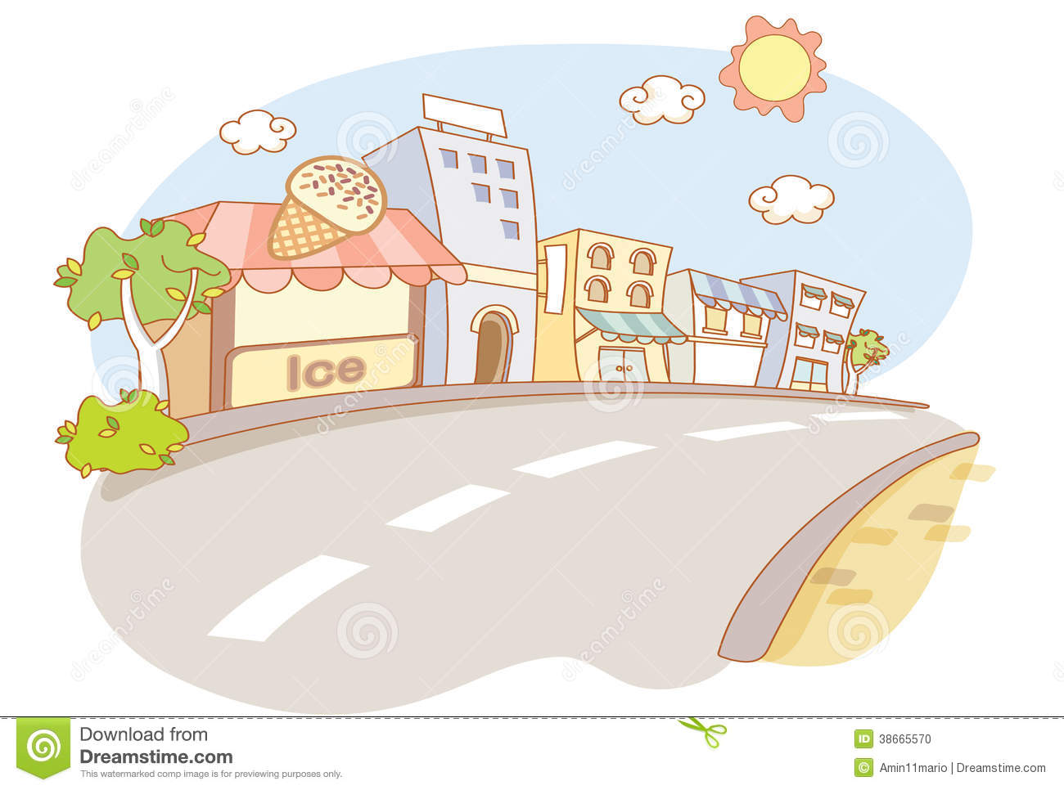
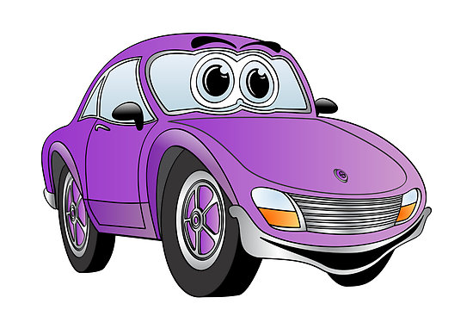
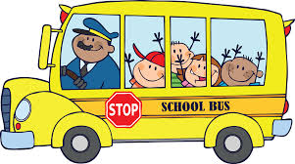
Check
homework
A C R
CAR
Car

Slide 4
Check
homework
A C R
CAR
doll

Slide 5
Check
homework
A C R
CAR
ship

Slide 6
Check
homework
A C R
CAR
Kite

Slide 7
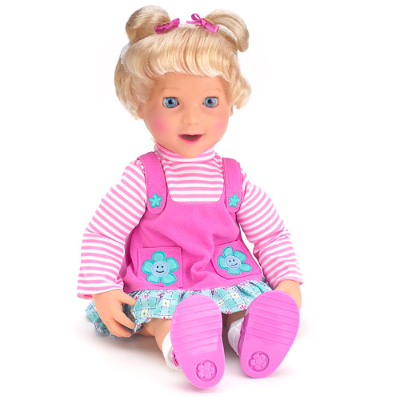
Check
homework
O L D L
DOLL
Robot

Slide 8
Check
homework
I K E T
KITE
Ball

Slide 9
Check
homework
L B A L
BALL
Yo - yo

Slide 10
Check
homework
O R O T B
ROBOT
Teddy bear

Slide 11
Check
homework
A C R
CAR
plane

Slide 12
Check
homework
A C R
CAR
truck

Slide 13
Unit 17:
What Toys do
you like?
Lesson 1: Part 1,2,3

Slide 14
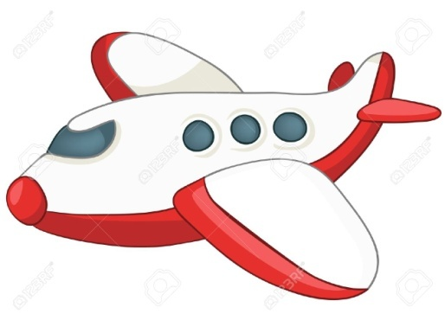
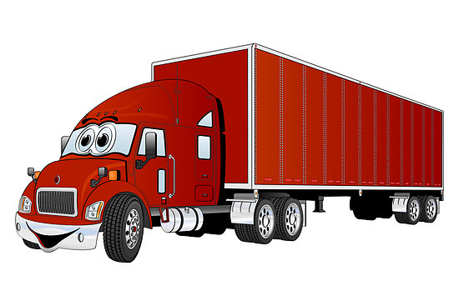
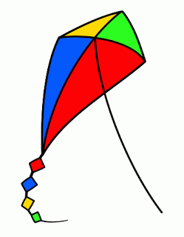
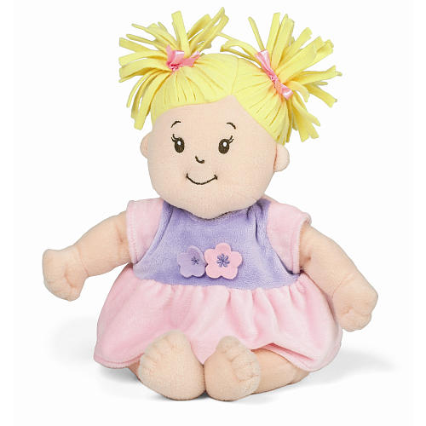
New words
Plane
Truck
Ship
Kite
Doll

Slide 15
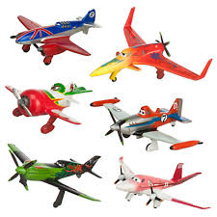
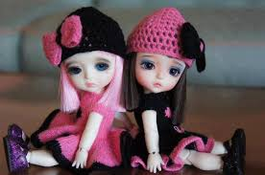
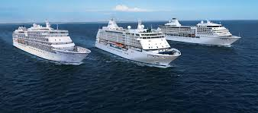
Check –up :
The bee finds the toys
1
dolls
2
ships
3
planes
4
kites

Slide 16
1. Look, listen and repeat:

Slide 17
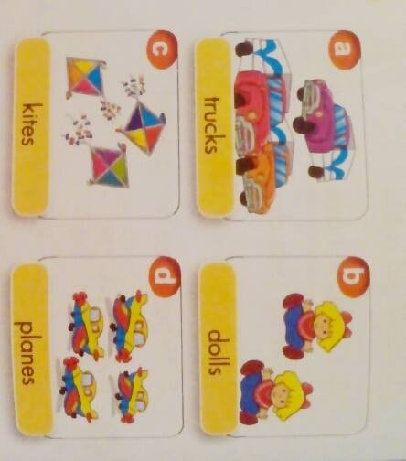
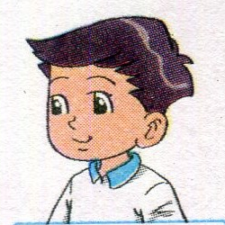
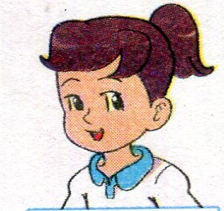
2.Point and say
What toys do you like?
I like_____.

Slide 18
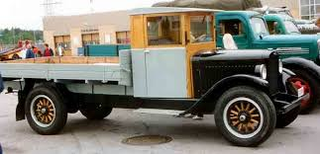
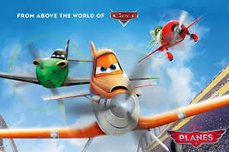
UNIT 17: WHAT TOYS DO YOU LIKE?
Lesson 1 : Part 1,2,3
2. Point and say (p.46)
b
a
A: What toys do you like?
A: What toys do you like?
trucks
dolls
B: I like trucks.
c
d
kites
planes

Slide 19
UNIT 17: WHAT TOYS DO YOU LIKE?
Lesson 1 : Part 1,2,3
2. Point and say :
a
trucks

Slide 20
UNIT 17: WHAT TOYS DO YOU LIKE?
Lesson 1 : Part 1,2,3
2. Point and say :
b
dolls

Slide 21
UNIT 17: WHAT TOYS DO YOU LIKE?
Period 112: Lesson 1 : Part 1,2,3
2. Point and say :
c
kites

Slide 22
UNIT 17: WHAT TOYS DO YOU LIKE?
Lesson 1 : Part 1,2,3
2. Point and say :
d
planes

Slide 23
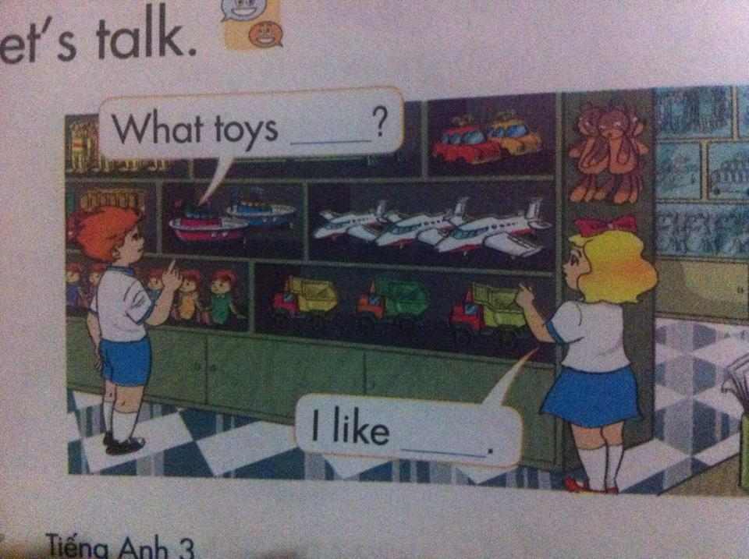
UNIT 17: WHAT TOYS DO YOU LIKE?
Lesson 1 : Part 1,2,3
3. Let’s talk :

Slide 24
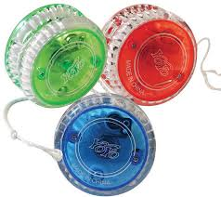
yo-yos
A: What toys do you like?
B: I like yo-yos.

Slide 25
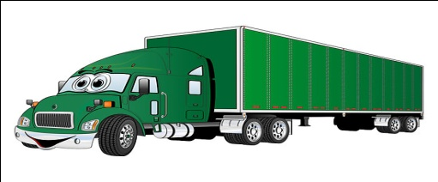
trucks
A: What toys do you like?
B: I like trucks.

Slide 26
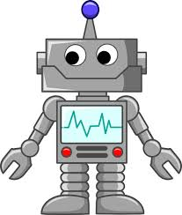
robots
A: What toys do you like?
B: I like robots.

Slide 27
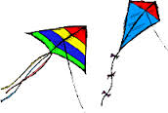
Play a game: Secret pictures
3
1
4
2
5

Slide 28
Home Link
Do exercises in workbook and ex 5, 6.
Learn by heart the new words.
Thank you!

Slide 29
The bye bye song
The bye bye song
Bye, bye.
See you tomorrow.
Bye, bye.
See you tomorrow.
Bye, bye.
See you tomorrow.
Bye, bye. Bye, bye.
Notes:
29

Slide 30
Thank you very much
Good bye! See you again!

