Slide 1
Welcome to our English class .
Class: 2
Teacher: Nguyen Thi Ly Va

Slide 2
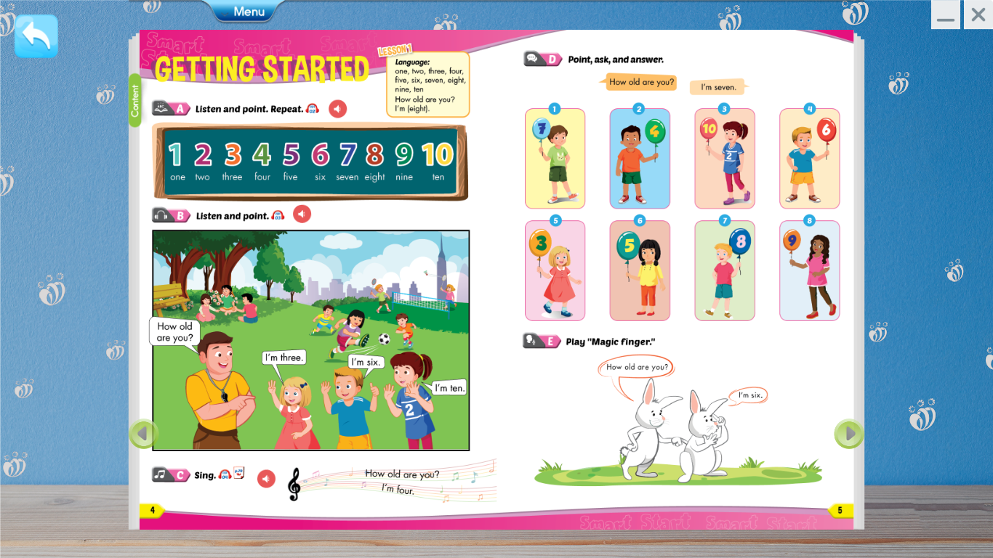

Slide 3
A. Listen and point. Repeat.

Slide 4
A. Listen and point. Repeat.
one
two
three
four
five
six
seven
eight
nine
ten

Slide 8
How old are you?
I’m seven.
I’m four.
I’m four.
I’m six.

Slide 9
How old are you?
I’m three.
I’m five.
I’m eight.
I’m nine.

Slide 10
How old are you?
I’m seven.

