Slide 1







Welcome to our English class .
Class: 4A
Teacher: Nguyen Thi Ly Va

Slide 2
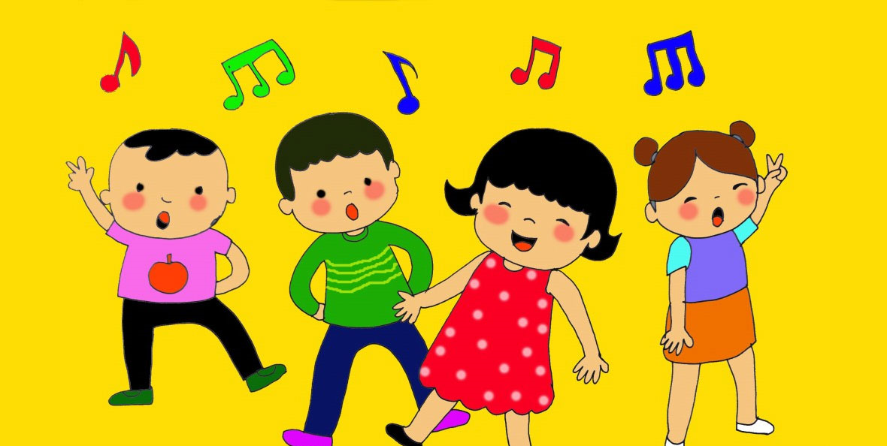
Monday, February 13th ,2023

Slide 3



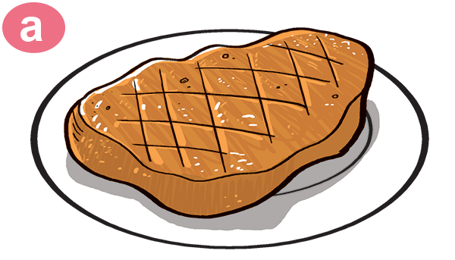
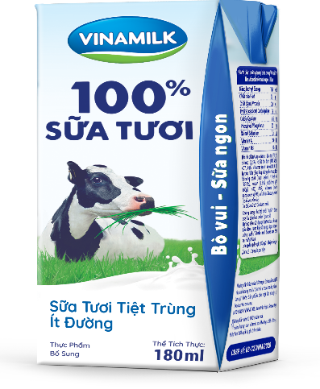

Slide 4
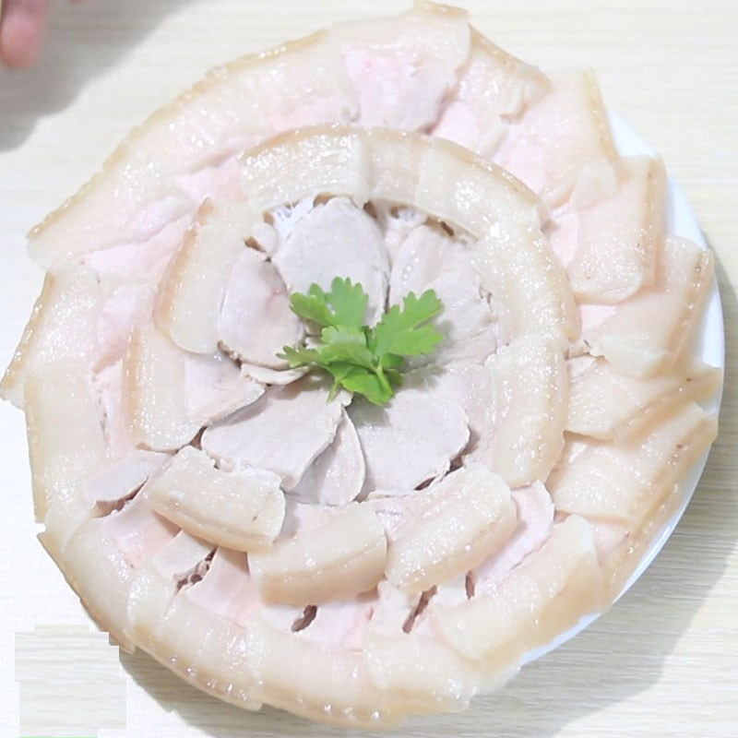
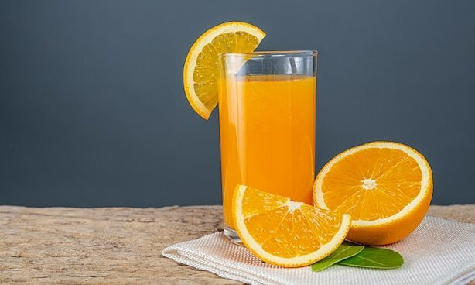

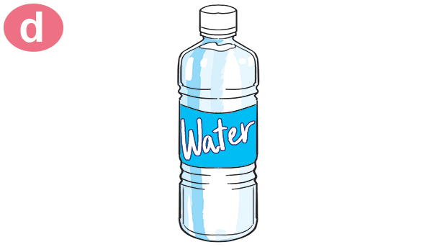
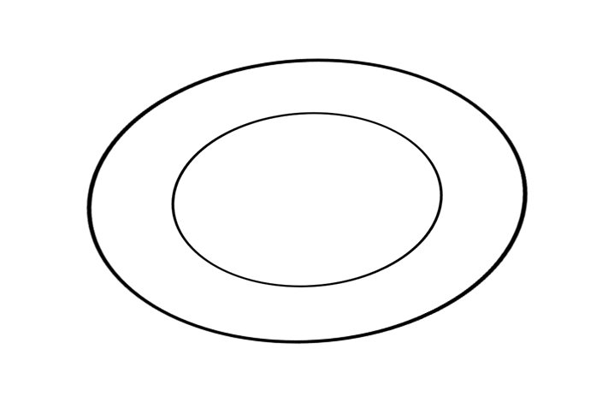
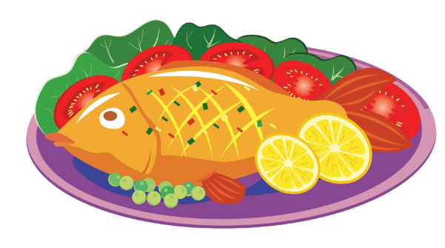

Slide 5
Monday, February 13th ,2023
Unit 13: Would you like some milk?
Lesson 1: Part 1,2/ Page 18

Slide 6

Vocabulary:
beef

Slide 7
Vocabulary:
pork

Slide 8
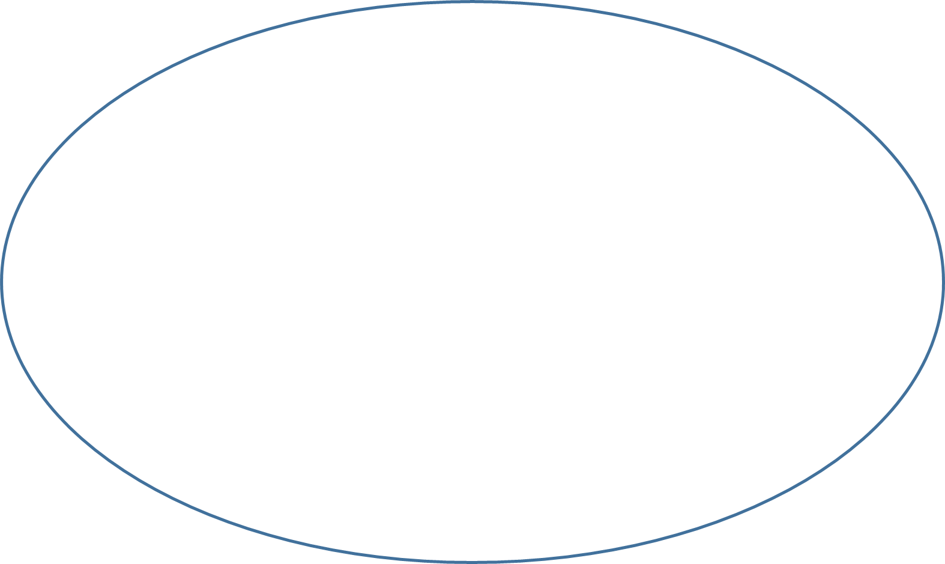
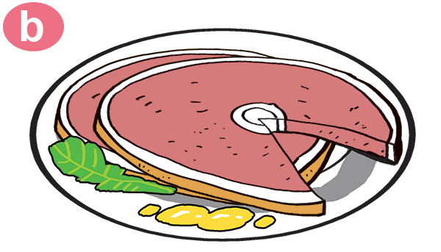
Vocabulary:
food

Slide 9
Vocabulary:
orange juice

Slide 10
Vocabulary:
water

Slide 11
Vocabulary:
drink

Slide 12

PLAY A GAME
RING THE BELL
Stick pictures to the right column FOOD or DRINK
Team A FOOD /DRINK | Team B FOOD /DRINK

Slide 13

Result
TEAM A | TEAM B

Slide 14
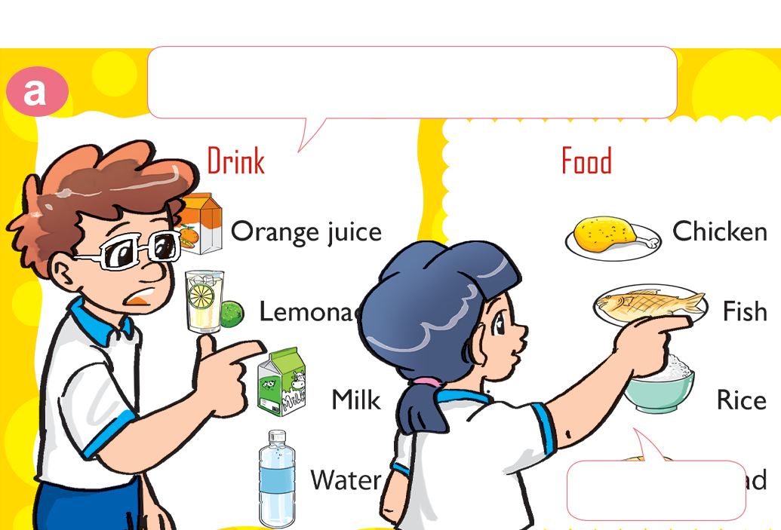
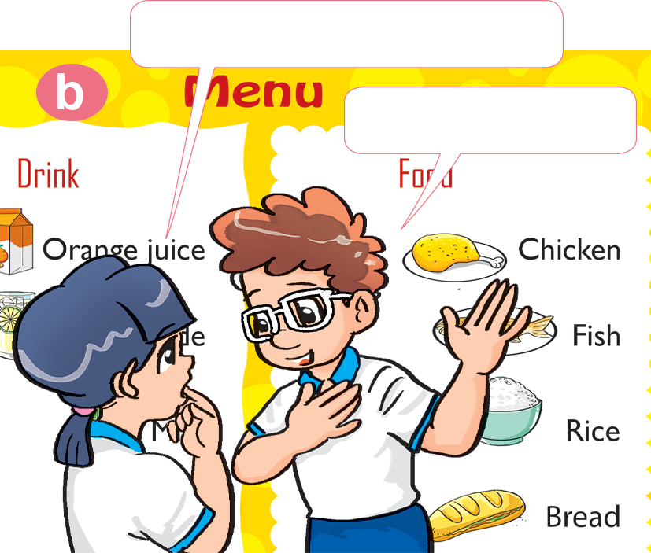
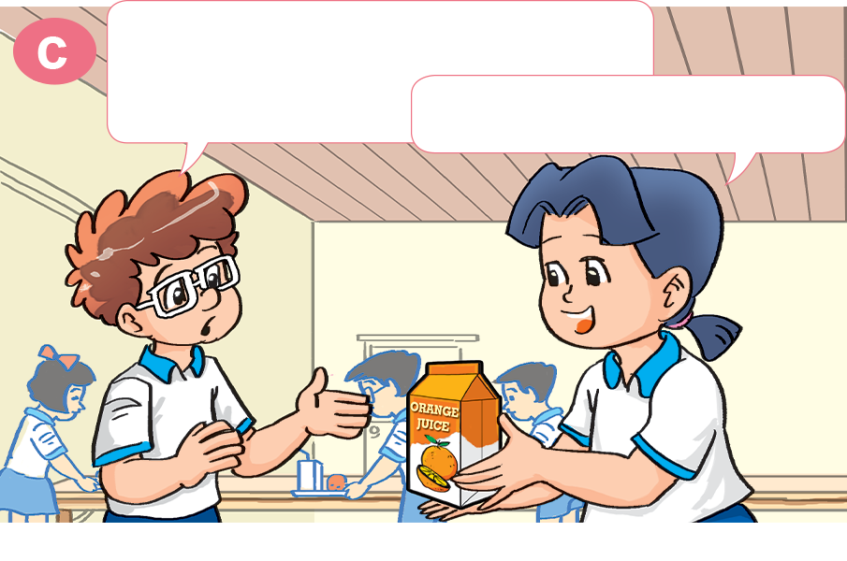
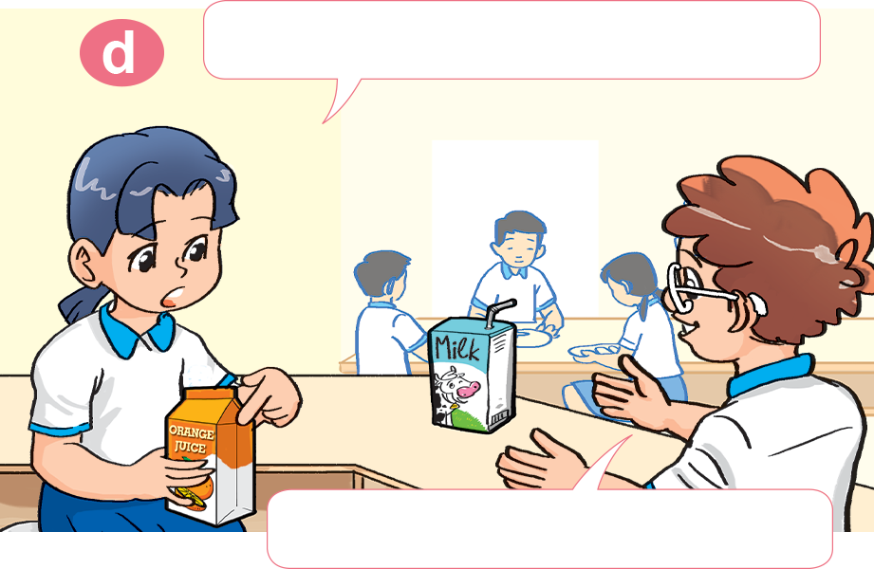
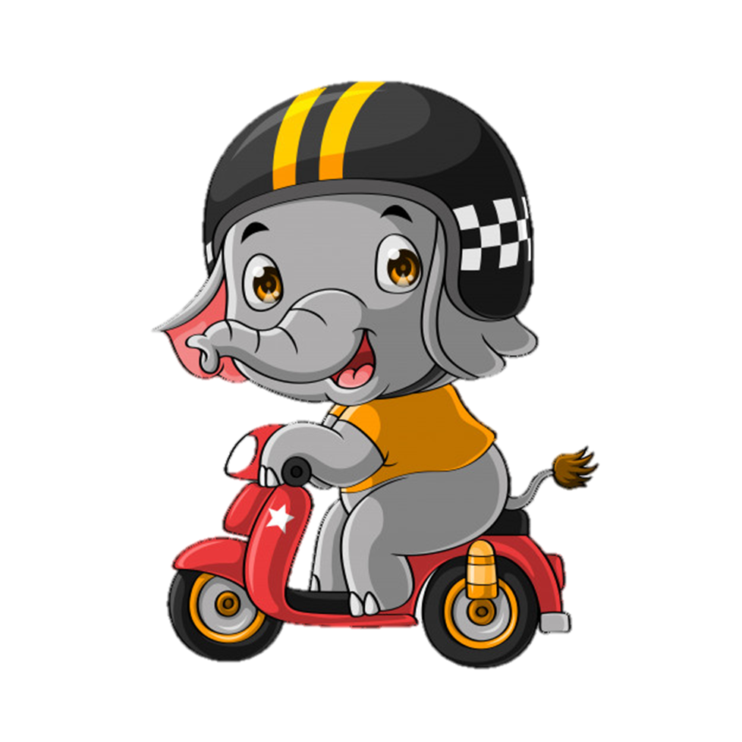
1. Look, listen and repeat
How about you, Tom?
What's your favourite food?
I like chicken.
It's fish.
What's your favourite drink, Mai?
Do you like orange juice?
It's orange juice.
No, I don't. I like milk.

Slide 15
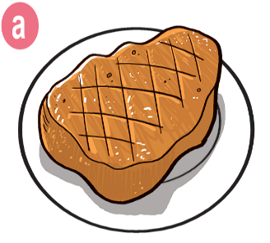
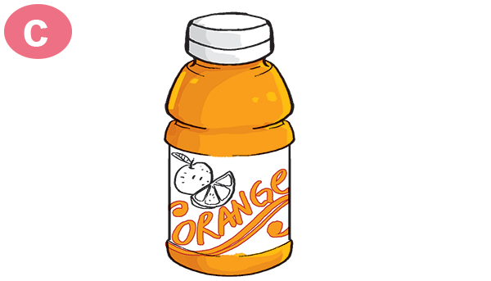
* Model sentence:
Hỏi đồ ăn / thức uống ưa thích của bạn là gì và cách trả lời
a.
A: What's your favourite ______?
food
B: It’s ____________.
beef
A: What's your favourite __________?
b.
drink
B: It’s _______________.
orange juice

Slide 16
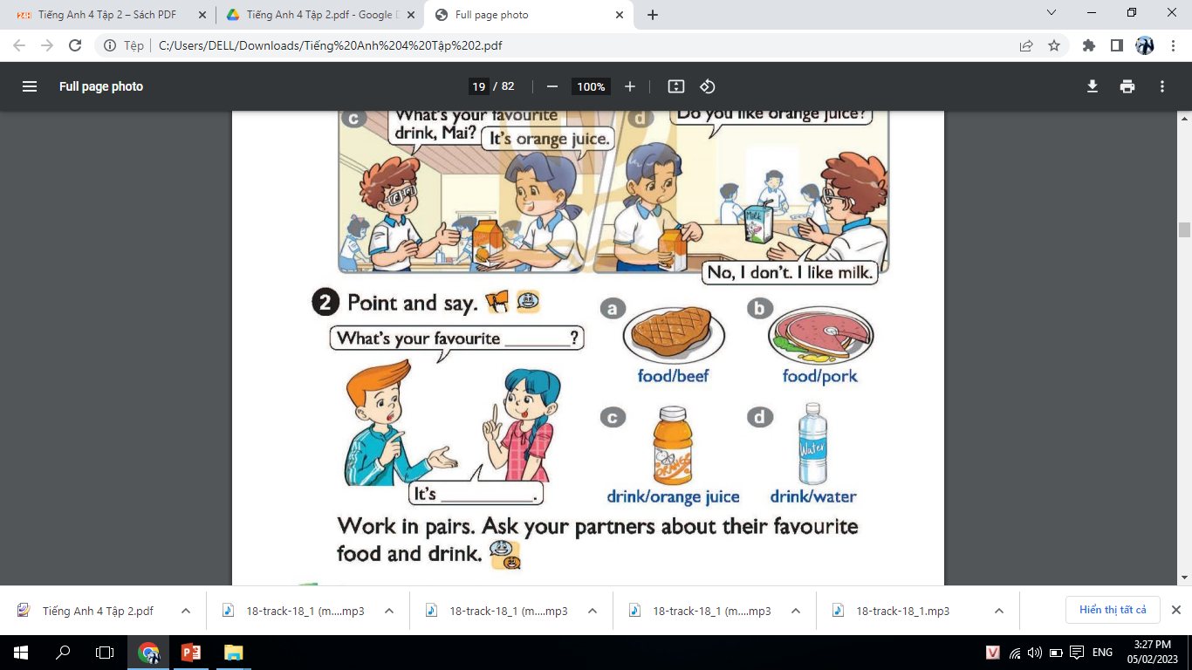
2/ 18. Point and say

Slide 17
2/ 18. Point and say
A: What's your favourite __________?
B: It's ___________.
food
beef

Slide 18
2/ 18. Point and say

Slide 19
2/ 18. Point and say
A: What's your favourite __________?
B: It's ___________.
food
beef

Slide 20
2. Point and say.
A: What's your favourite __________?
B: It's ___________.
food
pork

Slide 21
2. Point and say.
drink
A: What's your favourite __________?
B: It's ______________.
orange juice

Slide 22
2. Point and say.
drink
A: What's your favourite __________?
B: It's ___________.
water

Slide 23

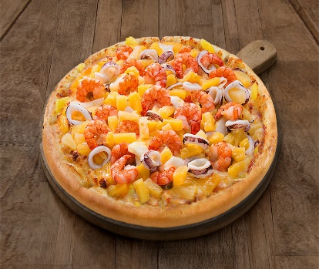

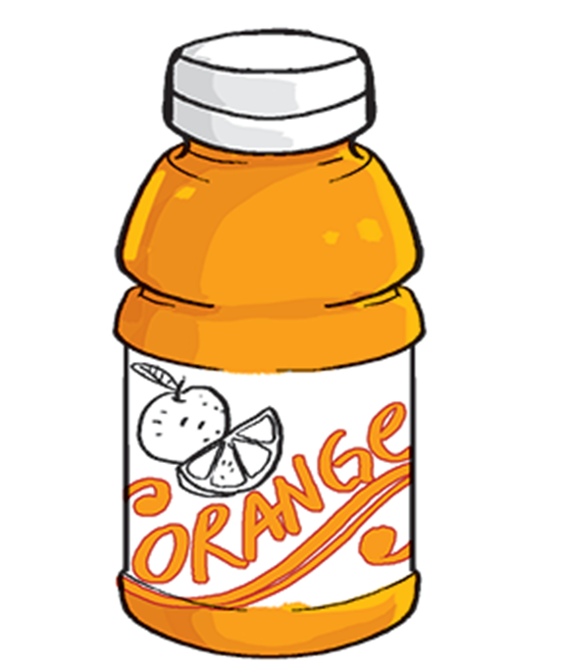
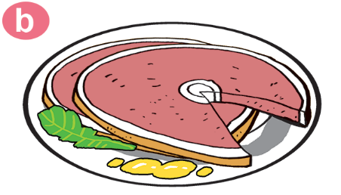
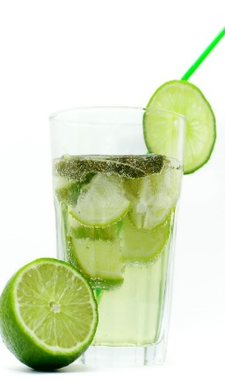
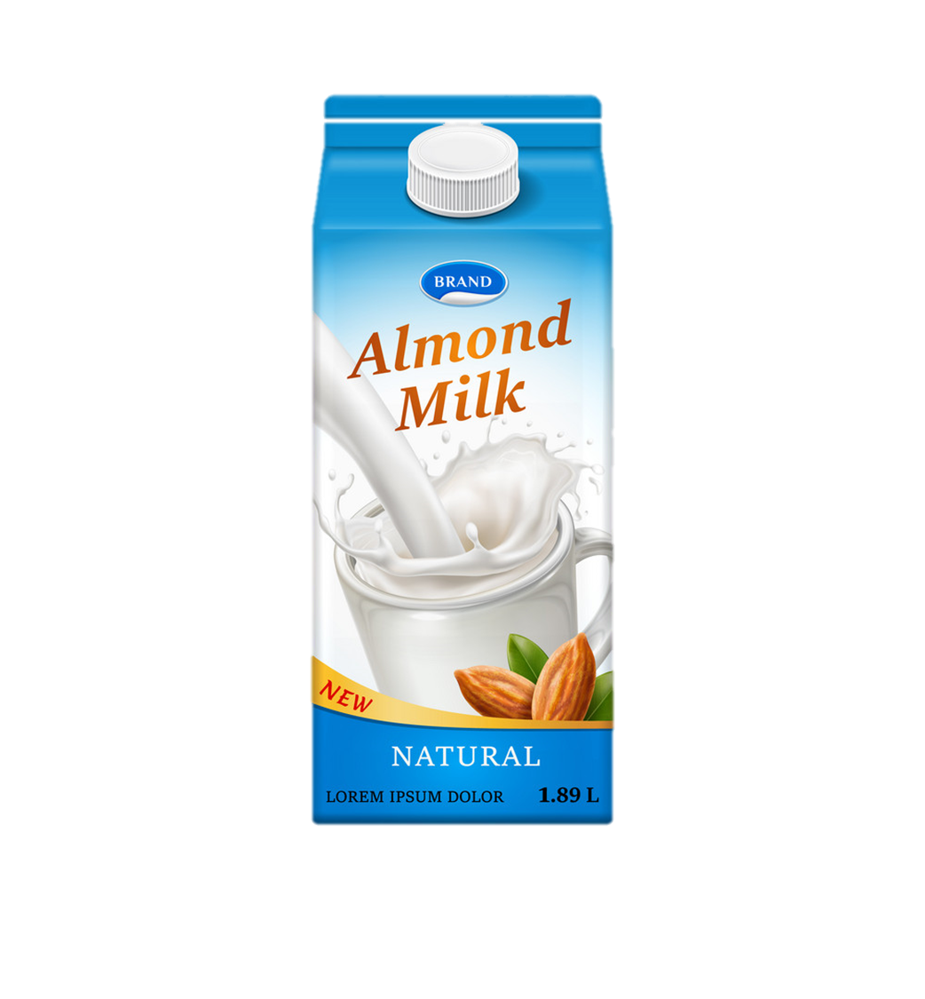


Ask and answer about favourite food and drink
What’s your favourite food/ drink?
It’s _______________.
MENU

Slide 24

Play a game
GET STICKERS

Slide 25

1.
What’s your favourite drink?
a. It’s beef.
b. It’s water.
c. It’s juice.
Next

Slide 26
2.
What’s your favourite food?
a. It’s beef.
b. It’s chicken.
c. It’s fish.
Next

Slide 27
3.
What’s your ______ drink?
a. favourite
b. drink
c. milk
Next

Slide 28
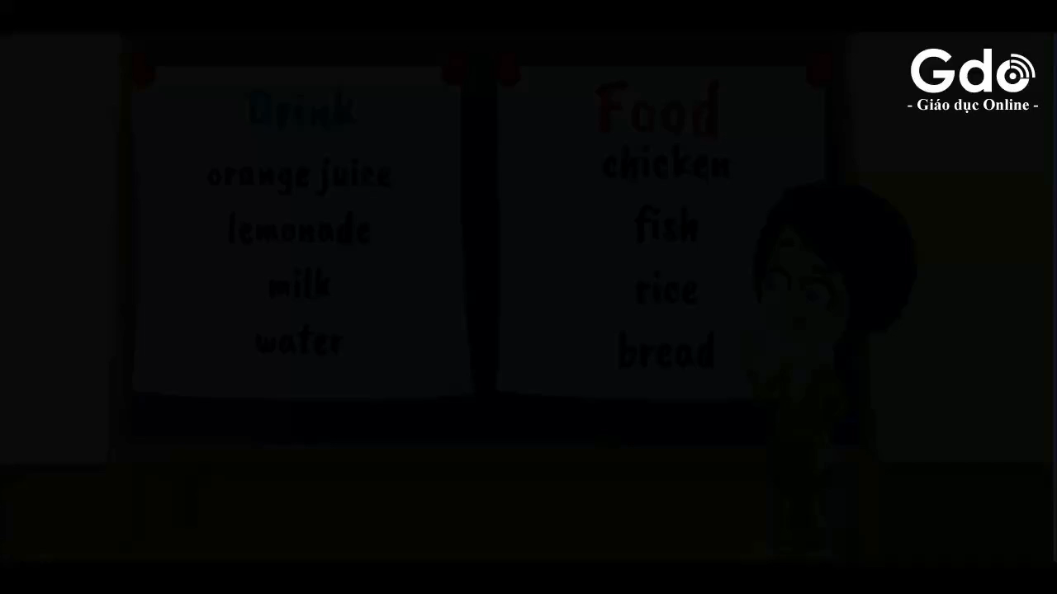
4.
Tom’s favourite food is____________.
a. fish
b. chicken
c. pork
Next

Slide 29
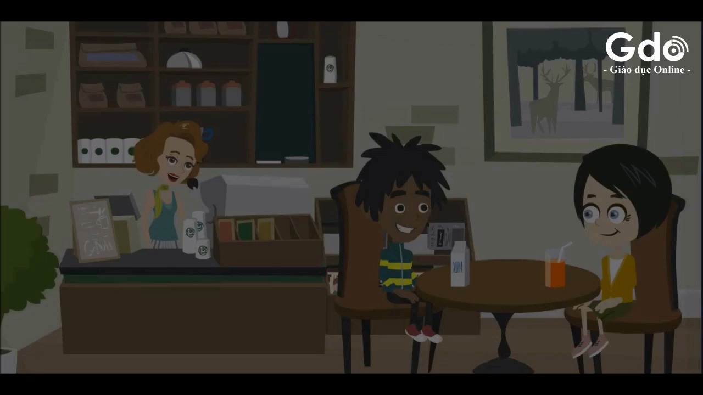
5.
Mai likes___________________ .
a. milk
b. orange juice
c. lemonade
Next

Slide 30
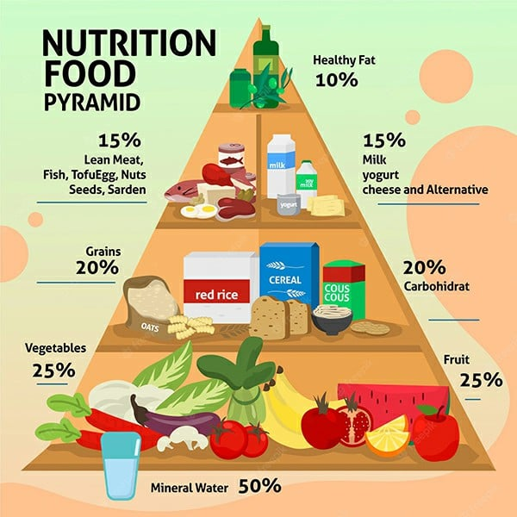

Slide 31
1. Vocabulary.
Monday , February 13th , 2023
Unit 13: Would you like some milk?
Lesson 1 : Part 1,2 /Page 18
-Food: beef, pork, chicken, fish
-Drink: milk, orange juice, water
2. Model sentence.
A: What’s your favourite food/ drink?
B: It’s ________.
A: What’s your favourite food?
B: It’s chicken.
A: What’s your favourite drink?
B: It’s orange juice.
3. Home work.

Slide 32
Best wishes to all of you.
Good bye. See you soon.

