Slide 1
Unit 4
Did you go to
the party?
Lesson 2 : Part s 4,5,6

Slide 2
Play a game

Slide 3
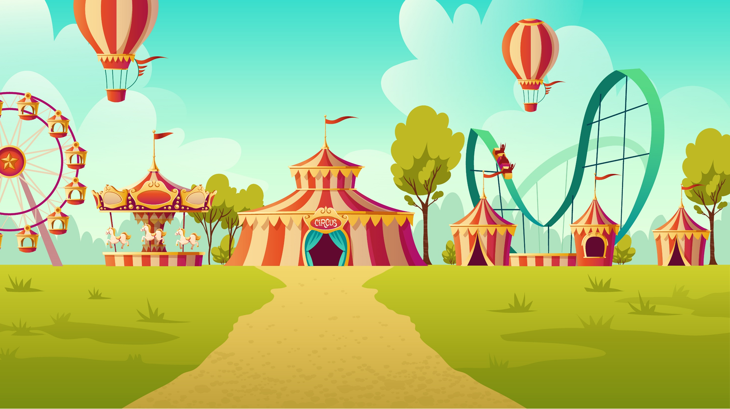
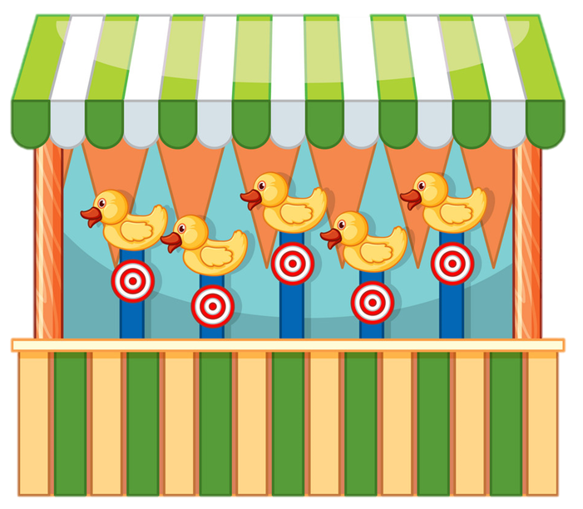
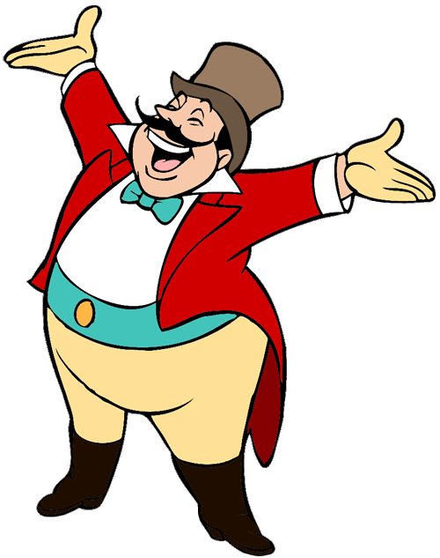
START

Slide 4
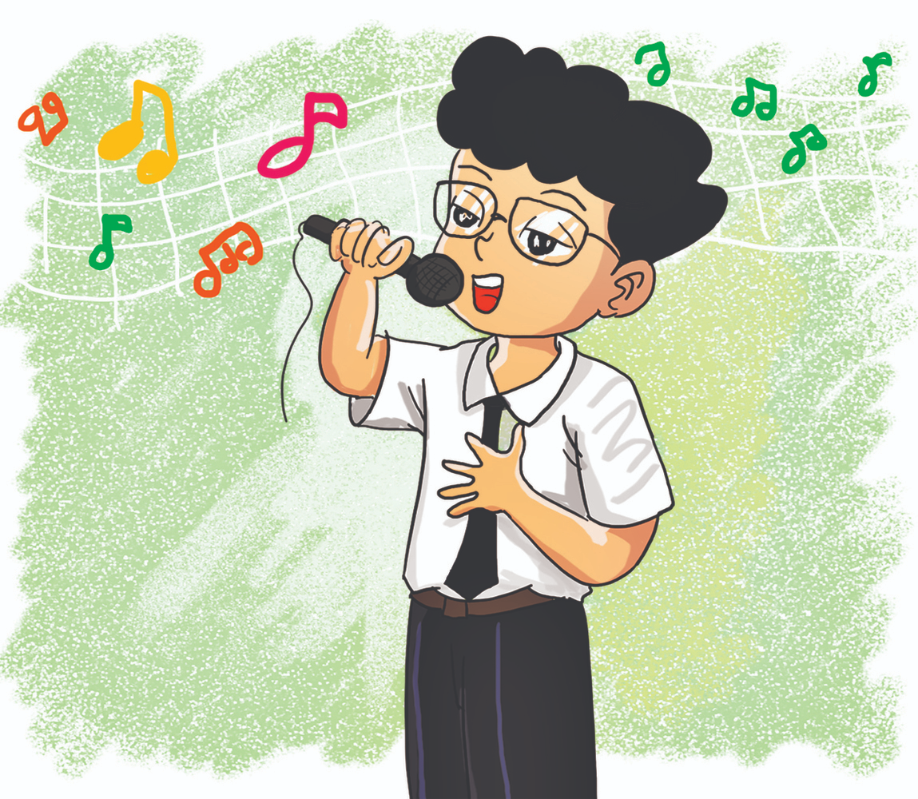
What did you do at the party?
We sing many songs.
We sang many songs.
We singed happily.

Slide 5
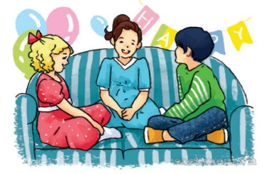
What did you do at the party?
We chat with my friends.
We chatted with my friends.
We chated with my friends.

Slide 6
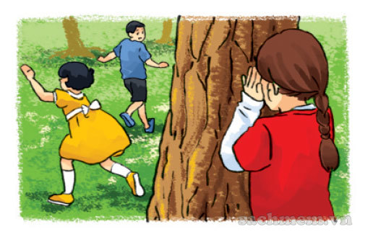
What did you do at the party?
We play hide-and-seek.
We plays hide-and-seek.
We played hide-and-seek.

Slide 7
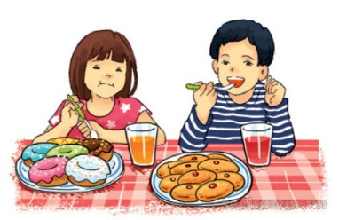
What did you do at the party?
We had nice food and drink.
We have nice food and drink.
We eat nice food and drink.
Next

Slide 8
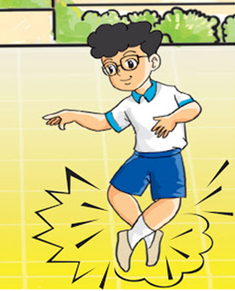
What did you do at the party?
We dances happily.
We dance happily.
We danced happily.

Slide 9
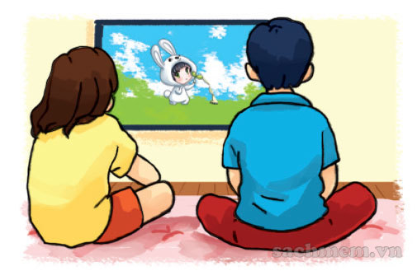
What did you do at the party?
We watched cartoons.
We watch cartoons.
We watches cartoons.
Next

Slide 10
What ___ you do at the party?
We had nice food and drink.
do
did
was

Slide 11
What did you ____
at the party?
was
did
do

Slide 12
Ms Huyền Phạm
0936.082.789

Slide 13
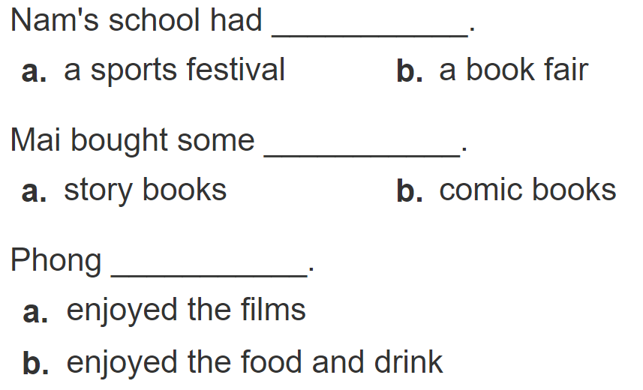
4/ 27. Listen and circle
1
2
3

Slide 14
5. Write about you.
Where were you yesterday?
__________________________________.
2. What did you do there?
__________________________________.
3. Did you enjoy it?
__________________________________.

Slide 15
5/27. Write about you.
Where were you yesterday?
2. What did you do there?
3. Did you enjoy it?
I was at home yesterday.
I watched cartoons and helped my parents.
Yes, I do. / No, I didn’t.

Slide 16
6/27. Le’s play .
Tic- tac-toe
Play a game

Slide 17
1
2
3
4
6
5
7
8
9

