Slide 1
Unit 4
Did you go to
the party?
Lesson 1 (1,2,3)

Slide 2
VOCABULARY

Slide 3
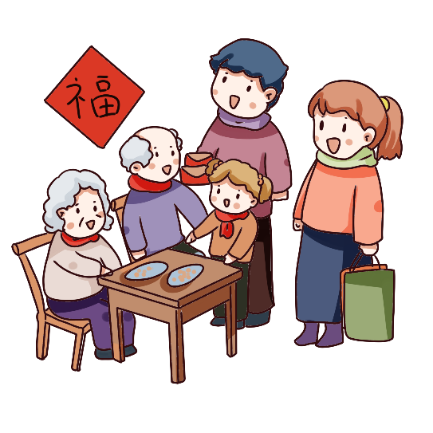
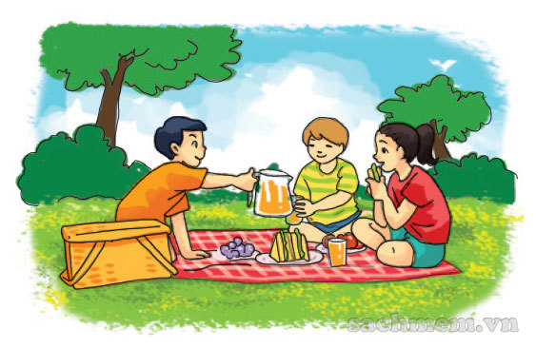
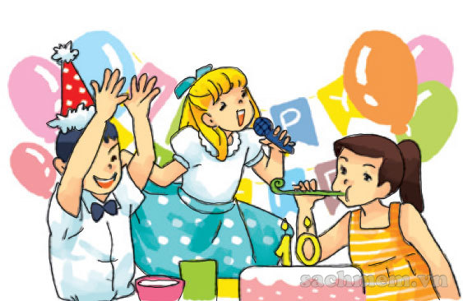
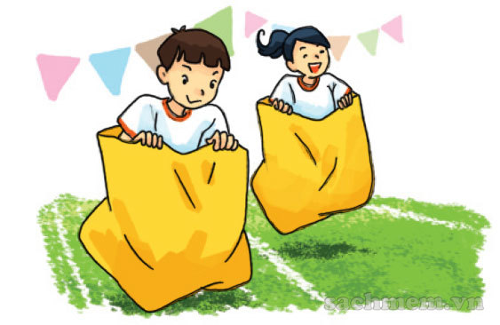
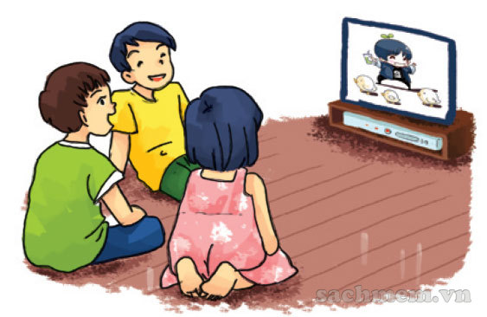
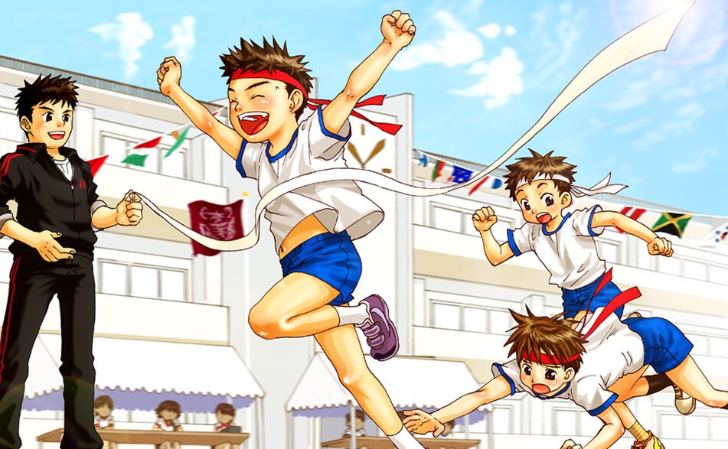
A. Vocabulary
visit my
grandparents
go on a picnic
enjoy a party
Đi dã ngoại
Thích bữa tiệc
Đi thăm ông bà
join the funfair
watch cartoon
sport festival
Tham gia hội trại
Xem hoạt hình
Lễ hội thể thao

Slide 4
Fill the blanket
visit my
grandparents
sport festival
_____
_____
watch cartoon
_____
Lễ hội thể thao
Xem hoạt hình
Đi thăm ông bà
go on a picnic
enjoy a party
___
_____
join the funfair
_____
Đi dã ngoại
Thích bữa tiệc
Tham gia hội trại

Slide 5
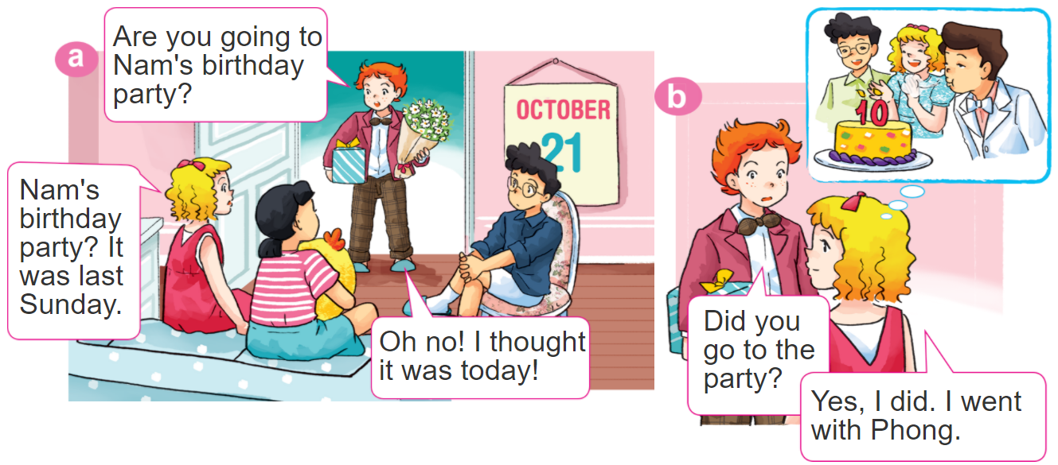

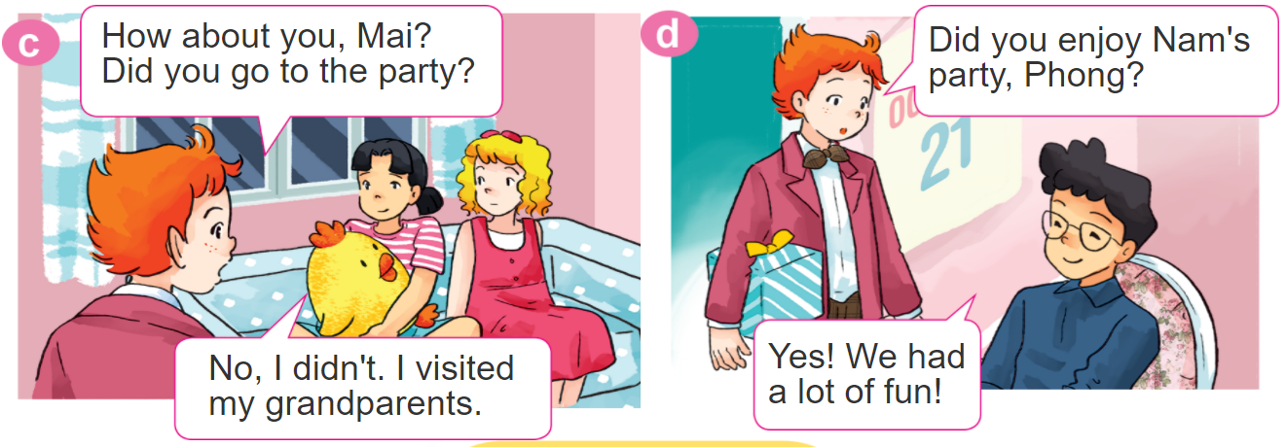
1. Look, listen and repeat.

Slide 6
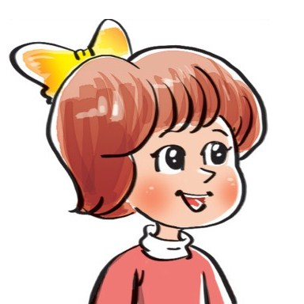

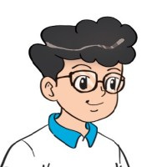

2. Point and say
Yes. I did.
Did you _________?
No, I didn't.
go on a picnic
watch TV
enjoy a party
join the funfair

Slide 7

3. Let’s talk
Did you go on a picnic?
Yes. I did.
Did you enjoy the weekend?
No, I didn't.
Did you watch TV?

Slide 8
B. Grammar
Hỏi và đáp bạn đã làm gì đó phải không:
Did you ___________?
+ activity
Yes. I did.
No, I didn't.

Slide 9




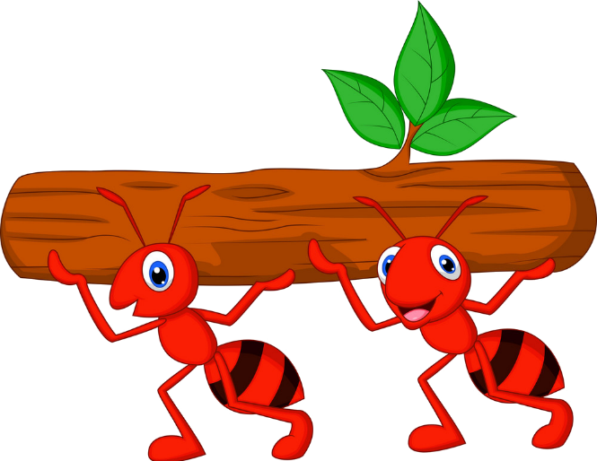



Kiến chăm chỉ
PLAY

Slide 10

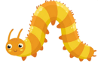





Did you join the festival?
Yes, I did.
Next
Notes:
Ms Huyền Phạm - 0936.082.789 – YOUTUBE: MsPham. Facebook: Dạy và học cùng công nghệ.

Slide 11
Did you visit your grandparents?
Yes, I did.
Next
Notes:
Ms Huyền Phạm - 0936.082.789 – YOUTUBE: MsPham. Facebook: Dạy và học cùng công nghệ.

Slide 12
Did you watch cartoon
No, I didn’t.
Next
Notes:
Ms Huyền Phạm - 0936.082.789 – YOUTUBE: MsPham. Facebook: Dạy và học cùng công nghệ.

Slide 13
Did you join the funfair?
No, I didn’t.
Next
Notes:
Ms Huyền Phạm - 0936.082.789 – YOUTUBE: MsPham. Facebook: Dạy và học cùng công nghệ.

Slide 14
Did you enjoy a party?
Yes, I did.
Next
Notes:
Ms Huyền Phạm - 0936.082.789 – YOUTUBE: MsPham. Facebook: Dạy và học cùng công nghệ.

Slide 15
Did you go on the picnic?
Yes, I did.
Next
Notes:
Ms Huyền Phạm - 0936.082.789 – YOUTUBE: MsPham. Facebook: Dạy và học cùng công nghệ.

Slide 16
Did you go to school
yesterday?
No, I didn’t.
Next
Notes:
Ms Huyền Phạm - 0936.082.789 – YOUTUBE: MsPham. Facebook: Dạy và học cùng công nghệ.

Slide 17
Did you get up early
this morning?
Yes, I did.
Next
Notes:
Ms Huyền Phạm - 0936.082.789 – YOUTUBE: MsPham. Facebook: Dạy và học cùng công nghệ.

Slide 18
WELL DONE!
EXIT
Notes:
Ms Huyền Phạm - 0936.082.789 – YOUTUBE: MsPham. Facebook: Dạy và học cùng công nghệ.

Slide 19

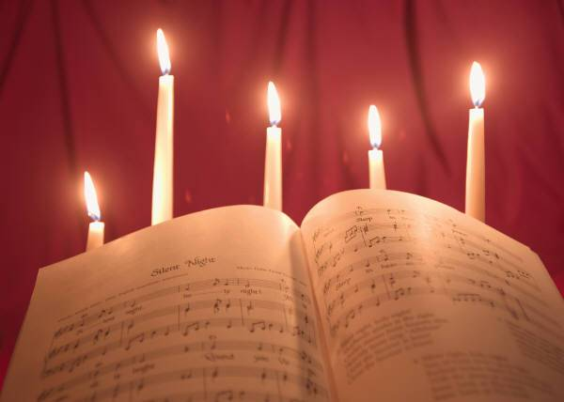

Homelink
Learn by heart the vocabulary and the model sentence .
-Do exercise in the workbook.
Prepare Unit 4. Lesson 1 (4,5,6).

Slide 20
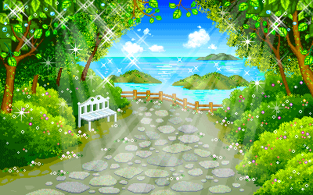
GOODBYE
THANK YOU VERY MUCH

