Slide 1
Unit 4
Did you go to
the party?
Lesson 1 (4,5,6)

Slide 2



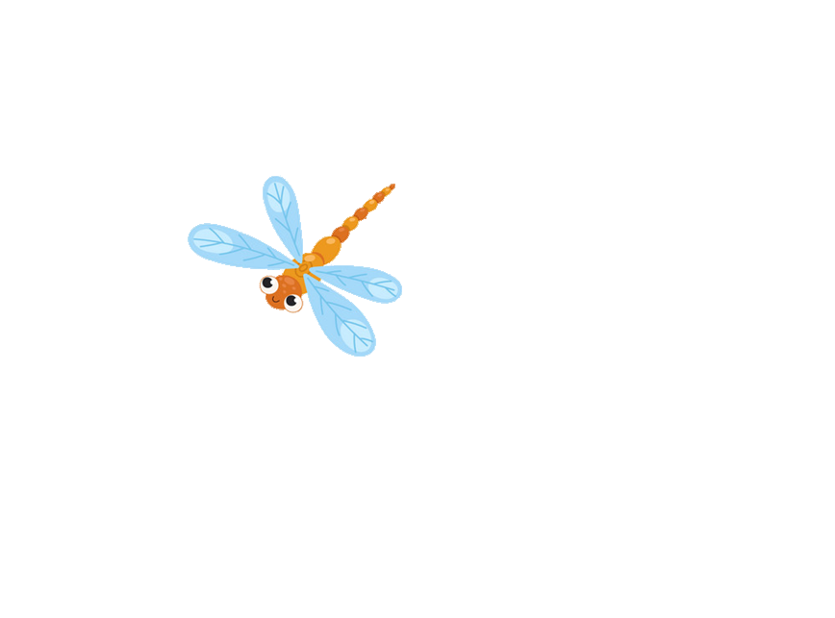
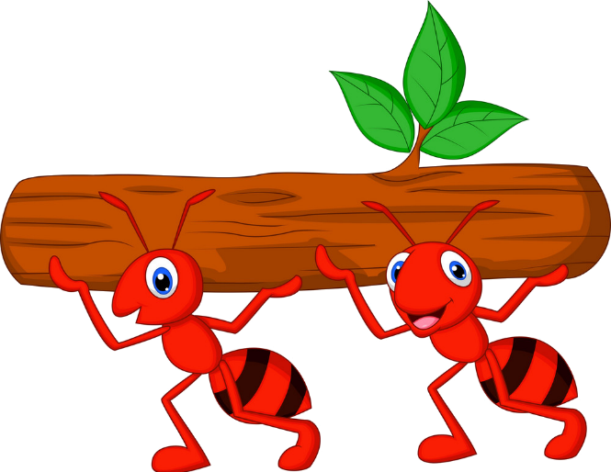



Kiến chăm chỉ
PLAY

Slide 3

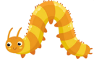


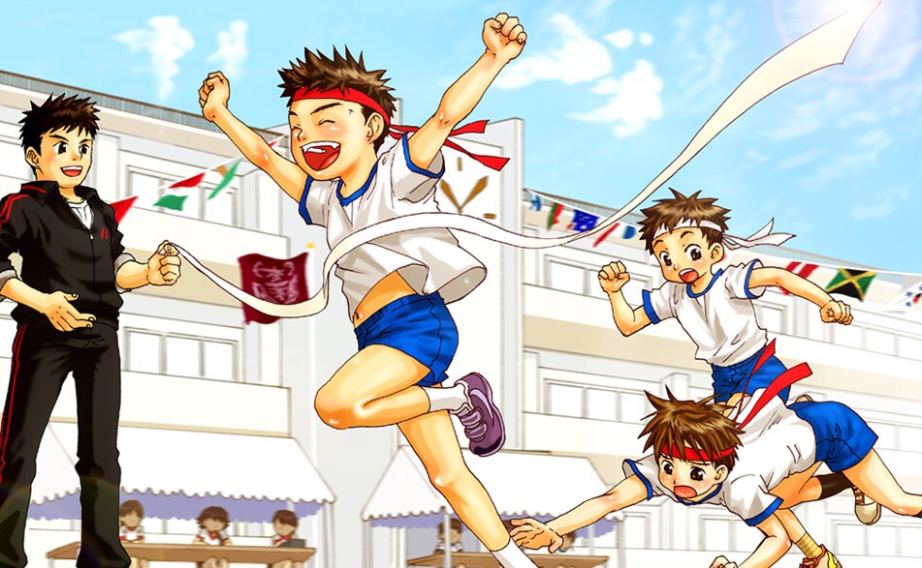




Did you join the festival?
Yes, I did.
Next
Notes:
Ms Huyền Phạm - 0936.082.789 – YOUTUBE: MsPham. Facebook: Dạy và học cùng công nghệ.

Slide 4
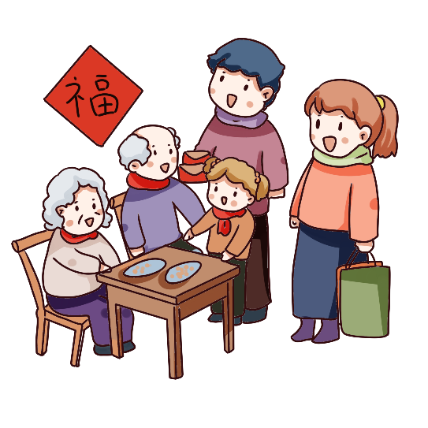
Did you visit your grandparents?
Yes, I did.
Next
Notes:
Ms Huyền Phạm - 0936.082.789 – YOUTUBE: MsPham. Facebook: Dạy và học cùng công nghệ.

Slide 5
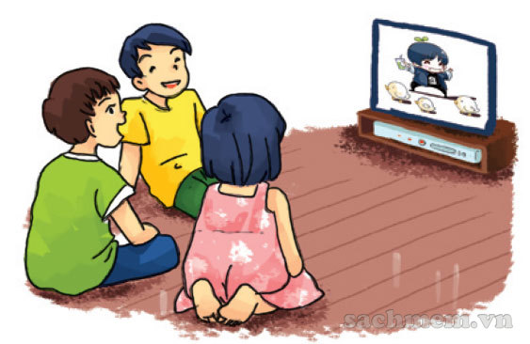

Did you watch cartoon
No, I didn’t.
Next
Notes:
Ms Huyền Phạm - 0936.082.789 – YOUTUBE: MsPham. Facebook: Dạy và học cùng công nghệ.

Slide 6
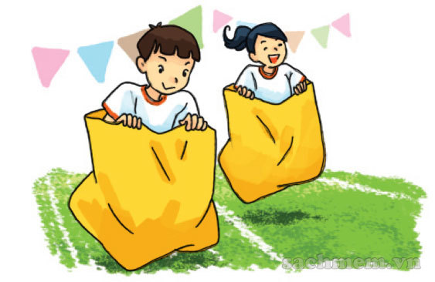
Did you join the funfair?
No, I didn’t.
Next
Notes:
Ms Huyền Phạm - 0936.082.789 – YOUTUBE: MsPham. Facebook: Dạy và học cùng công nghệ.

Slide 7
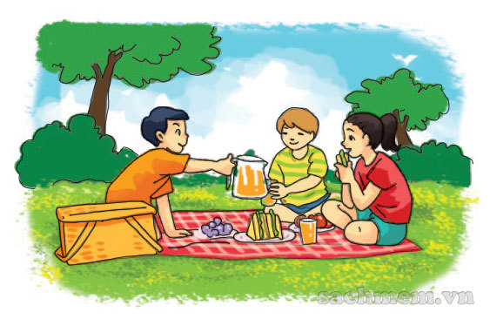
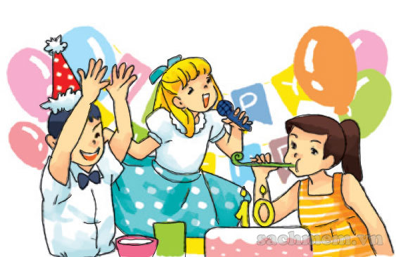
Did you enjoy a party?
Yes, I did.
Next
Notes:
Ms Huyền Phạm - 0936.082.789 – YOUTUBE: MsPham. Facebook: Dạy và học cùng công nghệ.

Slide 8
Did you go on the picnic?
Yes, I did.
Next
Notes:
Ms Huyền Phạm - 0936.082.789 – YOUTUBE: MsPham. Facebook: Dạy và học cùng công nghệ.

Slide 9
Did you go to school
yesterday?
No, I didn’t.
Next
Notes:
Ms Huyền Phạm - 0936.082.789 – YOUTUBE: MsPham. Facebook: Dạy và học cùng công nghệ.

Slide 10
Did you get up early
this morning?
Yes, I did.
Next
Notes:
Ms Huyền Phạm - 0936.082.789 – YOUTUBE: MsPham. Facebook: Dạy và học cùng công nghệ.

Slide 11
WELL DONE!
EXIT
Notes:
Ms Huyền Phạm - 0936.082.789 – YOUTUBE: MsPham. Facebook: Dạy và học cùng công nghệ.

Slide 12

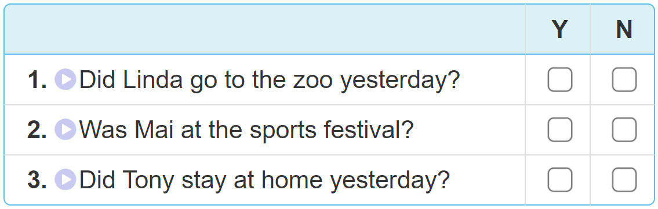

4. Listen and tick Yes (Y) or No (N).

Slide 13
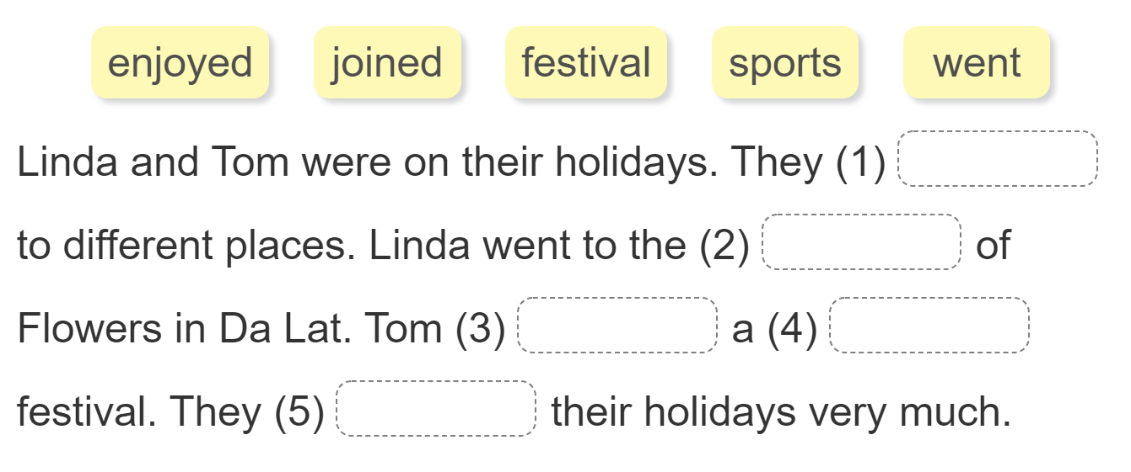
5. Read and complete.
went
festival
joined
sports
enjoyed

Slide 14
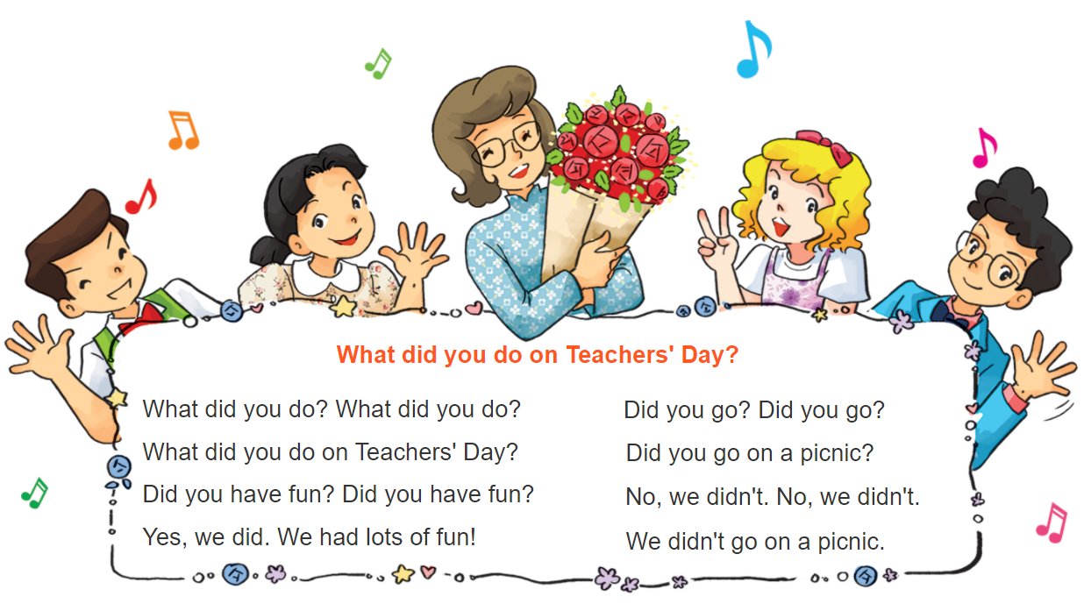



6. Let’s sing

Slide 15

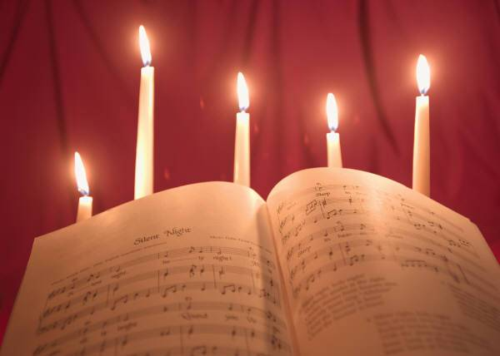
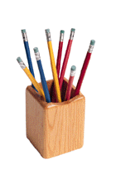
Homelink
- Review the vocabulary and the model sentence.
-Do exercise in work book.
- Prepare Unit 4. Lesson 2(1,2,3).

Slide 16

Good bye every body

