Slide 1
Unit 6
HOW MANY LESSONS
DO YOU HAVE TODAY?
Lesson 3

Slide 2
REVIEW

Slide 3
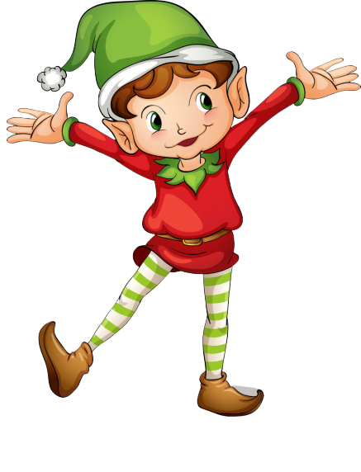
RING THE GOLDEN BELL
Notes:
Ms Huyền Phạm - 0936.082.789 – YOUTUBE: MsPham. Facebook: Dạy và học cùng công nghệ.

Slide 4
Ring The Golden Bell
Question 1
Answer
___________?
I have four: Maths, English, Art, IT.
How many lessons do you have today?
1
2
3
4
5
6
7
8
9
10
Next
Notes:
Ms Huyền Phạm - 0936.082.789 – YOUTUBE: MsPham. Facebook: Dạy và học cùng công nghệ.

Slide 5
Ring The Golden Bell
Question 2
Answer
________________?
I have Maths everyday.
How often do you have Maths
1
2
3
4
5
6
7
8
9
10
Next
Notes:
Ms Huyền Phạm - 0936.082.789 – YOUTUBE: MsPham. Facebook: Dạy và học cùng công nghệ.

Slide 6
Ring The Golden Bell
Question 3
Answer
________________?
I have English four times a week.
How often do you have English?
1
2
3
4
5
6
7
8
9
10
Next
Notes:
Ms Huyền Phạm - 0936.082.789 – YOUTUBE: MsPham. Facebook: Dạy và học cùng công nghệ.

Slide 7
Ring The Golden Bell
Question 4
Answer
________________?
I have Art twice a week.
How often do you have Art?
1
2
3
4
5
6
7
8
9
10
Next
Notes:
Ms Huyền Phạm - 0936.082.789 – YOUTUBE: MsPham. Facebook: Dạy và học cùng công nghệ.

Slide 8
Ring The Golden Bell
Question 5
Answer
___________?
I have three: Vietnamese, Music, PE, Maths.
How many lessons do you have today?
1
2
3
4
5
6
7
8
9
10
Next
Notes:
Ms Huyền Phạm - 0936.082.789 – YOUTUBE: MsPham. Facebook: Dạy và học cùng công nghệ.

Slide 9
Ring The Golden Bell
Question 6
Answer
___________?
I have five: Music, Science, Maths, English, Art.
How many lessons do you have today?
1
2
3
4
5
6
7
8
9
10
Next
Notes:
Ms Huyền Phạm - 0936.082.789 – YOUTUBE: MsPham. Facebook: Dạy và học cùng công nghệ.

Slide 10
Ring The Golden Bell
Question 7
Answer
________________?
I have Science once a week.
How often do you have Science?
1
2
3
4
5
6
7
8
9
10
Next
Notes:
Ms Huyền Phạm - 0936.082.789 – YOUTUBE: MsPham. Facebook: Dạy và học cùng công nghệ.

Slide 11
Ring The Golden Bell
Question 8
Answer
___________?
I have four: Maths, English, Art, IT.
How often do you have Science?
1
2
3
4
5
6
7
8
9
10
Next
Notes:
Ms Huyền Phạm - 0936.082.789 – YOUTUBE: MsPham. Facebook: Dạy và học cùng công nghệ.

Slide 12
Ring The Golden Bell
Question 9
Answer
___________?
I have six books.
How many books do you have today
1
2
3
4
5
6
7
8
9
10
Next
Notes:
Ms Huyền Phạm - 0936.082.789 – YOUTUBE: MsPham. Facebook: Dạy và học cùng công nghệ.

Slide 13
Ring The Golden Bell
Question 10
Answer
___________?
I do morning exercises everyday.
How often do you do morning exercises?
1
2
3
4
5
6
7
8
9
10
Next
Notes:
Ms Huyền Phạm - 0936.082.789 – YOUTUBE: MsPham. Facebook: Dạy và học cùng công nghệ.

Slide 15
PRONUNCIATION

Slide 16
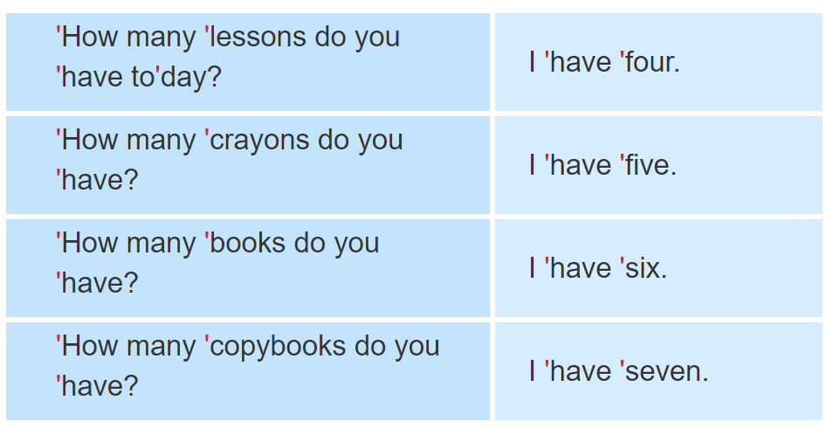
1. Listen and repeat.

Slide 17
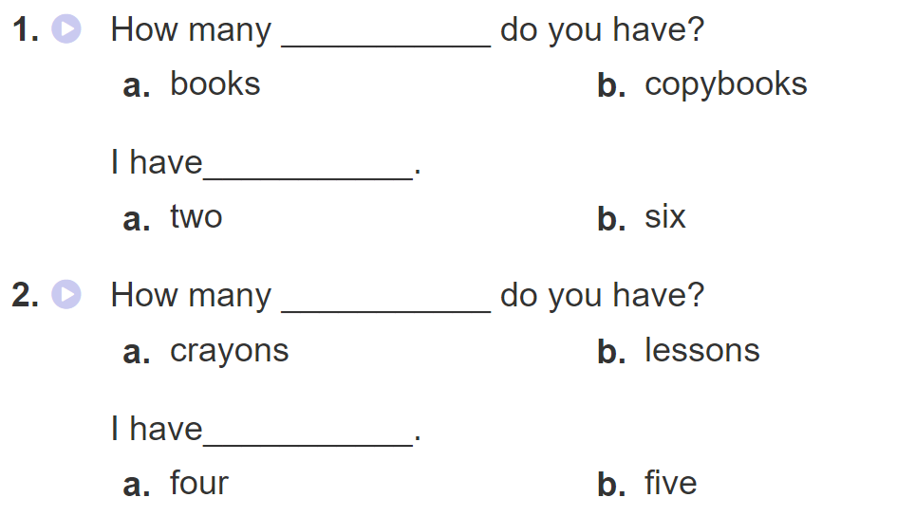
2. Listen and circle a or b. Then say the sentences aloud.

Slide 18
PRACTISE

Slide 19
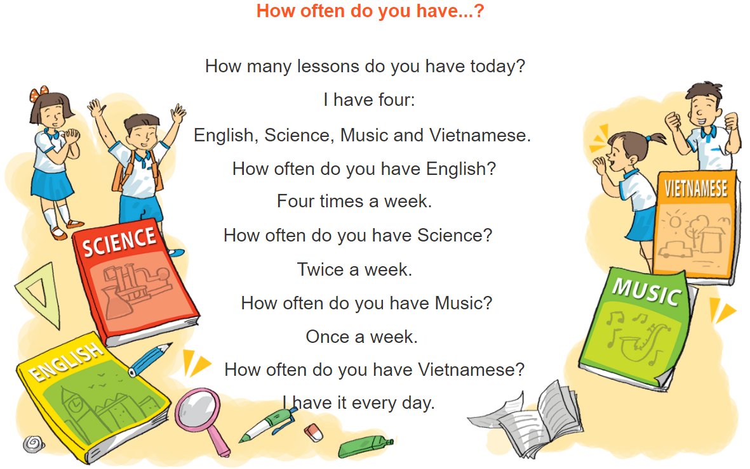
3. Let’s chant

Slide 20
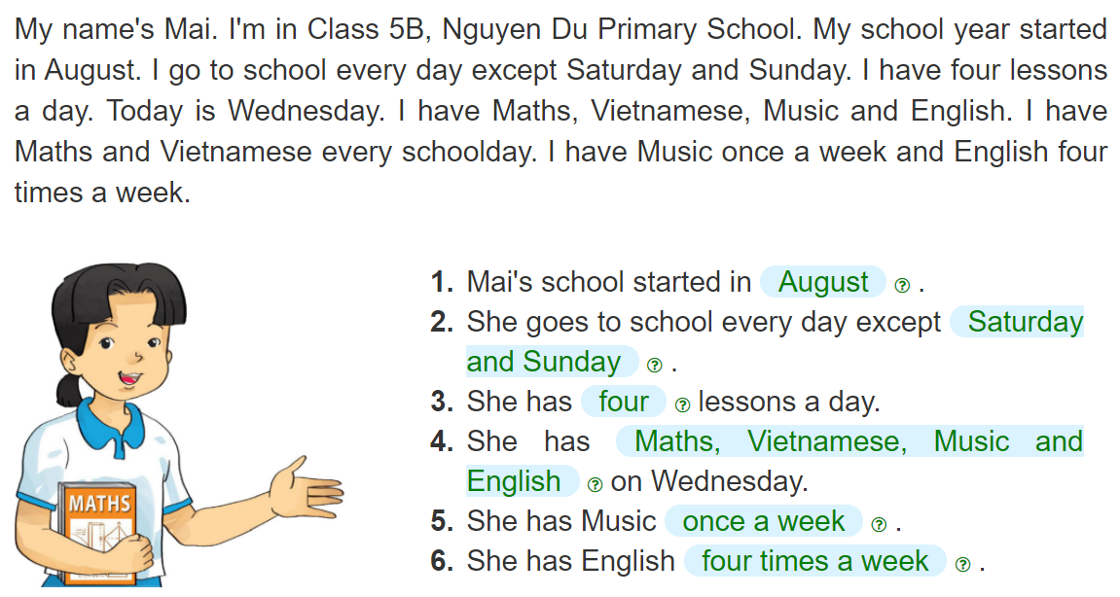
4. Read and complete
__________
__________
______________
______
________________________________________
________
______________
_____________________

Slide 21
5. Write about your school and lessons.
My school started in_________________.
I go to school _________________.
I have_______ lessons a day. I have _______________
_____________________________________________
on Wednesday. I have Music_____________________.
I have English _____________________.

Slide 22
6. Project
Write a letter to a pen friend to talk
about your timetable.

