Slide 1
Unit 7
How do you
lern English
Lesson 2 (4,5,6)

Slide 3
What
How
______ do you learn English?
Because I want to be an English teacher.
Why

Slide 4
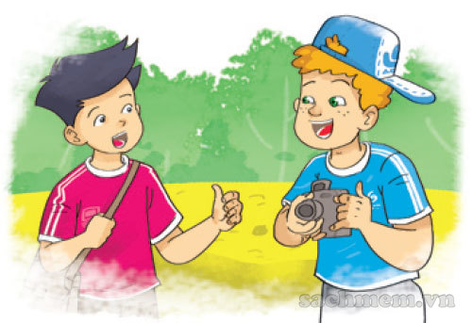
Because I want to watch English cartoons on TV.
Because I want to talk with my foreign friends.
Why do you learn English?
Because I want to read English comic books.

Slide 5
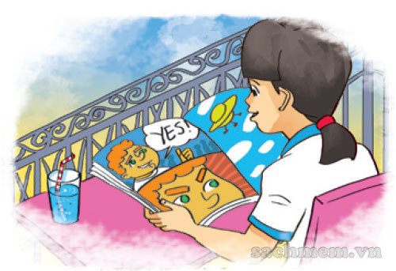
Because I want to read English comic books.
Because I want to watch English cartoons on TV.
Why do you learn English?
Because I want to talk with my foreign friends.

Slide 6
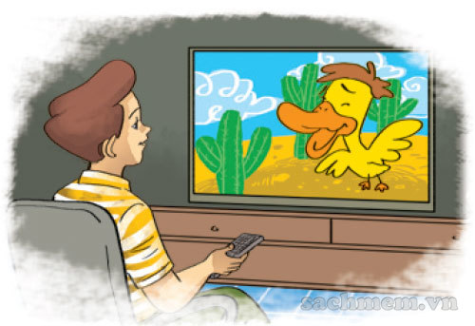
Because I want to watch English cartoons o TV.
Because I want to talk with my foreign friends.
Why do you learn English?
Because I want to read English comic book.

Slide 7
How do you learn English?
Why do you learn English?
Because I want to
sing English song.
Do do you like to learn English?

Slide 8
do
are
How _____ you learn English?
were

Slide 9
I watch English cartoons on TV.
I read English comic books.
How do you
learn English?
I talk with my foreign friends.

Slide 10
I watch English cartoons on TV.
I talk with my foreign friends.
How do you
learn English?
I read English comic books.

Slide 11
I sing English song.
I talk with my foreign friends.
How do you
learn English?
I watch English cartoons on TV.

Slide 12
Time’s up!

Slide 13
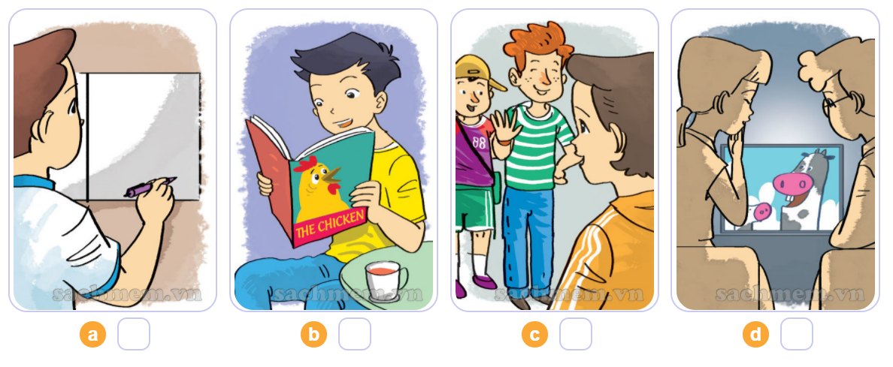
4. Listen and number
2
4
1
3
1
2
3
4

Slide 14
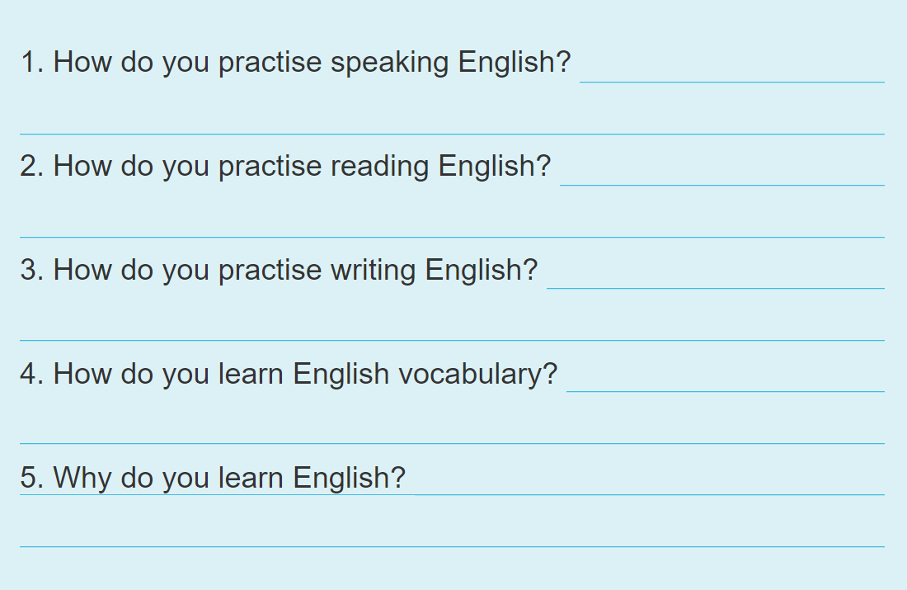
5. Write about you.

Slide 15
5. Write about you.
I speak English every day.
I read English comic book.
I write emails to my friends.
I write new words in my notebook and read them aloud.
Because I want to watch English cartoon on TV.

Slide 16
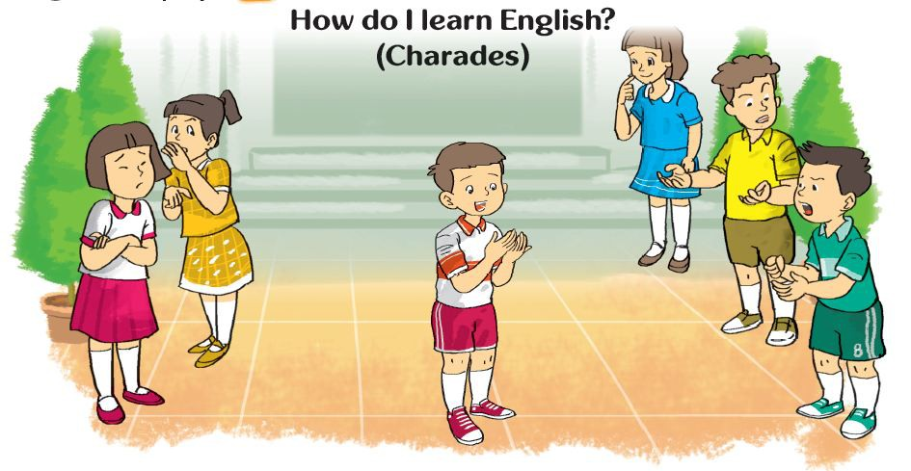
6. Let’s play

