Slide 1
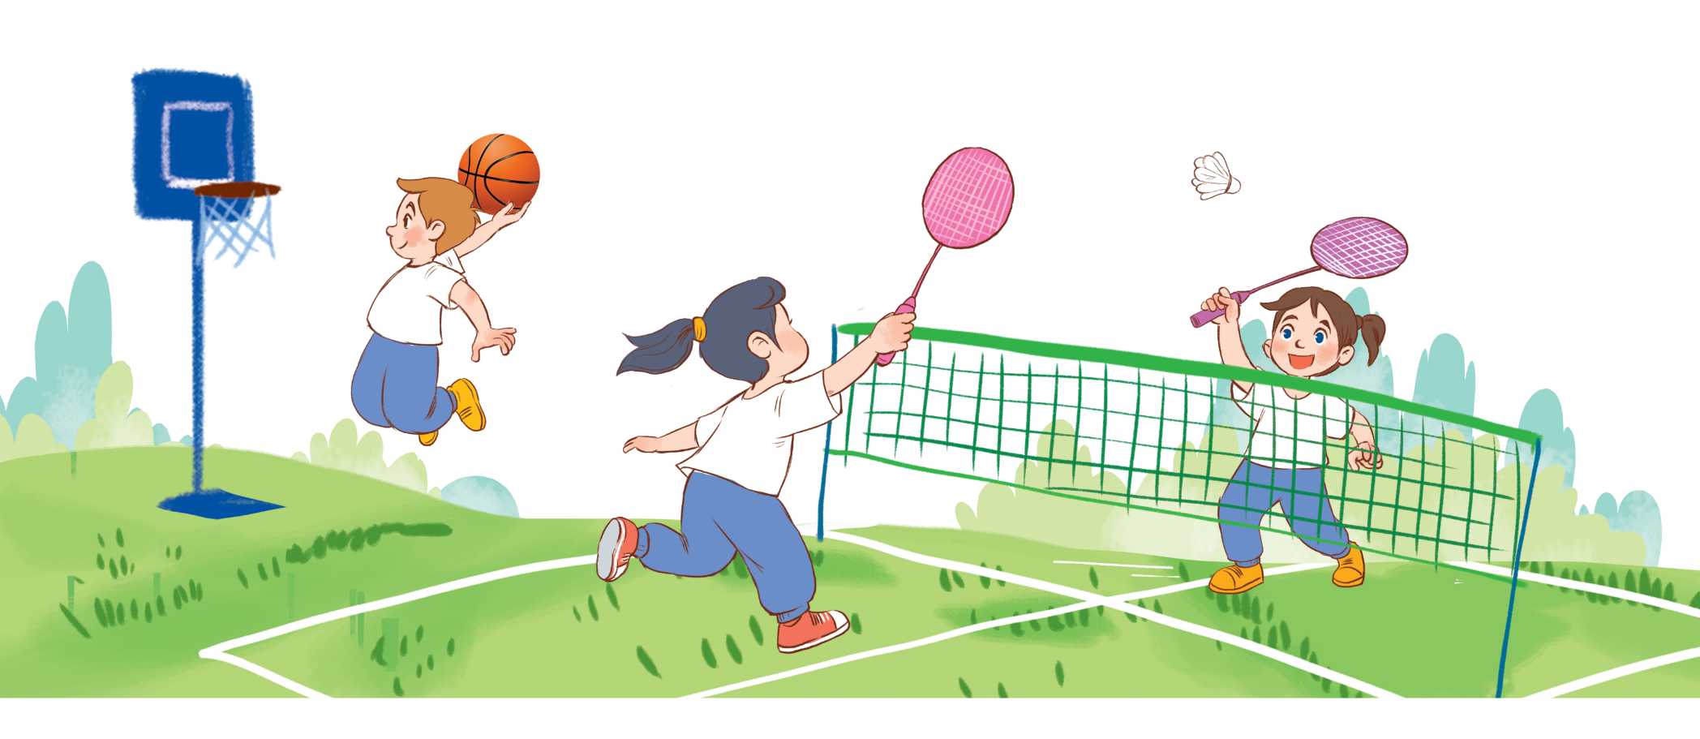
Unit 10
Break time
activities
Lesson 3 – Part 1,2,3
Teacher: Ha Thi Xuan THu

Slide 2
Phonics
Next

Slide 3
Phonics
f
/f/

Slide 4
Phonics
Next

Slide 5
Phonics
v
/v/

Slide 6
MsPham-0936082789
1
Listen and repeat.
MsPham-0936082789
MsPham-0936082789
f | football | I play football at break time.
v | volleyball | I play volleyball at break time.
MsPham-0936082789

Slide 7
MsPham-0936082789
2
Listen and circle.
MsPham-0936082789
MsPham-0936082789
1. A: What do you do at break time? B: I play _________.
a. volleyball b. badminton c. football
2. A: What do you do at break time? B: I play _________.
a. basketball b. football c. volleyball
MsPham-0936082789

Slide 8
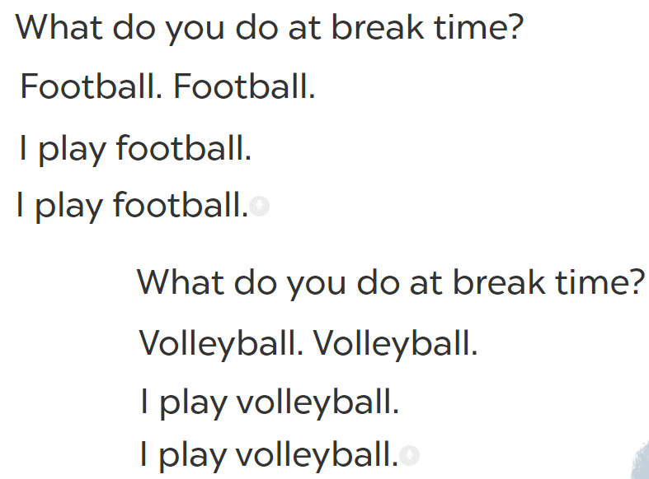
MsPham-0936082789
3
Let’s chant.
MsPham-0936082789
MsPham-0936082789
MsPham-0936082789

Slide 9
MsPham-0936082789
MsPham-0936082789
MsPham-0936082789
MsPham-0936082789
Thank you
For enjoying!
MsPham-0936082789

