Slide 1

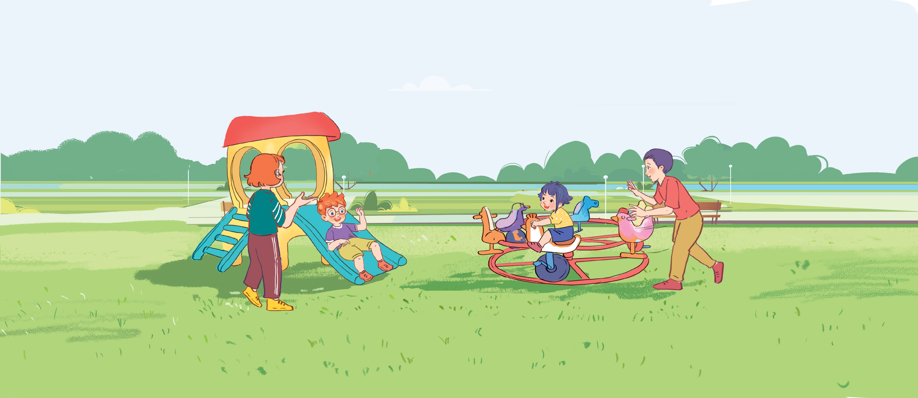




Unit 11
My family
Lesson 1 - Period 1
Teacher: Ms Linh

Slide 2

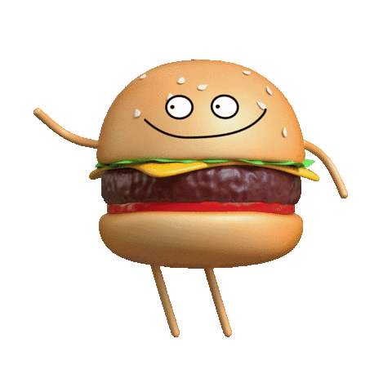
MsPham-0936082789
Warm - up
Play

Slide 3


Slide 4


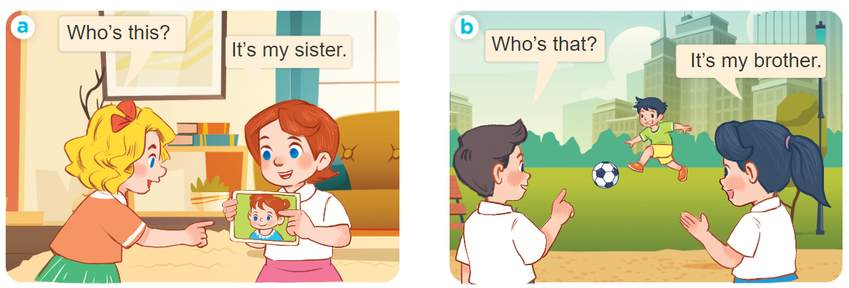
1
Look, listen and repeat.
MsPham-0936082789
MsPham-0936082789

Slide 5
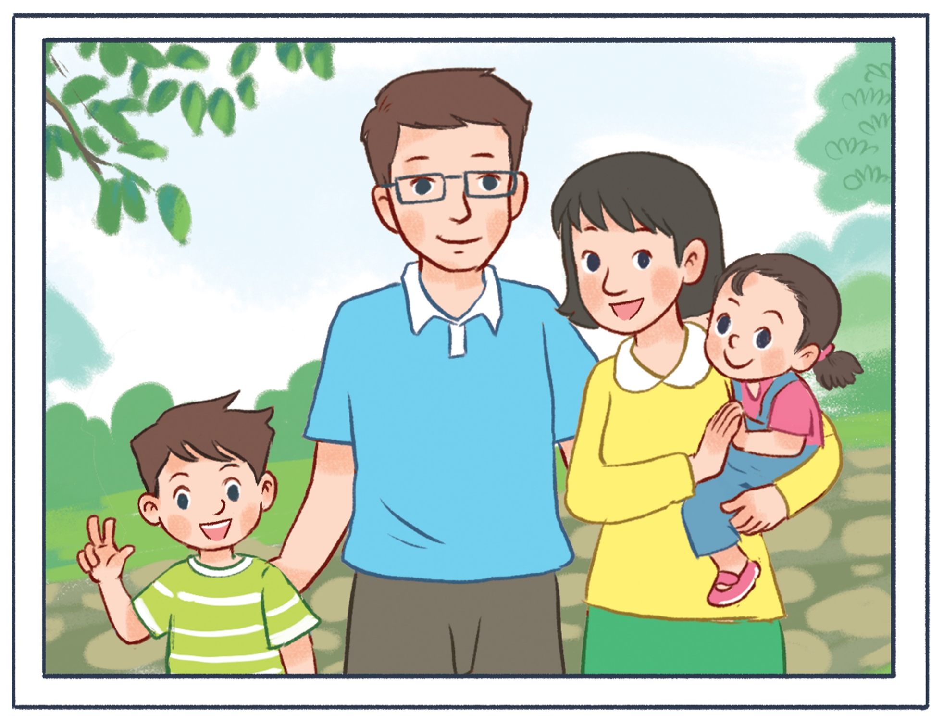

MsPham-0936082789
Vocabulary
MsPham-0936082789
MsPham-0936082789
mother
father
/ˈmʌðər/
/ˈfɑːðər/
MsPham-0936082789
MsPham-0936082789
MsPham-0936082789
sister
brother
/ˈsɪstər/
/ˈbrʌðər/
MsPham-0936082789

Slide 6
MsPham-0936082789
Vocabulary
MsPham-0936082789
MsPham-0936082789
father
/ˈfɑːðər/
Bố
mother
/ˈmʌðər/
Mẹ
MsPham-0936082789
brother
/ˈbrʌðər/
Anh trai, em trai
MsPham-0936082789
sister
/ˈsɪstər/
Chị gái, em gái
who
/huː/
Ai
my
/maɪ/
Của tôi, của tớ
MsPham-0936082789

Slide 7

MsPham-0936082789
MsPham-0936082789
Structures
MsPham
0936092789
MsPham-0936082789
MsPham-0936082789
MsPham
0936092789
Cách hỏi một người nào đó là ai:
is = ’s
Who is this?
(Đây là ai?)
MsPham-0936082789
It is my ________.
(Đây là ______ của tớ.)
MsPham-0936082789
MsPham-0936082789
Who is that?
(Kia là ai?)
It is my ________.
(Đó là ______ của tớ.)
MsPham-0936082789
MsPham-0936082789

Slide 8


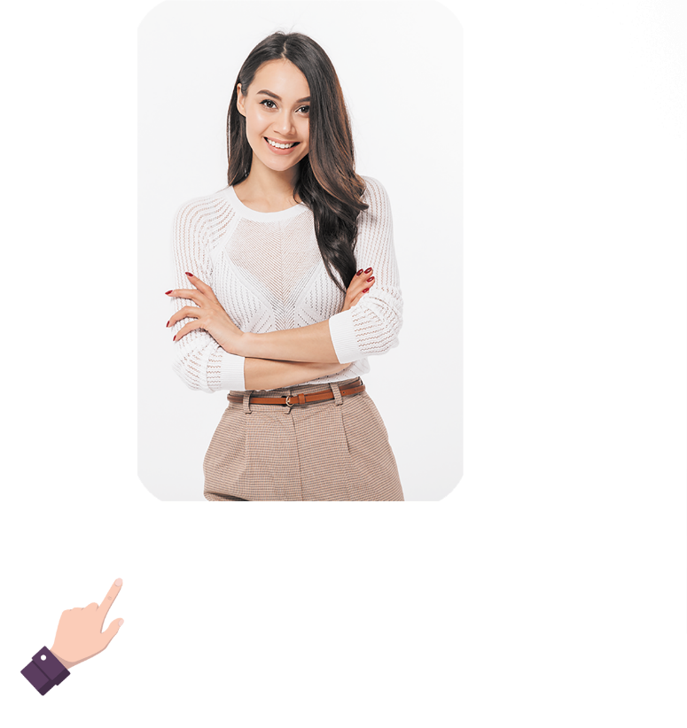



2
Listen, point and say.
MsPham
0936082789
Who’s _______?
It’s my _________.
MsPham-0936082789
mother
father
brother
sister

Slide 9
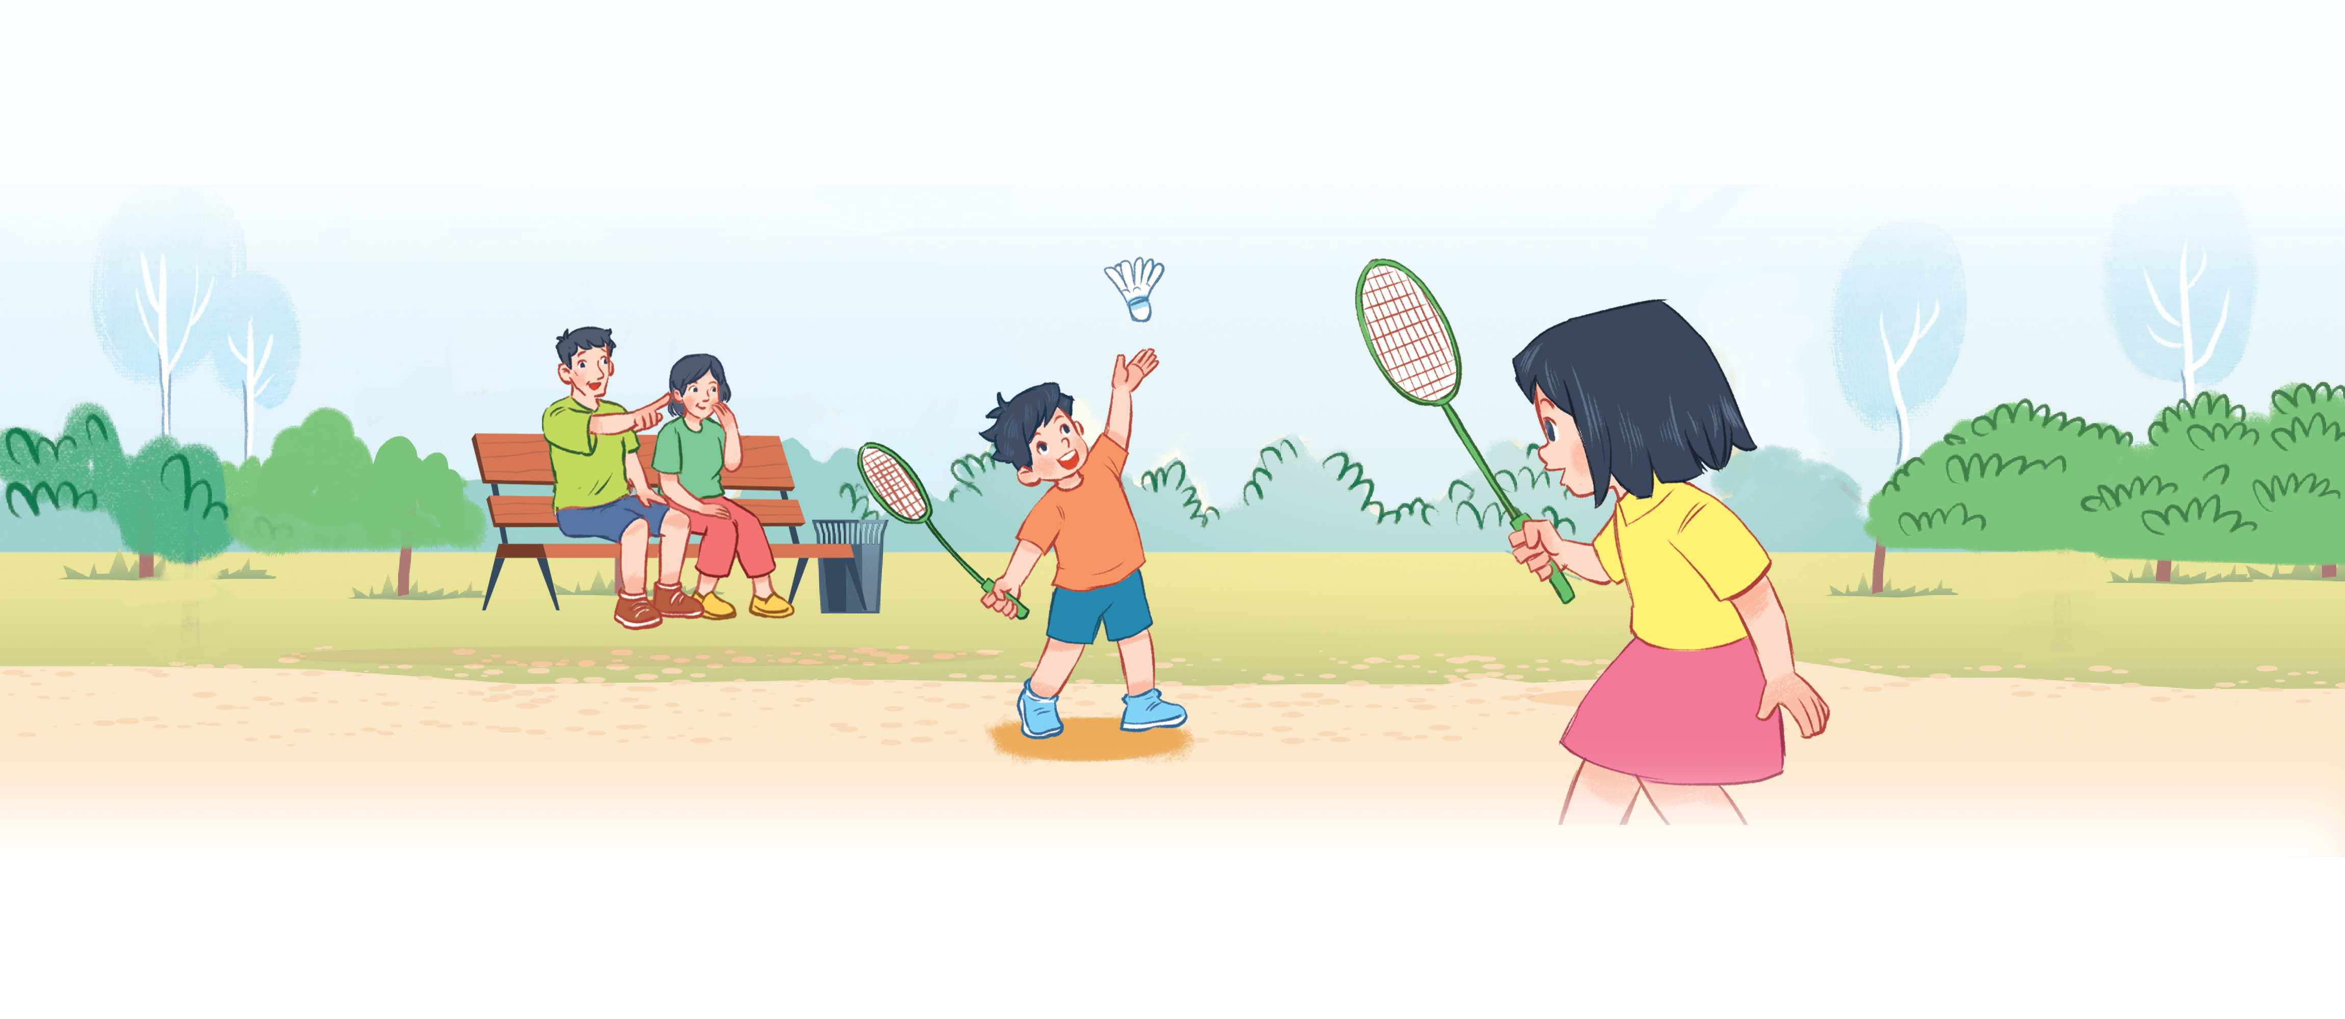
3
Let’s talk.
MsPham-0936082789

Slide 10


Fun corner wrap-up
MsPham-0936082789
MsPham-0936082789
and
MsPham-0936082789
MsPham-0936082789
Notes:
Step 1: Ask pupils to look at the pictures and say the sentences.
Step 2: Ask some pupils to say the names or the sentences of the characters.
Step 3: Wrap up the lesson.

Slide 11



MsPham-0936082789
MsPham-0936082789
MsPham-0936082789
MsPham-0936082789

Slide 12
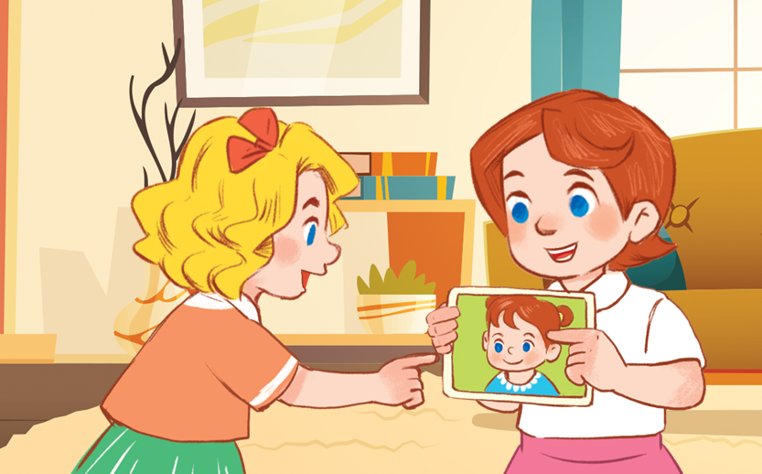





MsPham-0936082789
Choose the best answer.
Who’s ______?
It’s my sister.
MsPham-0936082789
MsPham-0936082789
this
that
MsPham-0936082789

Slide 13
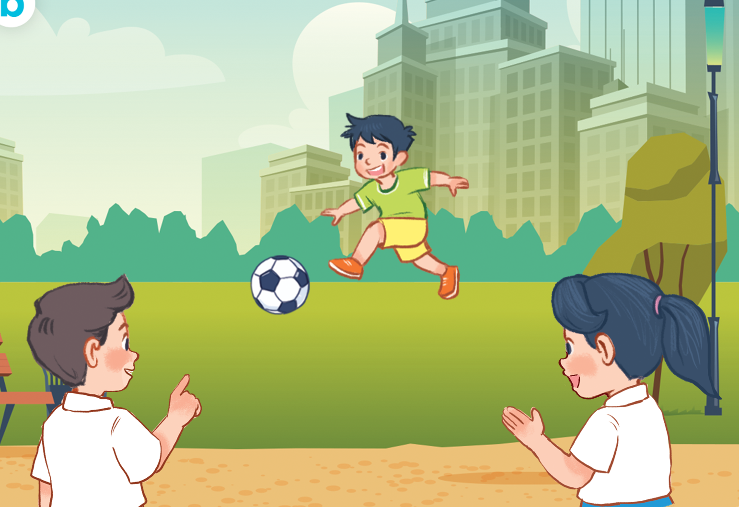
MsPham-0936082789
Choose the best answer.
Who’s ______?
It’s my brother.
MsPham-0936082789
MsPham-0936082789
this
that
MsPham-0936082789

Slide 14
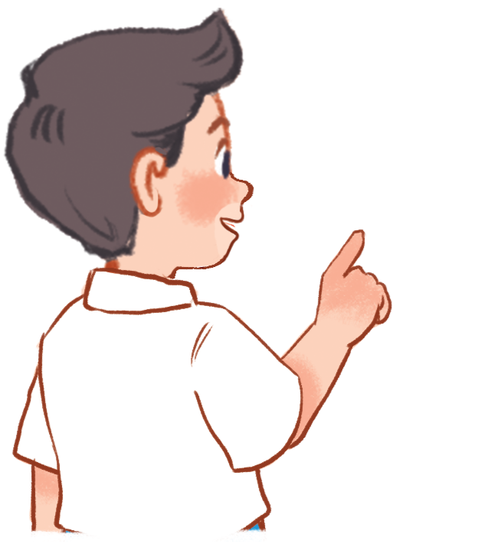
MsPham-0936082789
Choose the best answer.
Who’s ______?
It’s my father.
MsPham-0936082789
MsPham-0936082789
this
that
MsPham-0936082789

Slide 15
MsPham-0936082789
Choose the best answer.
Who’s ______?
It’s my mother.
MsPham-0936082789
MsPham-0936082789
this
that
MsPham-0936082789

Slide 16
MsPham-0936082789
Choose the best answer.
Who’s that?
It’s my _____.
MsPham-0936082789
MsPham-0936082789
mother
sister
MsPham-0936082789

Slide 17
MsPham-0936082789
Choose the best answer.
Who’s that?
It’s my _____.
MsPham-0936082789
MsPham-0936082789
mother
father
MsPham-0936082789

Slide 18
MsPham-0936082789
Choose the best answer.
Who’s this?
It’s my _____.
MsPham-0936082789
MsPham-0936082789
father
brother
MsPham-0936082789

Slide 19
MsPham-0936082789
Choose the best answer.
Who’s this?
It’s my _____.
MsPham-0936082789
MsPham-0936082789
sister
brother
MsPham-0936082789

Slide 20

MsPham-0936082789
MsPham-0936082789
MsPham-0936082789
MsPham-0936082789

