Slide 1

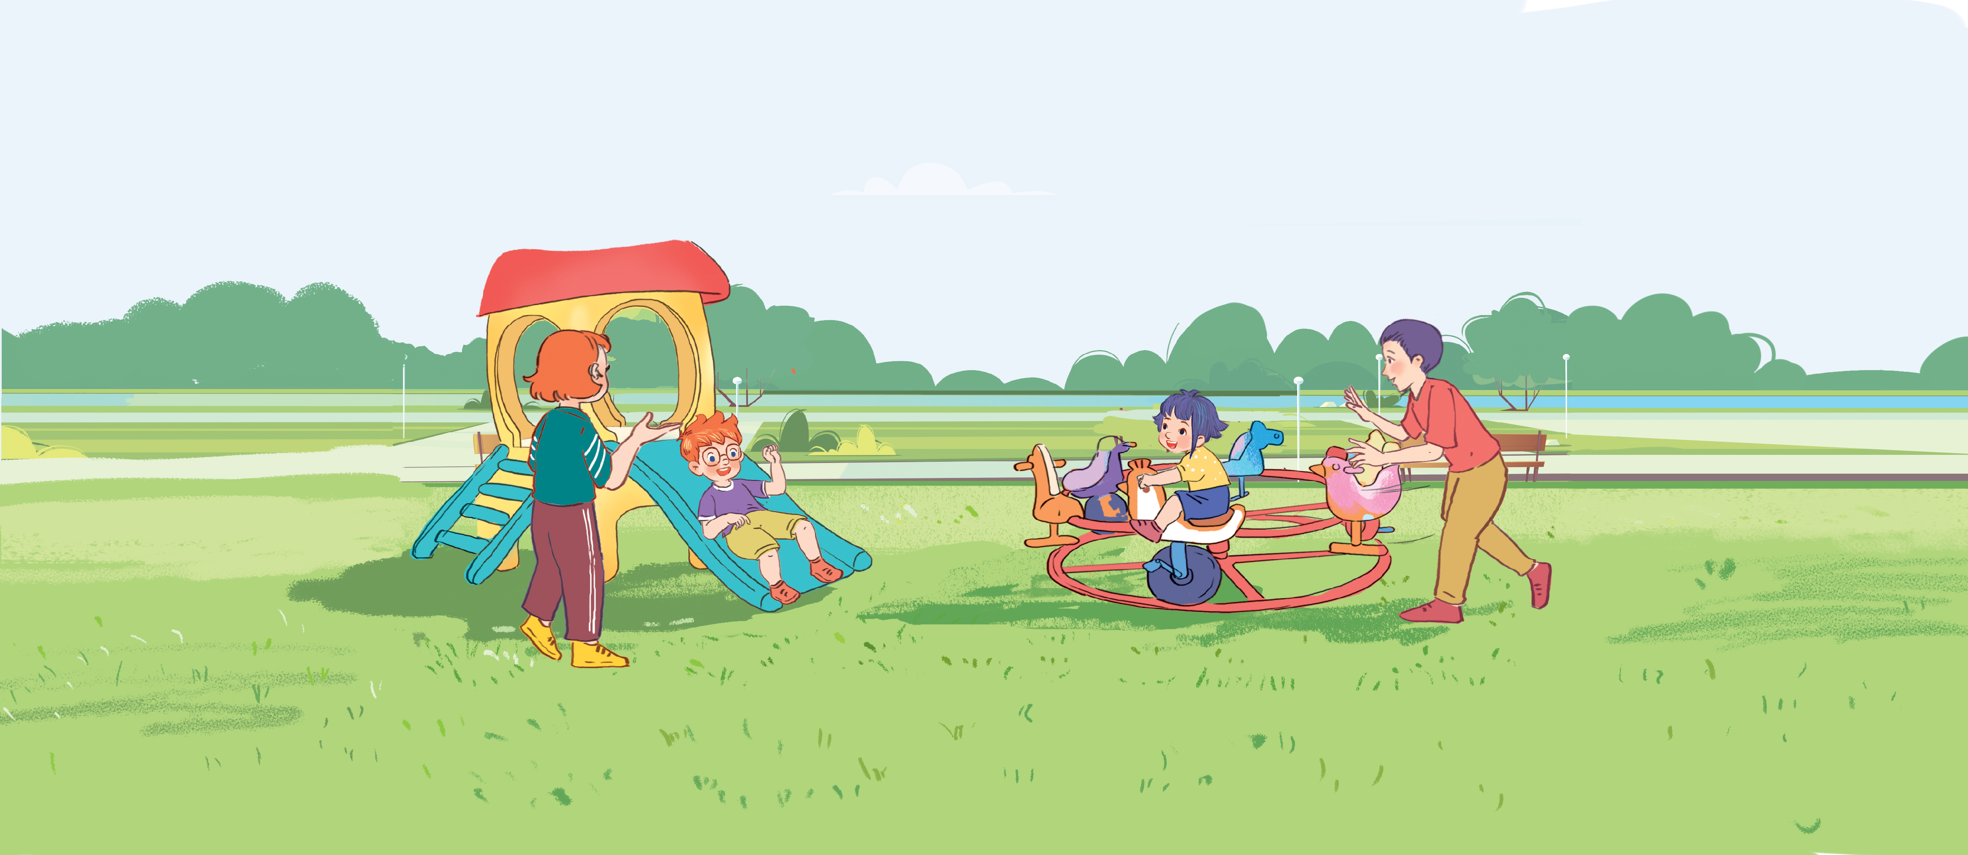




Unit 11
My family
Lesson 1 - Period 2
Teacher: Ms Linh

Slide 2

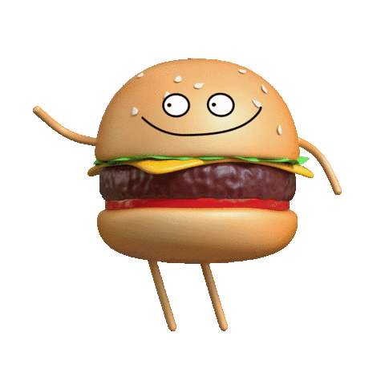
MsPham-0936082789
Warm - up
Play

Slide 3


Slide 4
MsPham-0936082789
Review
Play

Slide 5


What is the letter missing?
Start

Slide 6

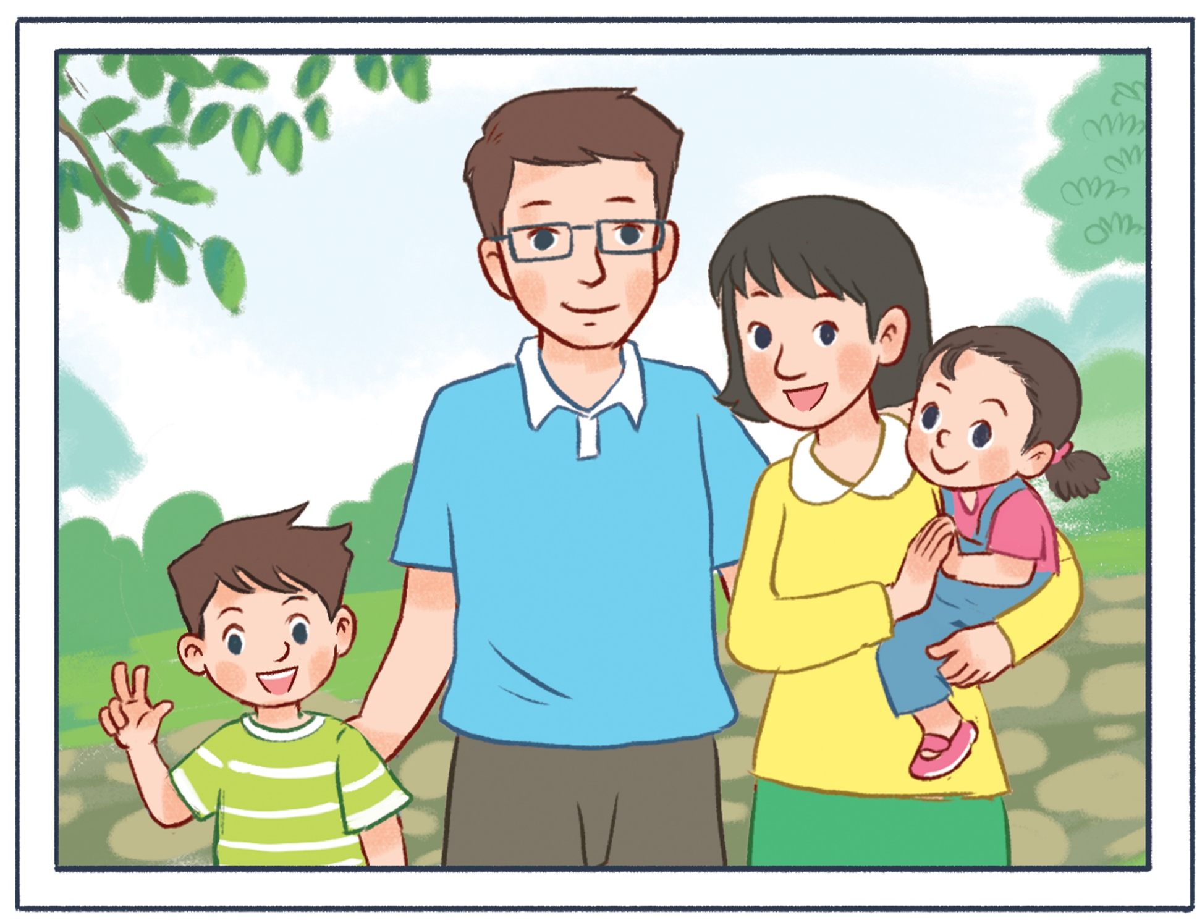


What is the letter missing?
Check
MsPham-0936082789
Next
F a t h e r
___

Slide 7
What is the letter missing?
Check
MsPham-0936082789
Next
B r o t h e r
__

Slide 8
What is the letter missing?
Check
MsPham-0936082789
Next
m y family
__

Slide 9
What is the letter missing?
Check
MsPham-0936082789
Next
s i s t e r
__

Slide 10
What is the letter missing?
Check
MsPham-0936082789
Next
__
m o t h e r

Slide 11
What is the letter missing?
?
Check
MsPham-0936082789
Next
W h o
__

Slide 12
Excellent!
End

Slide 13




4
Listen and tick.
1
MsPham-0936082789
MsPham-0936082789
2

Slide 14
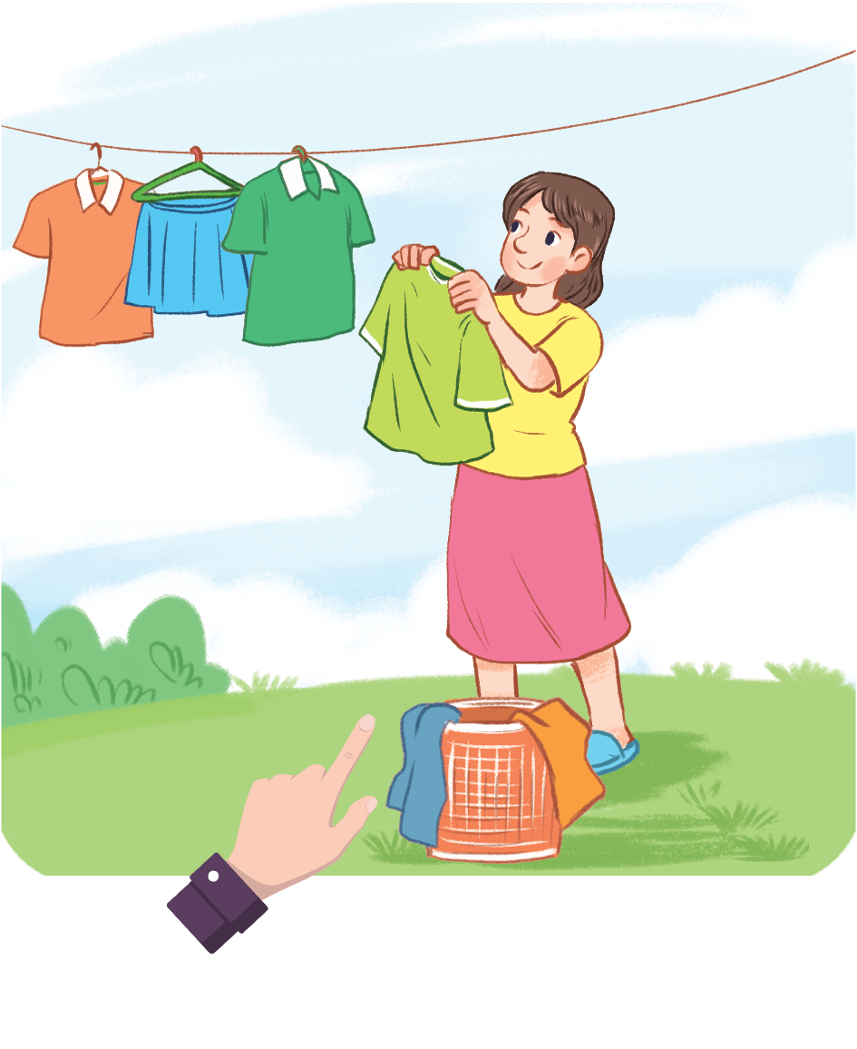
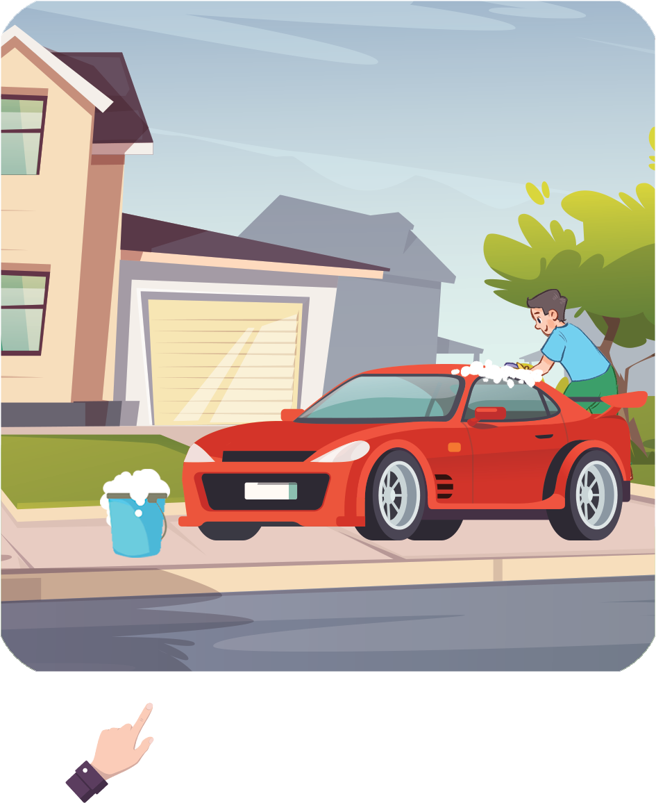
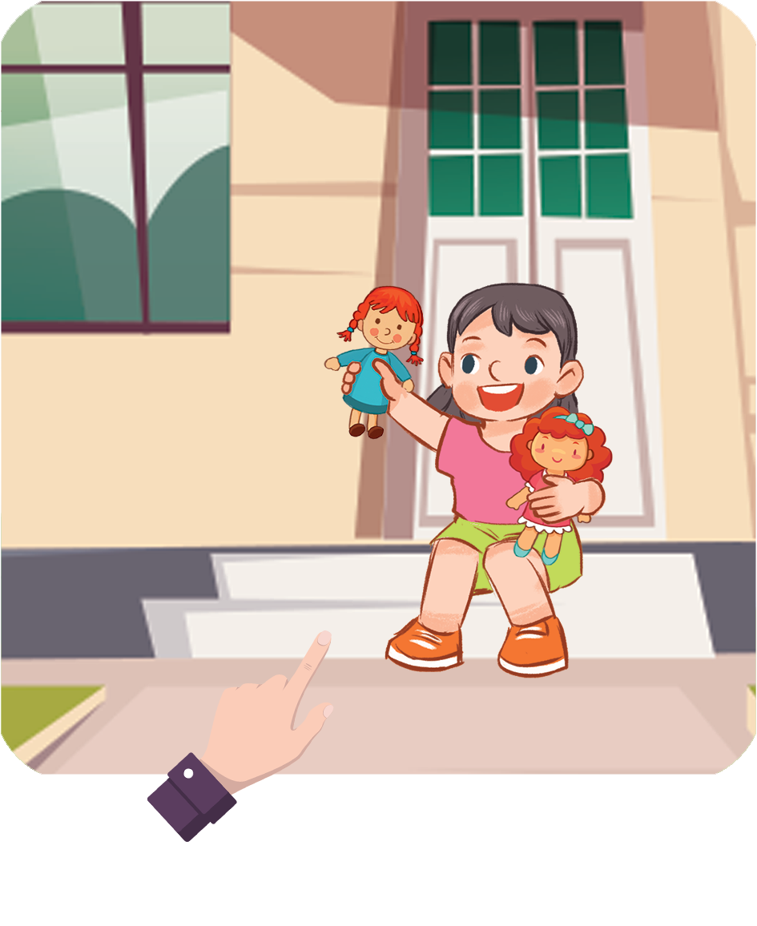
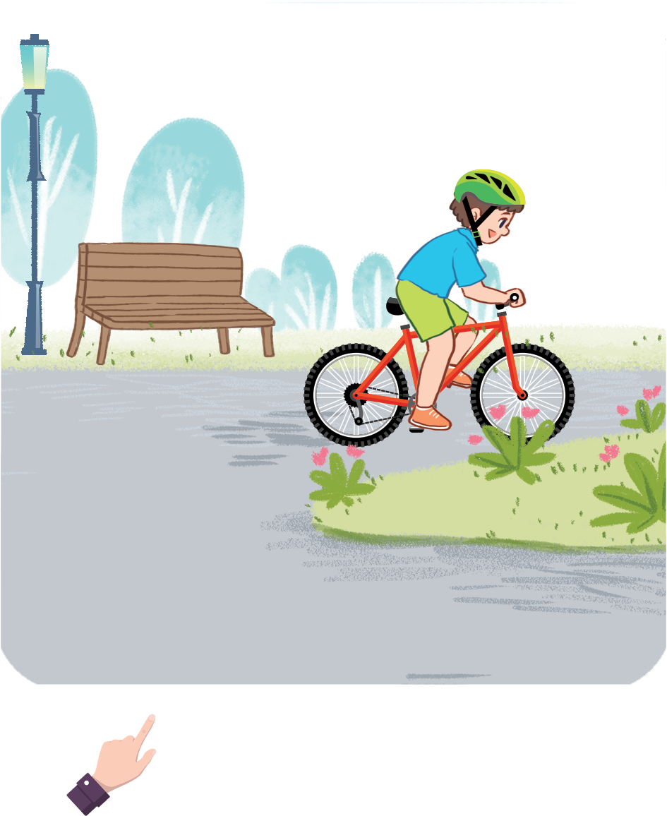
5
Look, complete and read.
A: Who’s this?
B: It’s my mother.
A: Who’s that?
B: It’s my father.
MsPham
0936082789
__________.
__________.
1
2
MsPham-0936082789
A. Who’s this?
B: It’s my sister.
A. Who’s that?
B: It’s my brother.
__________.
__________.
3
4

Slide 15



MsPham-0936082789
MsPham-0936082789
MsPham-0936082789
Start
MsPham-0936082789

Slide 16
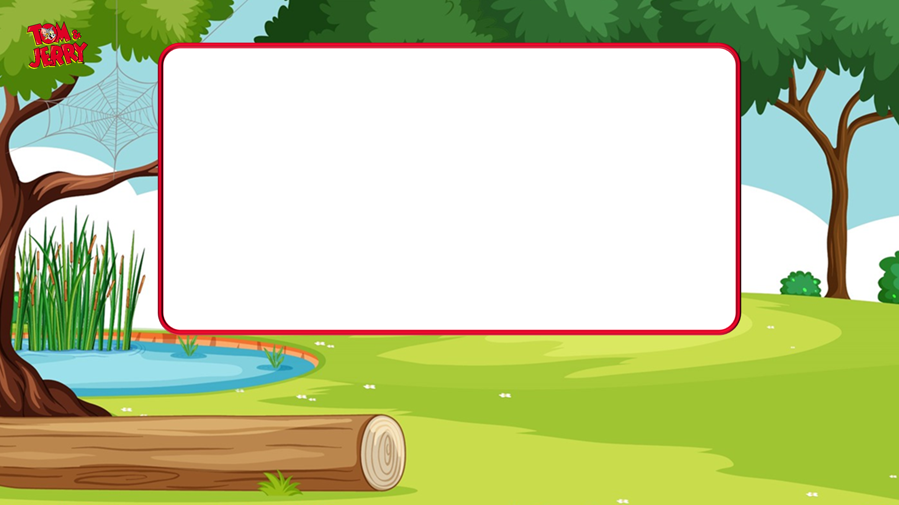
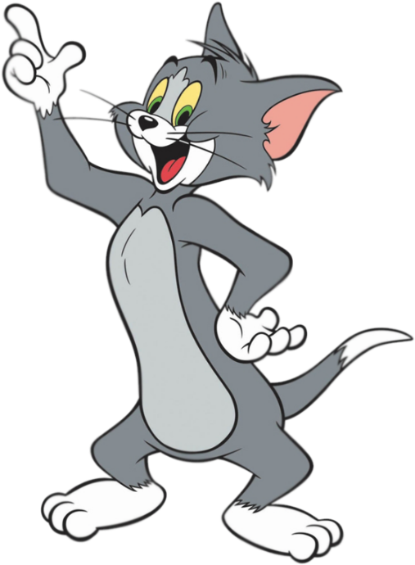
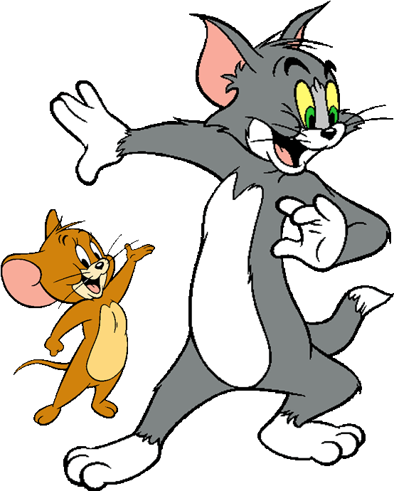




MsPham-0936082789
It’s my ____.
MsPham-0936082789
sister
mother
MsPham-0936082789
Next
MsPham-0936082789

Slide 17
MsPham-0936082789
It’s my ____.
MsPham-0936082789
brother
father
MsPham-0936082789
Next
MsPham-0936082789

Slide 18
MsPham-0936082789
It’s my ____.
MsPham-0936082789
sister
brother
MsPham-0936082789
Next
MsPham-0936082789

Slide 19
MsPham-0936082789
It’s my ____.
MsPham-0936082789
mother
father
MsPham-0936082789
Next
MsPham-0936082789

Slide 20
MsPham-0936082789
__________
It’s my mother.
MsPham-0936082789
Who that?
Who this?
MsPham-0936082789
Next
MsPham-0936082789

Slide 21
MsPham-0936082789
__________
It’s my brother.
MsPham-0936082789
Who this?
Who that?
MsPham-0936082789
Next
MsPham-0936082789

Slide 22
MsPham-0936082789
__________
It’s my father.
MsPham-0936082789
Who that?
Who this?
MsPham-0936082789
Next
MsPham-0936082789

Slide 23
MsPham-0936082789
__________
It’s my father.
MsPham-0936082789
Who this?
Who that?
MsPham-0936082789
Next
MsPham-0936082789

Slide 24


MsPham-0936082789
MsPham-0936082789
To be continued…
MsPham-0936082789
End
MsPham-0936082789

Slide 25

6
Let’s sing.
Who’s this?
It’s my brother.
Who’s this?
It’s my sister.
My brother and my sister.
Who’s that?
It’s my mother.
Who’s that?
It’s my father.
My mother and my father.
MsPham-0936082789

Slide 26


MsPham-0936082789
Thank you!

