Slide 1
Unit 7
How do you
lern English
Lesson 2: Part 1,2,3

Slide 2
VOCABULARY

Slide 3
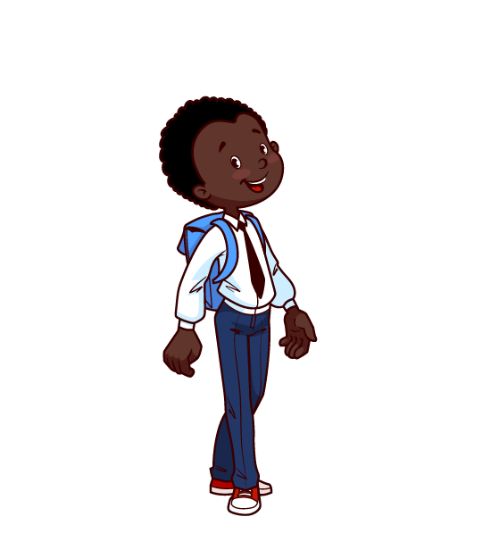
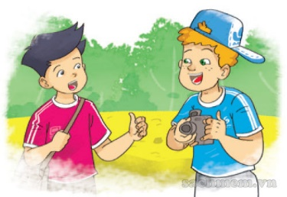
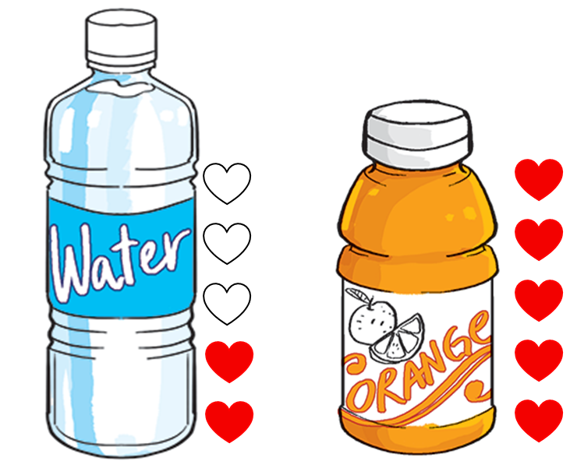
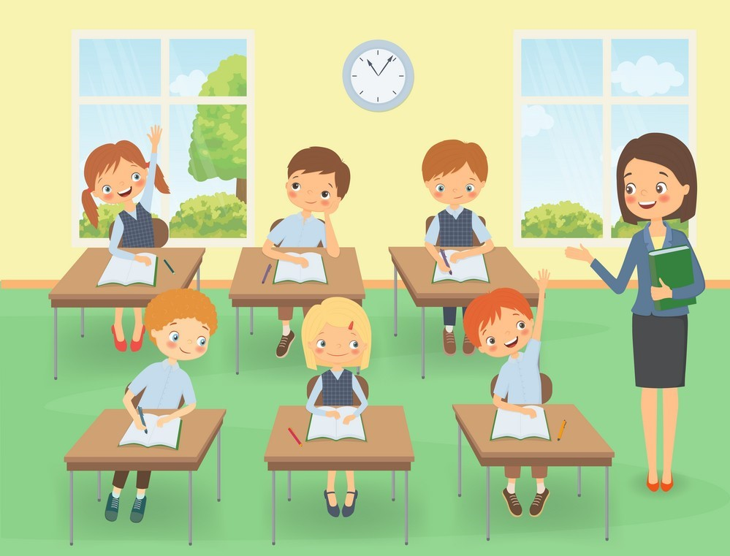
A. Vocabulary
French
English
French
language
foreign
/frentʃ/
/ˈlæŋɡwɪdʒ/
/ˈfɔːrən/
Tiếng Pháp
Ngôn ngữ
Nước ngoài
talk
favourite
learn
/tɔːk/
/ˈfeɪvərɪt/
/lɜːrn/
Nói chuyện
Yêu thích
Học

Slide 4
Choose the correct picture
a
b
c
d
language
French
English

Slide 5
Choose the correct picture
a
b
c
d
French
French
English

Slide 6
Choose the correct picture
a
b
c
d
foreign
French
English

Slide 7
Choose the correct picture
a
b
French
English
c
d
favourite

Slide 8
Choose the correct picture
a
b
c
d
talk

Slide 9
Choose the correct picture
a
b
French
English
c
d
learn

Slide 10
GRAMMAR

Slide 11
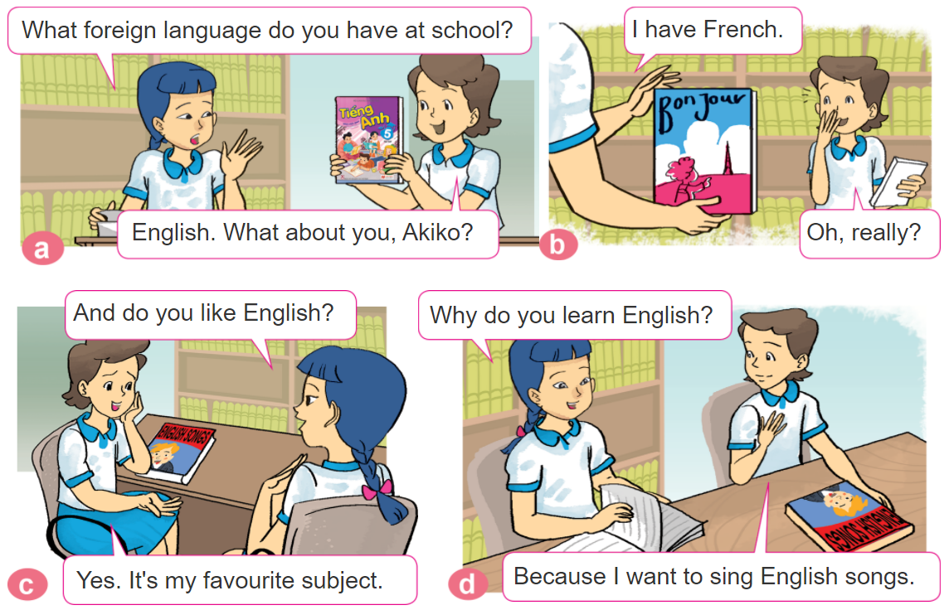
1. Look, listen and repeat.

Slide 12
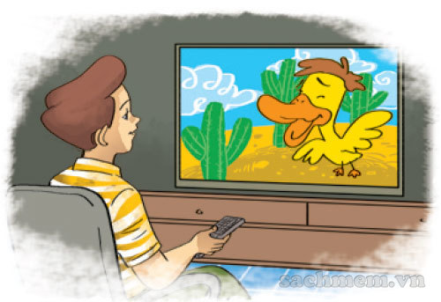
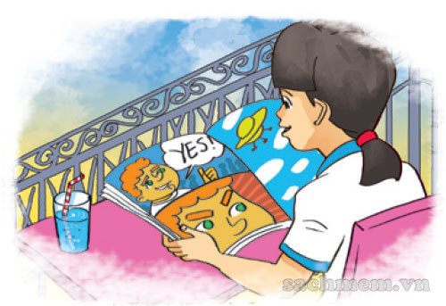
2. Point and say
Why do you learn English?
Because I want to __________.
watch English cartoons on TV
talk with my foreign friends
read English comic books

Slide 13
B. Grammar
Hỏi và trả lời vì sao bạn thích học Tiếng Anh:
(Tại sao bạn thích học Tiếng Anh)
Why do you learn English?
Because I want to ____________.
+ lí do thích học
(Bởi vì tớ muốn ______________)

Slide 14
3. Let’s talk
How do you
learn English?
I _____________
Because I want to ______.
Why do you learn English?

Slide 15
PLAY A GAME

Slide 17
What
How
______ do you learn English?
Because I want to be an English teacher.
Why

Slide 18
Because I want to watch English cartoons on TV.
Because I want to talk with my foreign friends.
Why do you learn English?
Because I want to read English comic books.

Slide 19
Because I want to read English comic books.
Because I want to watch English cartoons on TV.
Why do you learn English?
Because I want to talk with my foreign friends.

Slide 20
Because I want to read English comic books.
Because I want to talk with my foreign friends.
Why do you learn English?
Because I want to watch English cartoons on TV.

Slide 21
How do you learn English?
Why do you learn English?
Because I want to
sing English song.
Do do you like to learn English?

Slide 22
do
are
How _____ you learn English?
were

Slide 23
I watch English cartoons on TV.
I read English comic books.
How do you
learn English?
I talk with my foreign friends.

Slide 24
I watch English cartoons on TV.
I talk with my foreign friends.
How do you
learn English?
I read English comic books.

Slide 25
I sing English song.
I talk with my foreign friends.
How do you
learn English?
I watch English cartoons on TV.

Slide 26
Time’s up!

Slide 27
MsPham-0936082789
MsPham-0936082789
MsPham-0936082789
MsPham-0936082789
Thank you
For enjoying!
MsPham-0936082789

