Slide 1

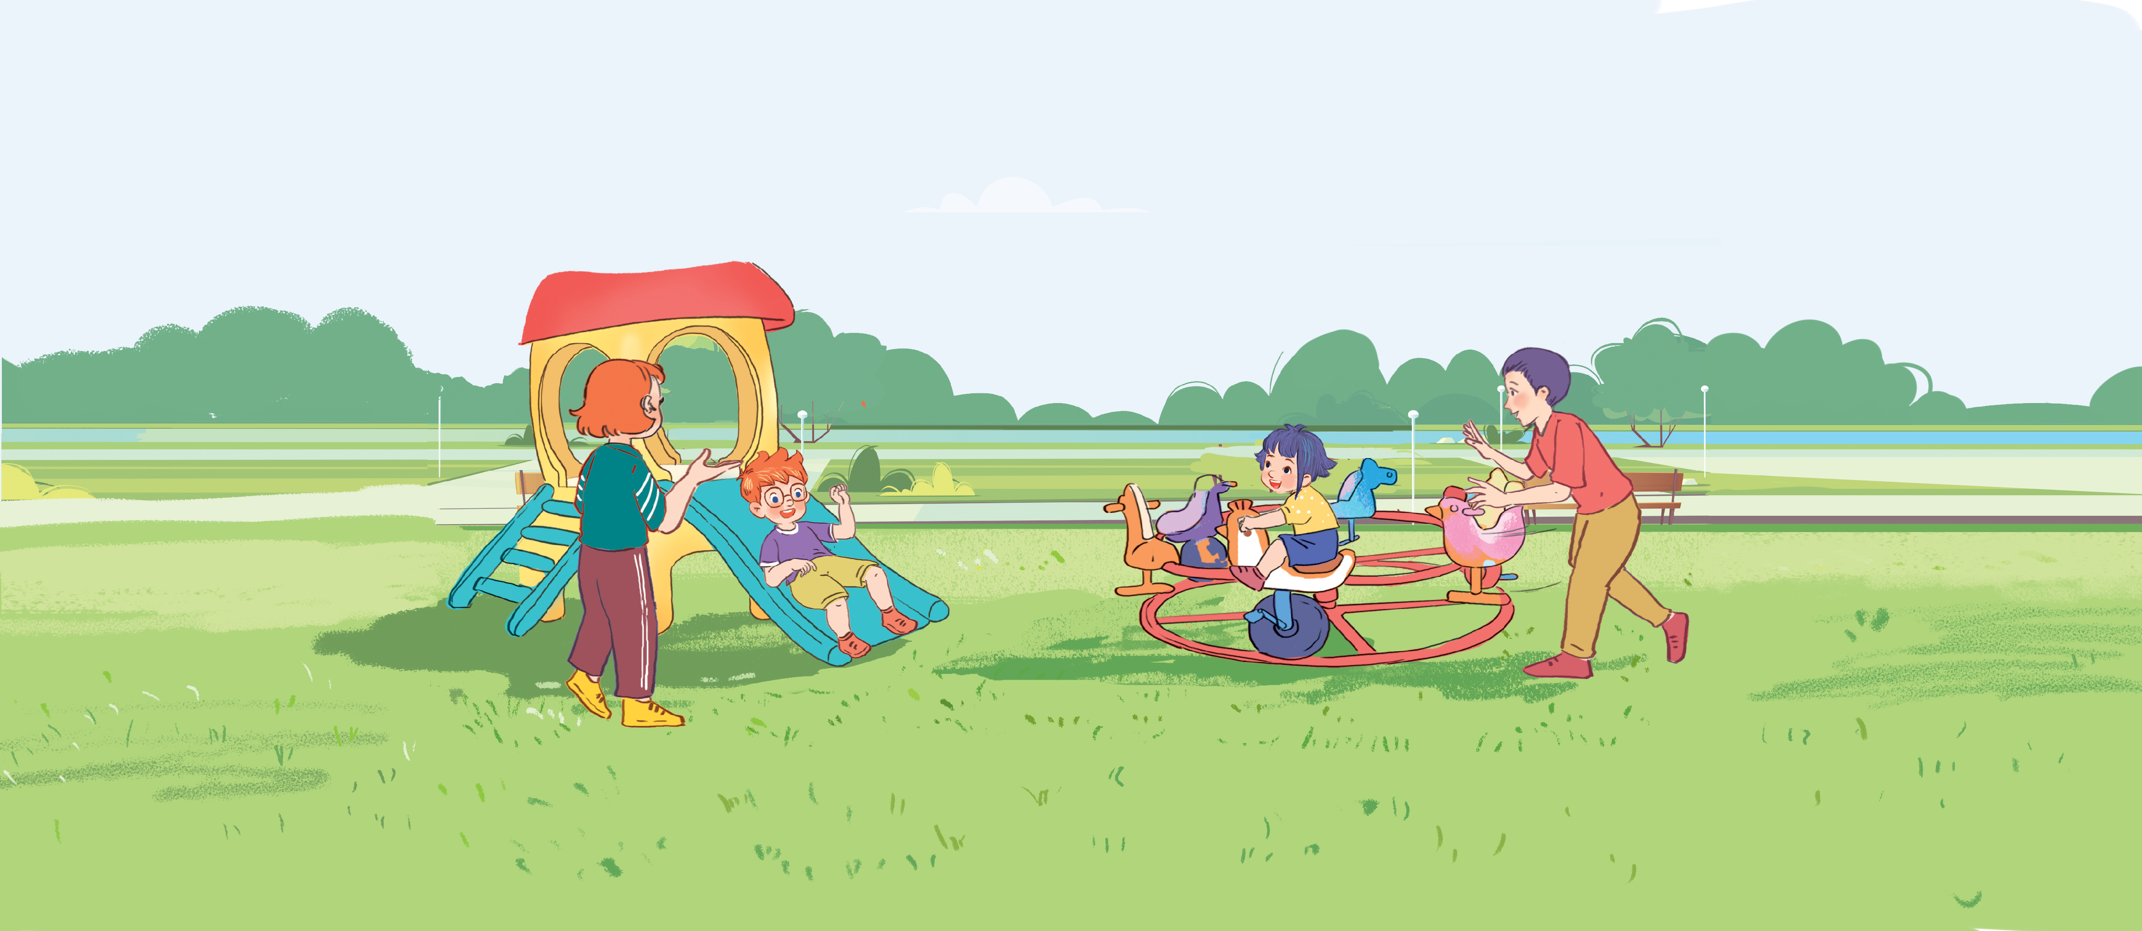




Unit 11
My family
Lesson 1 - Period 2
Teacher: Ms Linh

Slide 2

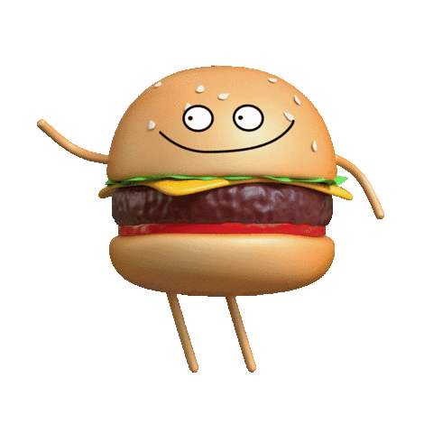
MsPham-0936082789
Warm - up
Play

Slide 3


Slide 4
MsPham-0936082789
Review
Play

Slide 5


What is the letter missing?
Start

Slide 6

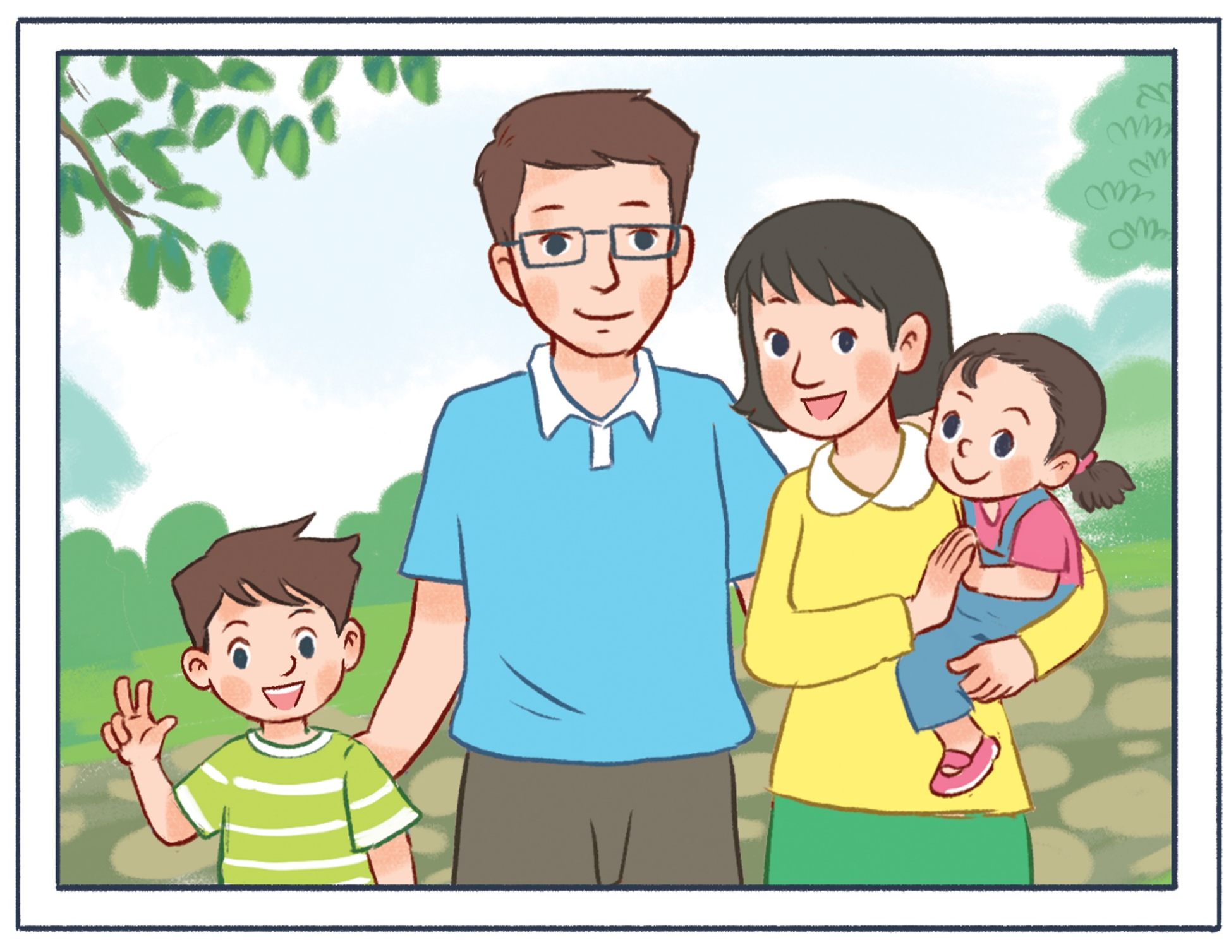


What is the letter missing?
Check
MsPham-0936082789
Next
F a t h e r
___

Slide 7
What is the letter missing?
Check
MsPham-0936082789
Next
B r o t h e r
__

Slide 8
What is the letter missing?
Check
MsPham-0936082789
Next
m y family
__

Slide 9
What is the letter missing?
Check
MsPham-0936082789
Next
s i s t e r
__

Slide 10
What is the letter missing?
Check
MsPham-0936082789
Next
__
m o t h e r

Slide 11
What is the letter missing?
?
Check
MsPham-0936082789
Next
W h o
__

Slide 12
Excellent!
End

Slide 13




4
Listen and tick.
1
MsPham-0936082789
MsPham-0936082789
2

Slide 14
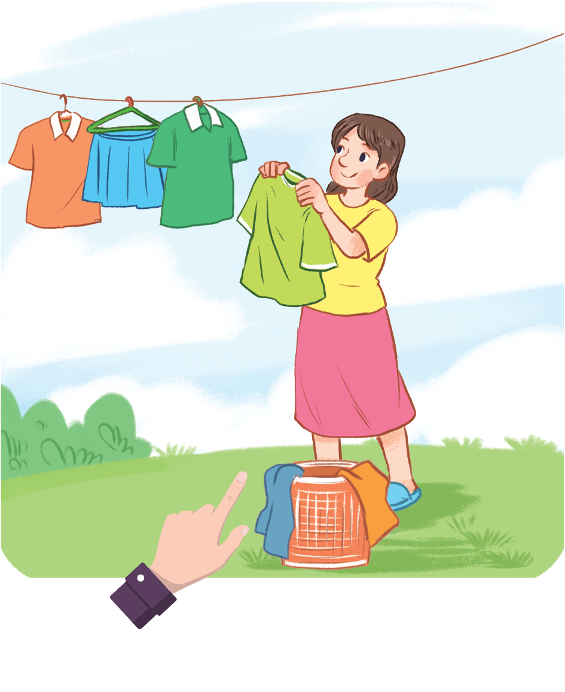
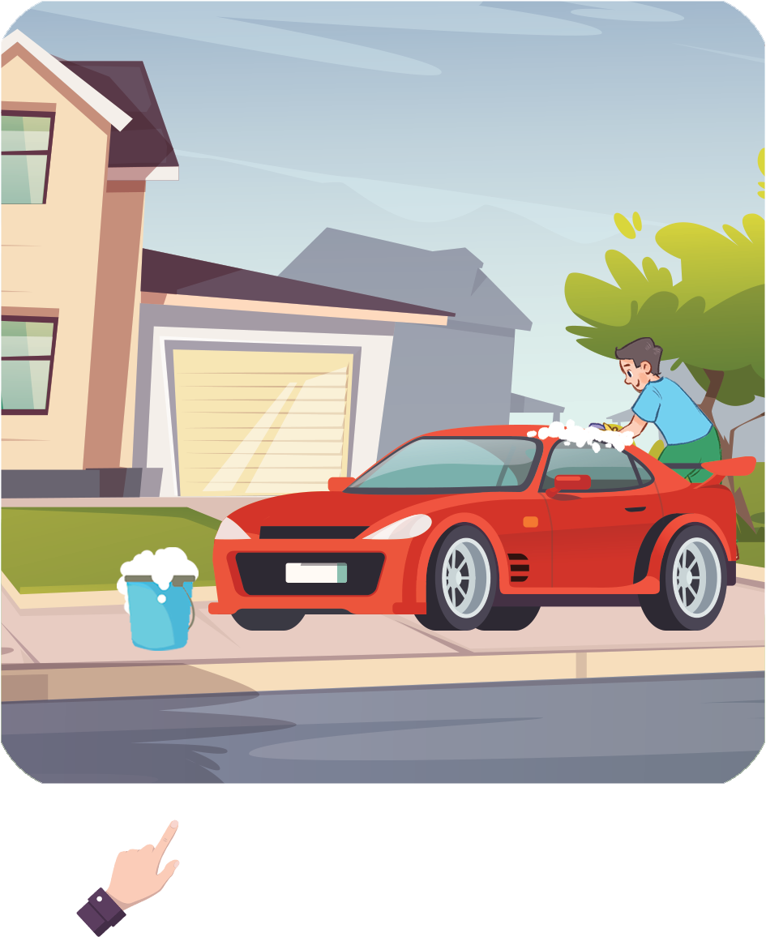
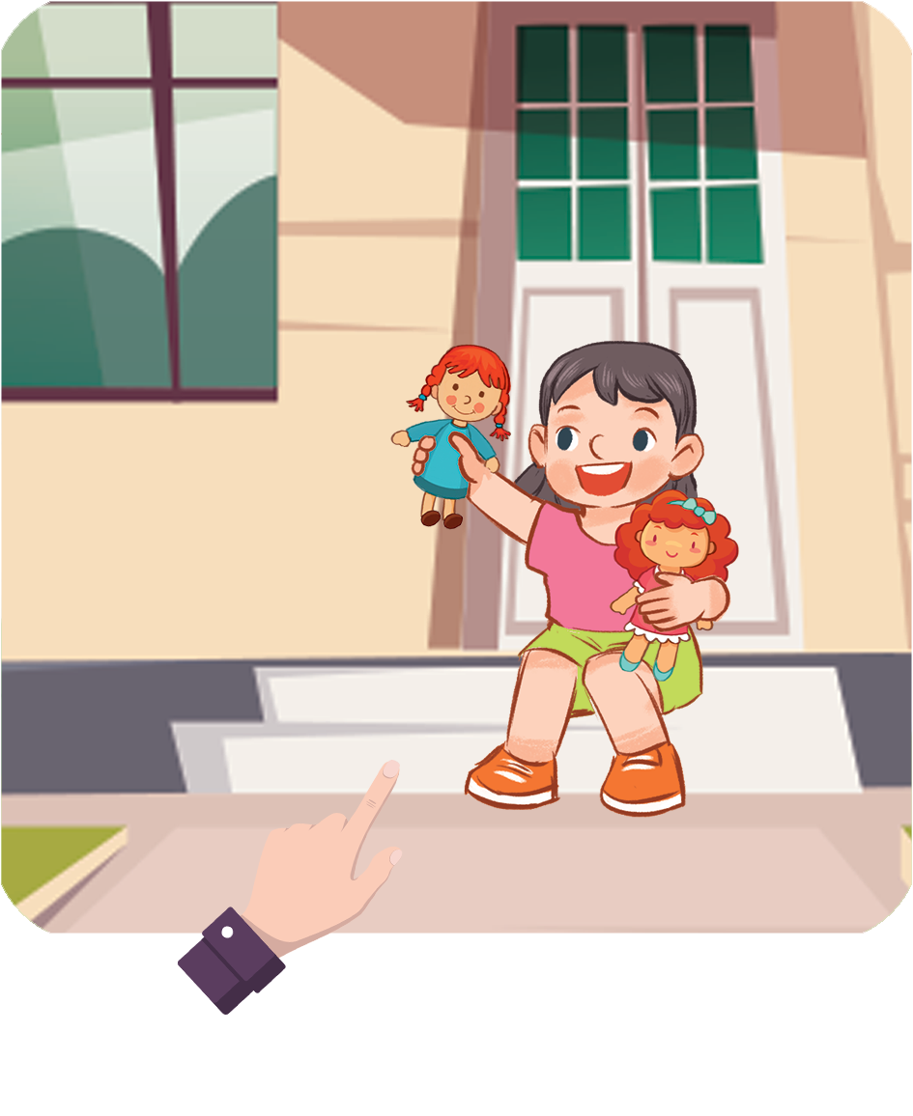
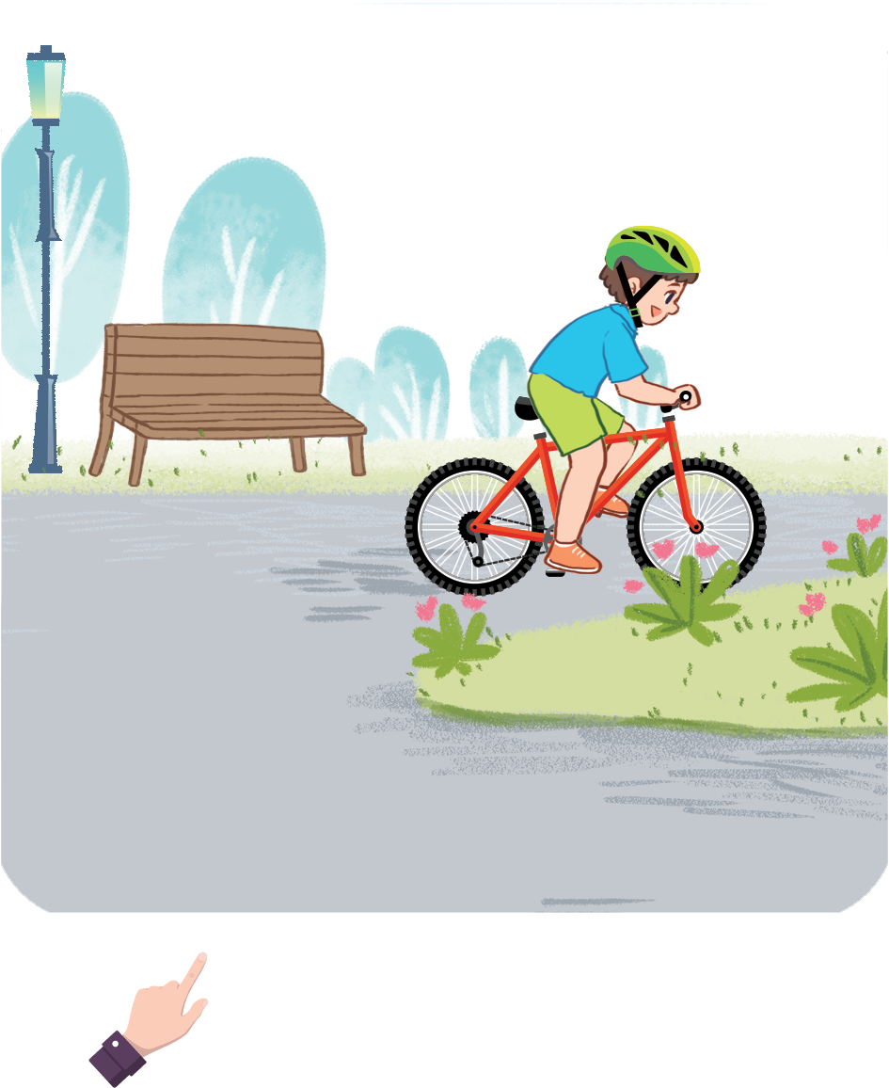
5
Look, complete and read.
A: Who’s this?
B: It’s my mother.
A: Who’s that?
B: It’s my father.
MsPham
0936082789
__________.
__________.
1
2
MsPham-0936082789
A. Who’s this?
B: It’s my sister.
A. Who’s that?
B: It’s my brother.
__________.
__________.
3
4

Slide 15



MsPham-0936082789
MsPham-0936082789
MsPham-0936082789
Start
MsPham-0936082789

Slide 16
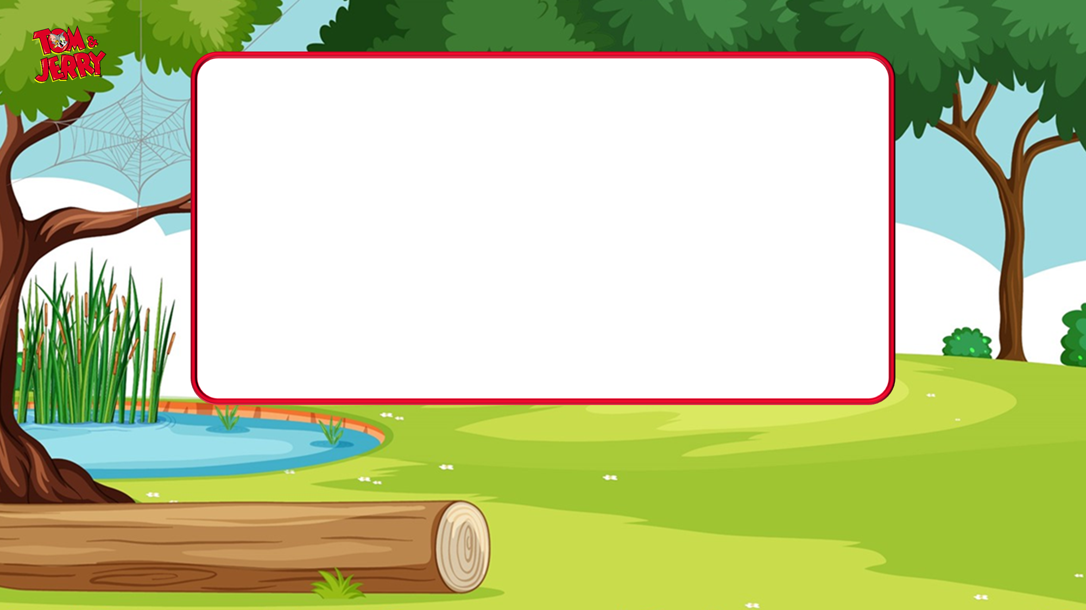

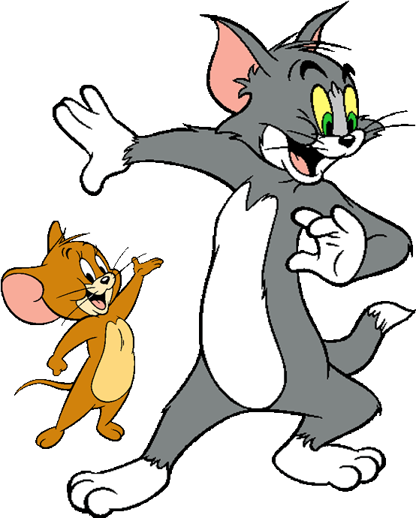




MsPham-0936082789
It’s my ____.
MsPham-0936082789
sister
mother
MsPham-0936082789
Next
MsPham-0936082789

Slide 17
MsPham-0936082789
It’s my ____.
MsPham-0936082789
brother
father
MsPham-0936082789
Next
MsPham-0936082789

Slide 18
MsPham-0936082789
It’s my ____.
MsPham-0936082789
sister
brother
MsPham-0936082789
Next
MsPham-0936082789

Slide 19
MsPham-0936082789
It’s my ____.
MsPham-0936082789
mother
father
MsPham-0936082789
Next
MsPham-0936082789

Slide 20
MsPham-0936082789
__________
It’s my mother.
MsPham-0936082789
Who that?
Who this?
MsPham-0936082789
Next
MsPham-0936082789

Slide 21
MsPham-0936082789
__________
It’s my brother.
MsPham-0936082789
Who this?
Who that?
MsPham-0936082789
Next
MsPham-0936082789

Slide 22
MsPham-0936082789
__________
It’s my father.
MsPham-0936082789
Who that?
Who this?
MsPham-0936082789
Next
MsPham-0936082789

Slide 23
MsPham-0936082789
__________
It’s my father.
MsPham-0936082789
Who this?
Who that?
MsPham-0936082789
Next
MsPham-0936082789

Slide 24

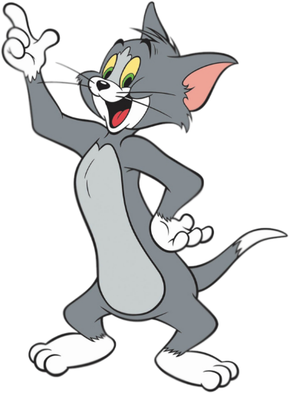
MsPham-0936082789
MsPham-0936082789
To be continued…
MsPham-0936082789
End
MsPham-0936082789

Slide 25

6
Let’s sing.
Who this?
It’s my brother.
Who this?
It’s my sister.
My brother and my sister.
Who that?
It’s my mother.
Who that?
It’s my father.
My mother and my father.
MsPham-0936082789

Slide 26


MsPham-0936082789
Thank you!

