Slide 1





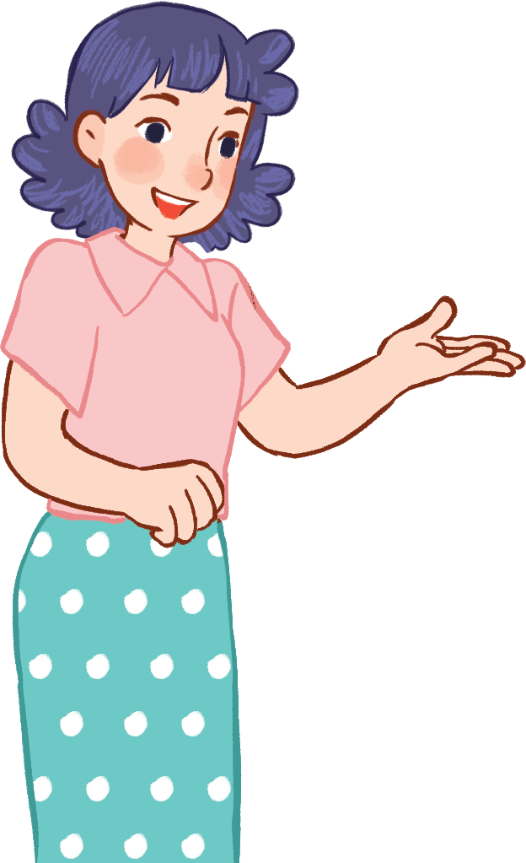
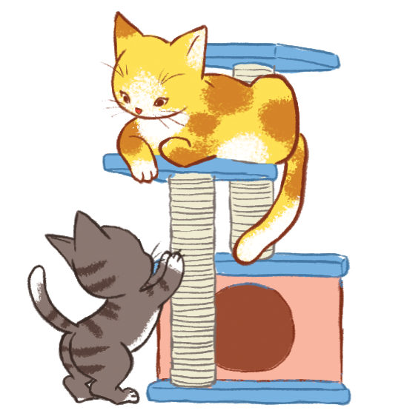
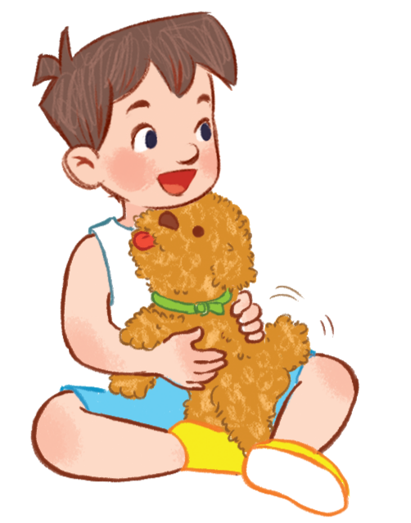


Unit 16
My pets
Lesson 1 - period 2
Teacher: Ha Thi Xuan Thu

Slide 2

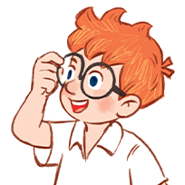
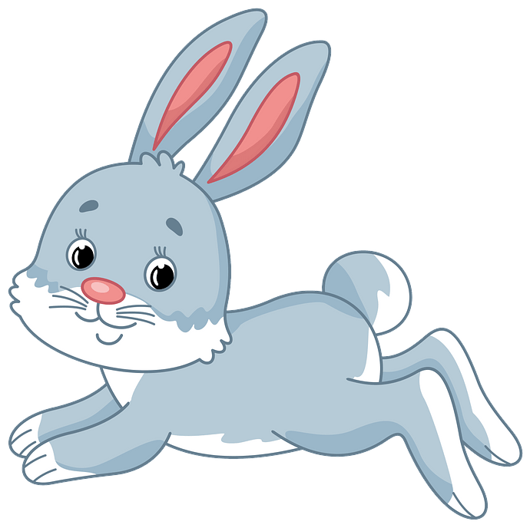


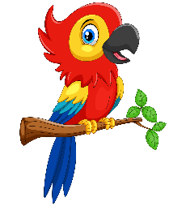
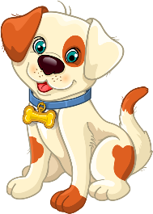
Structure
Yes, I do.
Do you have any ______?
No, I don’t.
parrots
dogs
rabbits
cats
birds

Slide 3

Make sentences!
3
points
No
cats
1
10 points
Yes
dogs
2
bomb
No
parrots
3
4
3
points
cats
Yes
birds
5
4
point
Yes
rabbits
6
10 points
No
birds
7
4
points
Yes
8

Slide 4

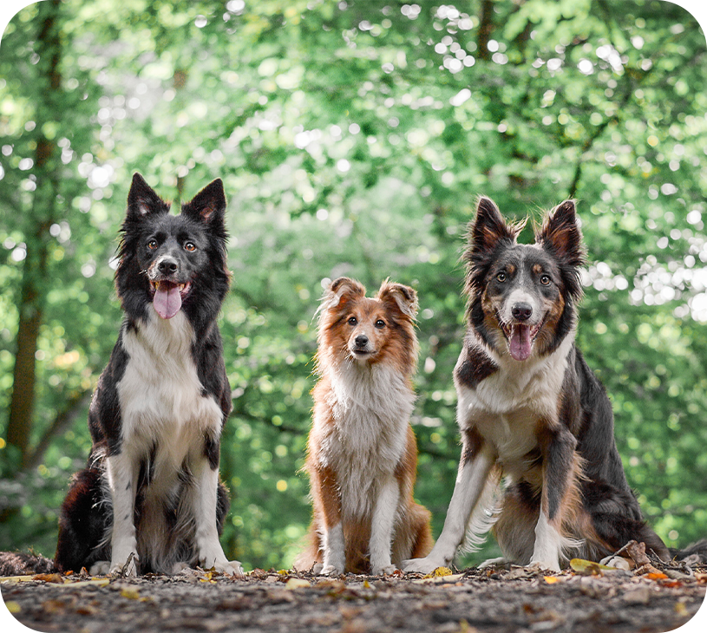
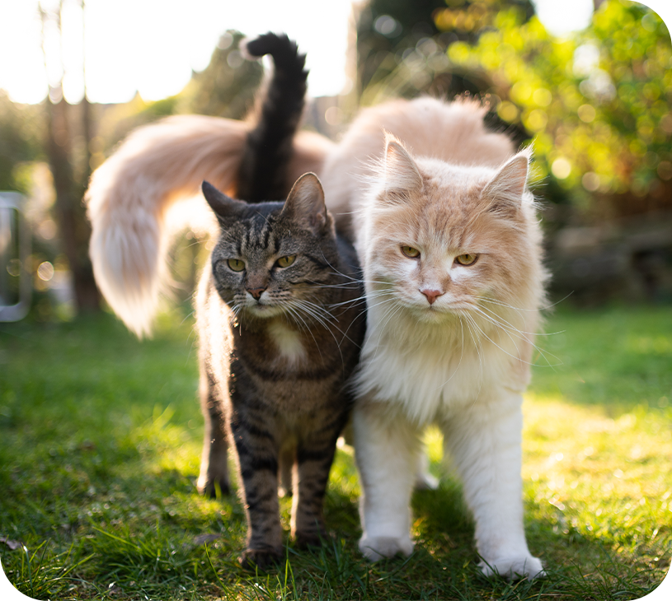

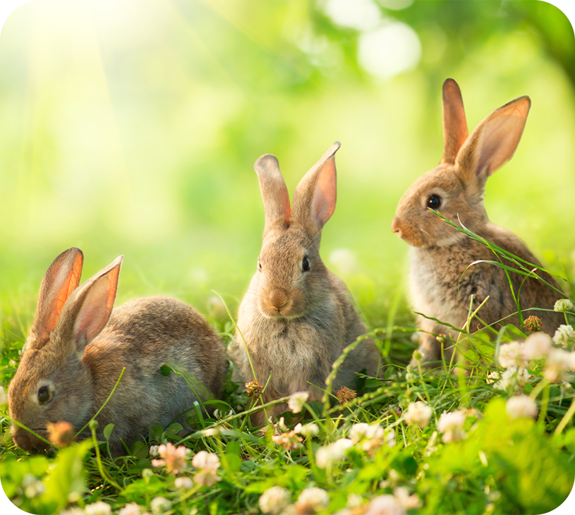
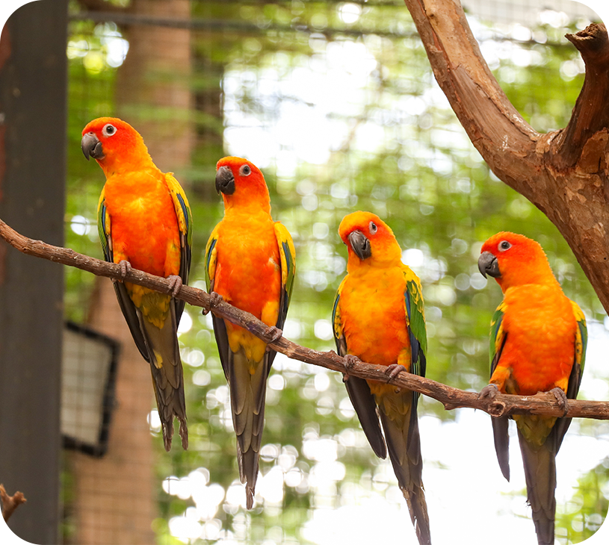
4
Listen and tick.
a
b
1
MsPham
0936082789
a
b
2
MsPham
0936082789

Slide 5
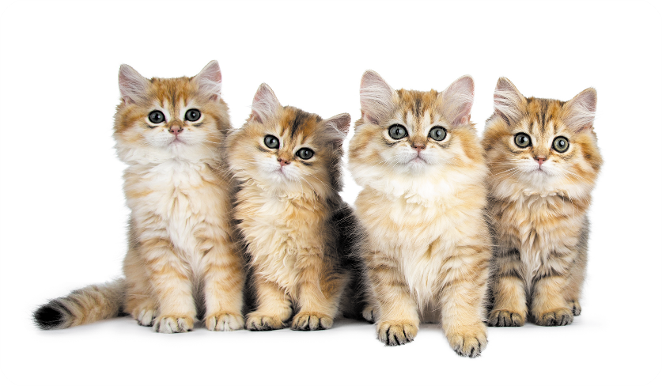
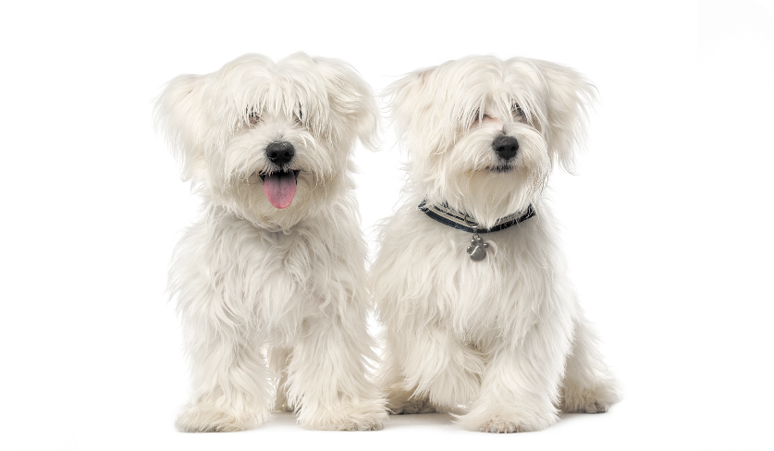
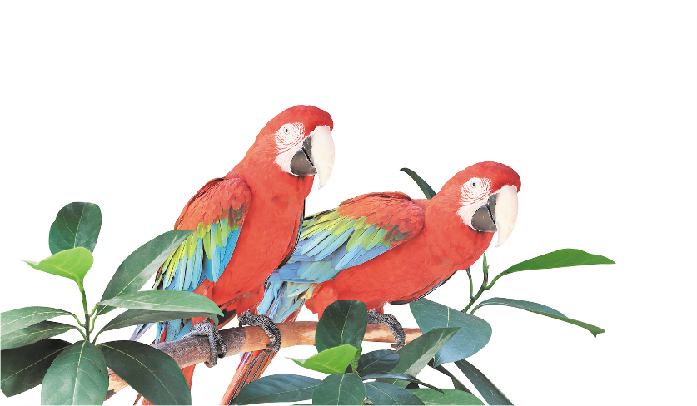
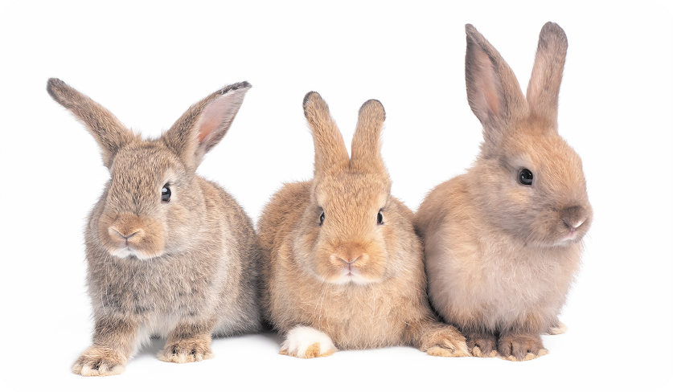
5
Look, complete and read.
1
2
A: Do you have any ________?
B: Yes, I do.
A: Do you have any ________?
B: Yes, I do.
cats
dogs
MsPham
0936082789
3
4
A: Do you ______ any rabbits?
B: No, I don’t. I have two _______.
A: Do you have any dogs?
B: No, I ______. I have three ______.
have
parrots
don’t
rabbits

Slide 6
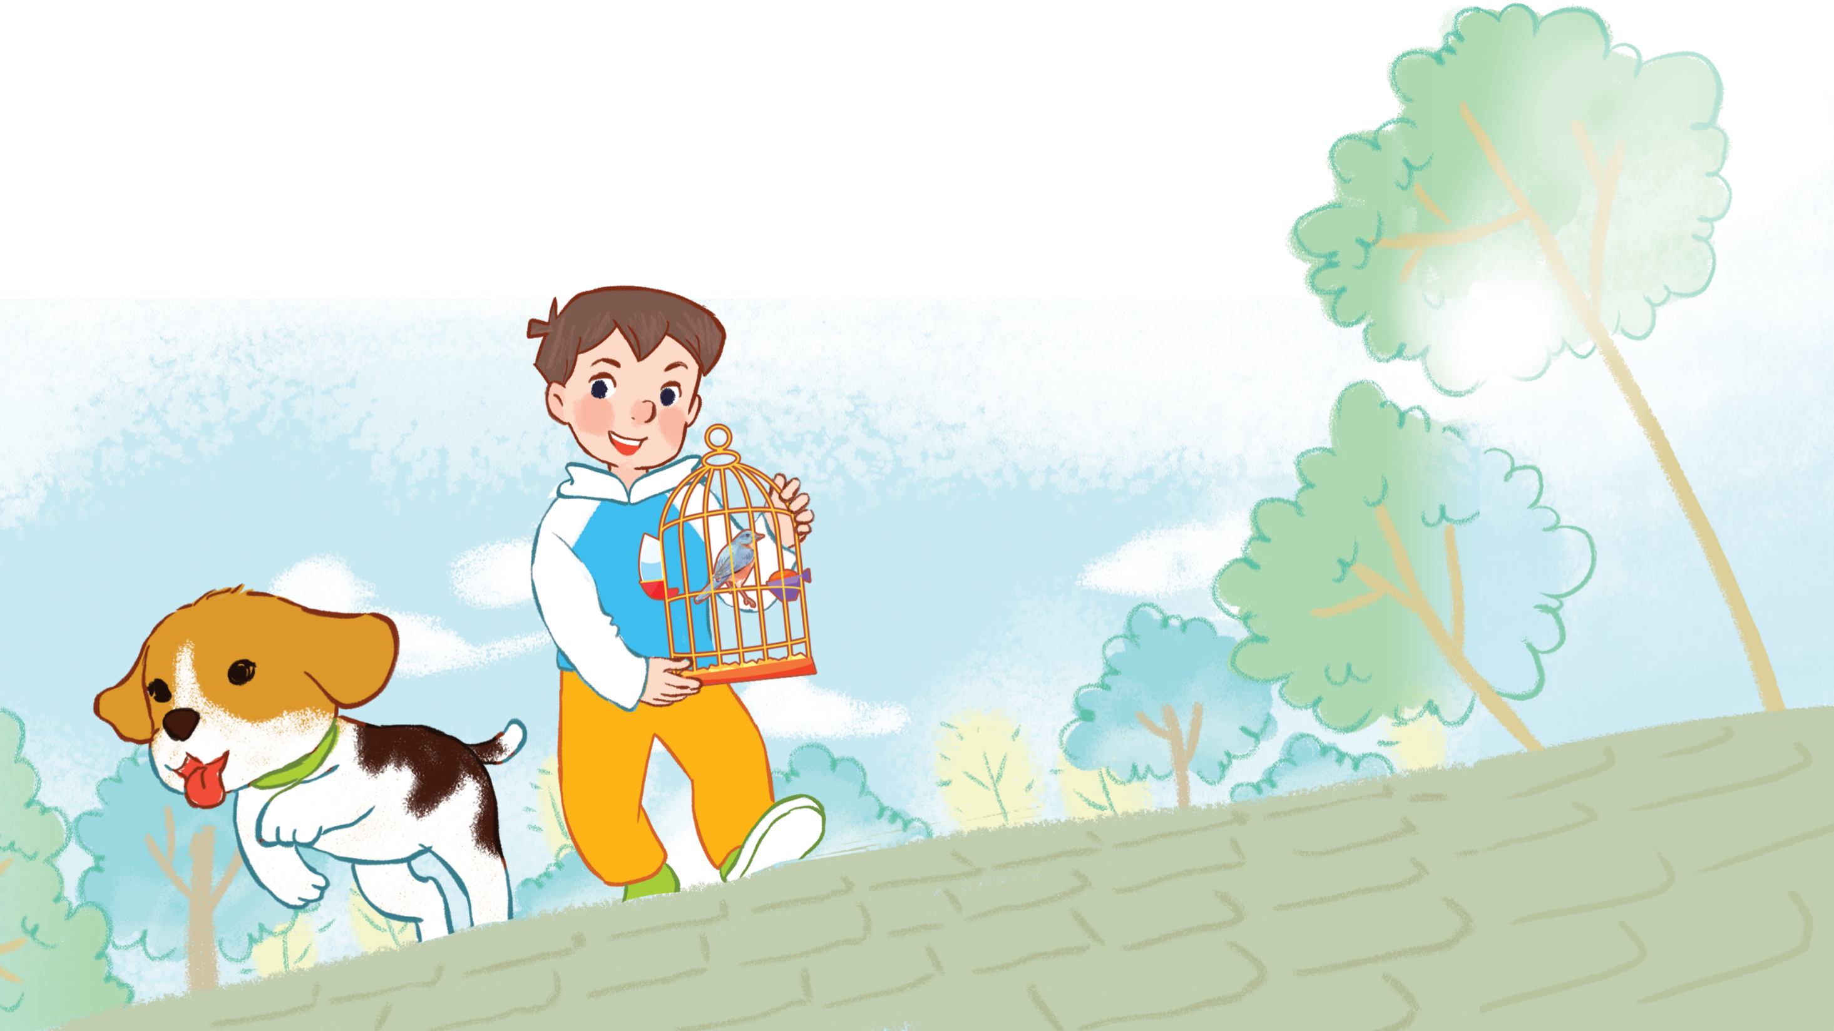
6
Let’s sing.
My pets
Do you have any dogs?
Do you have any dogs?
Yes, I do.
Yes, I do.
I have one dog.
Do you have any cats?
Do you have any cats?
No, I don’t.
No, I don’t.
I have one bird.

Slide 7


Thank you
For enjoying!

