Slide 1

Unit 17
What would you like to eat?
Lesson 1: Part 1,2,3

Slide 2
VOCABULARY

Slide 3

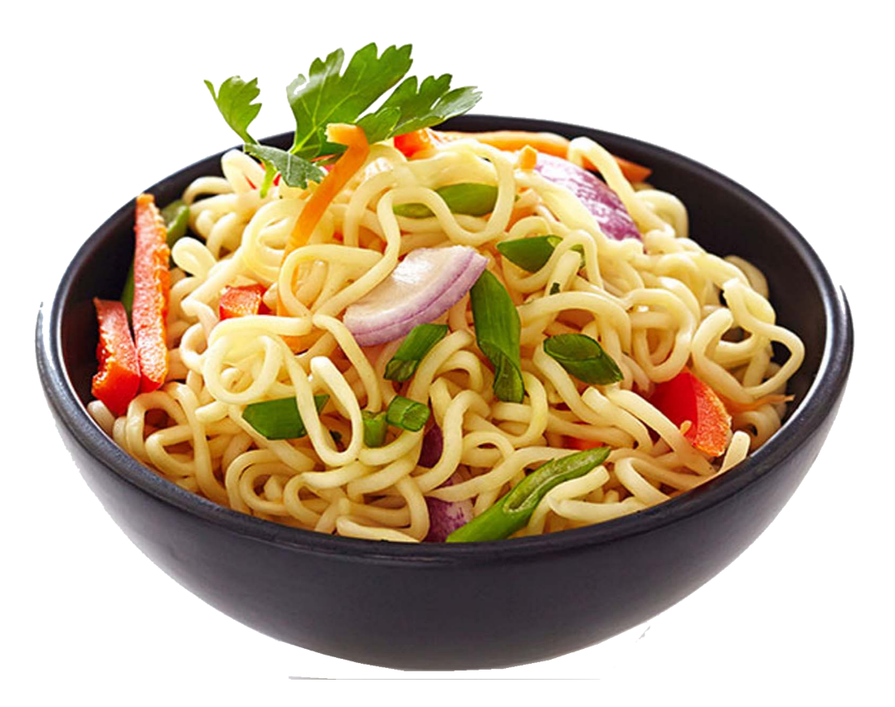
Vocabulary
noodle
s
/ˈnuːdlz/

Slide 4
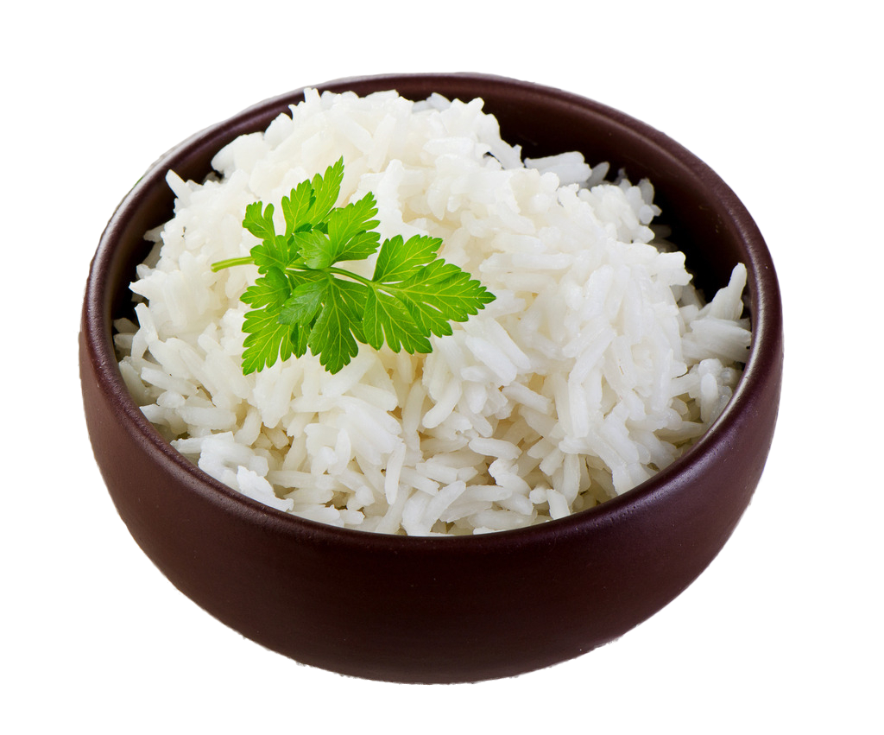
Vocabulary
rice
/raɪs/

Slide 5
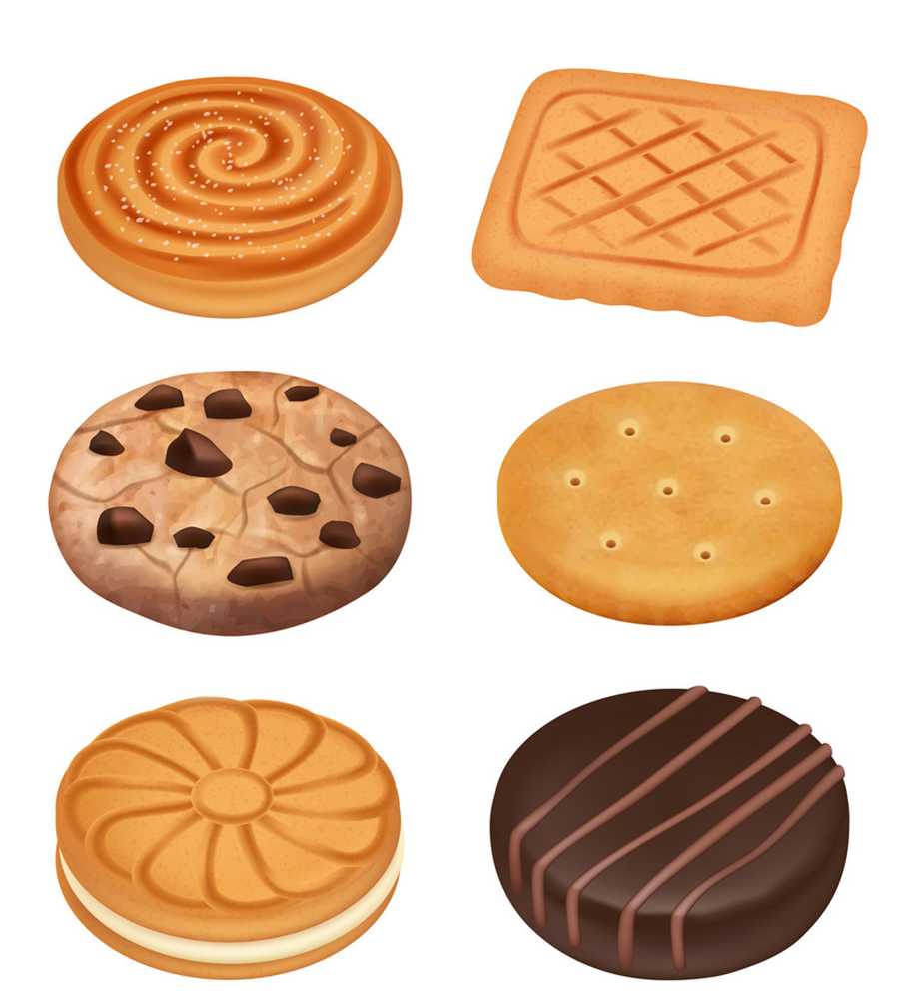
Vocabulary
biscuit
s
/ˈbɪskɪts/

Slide 6

Vocabulary
lemonade
/ˌleməˈneɪd/

Slide 7

Vocabulary
orange juice
/ˈɔːrɪndʒ dʒuːs/

Slide 8

Vocabulary
water
/ˈwɔːtər/

Slide 9
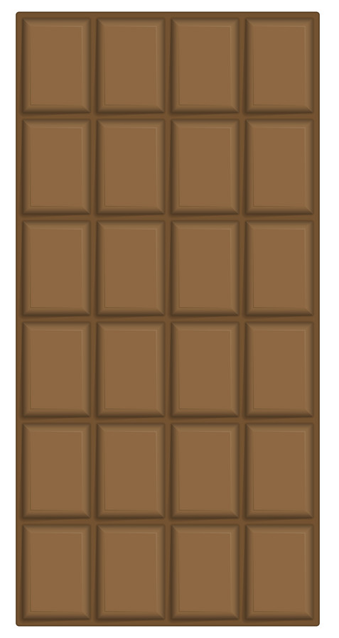
Vocabulary
bar
/bɑːr/

Slide 10
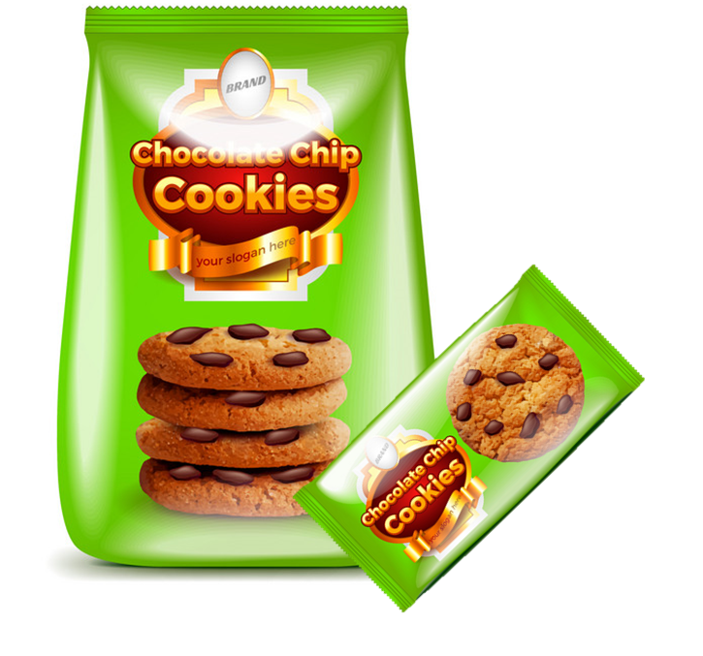
Vocabulary
packet
/ˈpækɪt/

Slide 11
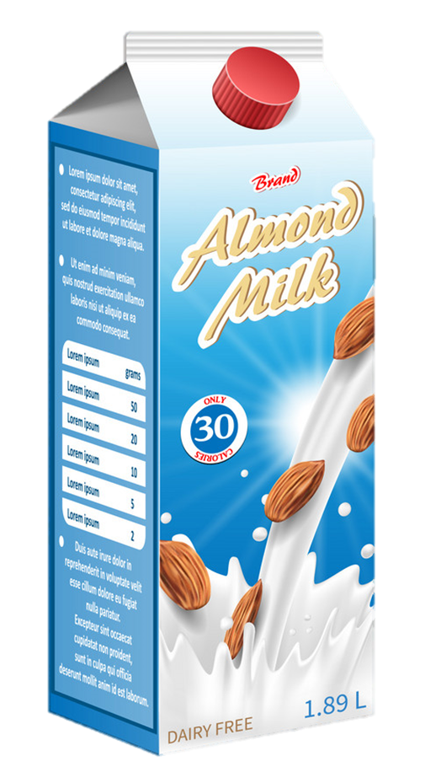

Vocabulary
carton
/ˈkɑːrtn/

Slide 12
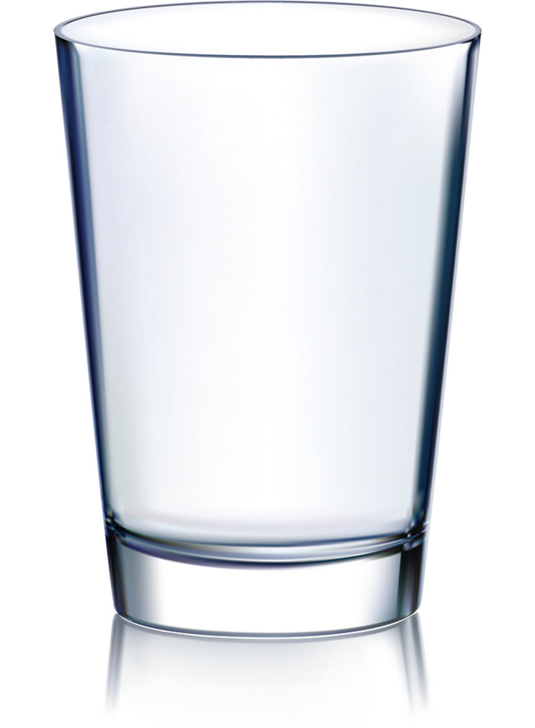
Vocabulary
glass
/ɡlæs/
glasses
/ɡlæsɪz/

Slide 13

Vocabulary
bowl
/bəʊl/

Slide 14
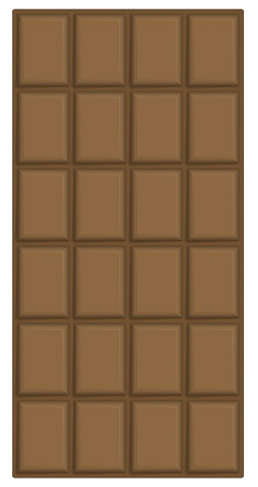
Vocabulary
a bar
a bowl
a carton
a packet
a glass

Slide 15
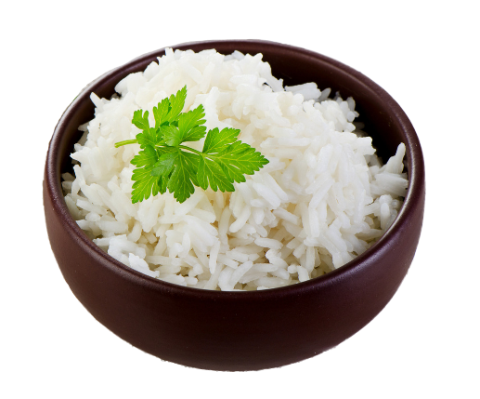
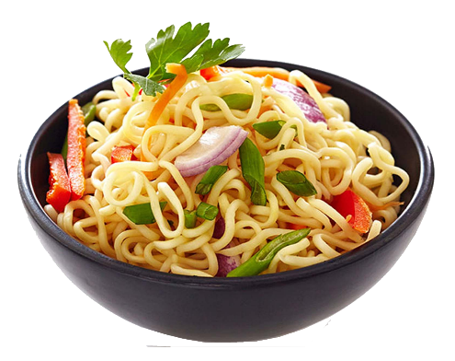
Vocabulary
water
lemonade
orange juice
rice
a biscuit
noodles

Slide 16

LET’S PLAY
PLAY

Slide 17
A. water
B. juice
C. glass
D. milk
Next

Slide 18
A. choclate
B. bread
C. rice
D. biscuit
Next

Slide 19
A. Orange juice
B. Lemonade
C. Lemon juice
D. Water
Next

Slide 20
A. noodles
B. bread
C. rice
D. biscuits
Next

Slide 21
A. Orange juice
B. Lemonade
C. Water
D. Milk
Next

Slide 22
A. rice
B. chocolate
C. biscuits
D. noodles
Next

Slide 23
A. packet
B. bar
C. bowl
D. bottle
Next

Slide 24
A. bar
B. glass
C. packet
D. bowl
Next

Slide 25
A. bowl
B. carton
C. glass
D. cup
Next

Slide 26
A. bottle
B. cup
C. glass
D. carton
Next

Slide 27
A. carton
B. glass
C. bowl
D. packet
Next

Slide 28
WELL DONE!

Slide 29
GRAMMAR

Slide 30
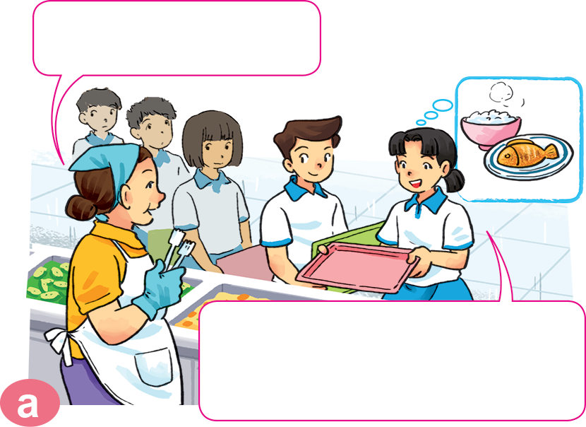
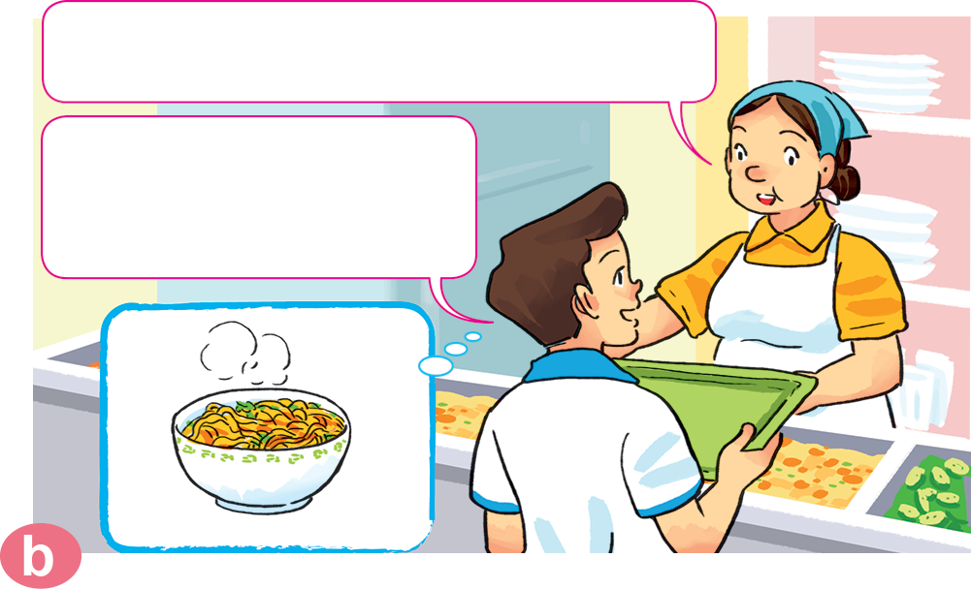

1. Look, listen and repeat.
Can I help you?
What would you like to eat?
I'd like a bowl of noodles, please.
Yes. I'd like some rice with fish, please.

Slide 31
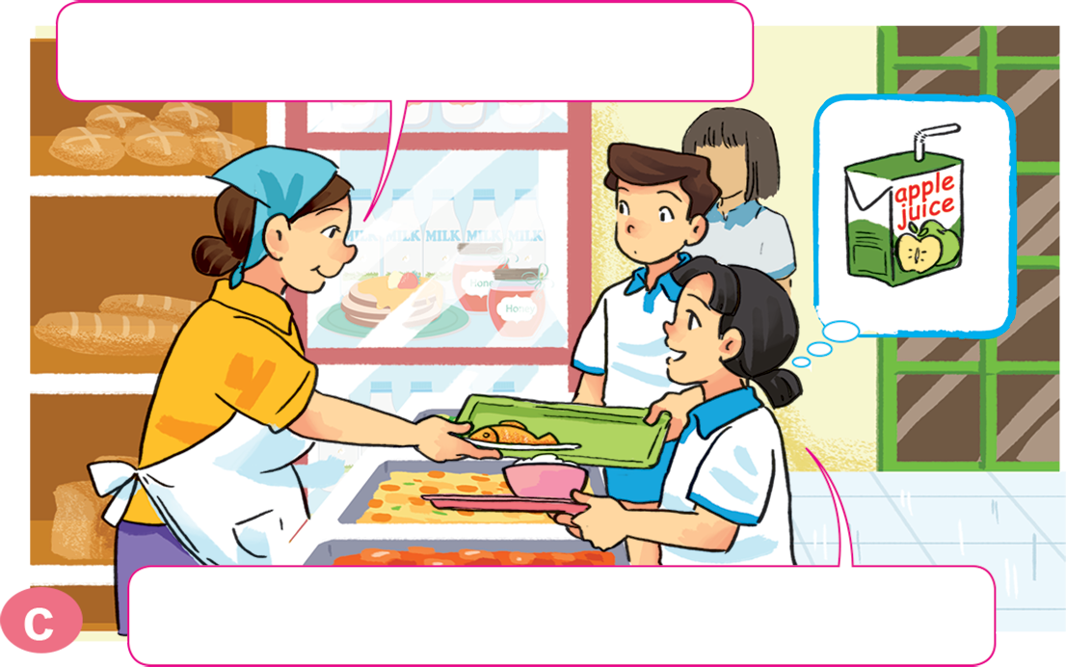
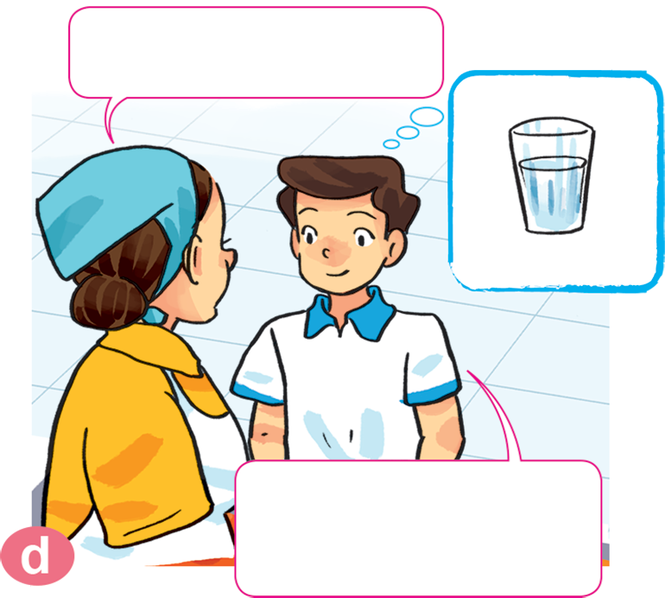
1. Look, listen and repeat.
What would you like to drink?
How about you?
I'd like a glass of water, please.
I'd like a carton of apple juice, please.

Slide 32
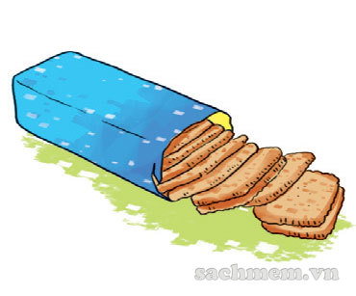
2. Point and say.
What would you like to eat?
I'd like ______________________, please.
a packet of biscuits

Slide 33

2. Point and say.
What would you like to eat?
I'd like ______________________, please.
a bar of chocolate

Slide 34

2. Point and say.
What would you like to drink?
I'd like ______________________, please.
a carton of lemonate

Slide 35

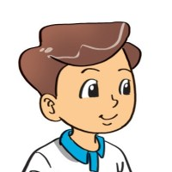
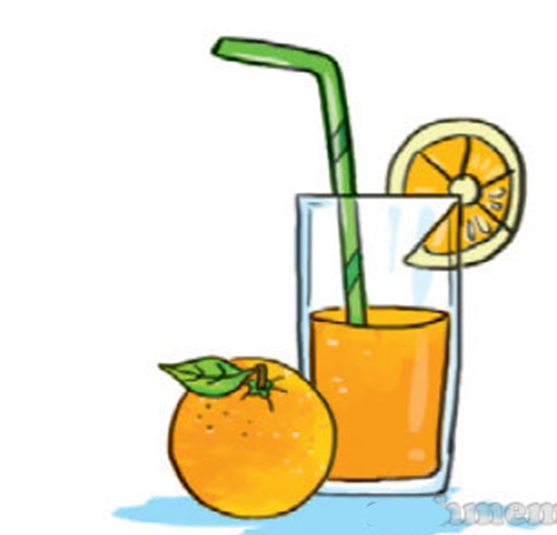
2. Point and say.
What would you like to drink?
I'd like ______________________, please.
a glass of orange juice

Slide 36


What would you like to eat/drink?
I'd like__________, please.
a packet of biscuits
a carton of lemonade
a bar of
chocolate
a glass of
orange juice
Ms.Phạm English

Slide 37

3. Let’s talk.
What would you like to eat/drink?
I'd like __________, please.

Slide 38
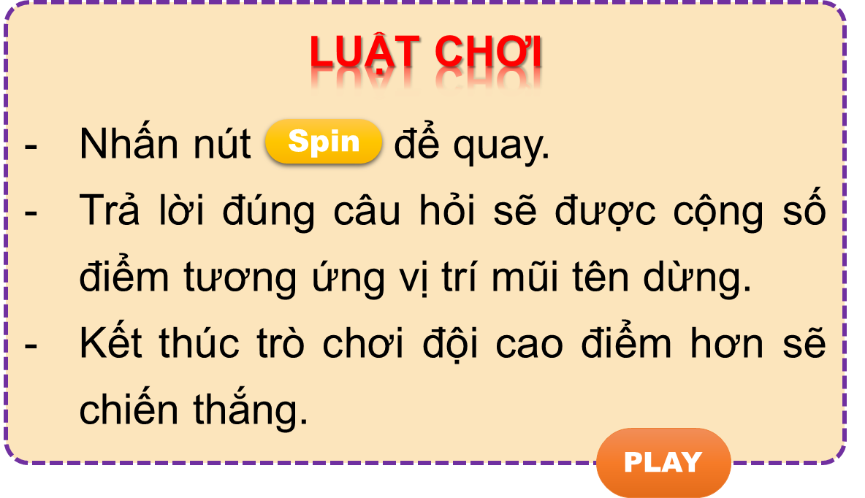


Vòng quay kì diệu
50
10
20
30
10
20
30
40
Spin
PLAY
LUẬT CHƠI
Nhấn nút để quay.
Trả lời đúng câu hỏi sẽ được cộng số điểm tương ứng vị trí mũi tên dừng.
Kết thúc trò chơi đội cao điểm hơn sẽ chiến thắng.
Spin
Notes:
Ms Huyền Phạm - 0936.082.789 – YOUTUBE: MsPham. Facebook: Dạy và học cùng công nghệ.

Slide 39
_______________?
I’d like some biscuits
50
10
20
30
10
20
30
40
What would you
like to eat?
Xem đáp án
Spin
Notes:
Ms Huyền Phạm - 0936.082.789 – YOUTUBE: MsPham. Facebook: Dạy và học cùng công nghệ.

Slide 40
What would you like to eat?
_______ a bar of chocolate.
50
10
20
30
10
20
30
04
I’d like
Xem đáp án
Spin
Notes:
Ms Huyền Phạm - 0936.082.789 – YOUTUBE: MsPham. Facebook: Dạy và học cùng công nghệ.

Slide 41
50
What ____ you like to drink?
I’d like a glass of water.
10
20
30
10
20
30
04
would
Xem đáp án
Spin
Notes:
Ms Huyền Phạm - 0936.082.789 – YOUTUBE: MsPham. Facebook: Dạy và học cùng công nghệ.

Slide 42
What would you ___ to drink?
I’d like a carton of milk.
50
10
20
30
10
20
30
40
like
Xem đáp án
Spin
Notes:
Ms Huyền Phạm - 0936.082.789 – YOUTUBE: MsPham. Facebook: Dạy và học cùng công nghệ.

Slide 43

50
What would you like to eat/drink?
I’d like a bowl of noodles.
10
20
30
10
20
30
40
eat
Xem đáp án
Spin
Notes:
Ms Huyền Phạm - 0936.082.789 – YOUTUBE: MsPham. Facebook: Dạy và học cùng công nghệ.

Slide 44
50
What would you like to eat/drink?
I’d like a carton of lemonade.
10
20
30
10
20
30
40
drink
Xem đáp án
Spin
Notes:
Ms Huyền Phạm - 0936.082.789 – YOUTUBE: MsPham. Facebook: Dạy và học cùng công nghệ.

Slide 45
50
What would you like to eat?
I’d like some chocolate/chocolates.
10
20
30
10
20
30
40
chocolate
Xem đáp án
Spin
Notes:
Ms Huyền Phạm - 0936.082.789 – YOUTUBE: MsPham. Facebook: Dạy và học cùng công nghệ.

Slide 46
50
10
What would you like to drink?
I’d like __________.
a. a packet of biscuits
b. a glass of orange juice
20
30
10
20
30
40
b. a glass of orange juice
Xem đáp án
Spin
Notes:
Ms Huyền Phạm - 0936.082.789 – YOUTUBE: MsPham. Facebook: Dạy và học cùng công nghệ.

Slide 47
What would you like to drink?
I’d like __________.
a. glass of water
b. a glass of water
50
10
20
30
10
20
30
04
b. a glass of water
Xem đáp án
Spin
Notes:
Ms Huyền Phạm - 0936.082.789 – YOUTUBE: MsPham. Facebook: Dạy và học cùng công nghệ.

Slide 48
What would you like to eat?
I’d like __________.
a. a bowl of rice
b. a bowl of noodle
50
10
20
30
10
20
30
04
a. a bowl of rice
Xem đáp án
Spin
Notes:
Ms Huyền Phạm - 0936.082.789 – YOUTUBE: MsPham. Facebook: Dạy và học cùng công nghệ.

Slide 49



50
10
20
30
10
20
30
40
EXIT
Notes:
Ms Huyền Phạm - 0936.082.789 – YOUTUBE: MsPham. Facebook: Dạy và học cùng công nghệ.

