Slide 1




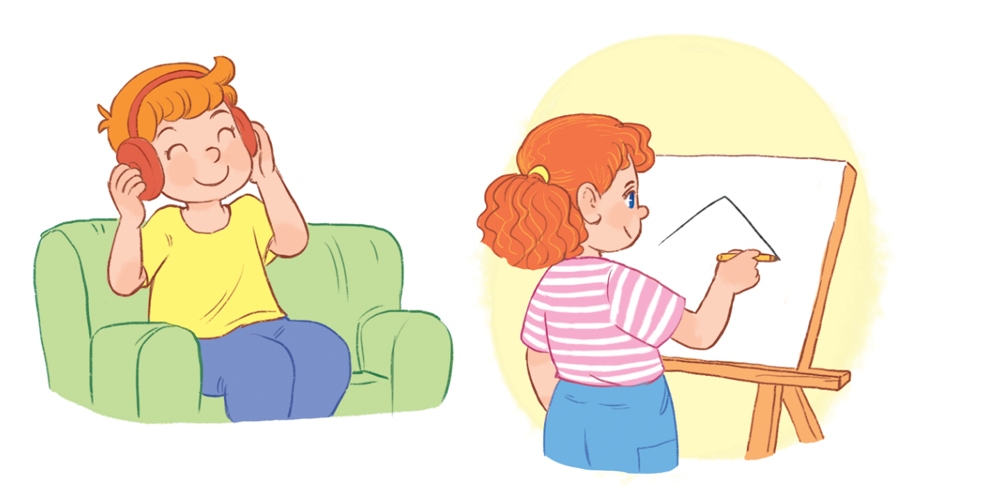

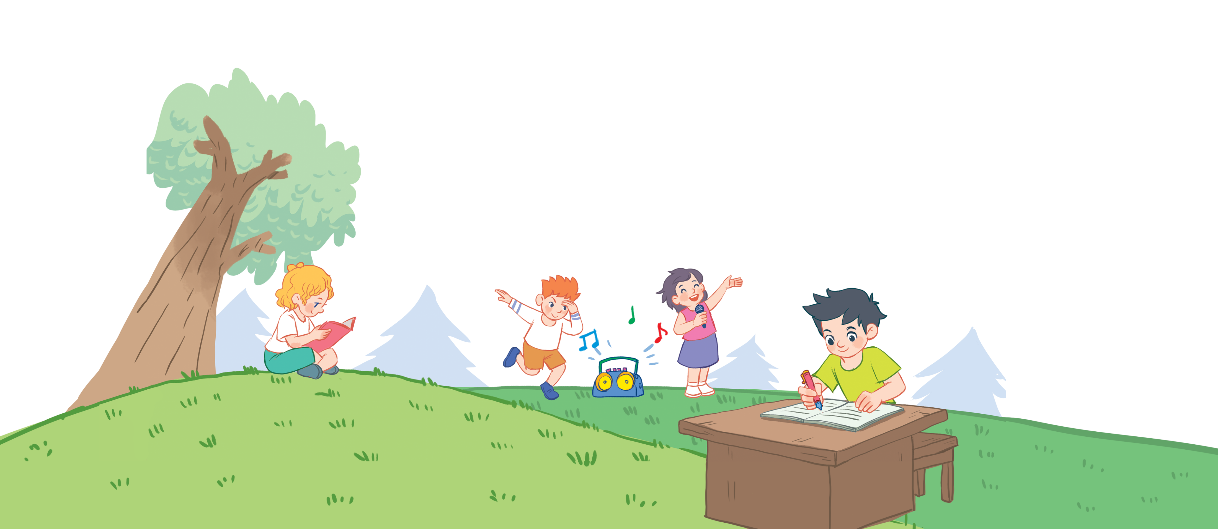

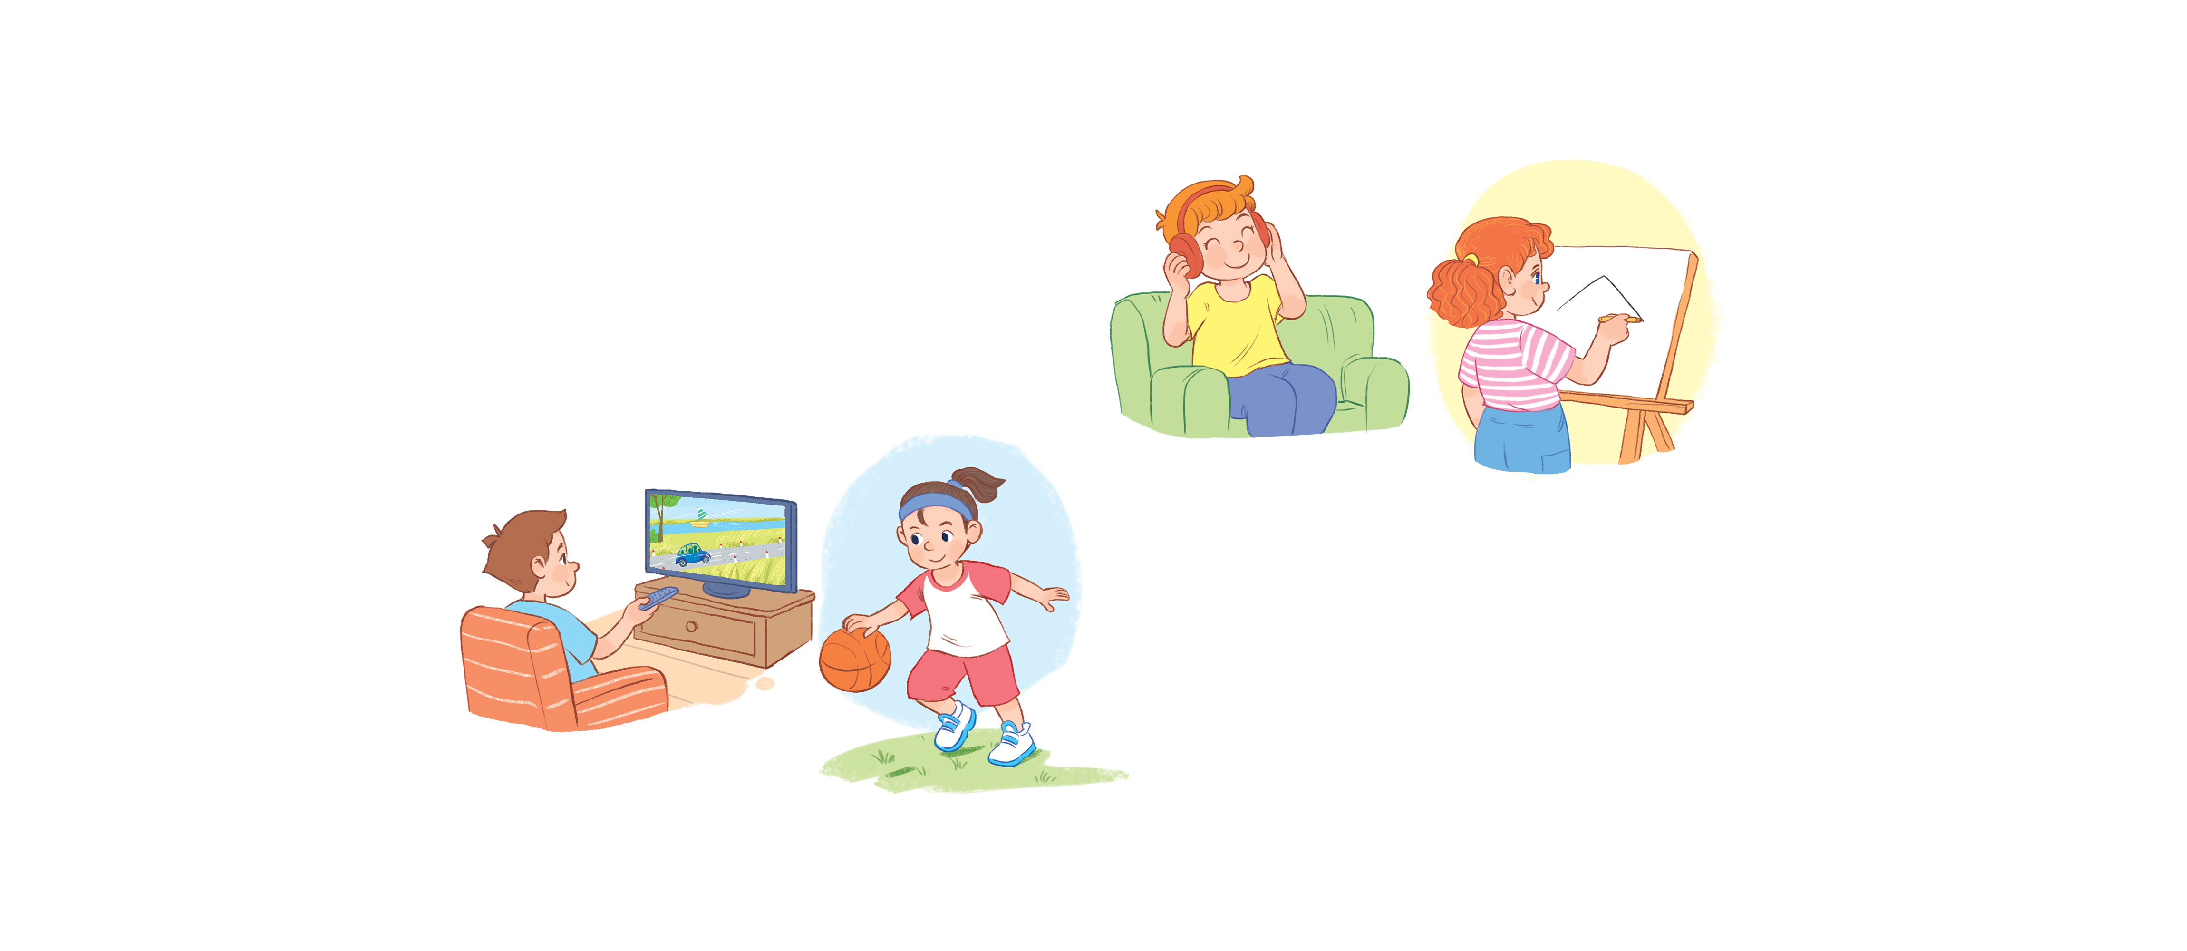


Unit 18
Playing and doing
Lesson 2 - period 2

Slide 2
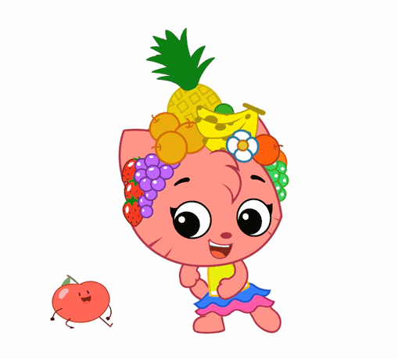
Warm - up
Play

Slide 3


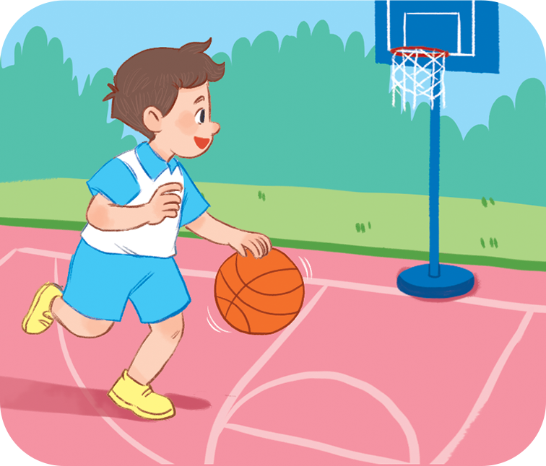
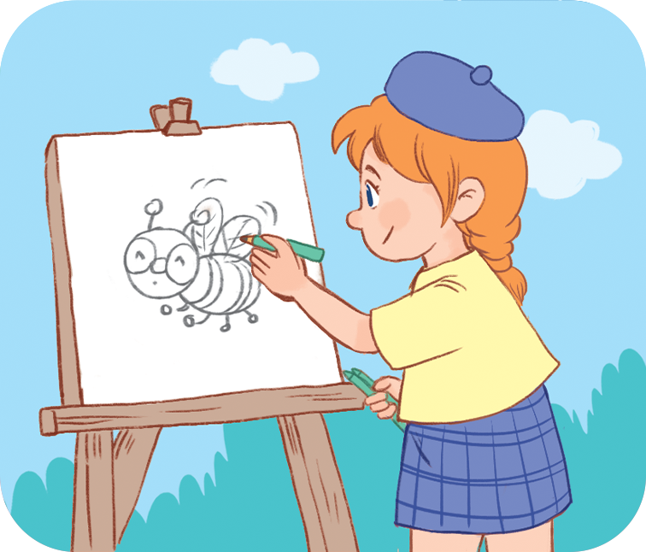
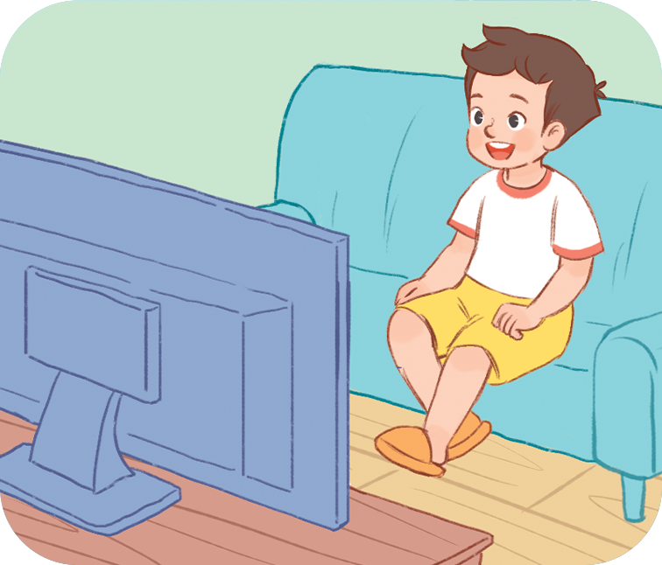
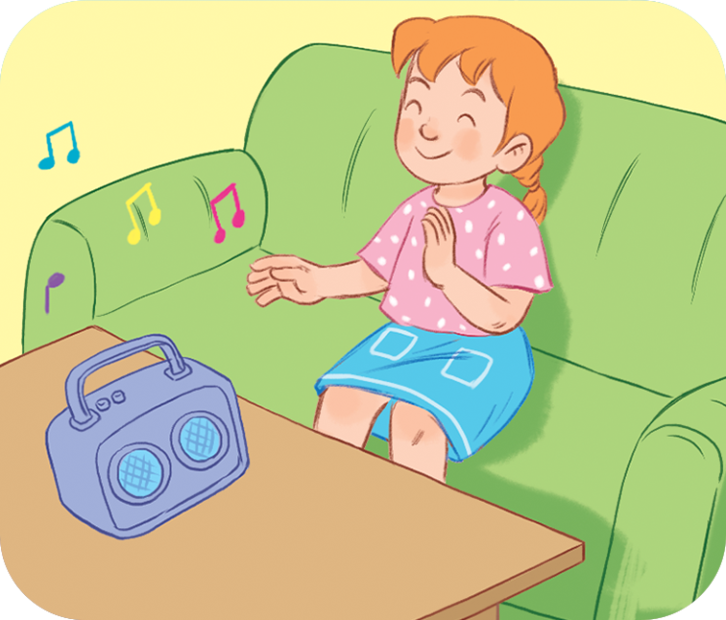
Review
What are you doing?
I’m _________________.
playing
basketball
drawing
a picture
listening
to music.
watching TV

Slide 4

4
Listen and number.
a
3
b
2
a
1
b
4
1
2
3
4

Slide 5

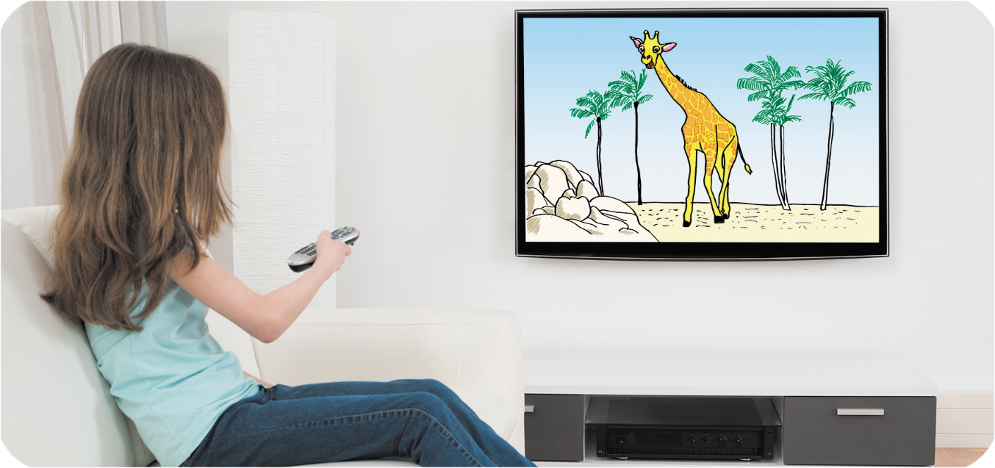
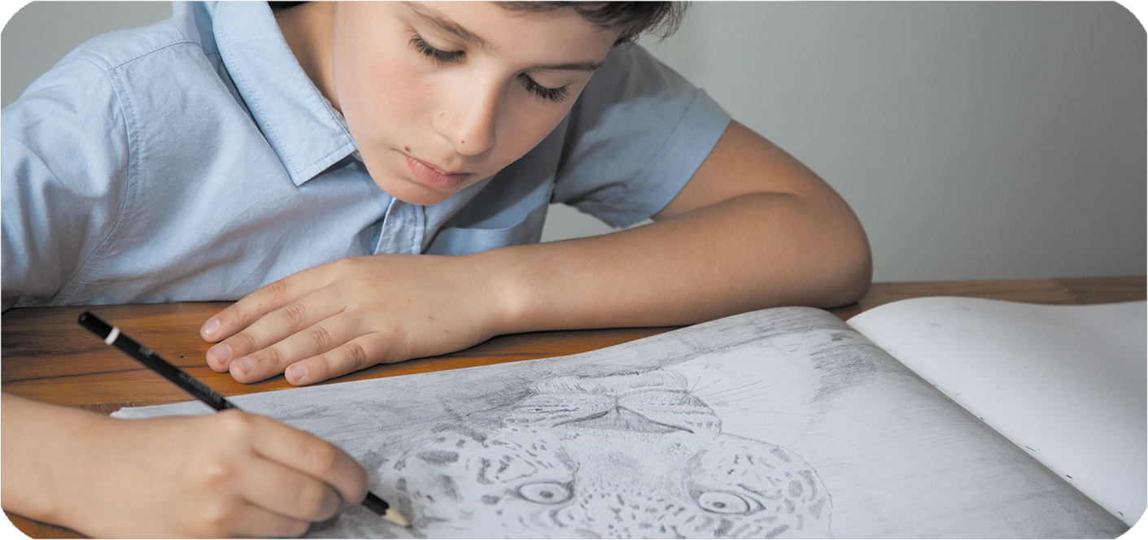
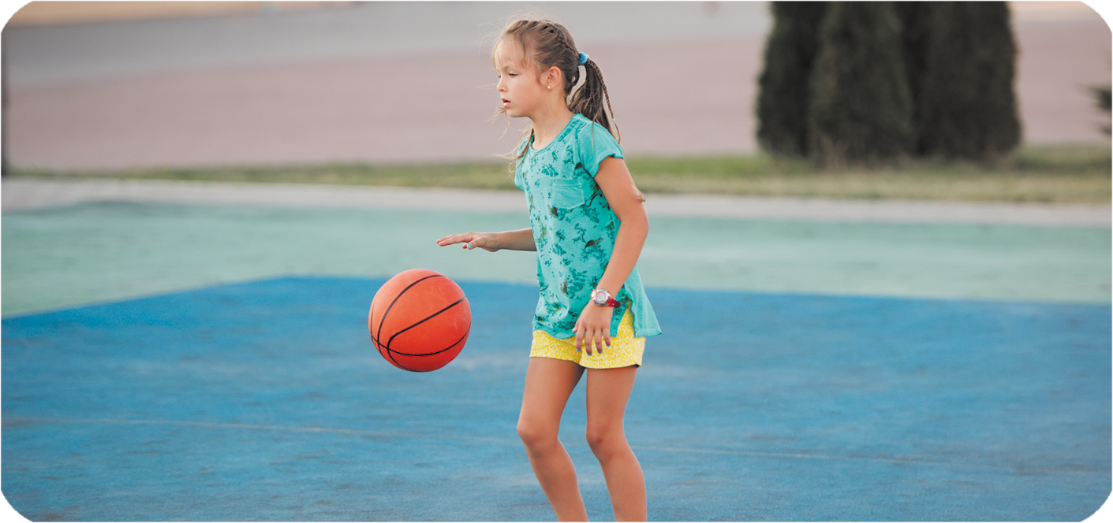
5
Look, complete and read.
1
2
A: What are you doing?
B: I’m listening to music.
A: What are you doing?
B: I’m watching TV.
________
________
3
4
________
A: What are you doing ?
B: I’m drawing a picture.
A: What are you doing?
B: I’m playing basketball.
________
________
________

Slide 6
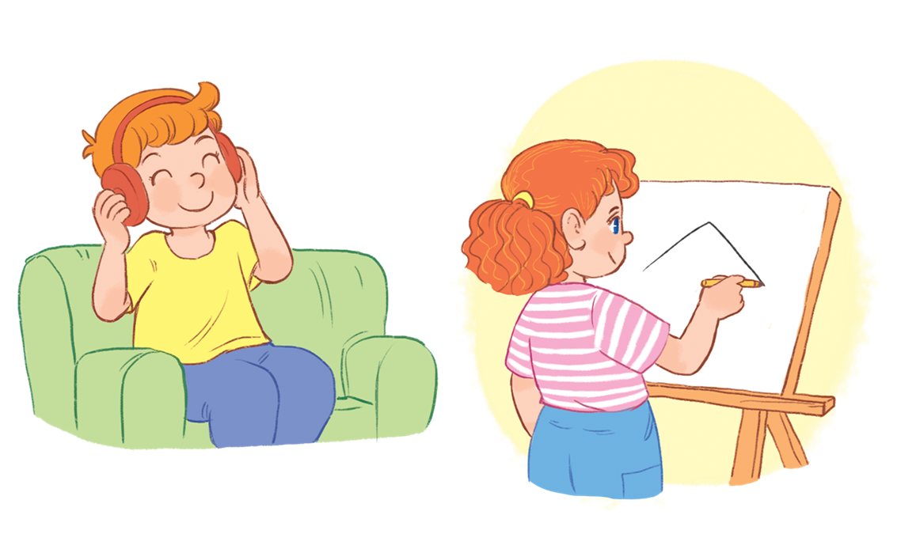
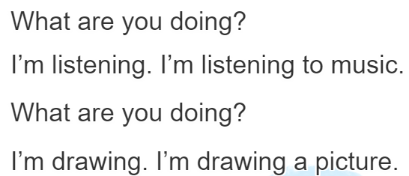
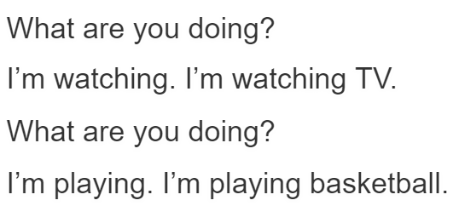
6
Let’s sing.

Slide 7






PRERENT WHEEL
10
50
30
30
20
Good job!
40
SPIN/STOP
60
START
60
40
20
30
10
50
Notes:
Ms Huyền Phạm - 0936.082.789

Slide 8


Look and say
I’m playing basketball.
What are you doing?
Answer
Notes:
Ms Huyền Phạm - 0936.082.789

Slide 9
Look and say
I’m watching TV.
What are you doing?
Answer
Notes:
Ms Huyền Phạm - 0936.082.789

Slide 10
Look and say
I’m listening
to music.
What are you doing?
Answer
Notes:
Ms Huyền Phạm - 0936.082.789

Slide 11
Look and say
I’m drawing a picture.
What are you doing?
Answer
Notes:
Ms Huyền Phạm - 0936.082.789

Slide 12
Look and say
What are you doing
_____________?
I’m listening to music.
Answer
Notes:
Ms Huyền Phạm - 0936.082.789

Slide 13
Look and say
doing
What are you _____?
I’m watching TV.
Answer
Notes:
Ms Huyền Phạm - 0936.082.789 –

Slide 14
Look and say
drawing
What are you doing?
I’m _____ a picture.
Answer
Notes:
Ms Huyền Phạm - 0936.082.789

Slide 15
Look and say
basketball
What are you doing?
I’m playing ________.
Answer
Notes:
Ms Huyền Phạm - 0936.082.789 –

Slide 16

Thank you!

