Slide 1
Unit 17
What would you like to eat
Lesson 1 – Part 4,5,6

Slide 2
LET’S PLAY
PLAY

Slide 3
A. water
B. juice
C. glass
D. milk
Next

Slide 4
A. choclate
B. bread
C. rice
D. biscuit
Next

Slide 5
A. Orange juice
B. Lemonade
C. Lemon juice
D. Water
Next

Slide 6
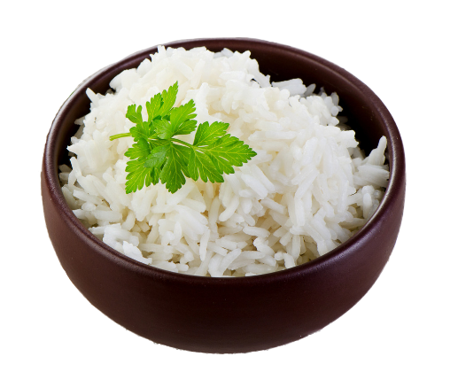
A. noodles
B. bread
C. rice
D. biscuits
Next

Slide 7
A. Orange juice
B. Lemonade
C. Water
D. Milk
Next

Slide 8
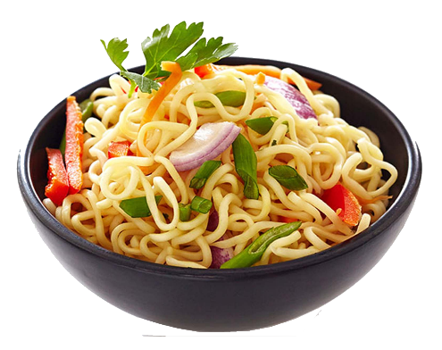
A. rice
B. chocolate
C. biscuits
D. noodle
Next

Slide 9
A. packet
B. bar
C. bowl
D. bottle
Next

Slide 10
A. bar
B. glass
C. packet
D. bowl
Next

Slide 11
A. bowl
B. carton
C. glass
D. cup
Next

Slide 12
A. bottle
B. cup
C. glass
D. carton
Next

Slide 13
A. carton
B. glass
C. bowl
D. packet
Next

Slide 14
WELL DONE!

Slide 15
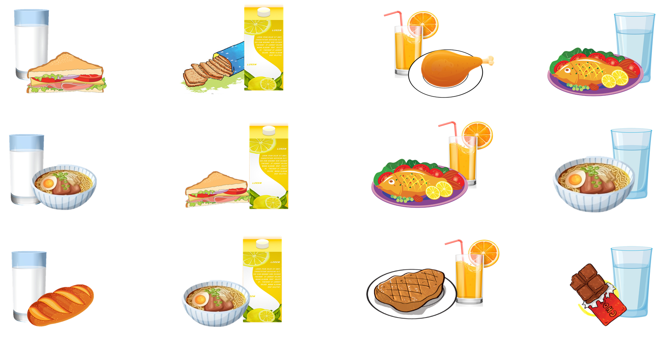
4. Listen and tick.
1.
2.
3.
4.
a
a
a
a
b
b
b
b
c
c
c
c

Slide 16
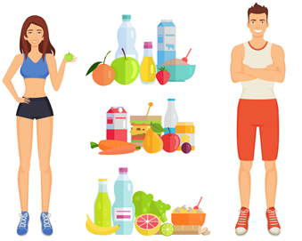
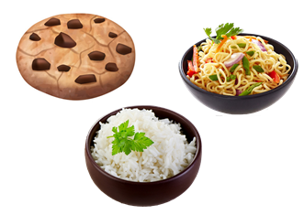
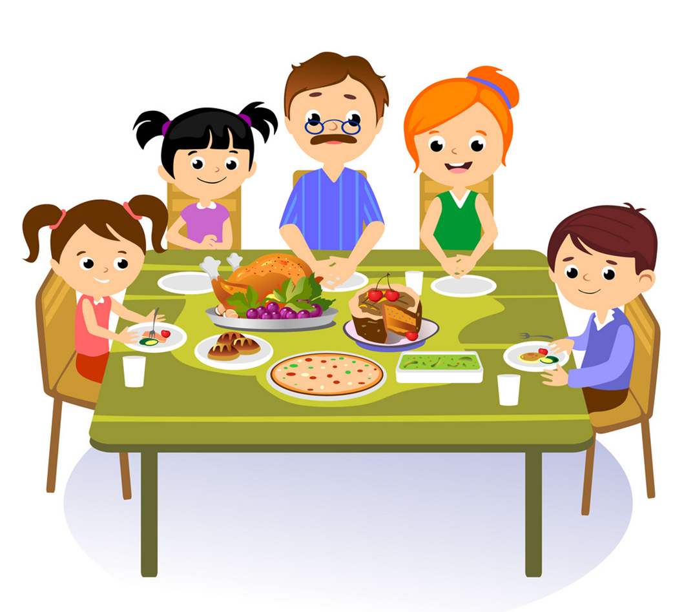
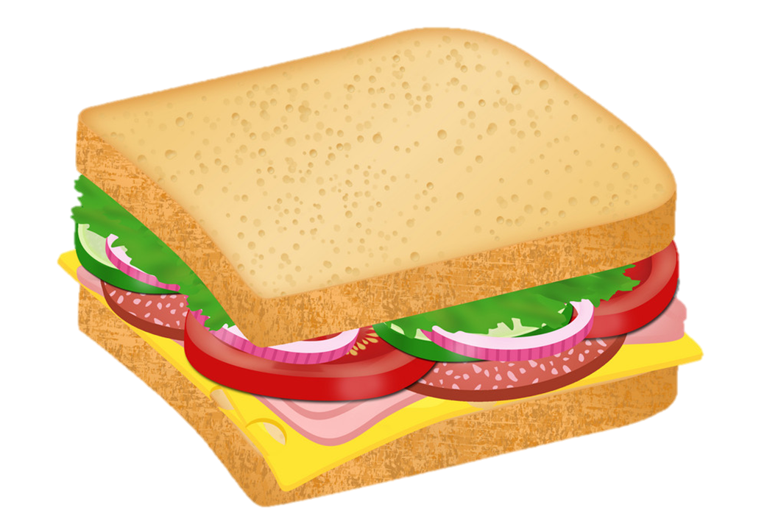
Vocabulary
lunch
food
drink
Healthy
/lʌntʃ/
/fuːd/
/drɪŋk/
/ˈhelθi/
milk
sandwich
meal
buy
/mɪlk/
/ˈsænwɪtʃ/
/miːl/
/baɪ/

Slide 17
5. Read and complete.
What do English children usually eat nowadays? At (1) ________, Jim goes to a shop and buys a (2) ________, some chocolate and some milk. Some of his friends buy (3) ________ at the shop, too. Some of the sandwiches are (4) ________, but some aren't. School meals are healthier, but Jim and his friends never (5) ______ at the school canteen.
healthy
lunch
eat
sandwich
lunch
food
sandwich
healthy
food
eat

Slide 18
Vòng quay kì diệu
50
10
20
30
10
20
30
40
Spin
PLAY
LUẬT CHƠI
Nhấn nút để quay.
Trả lời đúng câu hỏi sẽ được cộng số điểm tương ứng vị trí mũi tên dừng.
Kết thúc trò chơi đội cao điểm hơn sẽ chiến thắng.
Spin
Notes:
Ms Huyền Phạm - 0936.082.789 – YOUTUBE: MsPham. Facebook: Dạy và học cùng công nghệ.

Slide 19
_______________?
I’d like some biscuits
50
10
20
30
10
20
30
40
What would you
like to eat?
Xem đáp án
Spin
Notes:
Ms Huyền Phạm - 0936.082.789 – YOUTUBE: MsPham. Facebook: Dạy và học cùng công nghệ.

Slide 20
What would you like to eat?
_______ a bar of chocolate.
50
10
20
30
10
20
30
04
I’d like
Xem đáp án
Spin
Notes:
Ms Huyền Phạm - 0936.082.789 – YOUTUBE: MsPham. Facebook: Dạy và học cùng công nghệ.

Slide 21
50
What ____ you like to drink?
I’d like a glass of water.
10
20
30
10
20
30
04
would
Xem đáp án
Spin
Notes:
Ms Huyền Phạm - 0936.082.789 – YOUTUBE: MsPham. Facebook: Dạy và học cùng công nghệ.

Slide 22
What would you ___ to drink?
I’d like a carton of milk.
50
10
20
30
10
20
30
40
like
Xem đáp án
Spin
Notes:
Ms Huyền Phạm - 0936.082.789 – YOUTUBE: MsPham. Facebook: Dạy và học cùng công nghệ.

Slide 23
50
What would you like to eat/drink?
I’d like a bowl of noodles.
10
20
30
10
20
30
40
eat
Xem đáp án
Spin
Notes:
Ms Huyền Phạm - 0936.082.789 – YOUTUBE: MsPham. Facebook: Dạy và học cùng công nghệ.

Slide 24
50
What would you like to eat/drink?
I’d like a carton of lemonade.
10
20
30
10
20
30
40
drink
Xem đáp án
Spin
Notes:
Ms Huyền Phạm - 0936.082.789 – YOUTUBE: MsPham. Facebook: Dạy và học cùng công nghệ.

Slide 25
50
What would you like to eat?
I’d like some chocolate/chocolates.
10
20
30
10
20
30
40
chocolate
Xem đáp án
Spin
Notes:
Ms Huyền Phạm - 0936.082.789 – YOUTUBE: MsPham. Facebook: Dạy và học cùng công nghệ.

Slide 26
50
10
What would you like to drink?
I’d like __________.
a. a packet of biscuits
b. a glass of orange juice
20
30
10
20
30
40
b. a glass of orange juice
Xem đáp án
Spin
Notes:
Ms Huyền Phạm - 0936.082.789 – YOUTUBE: MsPham. Facebook: Dạy và học cùng công nghệ.

Slide 27
What would you like to drink?
I’d like __________.
a. glass of water
b. a glass of water
50
10
20
30
10
20
30
04
b. a glass of water
Xem đáp án
Spin
Notes:
Ms Huyền Phạm - 0936.082.789 – YOUTUBE: MsPham. Facebook: Dạy và học cùng công nghệ.

Slide 28
What would you like to eat?
I’d like __________.
a. a bowl of rice
b. a bowl of noodle
50
10
20
30
10
20
30
04
a. a bowl of rice
Xem đáp án
Spin
Notes:
Ms Huyền Phạm - 0936.082.789 – YOUTUBE: MsPham. Facebook: Dạy và học cùng công nghệ.

Slide 29
50
10
20
30
10
20
30
40
EXIT
Notes:
Ms Huyền Phạm - 0936.082.789 – YOUTUBE: MsPham. Facebook: Dạy và học cùng công nghệ.

Slide 30
6. Let’s sing

