Slide 1




Slide 2



Hua Tao Primary School
Welcome to class 3D
Unit 5:My hobbies
Lesson 1- Part 1,2,3/Page 34
Teacher: Ha Thi Xuan Thu
11/15/2023
Võ Thị Thoa

Slide 3




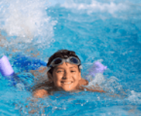
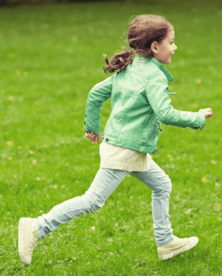


5
My hobbies
LESSON 1
Period 1

Slide 4
Contents
03
Listen, point and say.
01
Warm-up
04
02
Look, listen and repeat.
Fun corner and wrap-up.
Let’s talk.
05

Slide 5
1
Warm-up
Let’s play a game.
Notes:
Review Numbers 1-10 and Alphabet

Slide 6
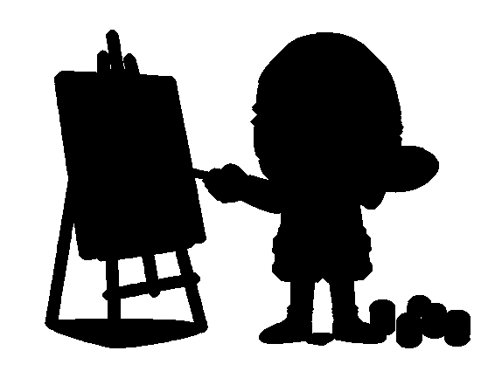



1
2
3
4
Action simulation
Notes:
- T shows picture.
- T asks some pupils who can simulate the actions in the pictures through the shadows. -> Choose the best ones and gives them points.

Slide 7
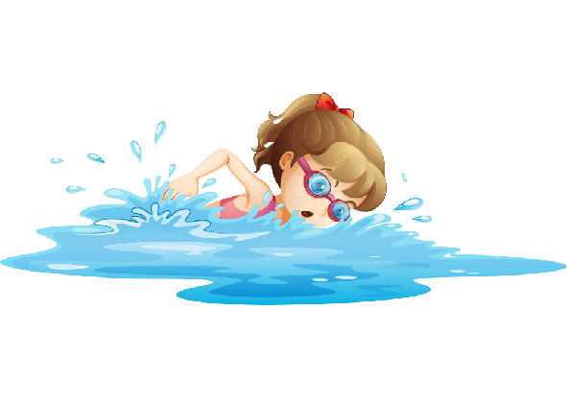


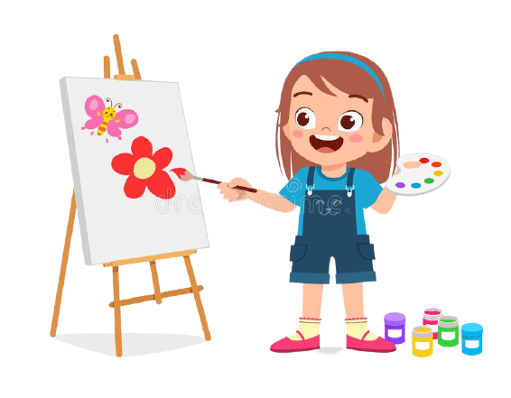
1
2
3
4
a
b
c
d
Notes:
- T asks pupils to match the pictures with their shadows in mind first (whole class).
- T says the numbers, pupils say the letters. -> Check the answers in the next slide.

Slide 8
1
2
3
4
a
d
c
b
Notes:
- T says the numbers 1 by 1 and click to shows the answer.

Slide 9
dancing
Notes:
T shows the shadows with their pictures and say the words and gives sentences: They are ____., She is _____., He is _____.

Slide 10
drawing
Notes:
T shows the shadows with their pictures and say the words and gives sentences: They are ____., She is _____., He is _____.

Slide 11
singing
Notes:
T shows the shadows with their pictures and say the words and gives sentences: They are ____., She is _____., He is _____.

Slide 12
swimming
Notes:
T shows the shadows with their pictures and say the words and gives sentences: They are ____., She is _____., He is _____.

Slide 13
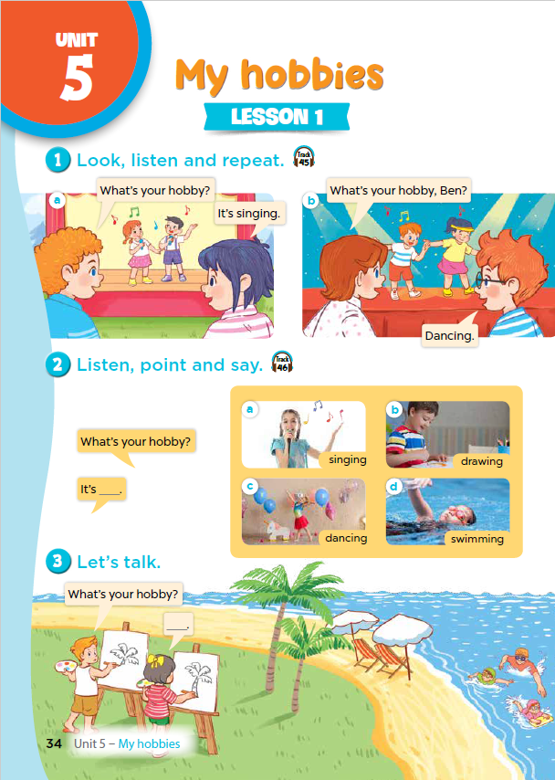
Notes:
T asks pupils to open their SB/ page 34.

Slide 14
2
Look, listen and repeat.

Slide 15
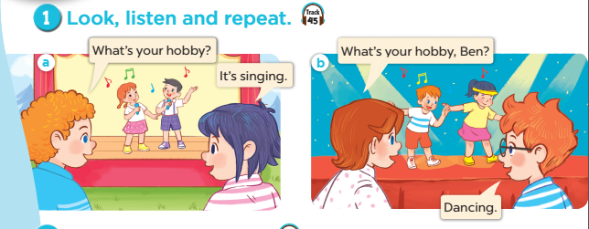

Notes:
Step 1: Ask pupils to look at context a. Play the recording for them to listen. Play the recording again, sentence by sentence, for them to listen and repeat. Correct pronunciation if necessary.
Step 2: Do the same with context b.
Step 4: Work in pair - role play.
Step 5: Invite few pairs to the front of the class and act.

Slide 16
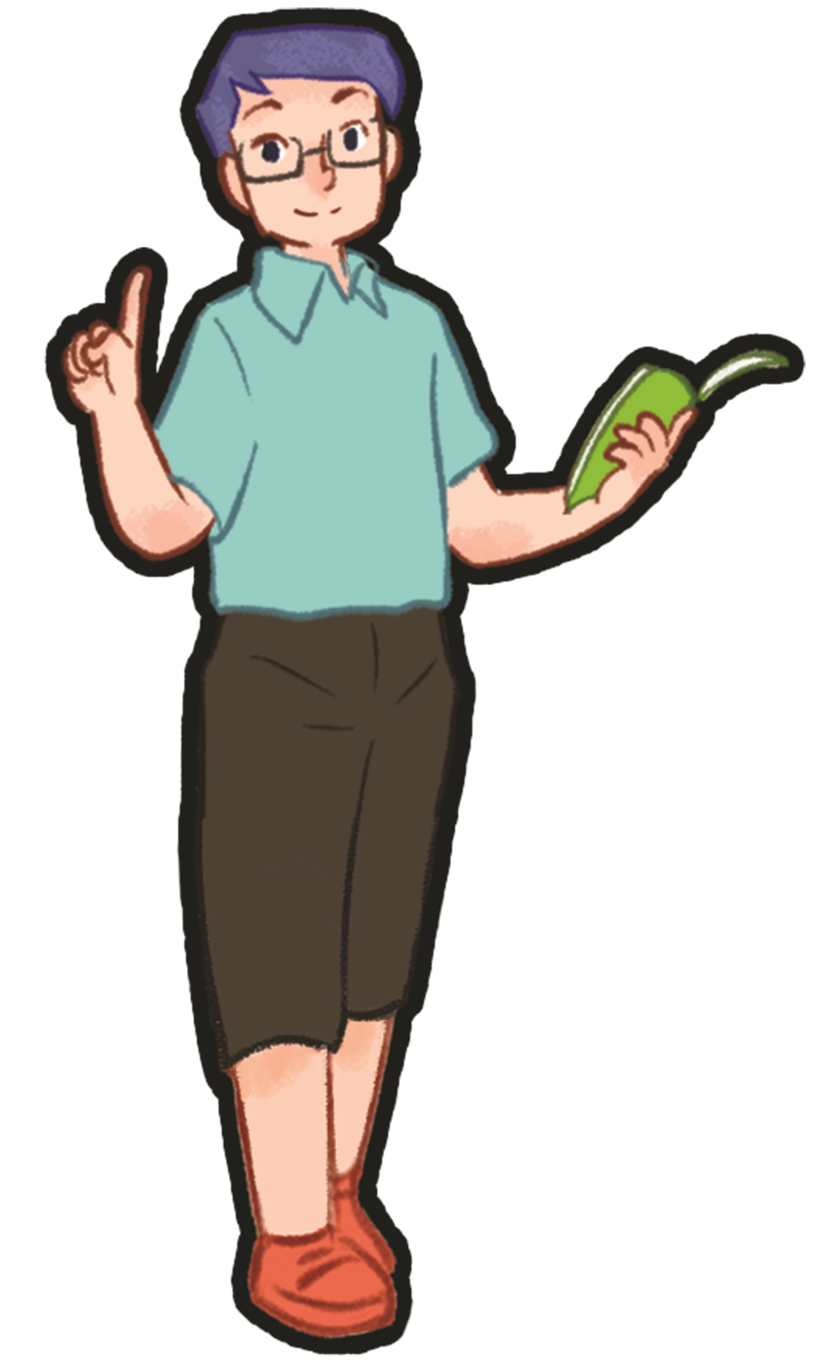
2
Listen, point and say.

Slide 17
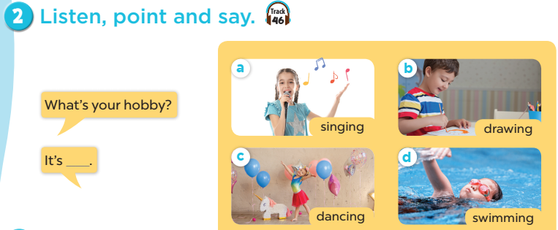
Notes:
Step 1: Have pupils look at the pictures and elicit the names of the pupils. Have the class repeat the words a few time.
Step 2: Ask 2 pupils to do as an example.
Step 4: Ask pupils to work in pairs, pointing to the questions and pictures and giving the answers.
Step 5: Invite few pairs to the front of the class and make questions and answers.

Slide 18

singing

Slide 19
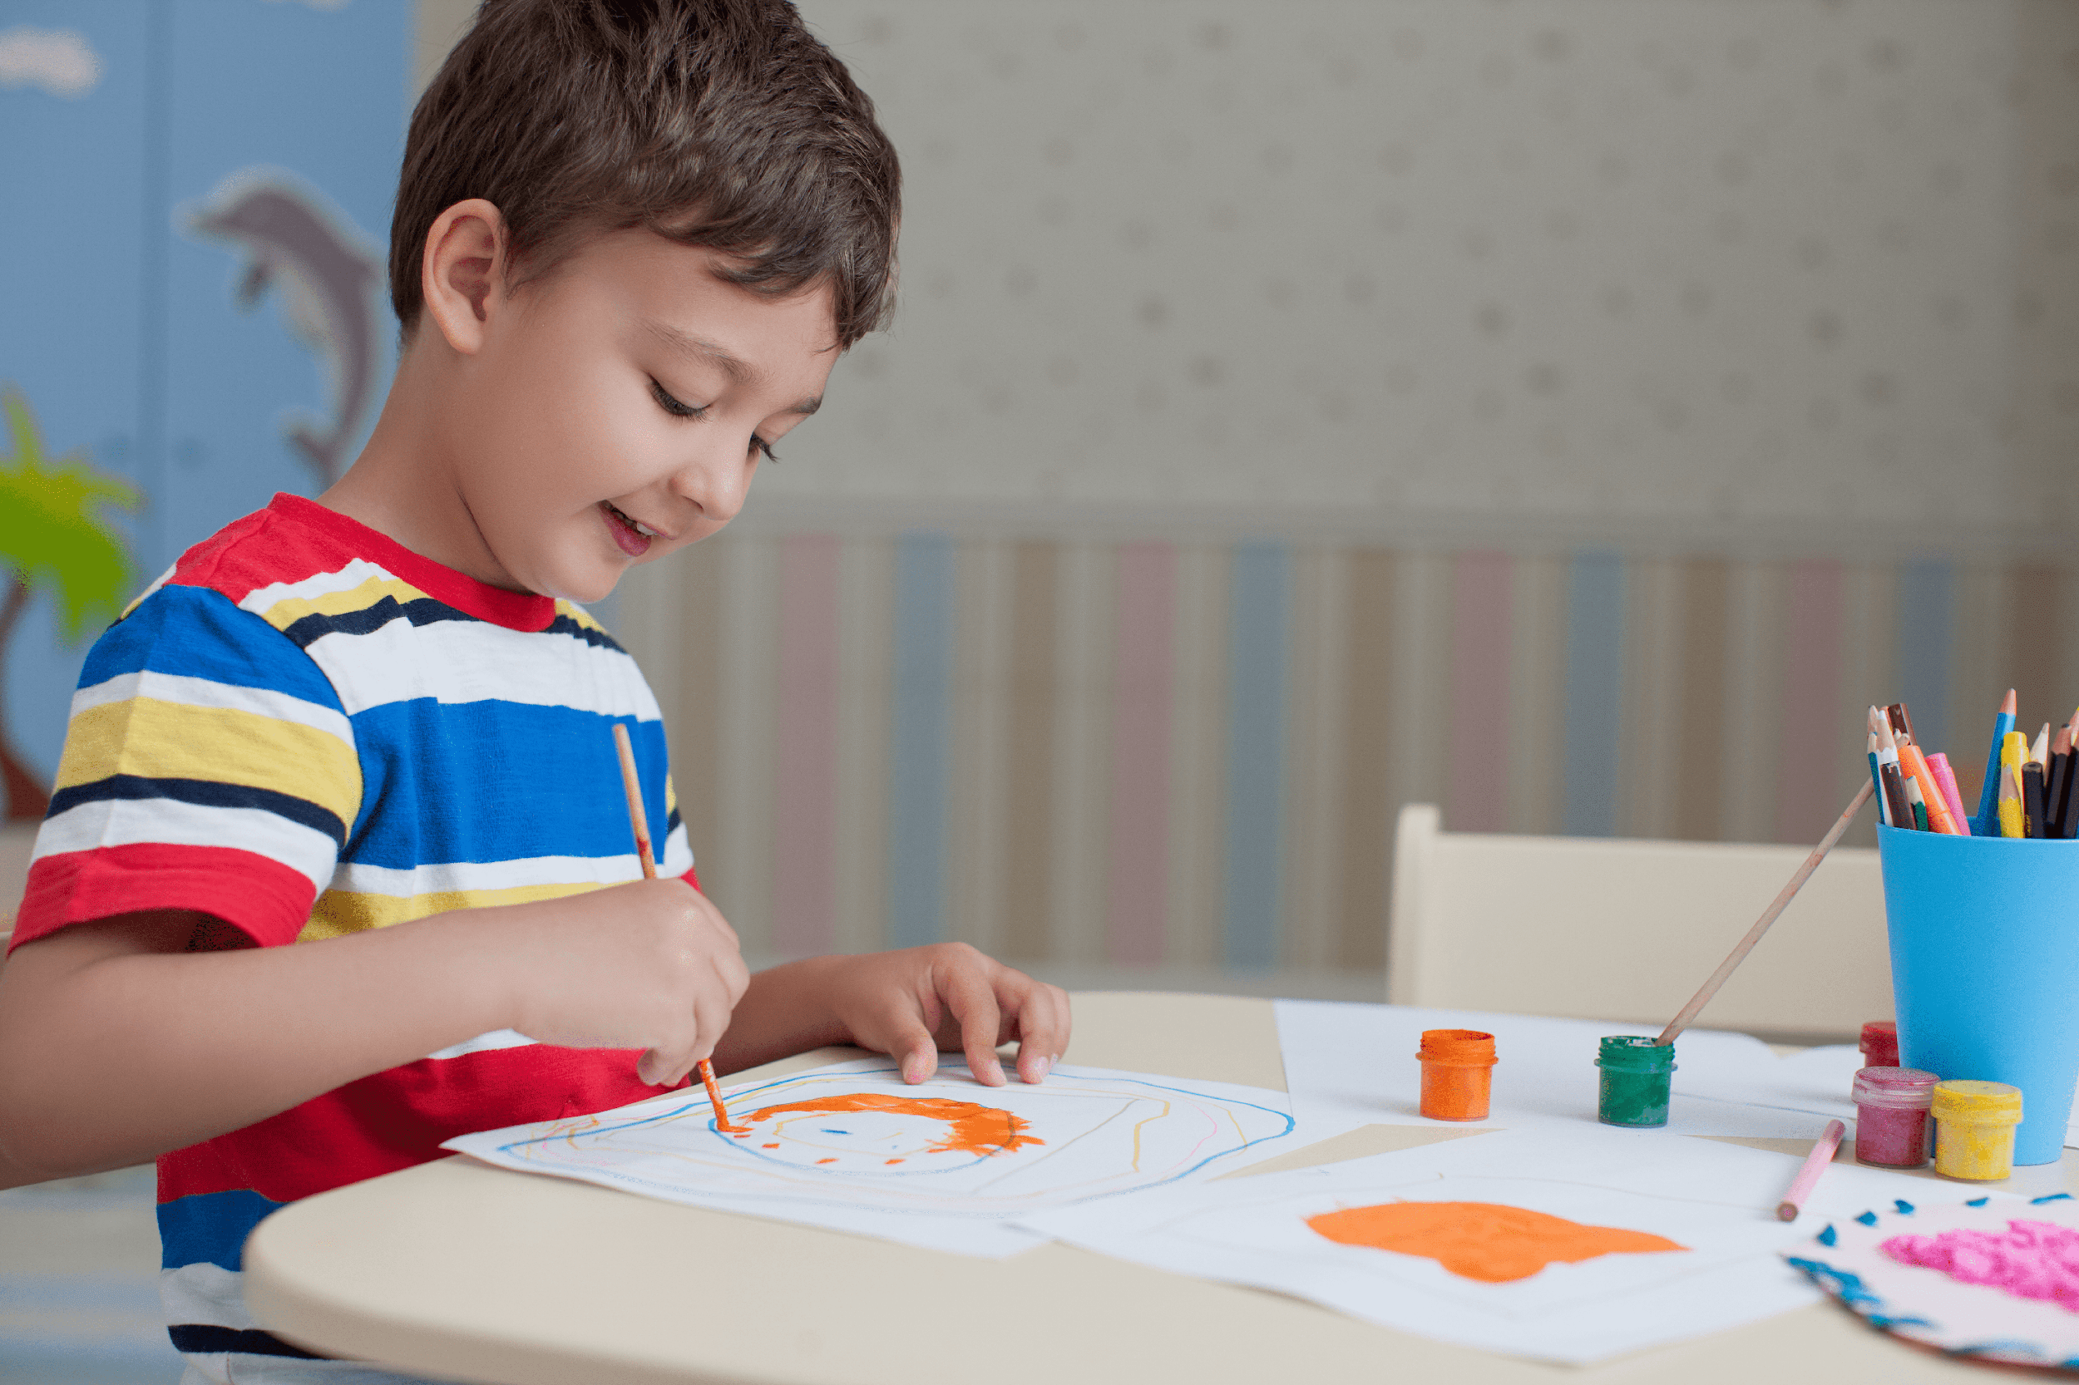
drawing

Slide 20
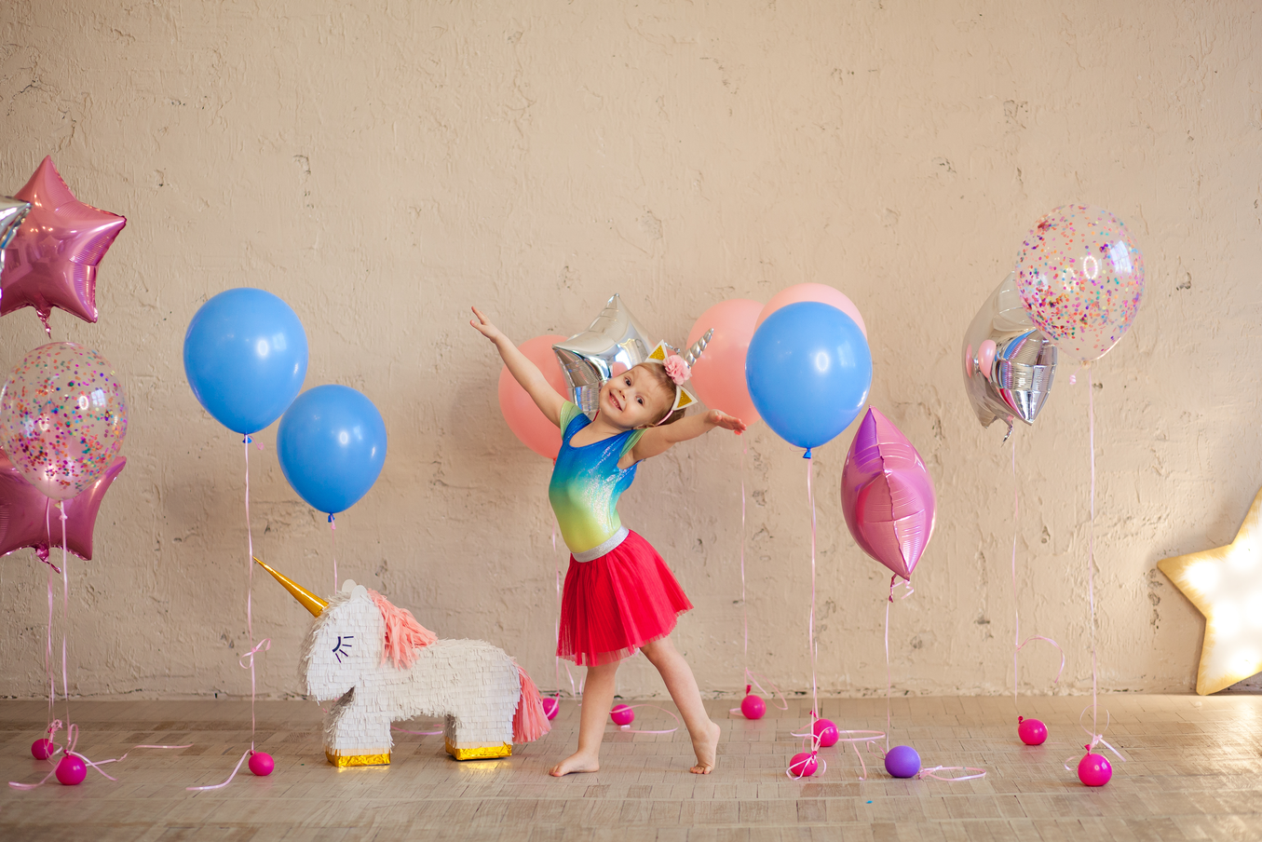
dancing

Slide 21
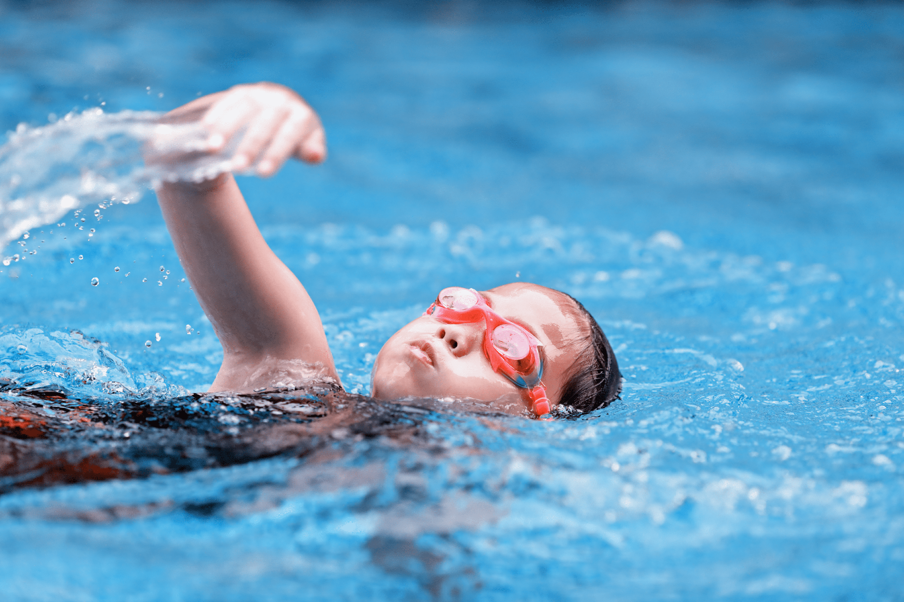
swimming

Slide 22
Notes:
Step 1: Have pupils look at the pictures and elicit the names of the pupils. Have the class repeat the words a few time.
Step 2: Ask 2 pupils to do as an example.
Step 4: Ask pupils to work in pairs, pointing to the questions and pictures and giving the answers.
Step 5: Invite few pairs to the front of the class and make questions and answers.

Slide 23
What’s missing?
Notes:
Game: What’s missing?
Divide the class into 4 groups.
A pupil from each group comes to the front, look at the pictures and say which is missing.
Who say it fast will get points.

Slide 24
What’s missing?

Slide 25
What’s missing?

Slide 26
What’s missing?

Slide 27
What’s missing?

Slide 28
4
Let’s talk.

Slide 29
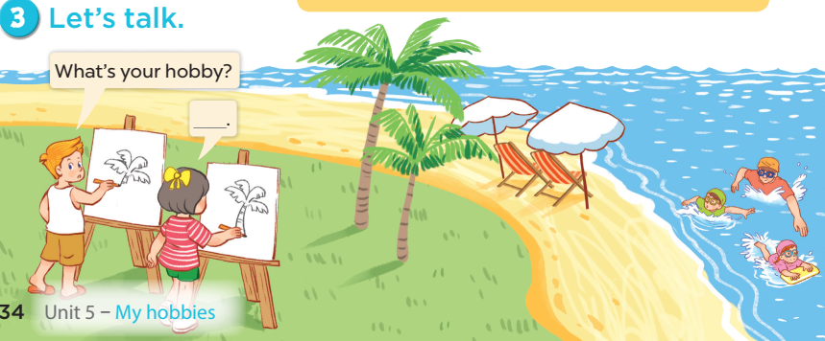

Slide 30
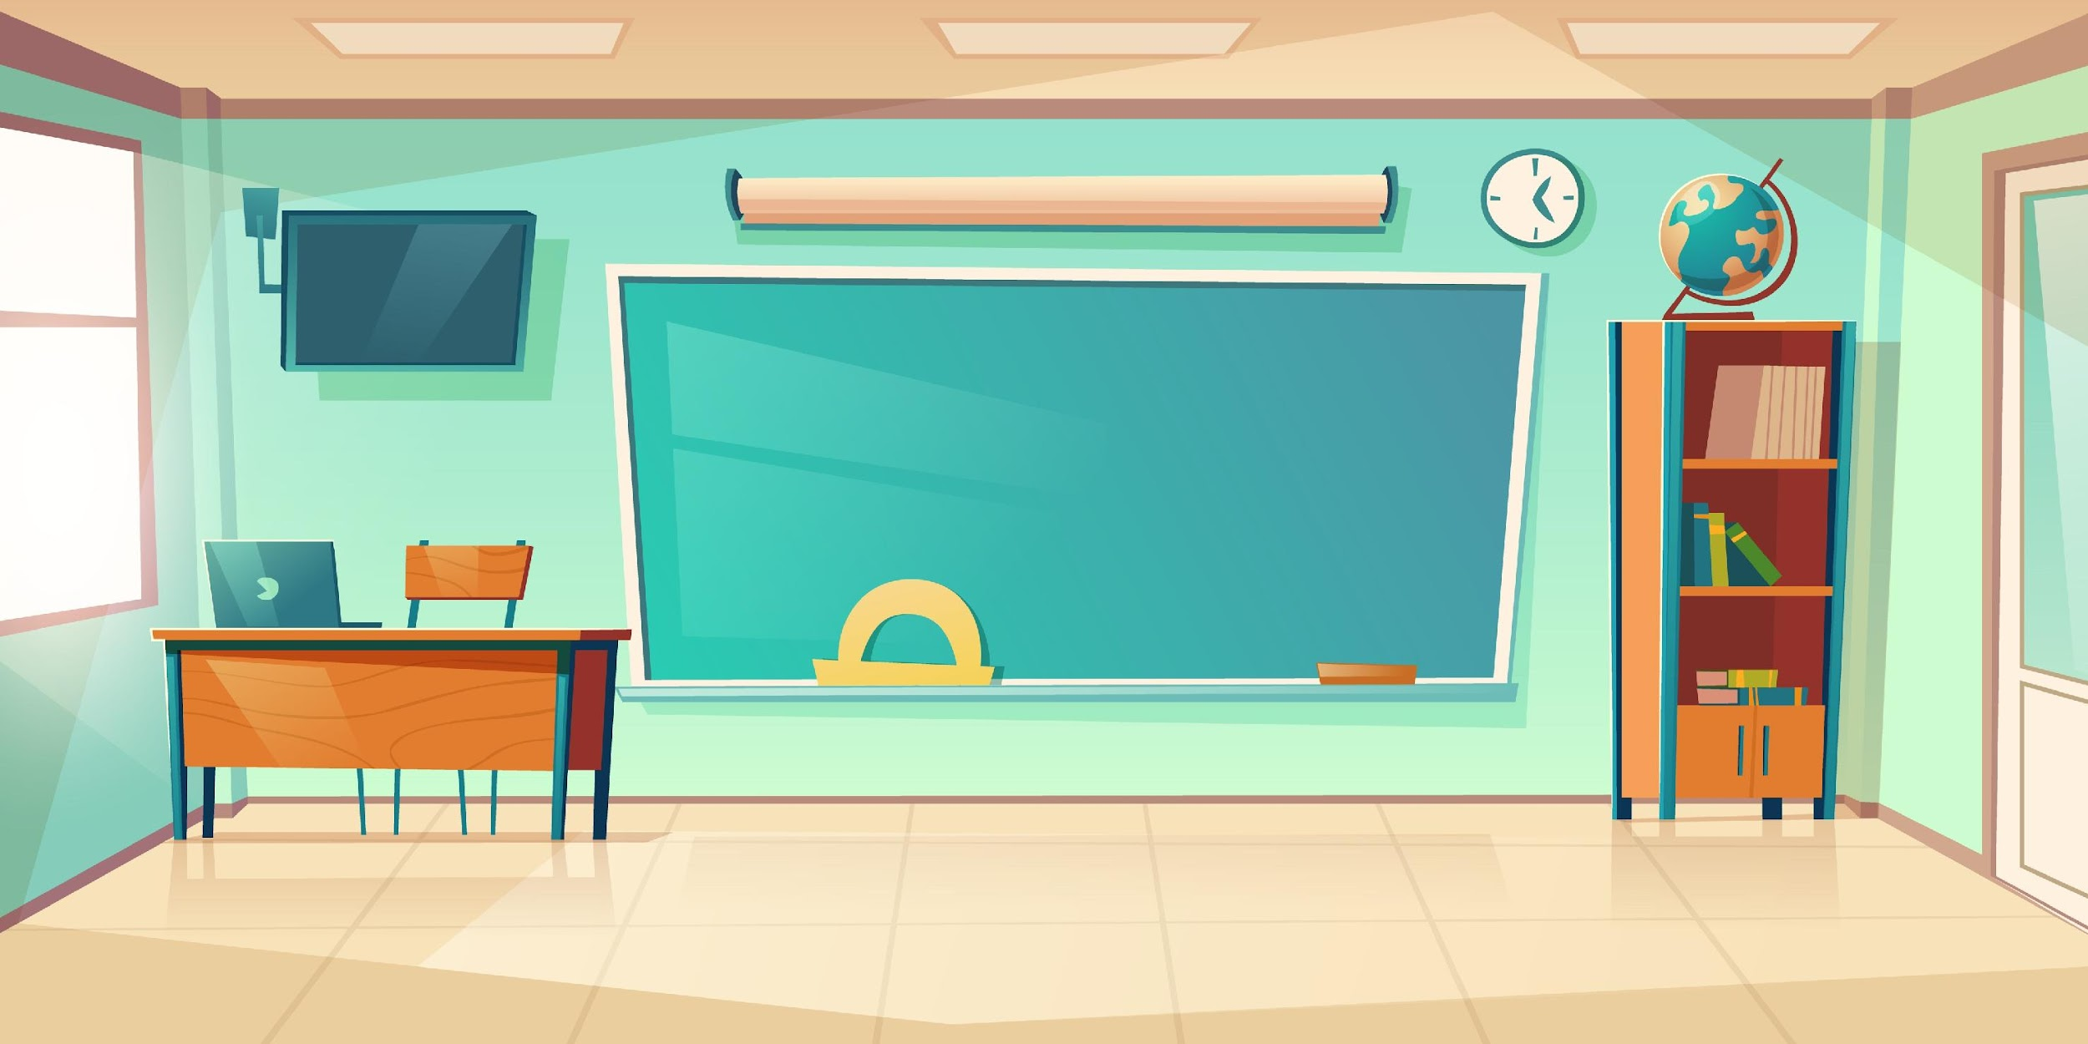

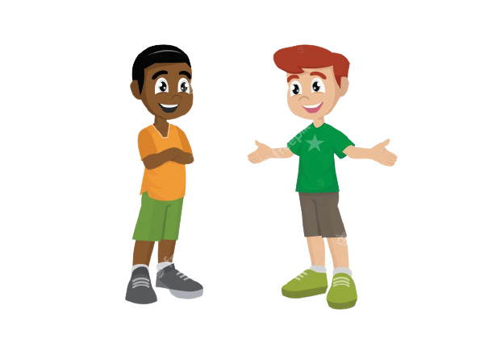
It’s ____.
What’s your hobby?
Notes:
- T asks pupils to practise in pairs asking and answering.
- T asks some pairs to present in front of class.

Slide 31
Matching game

Slide 32
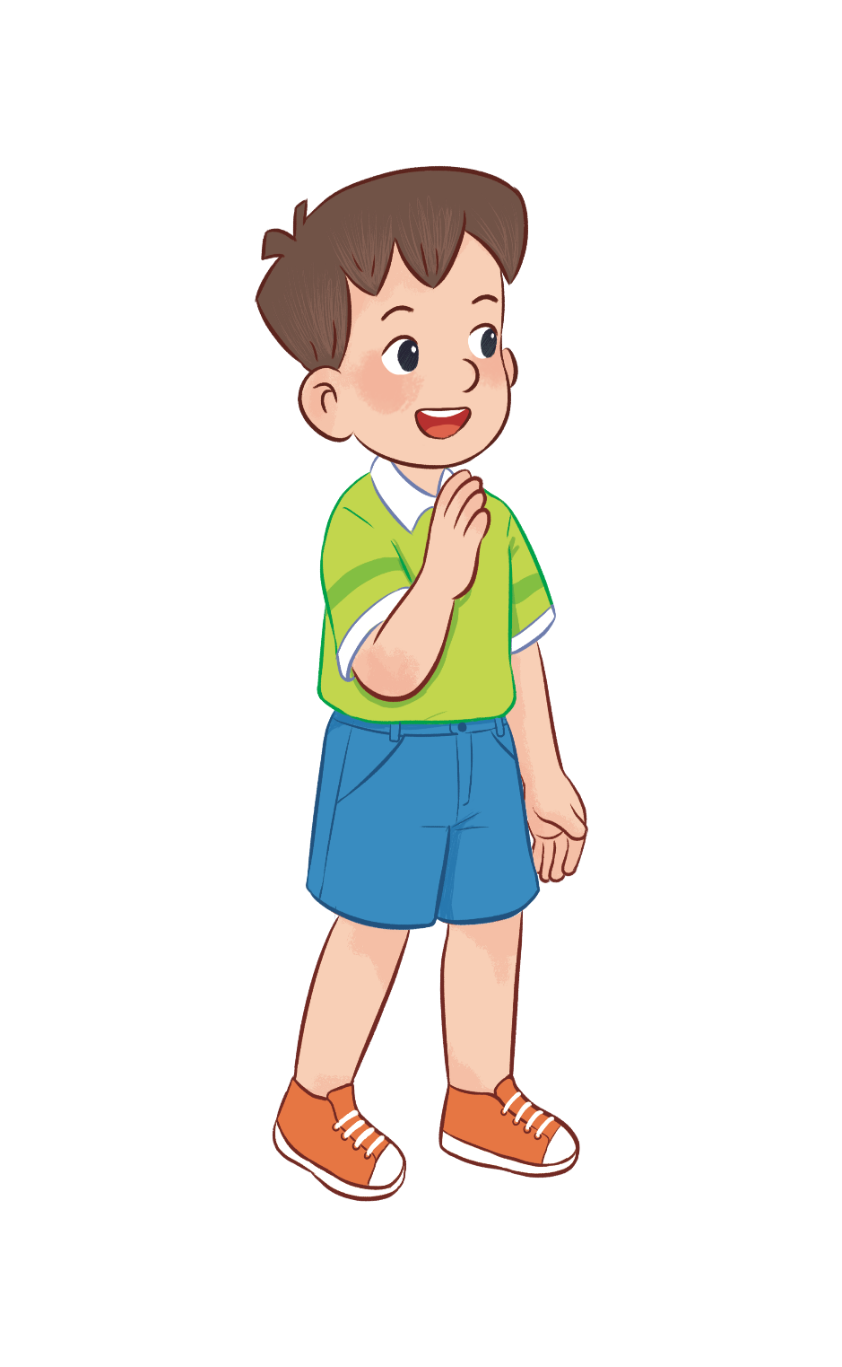
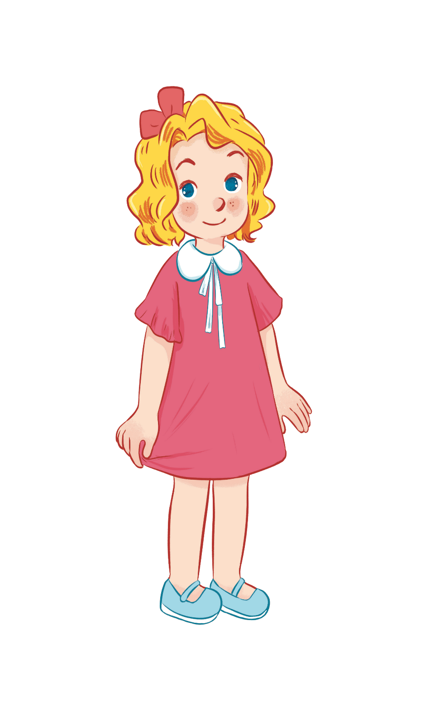
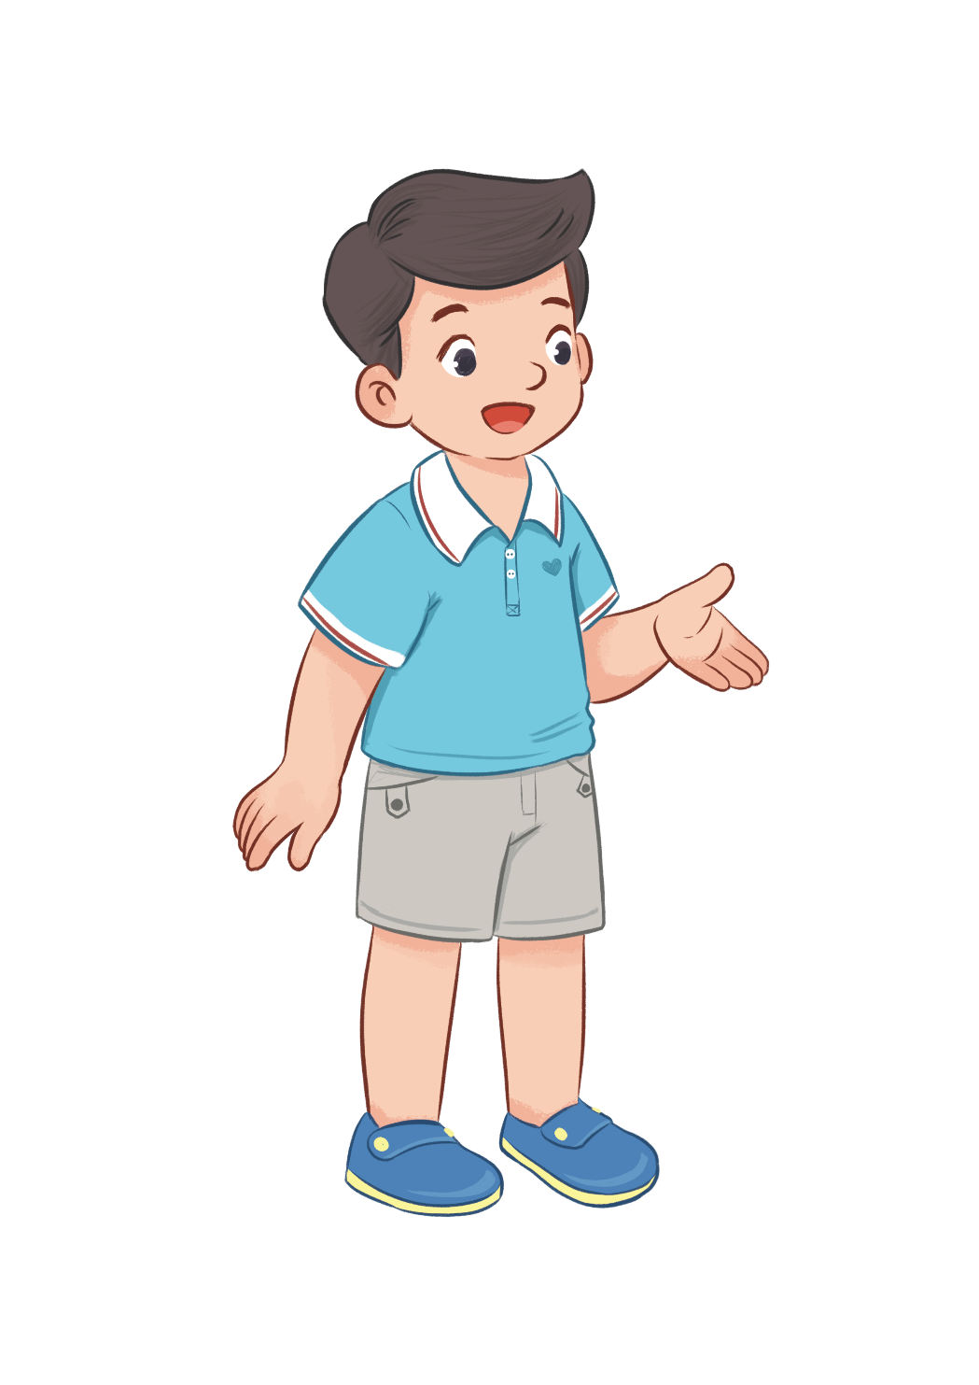
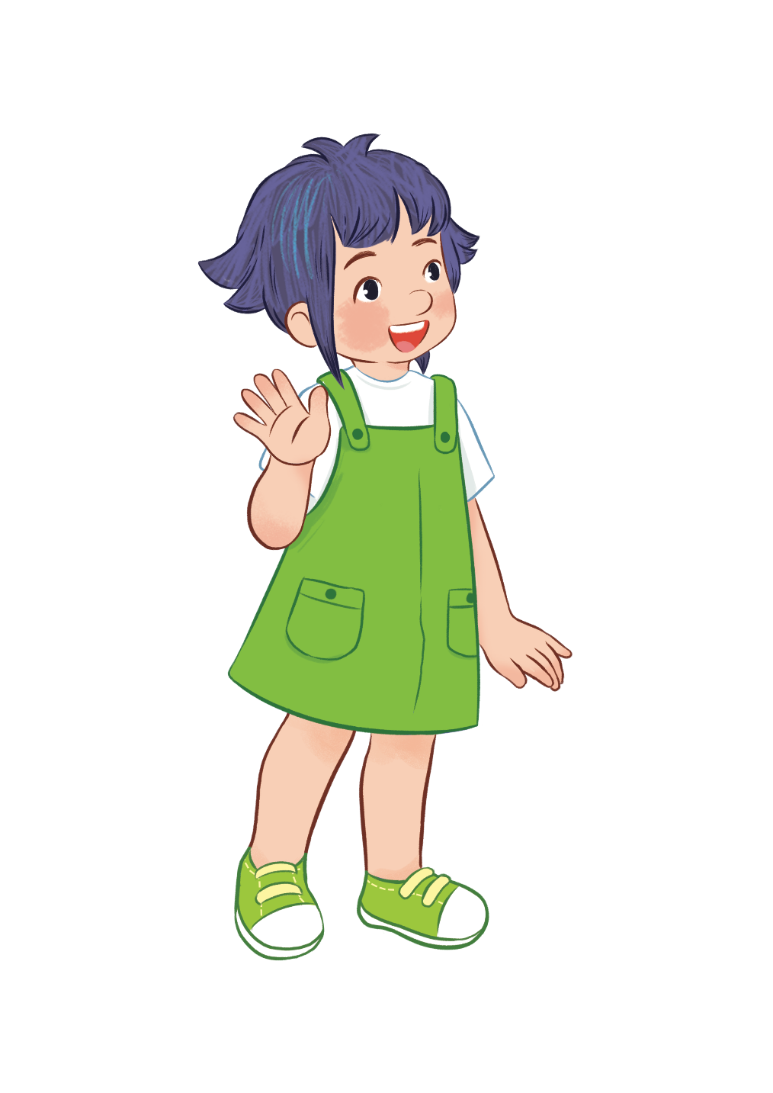
HOBBIES
drawing
swimming
dancing
singing
Notes:
- T writes 4 new words on the board and asks pupils to read (whole class).
- T asks 4 pupils to come to the board and write their hobbies in the pieces of paper and keep them in secret.

Slide 33


swimming/ drawing, ..?
dancing/ singing, ..?
dancing/ singing, ...?
swimming/ drawing, ...?
HOBBIES
drawing
swimming
dancing
singing
Notes:
T asks 1 pupil come to the board and guess their hobbies written in the paper (He has to write the answers in the small pieces of paper and stick to 4 pupils).

Slide 34
It’s swimming.
HOBBIES
drawing
swimming
dancing
singing
What’s your hobby?
swimming
singing
dancing
drawing
Notes:
T asks the pupil to ask the question to find the answers and gives him or her point if correct (repeat the activities depending the time).

Slide 35
5
Fun corner and
Wrap-up

Slide 36


Notes:
- T asks 1 student come to the board and face to the class.
- T shows 1 picture of 4 hobbies and lets the others act so that the pupil on the board can guess the name of the hobby in the picture (1 pupil will guess 3 pictures).

Slide 37



What’s your hobby?
Notes:
T shows 4 pictures on the board and asks pupils to repeat -> Wrap up.

