Slide 1




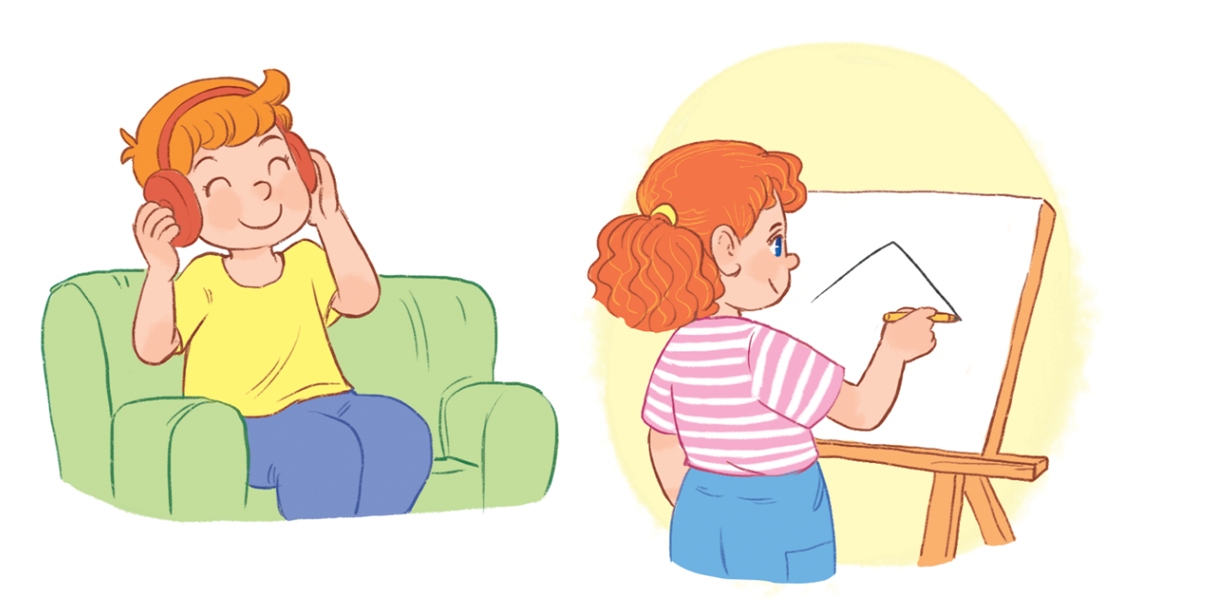

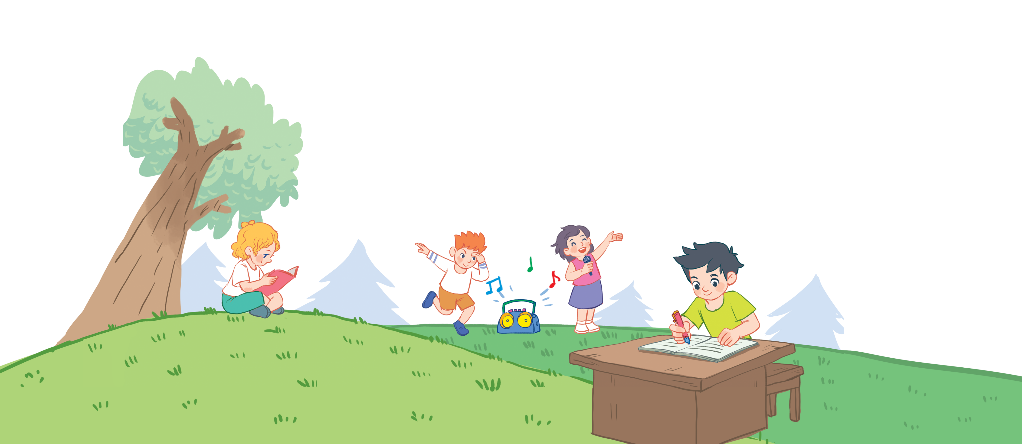

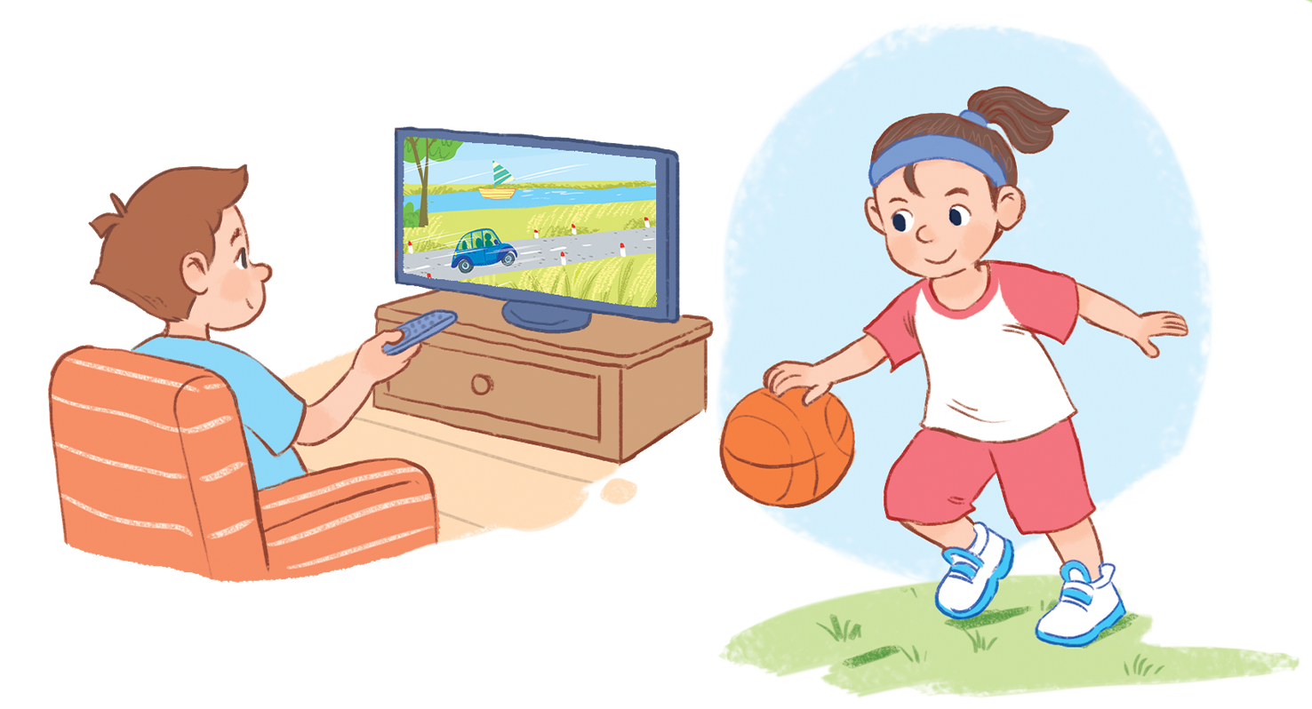


Unit 18
Playing and doing
Lesson 2 - period 1

Slide 2
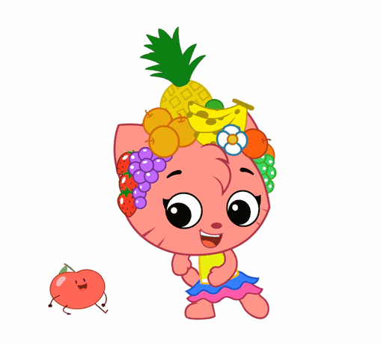
Warm - up
Play

Slide 3

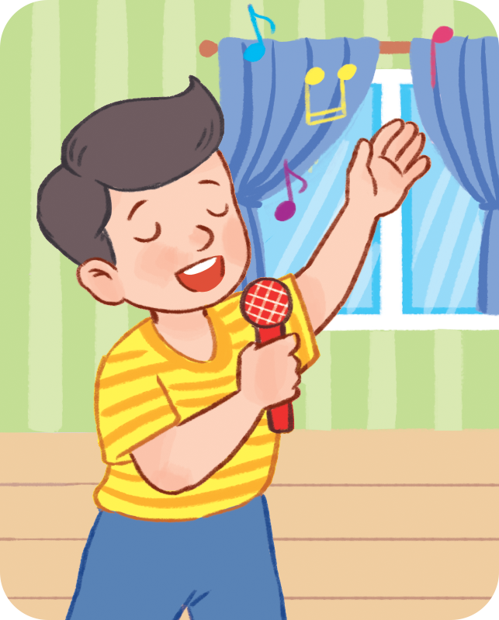
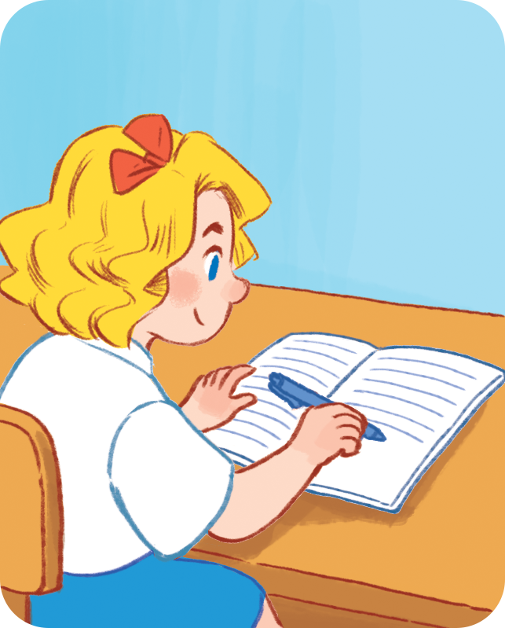
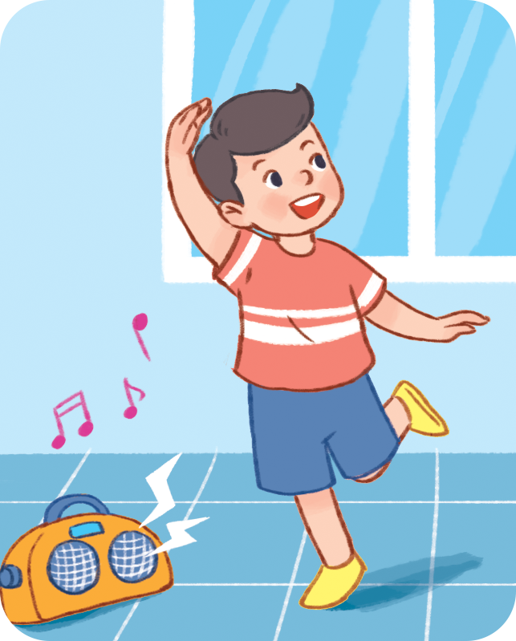
Review
I’m ________.
reading
singing
writing
dancing

Slide 4

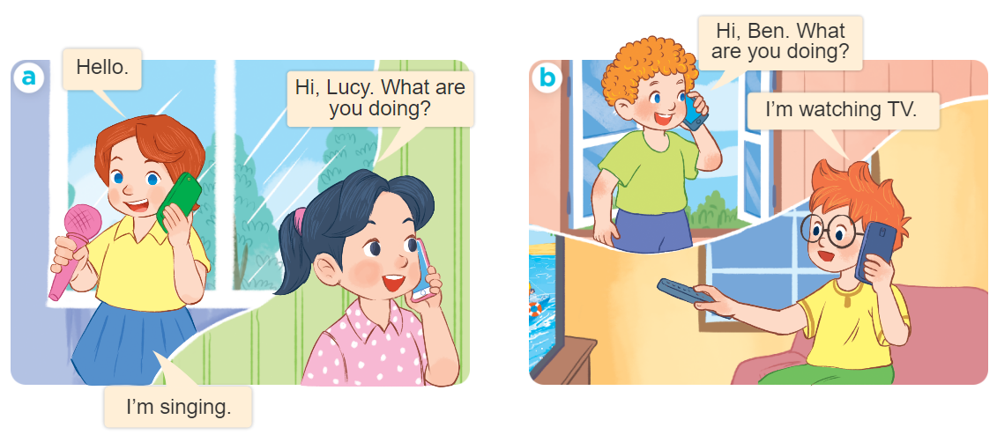
1
Look, listen and repeat.

Slide 5
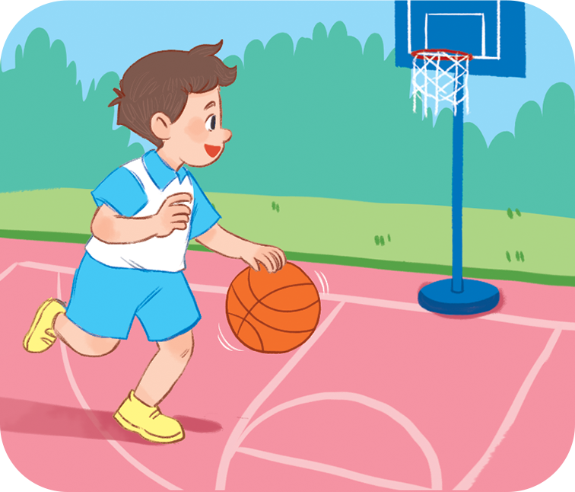
Vocabulary
playing basketball
ˈpleɪɪŋ ˈbɑːskɪtˌbɔːl
Chơi bóng rổ

Slide 6
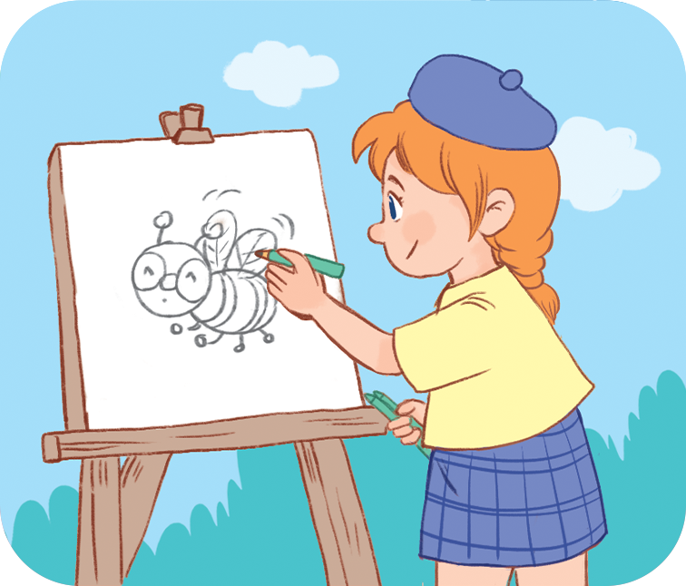
Vocabulary
drawing a picture
ˈdrɔːɪŋ ə ˈpɪkʧə
Vẽ tranh

Slide 7
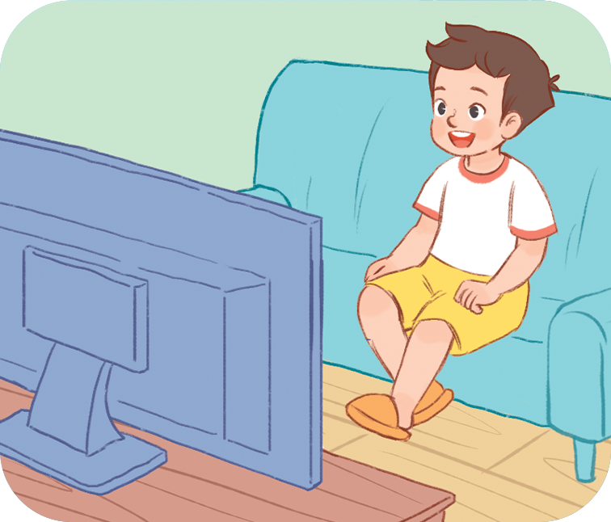
Vocabulary
watching TV
ˈwɒʧɪŋ ˌtiːˈviː
Xem tivi

Slide 8
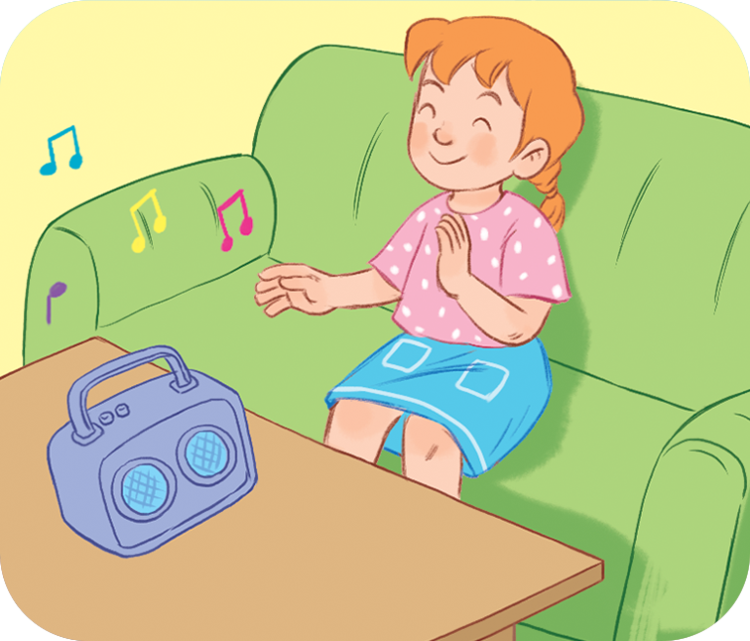
Vocabulary
listening to music
ˈlɪsnɪŋ tə ˈmjuːzɪk
Nghe nhạc

Slide 9
Vocabulary
playing basketball
: Chơi bóng rổ
ˈpleɪɪŋ ˈbɑːskɪtˌbɔːl
drawing a picture
: Vẽ tranh
ˈdrɔːɪŋ ə ˈpɪkʧə
watching TV
: Xem TV
ˈwɒʧɪŋ ˌtiːˈviː
listening to music
: Nghe nhạc
ˈlɪsnɪŋ tə ˈmjuːzɪk

Slide 10
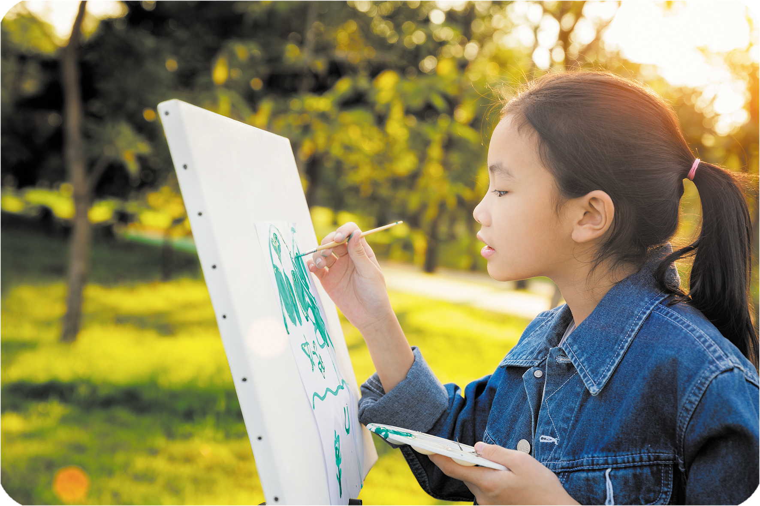


2
Listen, point and say.
drawing
a picture
What are you doing?
drawing a picture
I’m _________________.

Slide 11
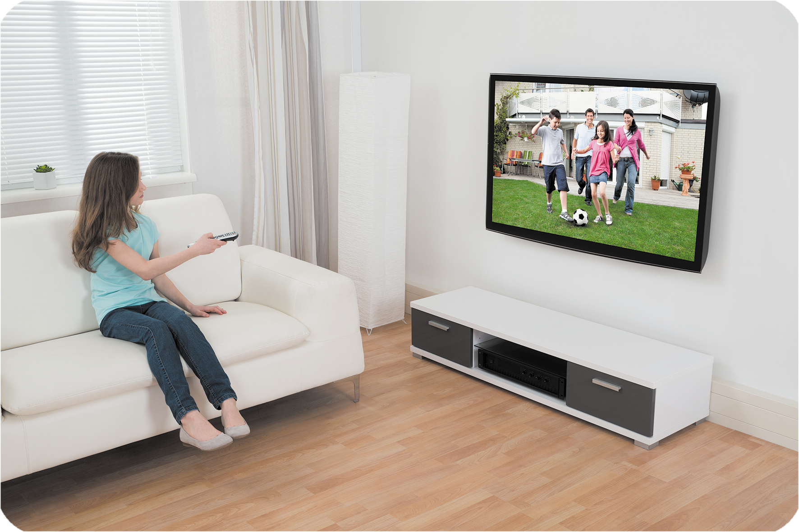
2
Listen, point and say.
watching TV
What are you doing?
watching TV
I’m _________________.

Slide 12
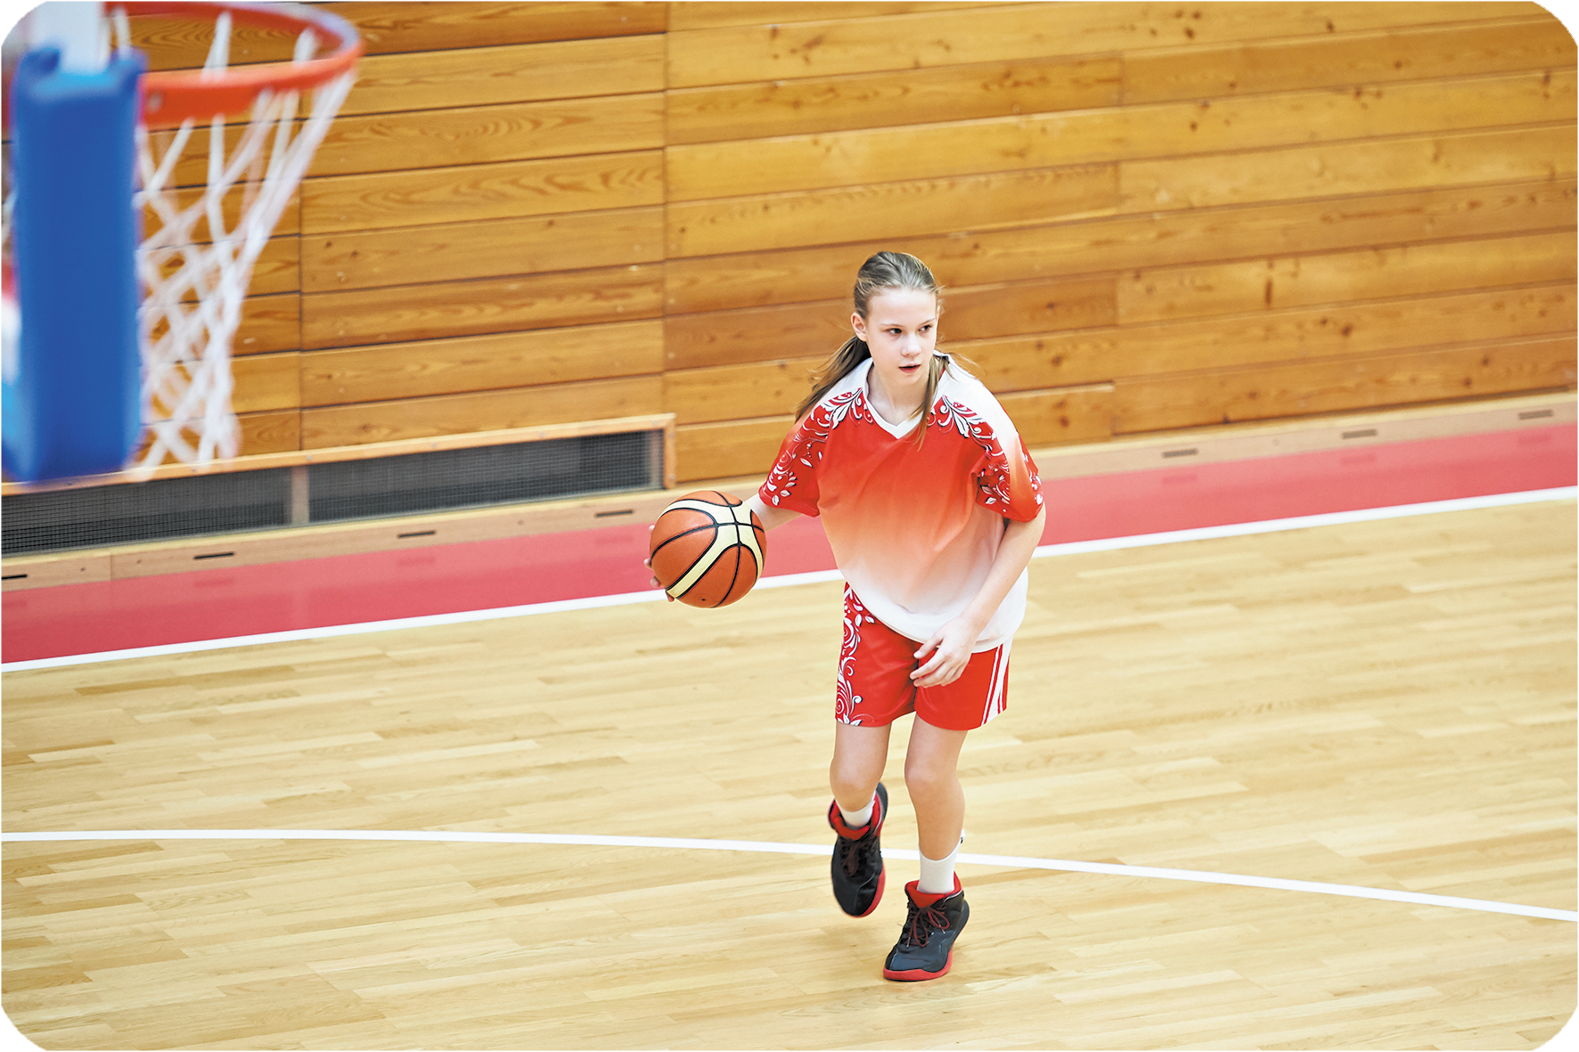
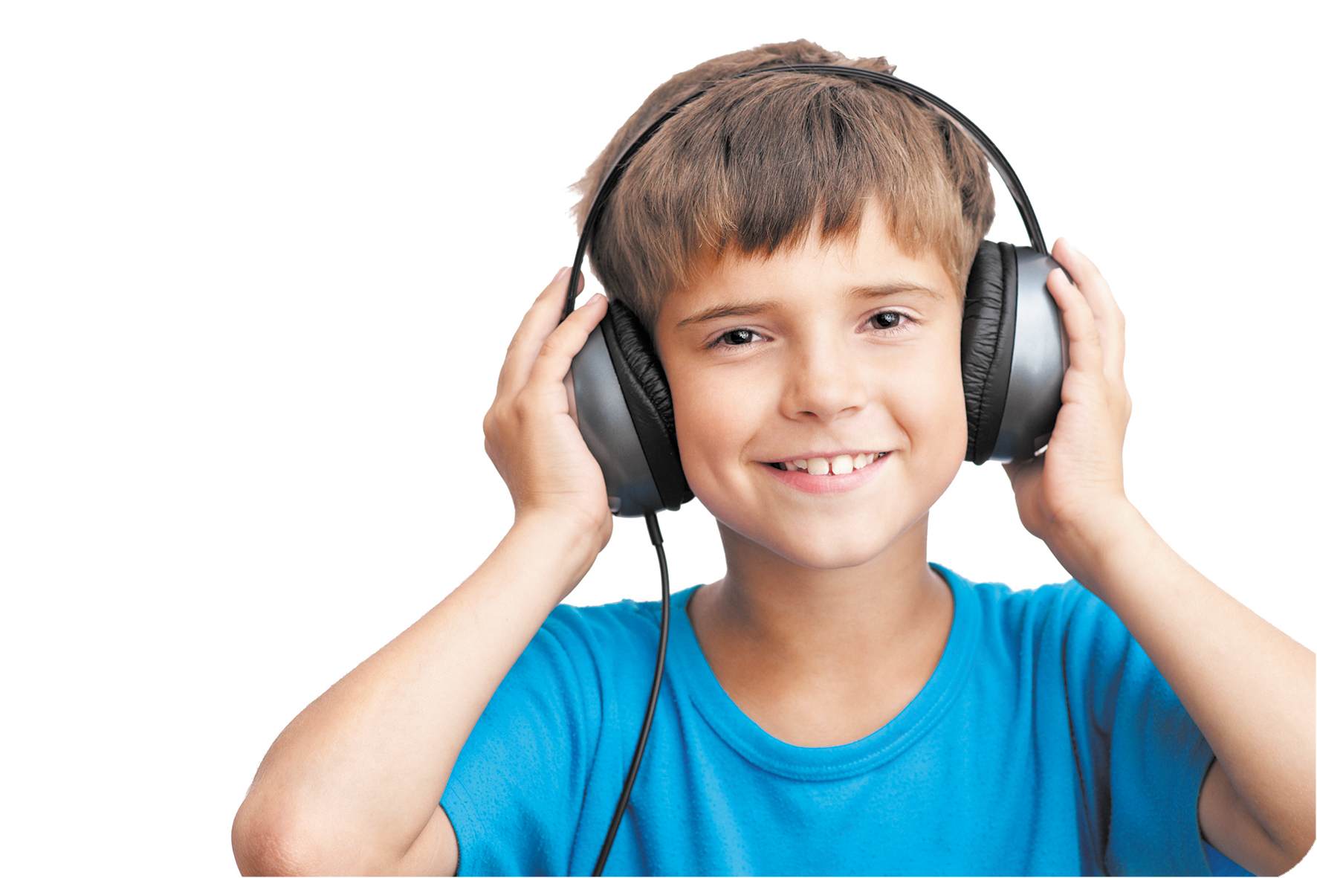
2
Listen, point and say.
playing
basketball
What are you doing?
playing basketball
I’m _________________.

Slide 13
2
Listen, point and say.
listening
to music.
What are you doing?
listening to music
I’m _________________.

Slide 14
What are you doing?
I’m _________________.
playing
basketball
drawing
a picture
listening
to music.
watching TV

Slide 15
Structures
Hỏi và trả lời bạn đang làm gì:
What are you doing?
(Bạn đang làm gì vậy?)
I’m _________.
(Tớ đang __________.)

Slide 16
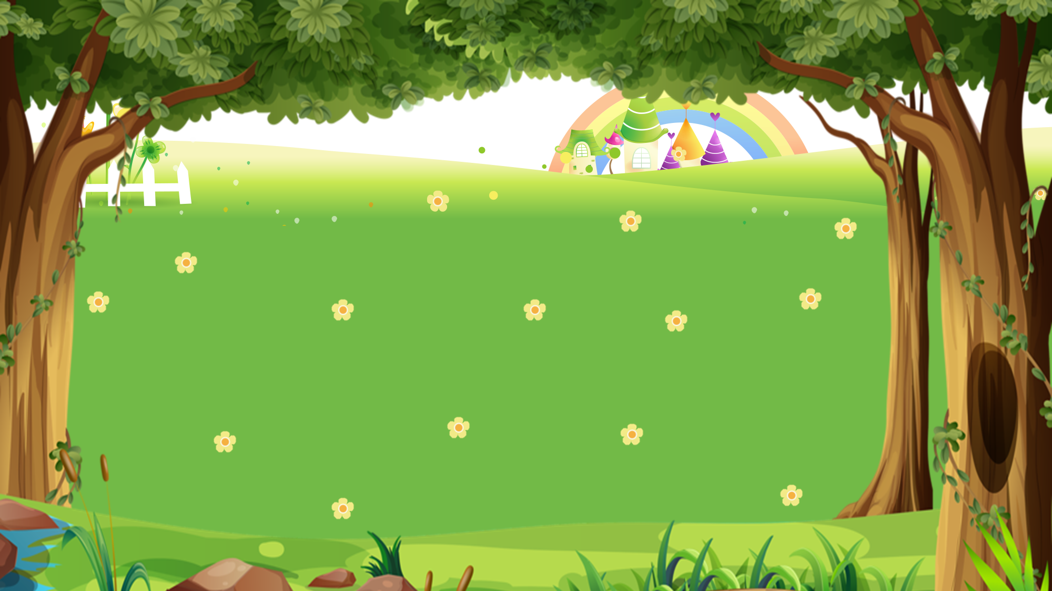
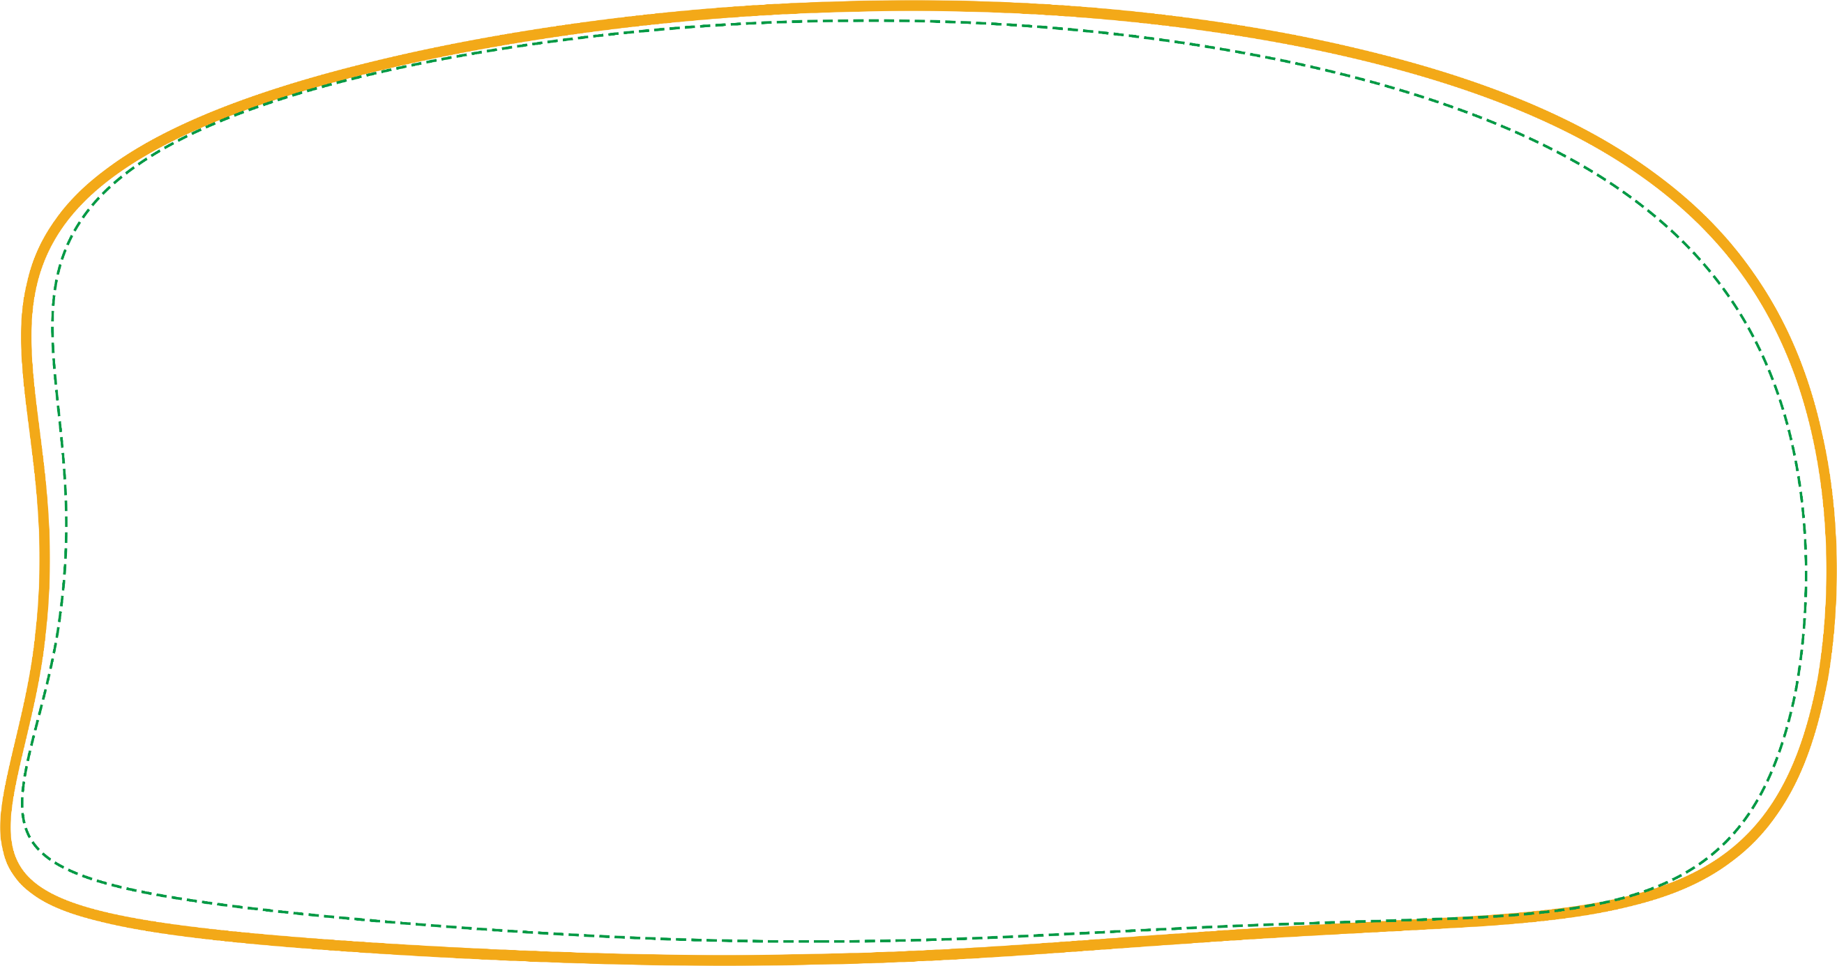
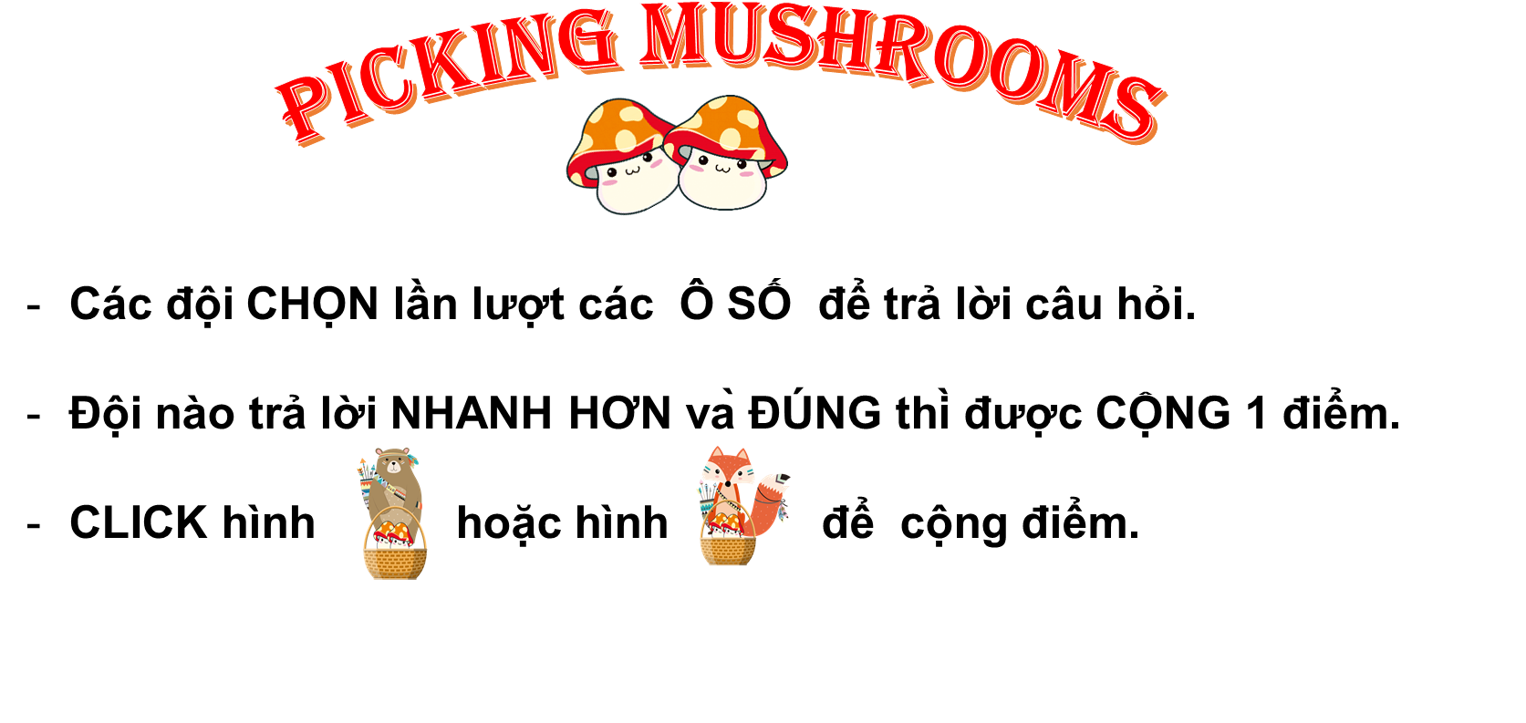

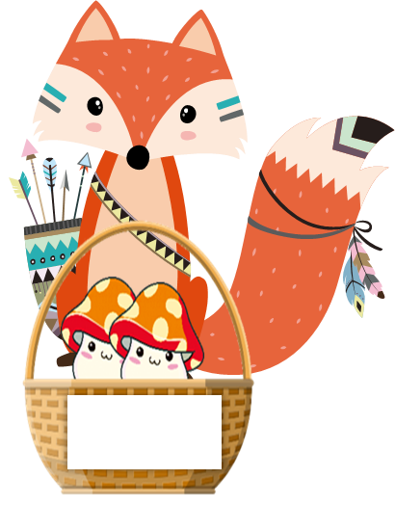





1
2
3
4
5
6
7
8
9
10
1
2
3
4
5
6
7
8
9
1
10
2
3
4
5
6
7
8
9
10

Slide 17






What are you doing?
I’m _____________.
Back
A. listening to music
B. drawing a picture
C. watching TV

Slide 18
What are you doing?
I’m _____________.
Back
A. playing
basketball
B. watching TV
C. listening to music

Slide 19
What are you doing?
I’m _____________.
Back
A. watching TV
B. playing
basketball
C. drawing a picture

Slide 20
What are you doing?
I’m _____________.
Back
A. drawing a picture
B. listening to music
C. playing
basketball

Slide 21
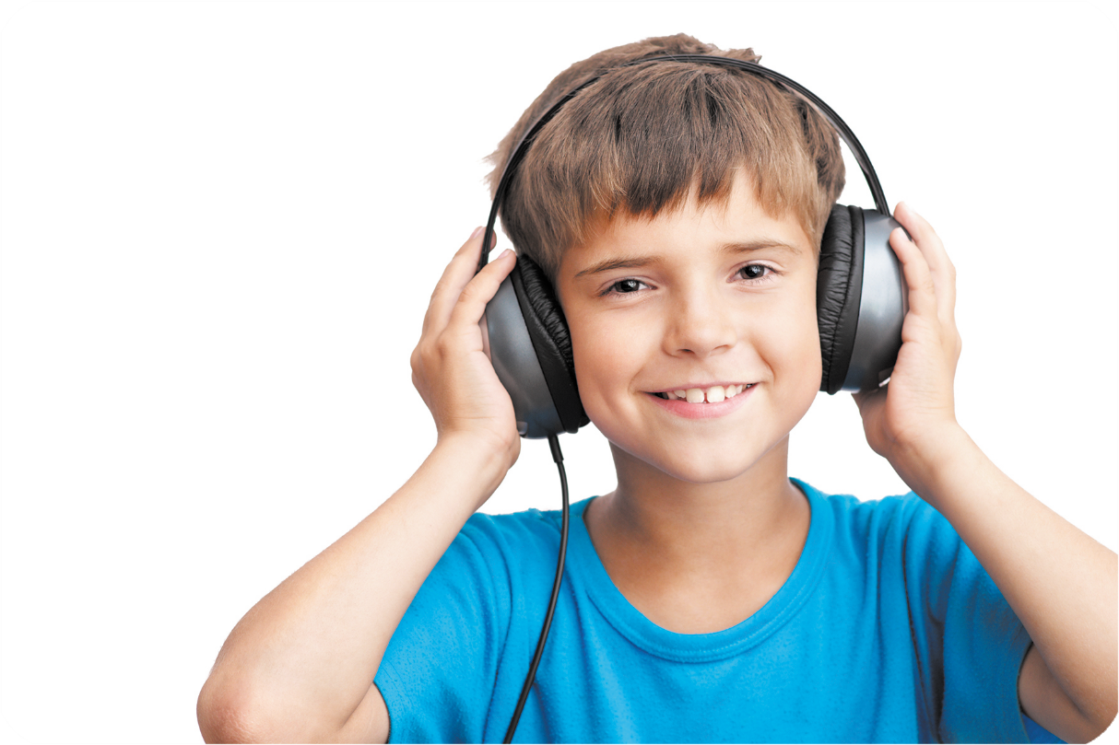
What are you doing?
I’m _____________.
Back
A. watching TV
B. listening to music
C. playing
basketball

Slide 22
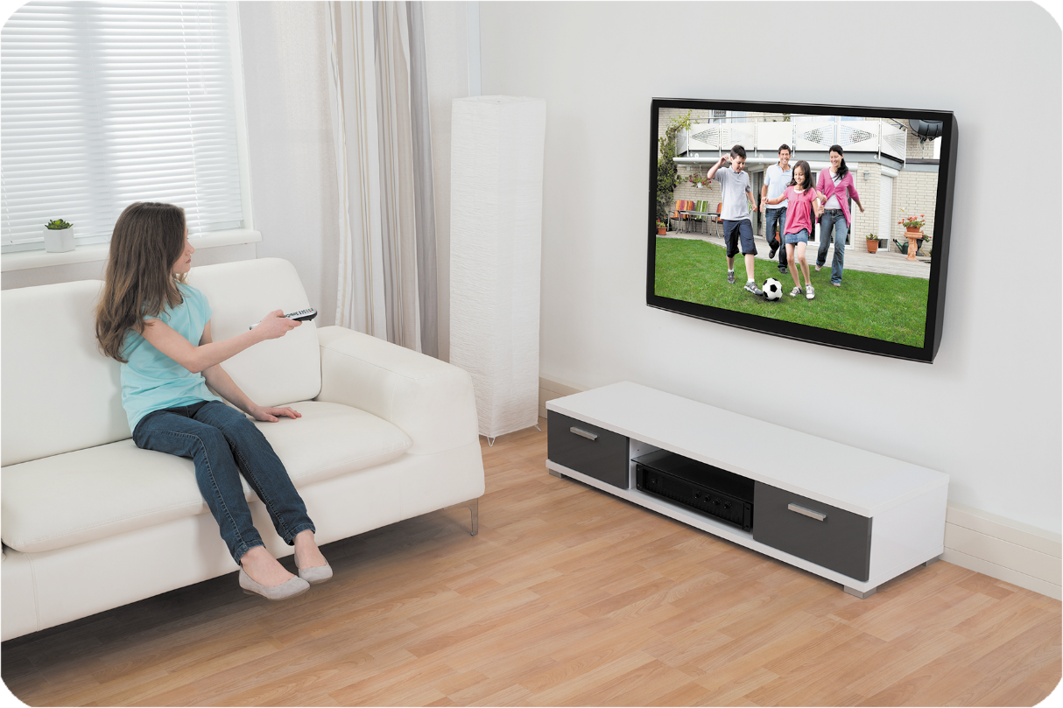
What are you doing?
I’m _____________.
Back
drawing a picture
B. watching TV
C. listening to music

Slide 23

What are you doing?
I’m _____________.
Back
A. playing
basketball
B. watching TV
C. drawing a picture

Slide 24
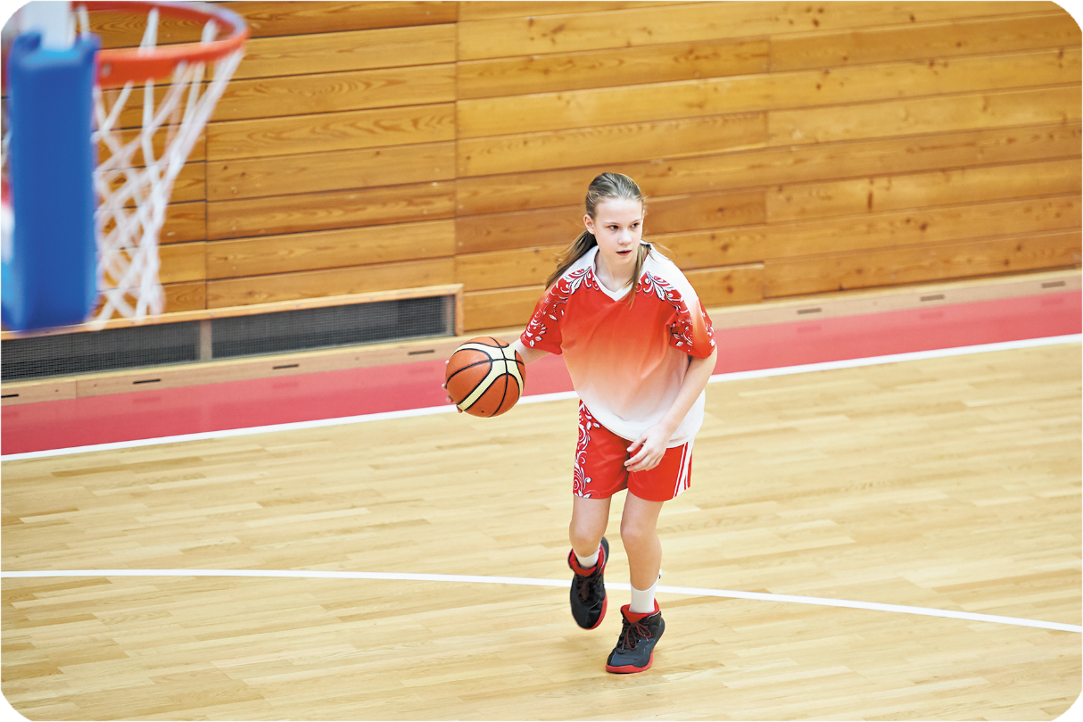
What are you doing?
I’m _____________.
Back
A. listening to music
B. playing
basketball
C. drawing a picture

Slide 25
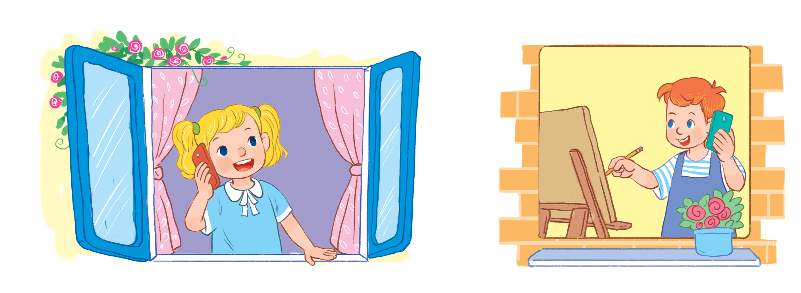
3
Let’s talk.

Slide 26
Review
What are you doing?
I’m _________________.
playing
basketball
drawing
a picture
listening
to music.
watching TV

Slide 27

Thank you!

