Slide 1
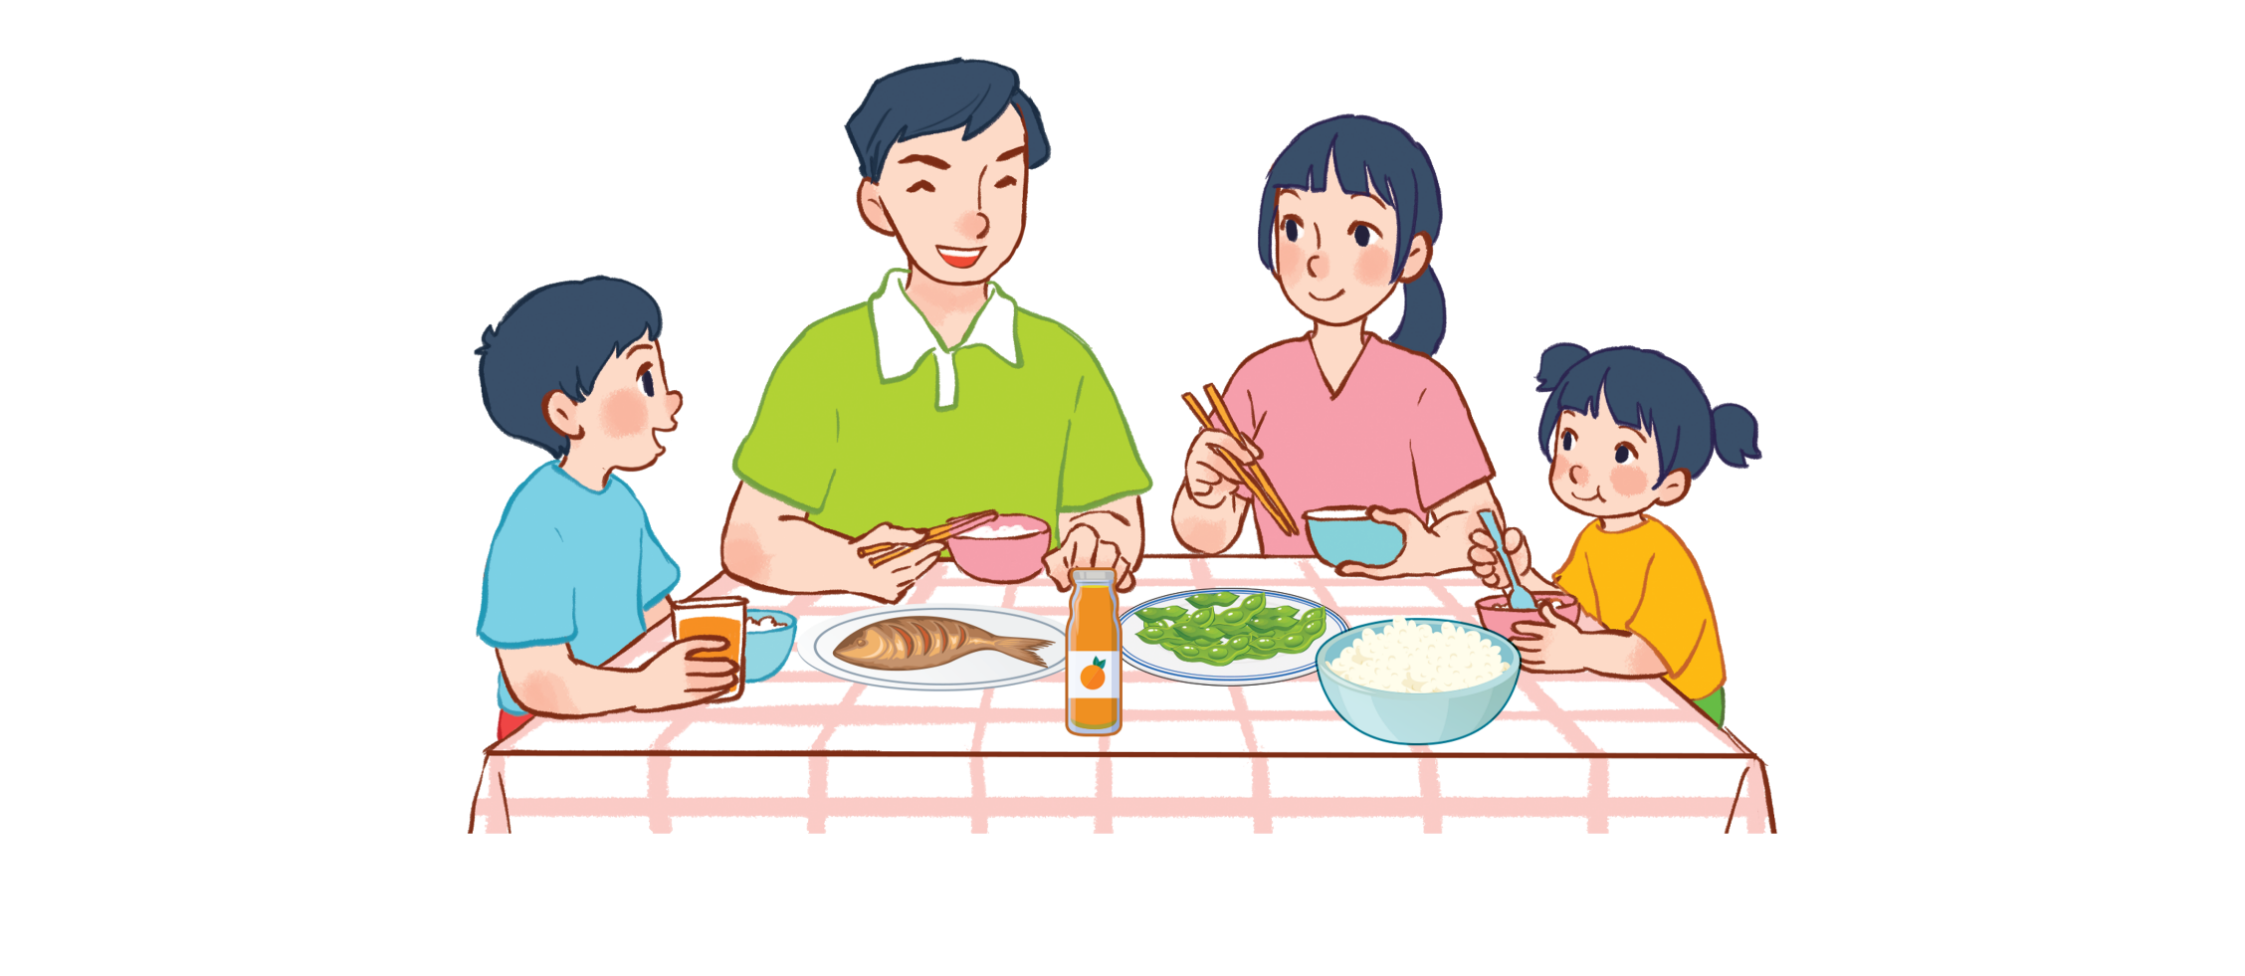
Unit 15
At the dining table
Lesson 3 - period 1
Teacher: Ha Thi Xuan Thu

