Slide 1

Unit 4 : Animals
Lesson 3.1: Vocabulary & Sentence Patterns
Page: 28

Slide 2
Lesson Outline
Warm-up
Vocabulary
Structure
Consolidation
Wrap-up

Slide 3
Objectives
By the end of this lesson, students will be able to identify animals and ask what animal it is, using ….
Vocabulary: duck, goat, pig, cow
Structure: What’s that?
It’s a (duck).

Slide 4

WARM UP

Slide 5

Let’s play!
Find the card
Notes:
Divide the class into teams.
Put some flashcards around the classroom.
Teacher call out a number.
Have students find the card.

Slide 6

It’s time to learn …

Slide 7

New words
duck,
goat,
pig,
cow

Slide 8

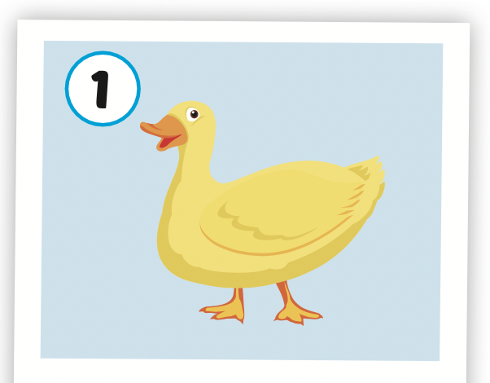

Click on the picture to hear the sound.
duck
/dʌk/
con vịt

Slide 9
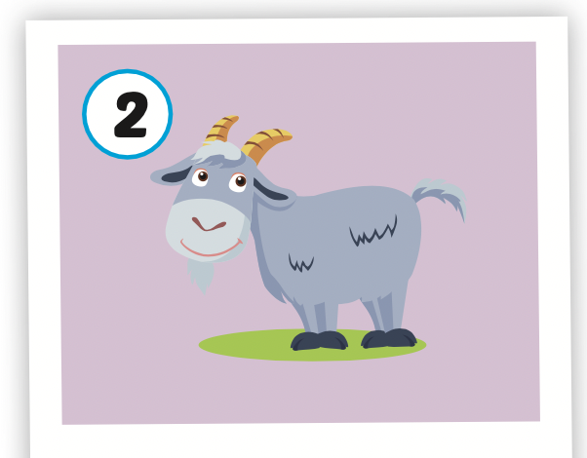
Click on the picture to hear the sound.
goat
/ɡoʊt/
con dê

Slide 10
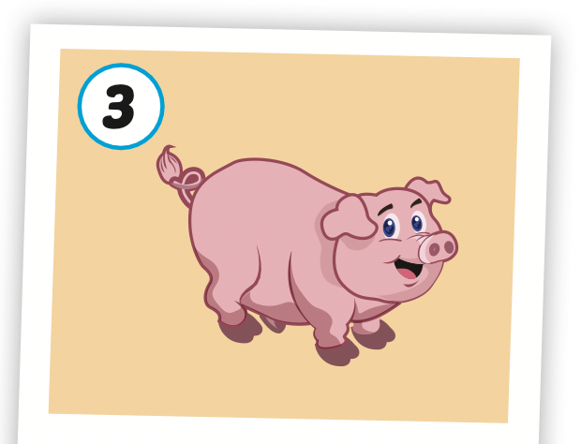
Click on the picture to hear the sound.
pig
/pɪɡ/
con lợn, con heo

Slide 11
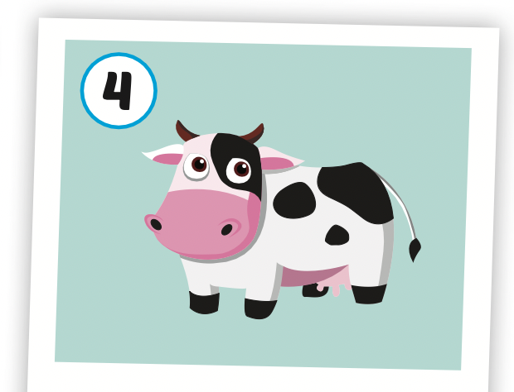
Click on the picture to hear the sound.
cow
/kaʊ/
con bò

Slide 12
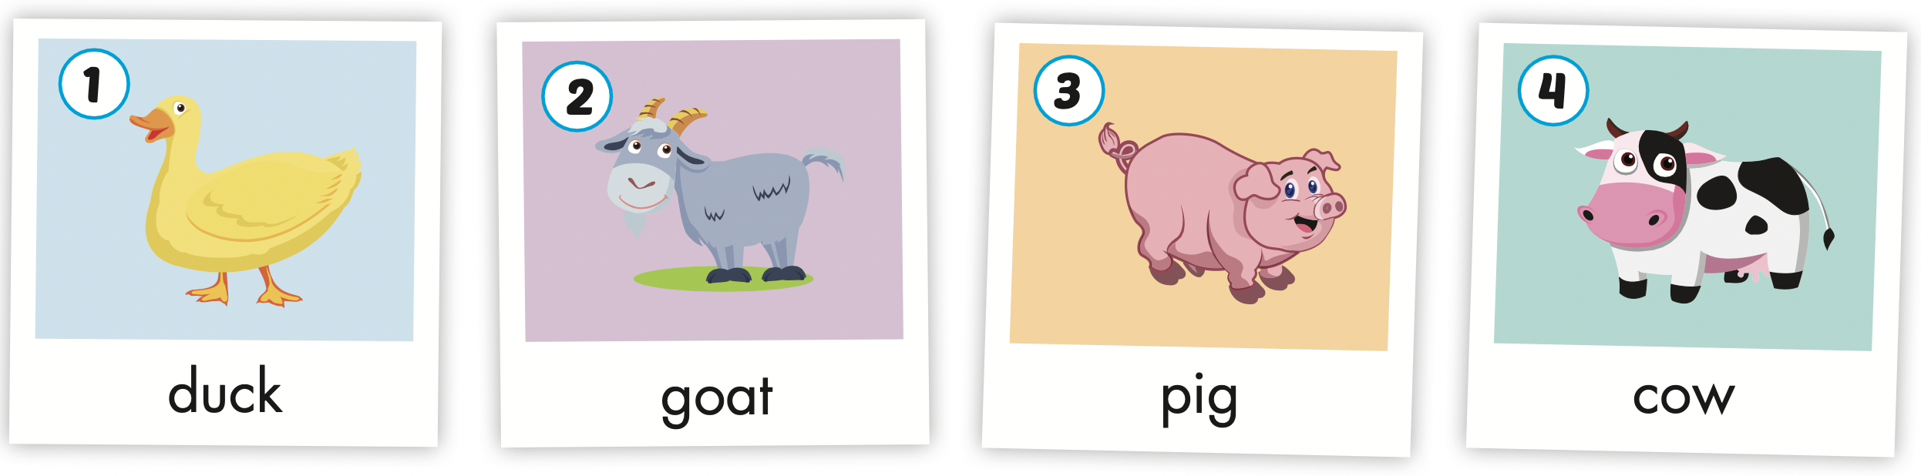
Click on the icon to hear the sound.

Slide 13
Let’s play!

Slide 14
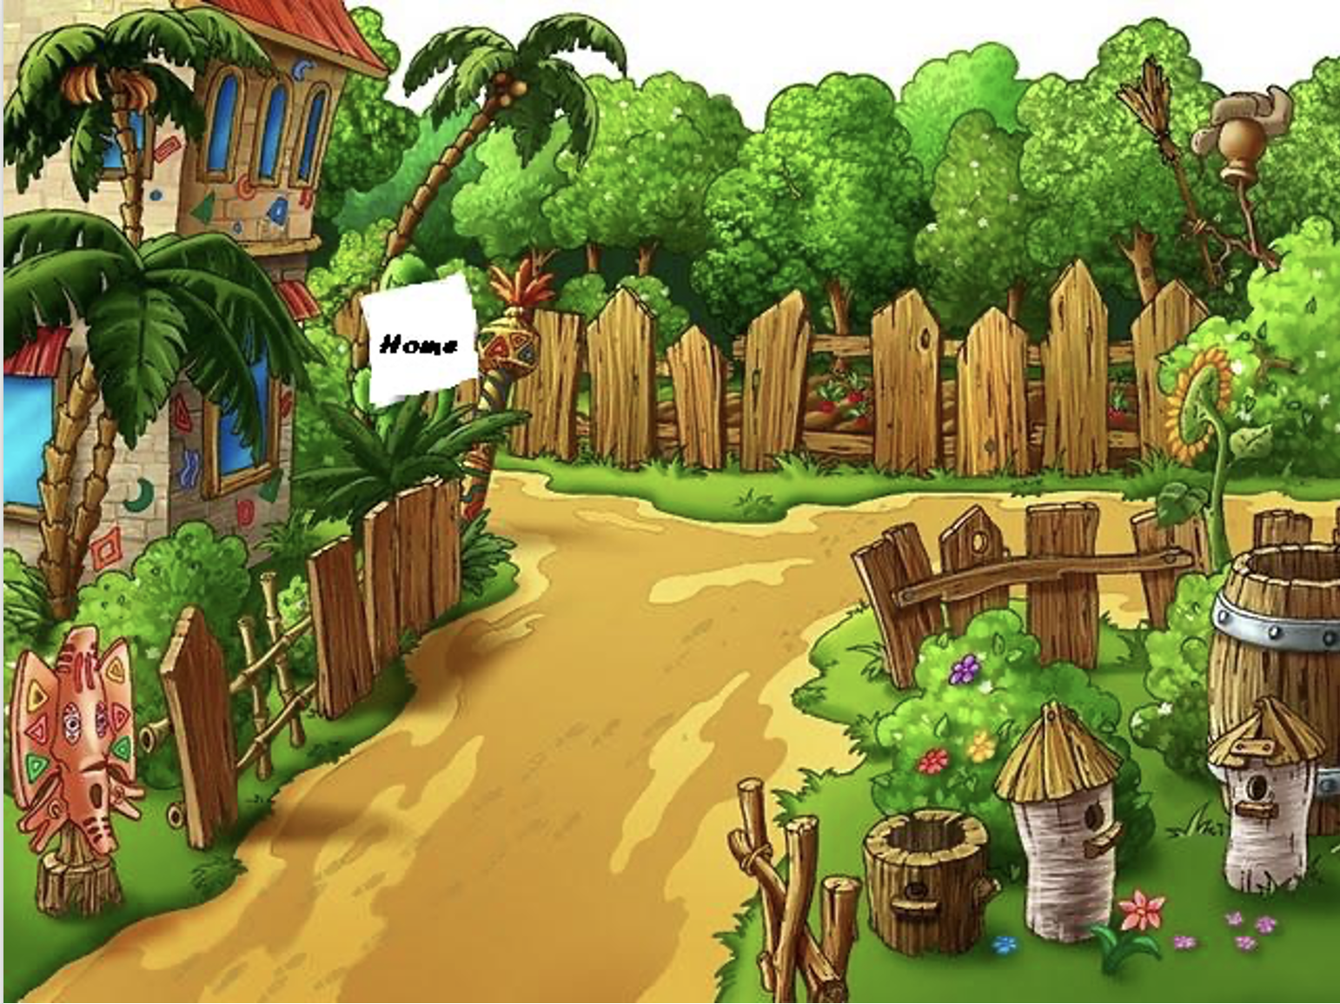
FARM ANIMALS

Slide 15
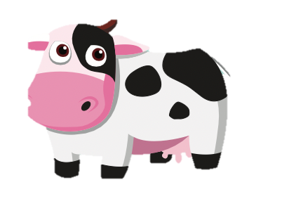
cow

Slide 16
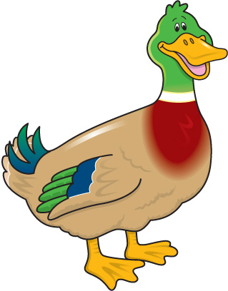
Duck

Slide 17
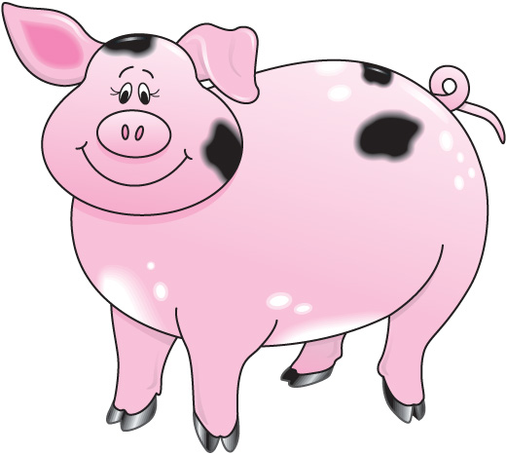
Pig

Slide 18
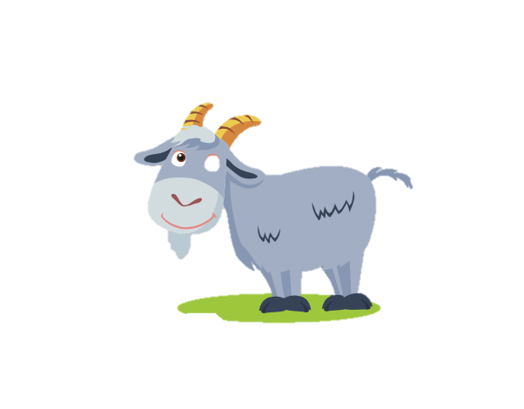
Goat

Slide 19
Structures
What’s that?
It’s a (duck).

Slide 20

Presentation

Slide 21

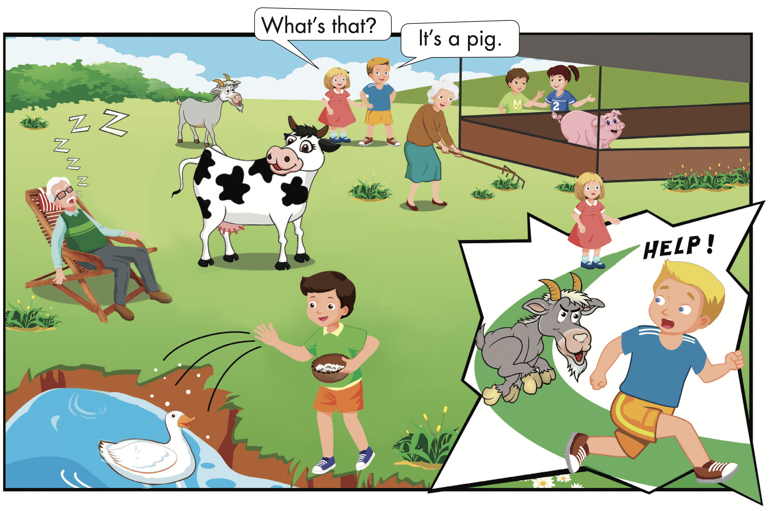

Slide 22

Practice

Slide 23



Slide 24
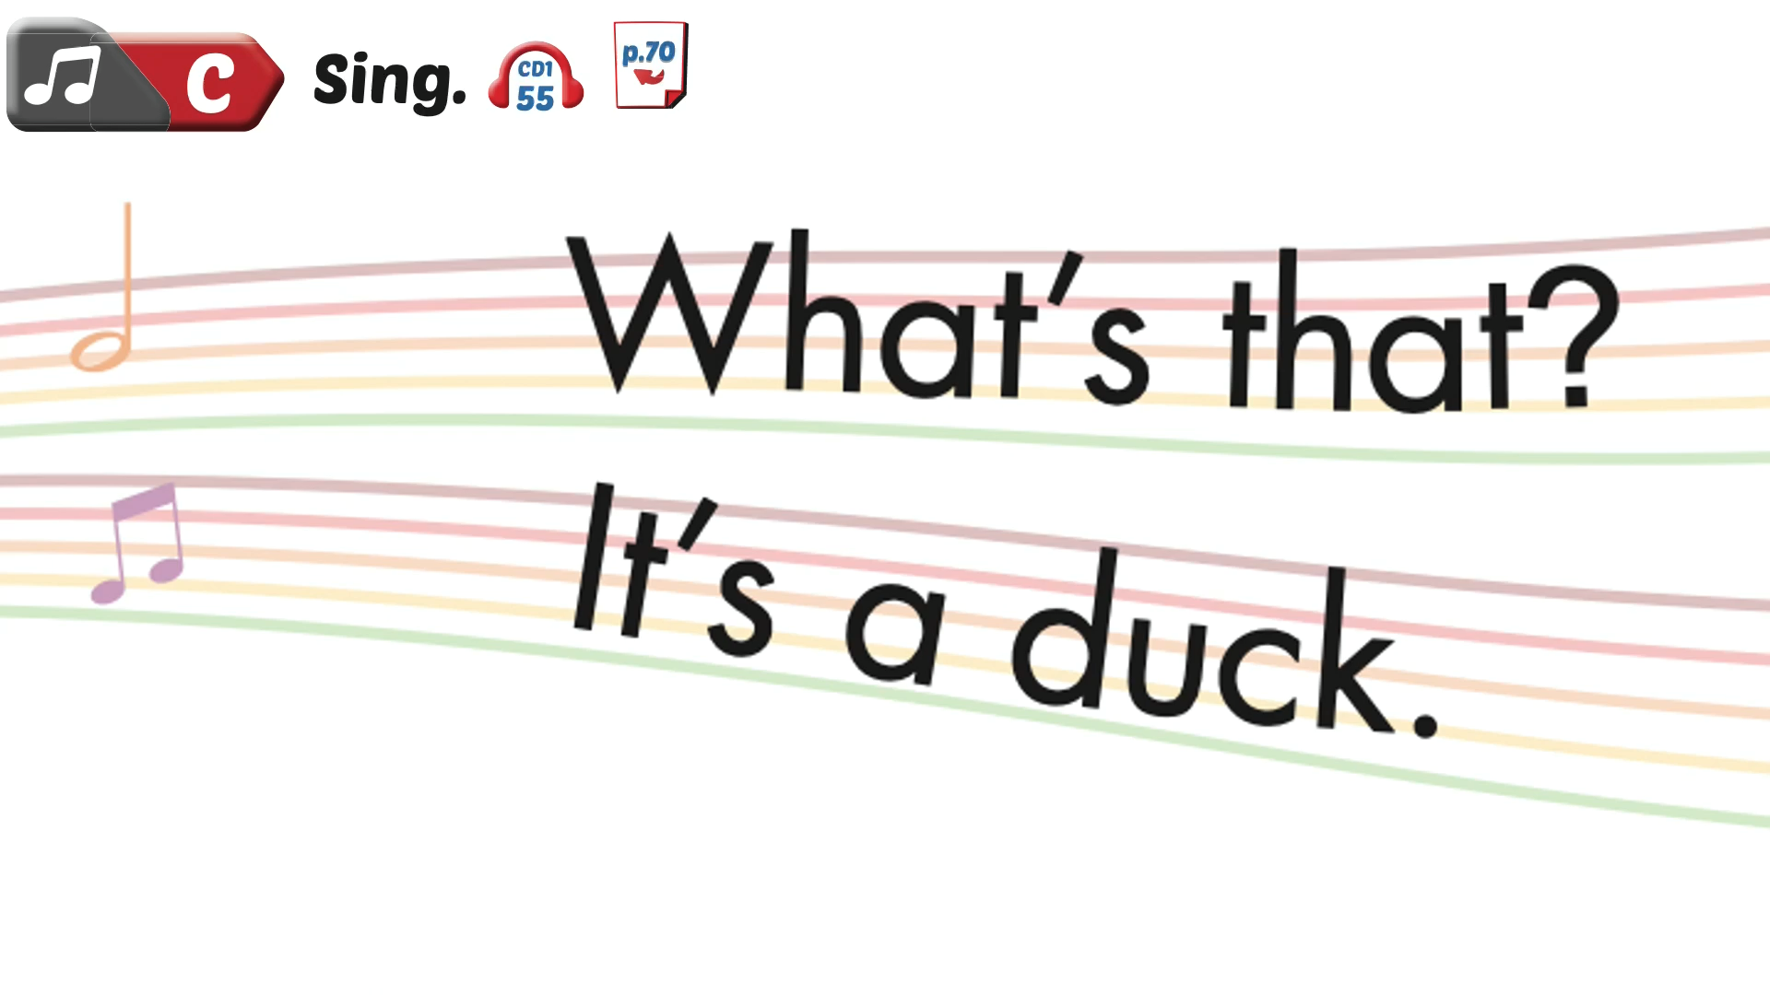

Slide 25

Production

Slide 26

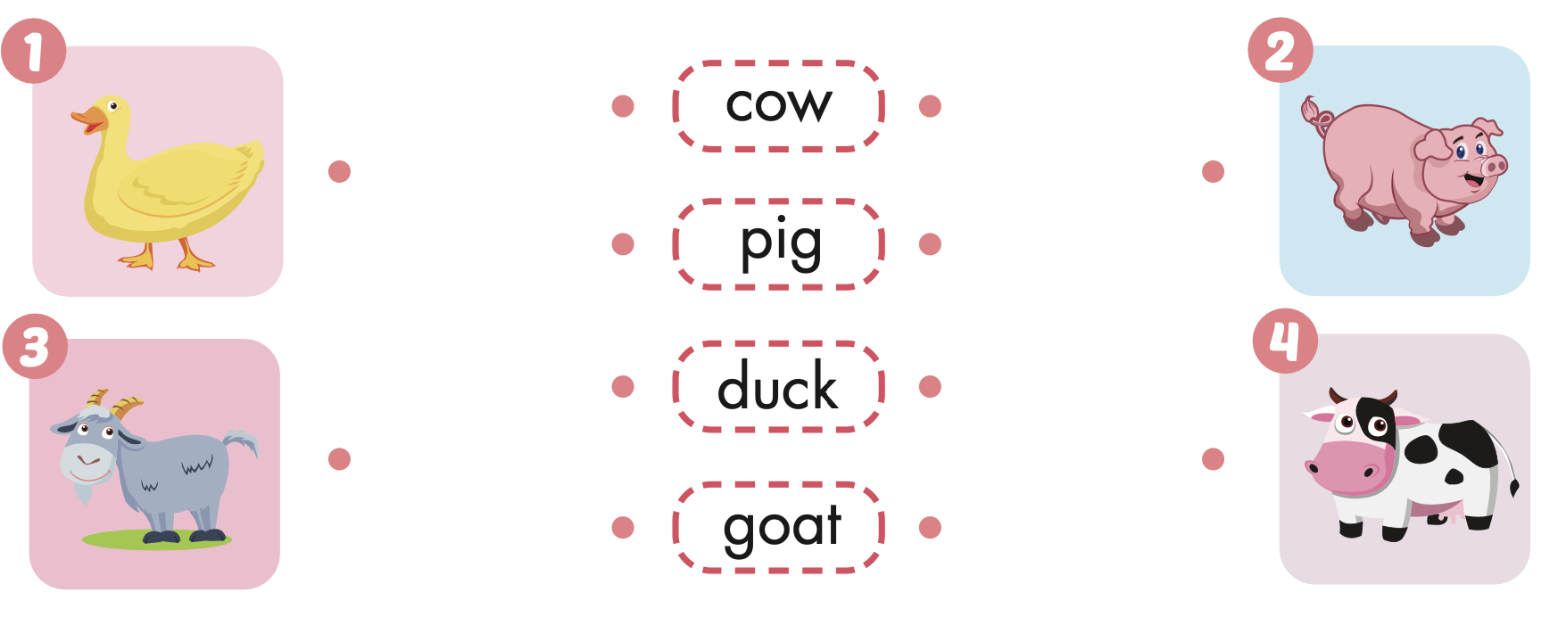
Extra Practice
WB, page 26

Slide 27
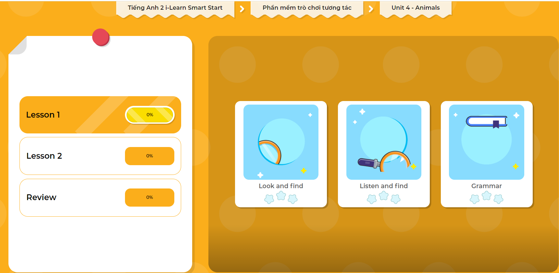
Extra Practice
DHA on Eduhome
LET’S PLAY!
Click on the picture below to play the games.

Slide 28

CONSOLIDATION

Slide 29
How to play

Slide 30

WRAP-UP

Slide 31
Lesson 3
Today’s lesson
Vocabularies
duck, goat, pig, cow
Structures/ Sentence patterns
What’s that?
It’s a (duck).

Slide 32
Homework
Practice the vocabularies and structure; and make sentences using them.
Do the exercises in Tiếng Anh 2 i-Learn Smart Start WB (page 26)
Do the exercises in Tiếng Anh 2 i-Learn Smart Start Notebook (page 24)
Prepare the next lesson (page 29 SB)
Play the consolidation games in Tiếng Anh 2 i-Learn Smart Start DHA App on www.eduhome.com.vn

Slide 33

Enjoy your day!

Slide 34
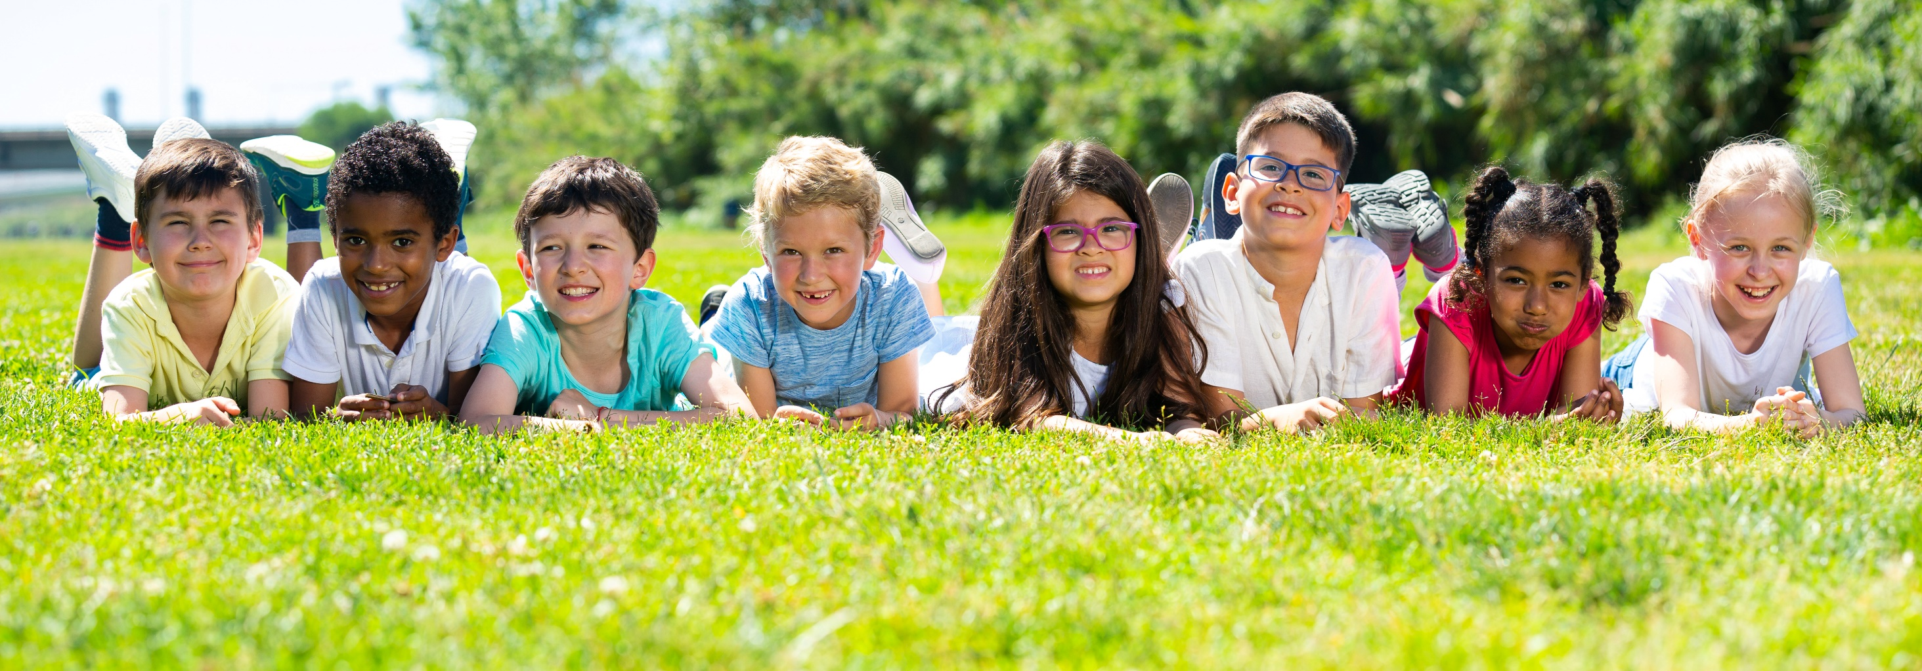
Have a nice day!

