Slide 1

Unit 4 : Animals
Lesson 2.2: Phonics
Page: 31

Slide 2
Lesson Outline
Warm-up
Listening
Production
Consolidation
Wrap-up

Slide 3
Objectives
By the end of this lesson, students will be able to recognize the /r/, /s/ sounds and pronounce them correctly.
Vocabulary: rabbit, robot, sea, sun
Phonics: /r/, /s/

Slide 4

WARM UP

Slide 5

Let’s play!
Guess the word
Notes:
Divide the class into teams.
Write a word on the board with several letters missing.
Have each team take turns calling out a letter.
Add the missing letters to the word if correctly guessed.

Slide 6
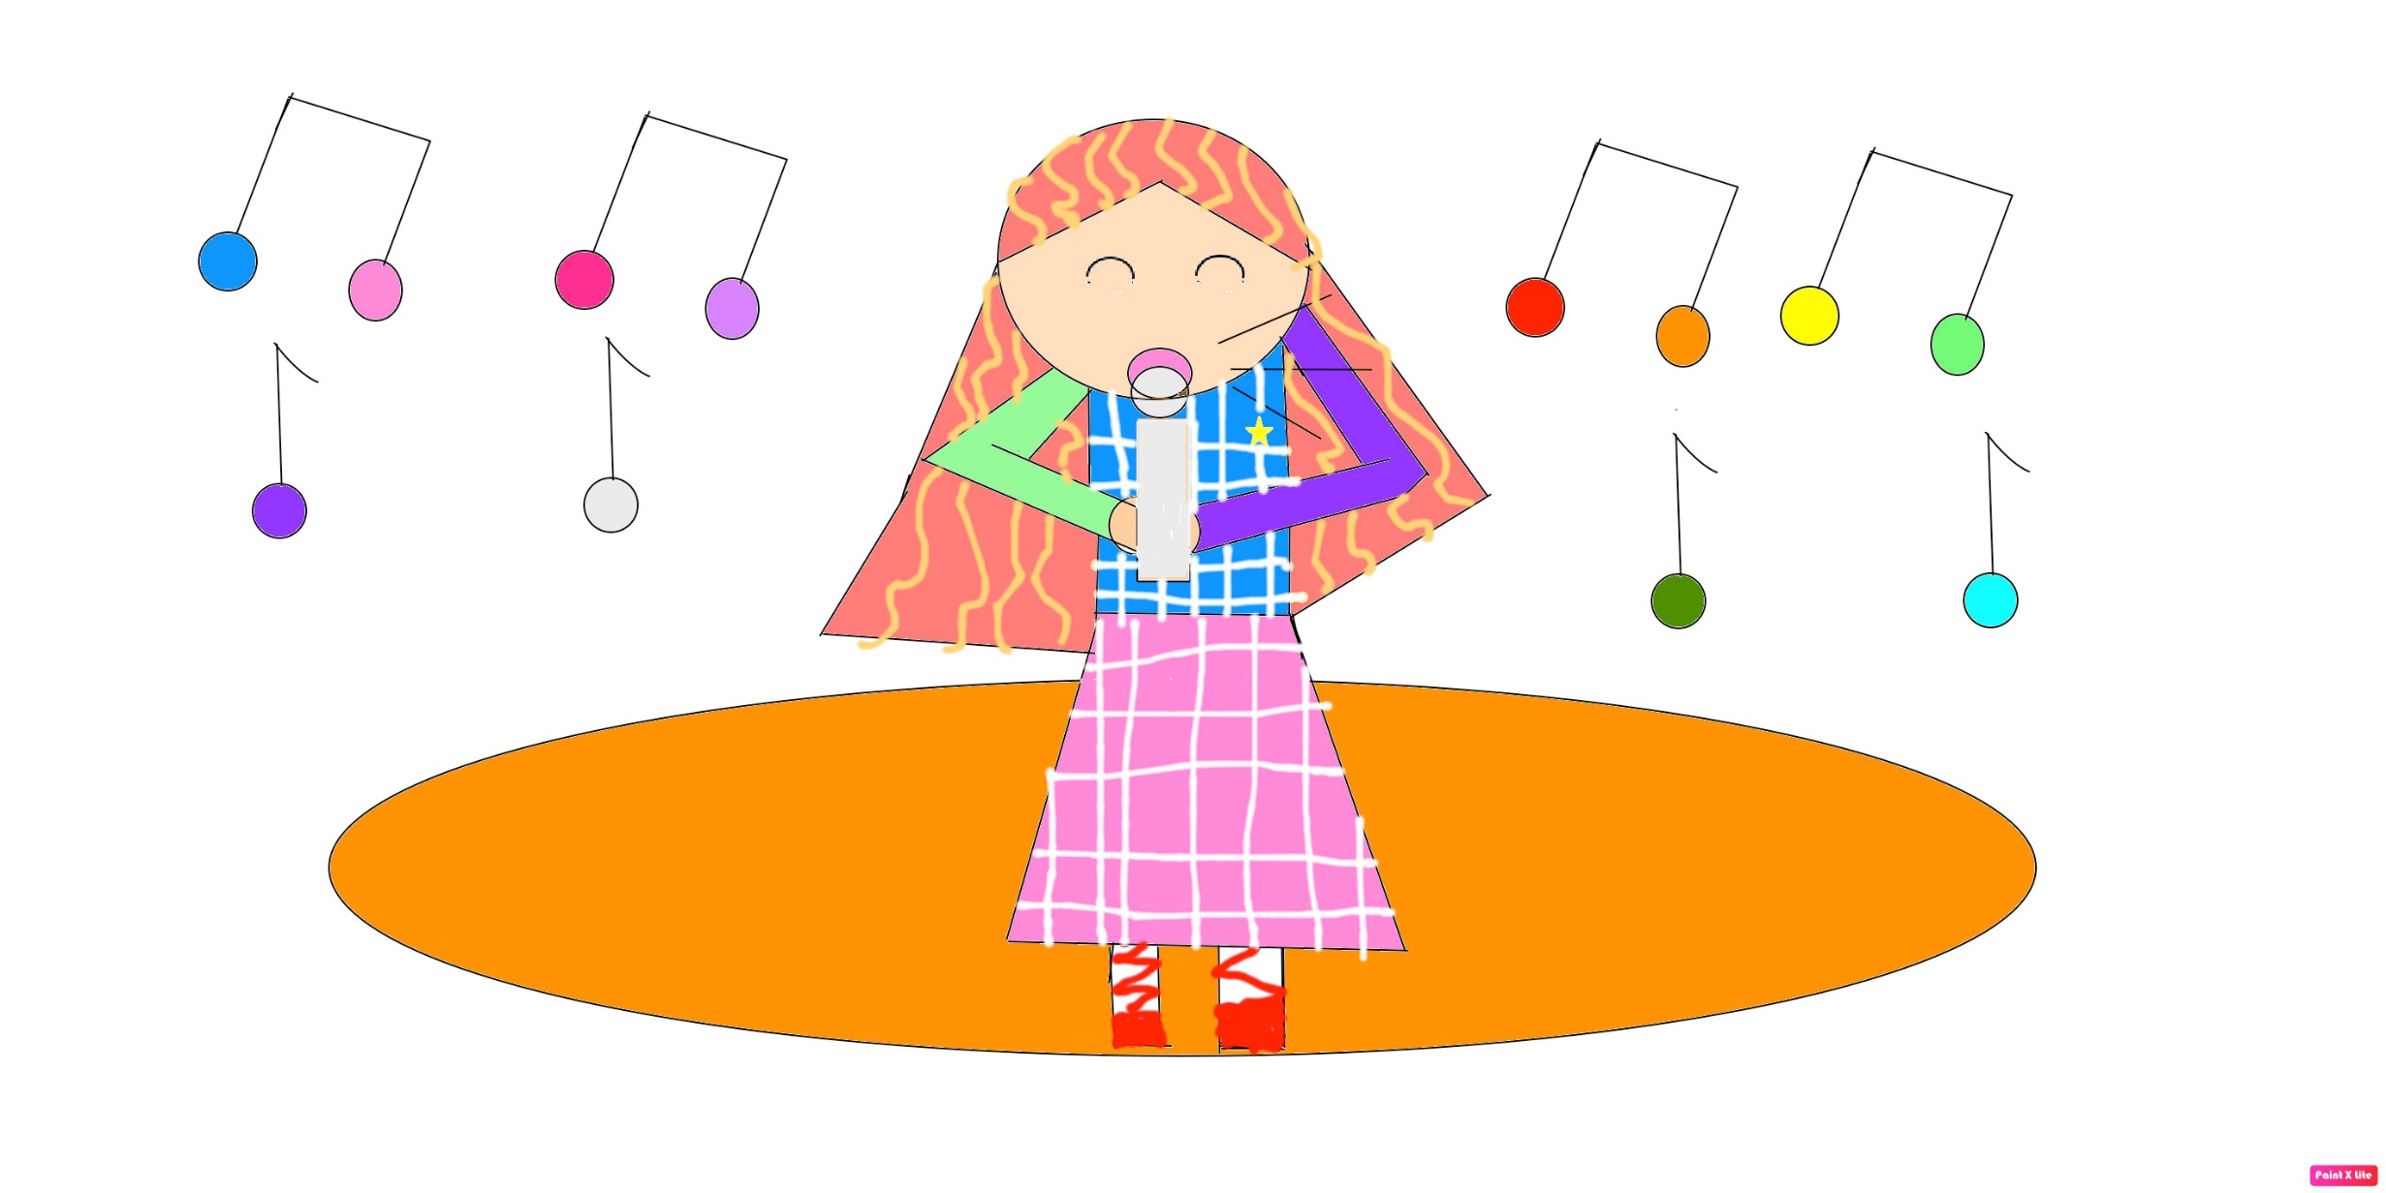
Let’s sing!

Slide 7


Alphabet song

Slide 8

It’s time to learn …

Slide 9

Phonics
/r/,
/s/,

Slide 10

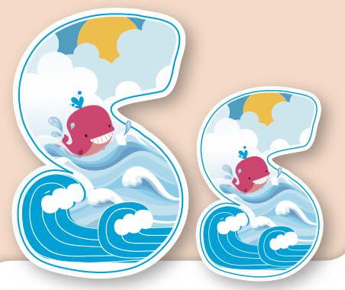
Click on the icon to hear the sound.
/s/

Slide 11
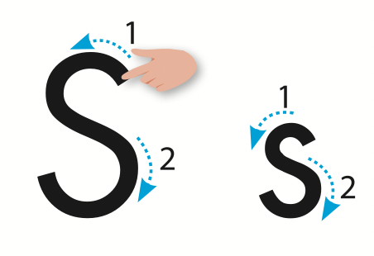
Let’s trace!

Slide 12

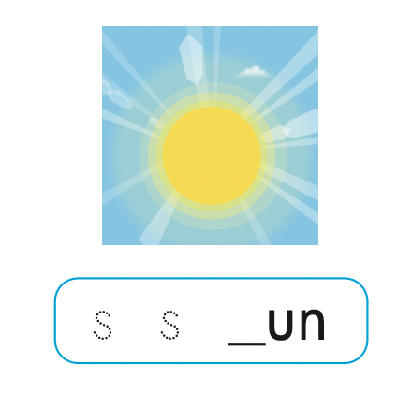
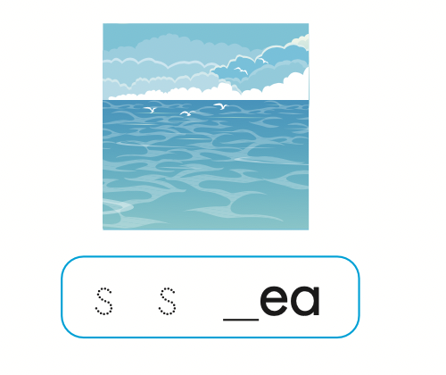
Click on the icon to hear the sound.
sea
sun
/s/
/s/

Slide 13
Let’s write!

Slide 14

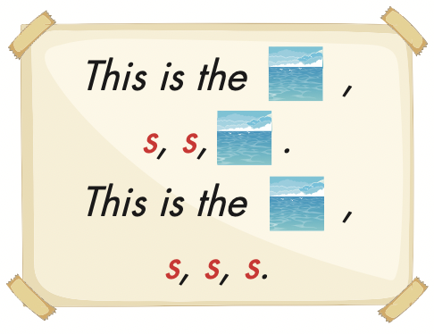

Slide 15

LISTEN and CHOOSE THE CORRECT WORD.

Slide 16

/r/
/s/

Slide 17
/r/
/s/

Slide 18

snake
rabbit

Slide 19
robot
snow

Slide 20
sea
rice

Slide 21
run
sun

Slide 22
GOOD JOB.

Slide 23

Production

Slide 24
Let’s play!

Slide 25



Slide 26
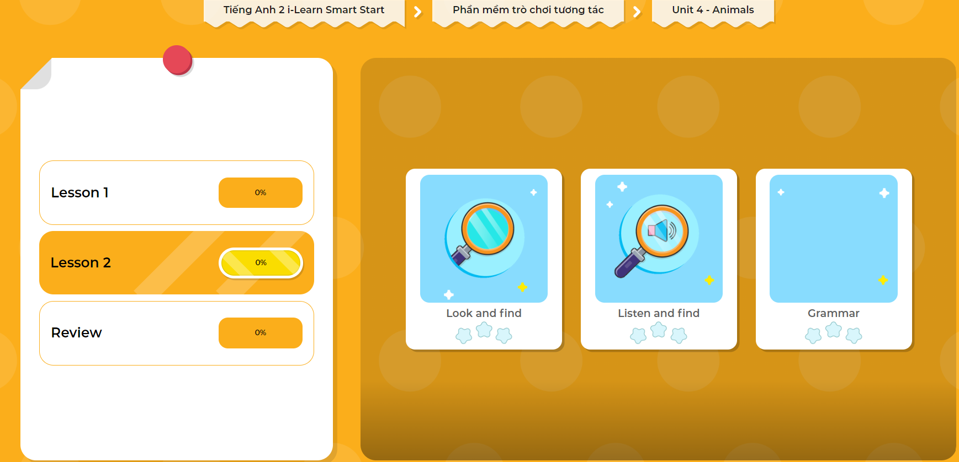
Extra Practice
DHA on Eduhome
LET’S PLAY!
Click on the picture below to play the games.

Slide 27

CONSOLIDATION

Slide 28

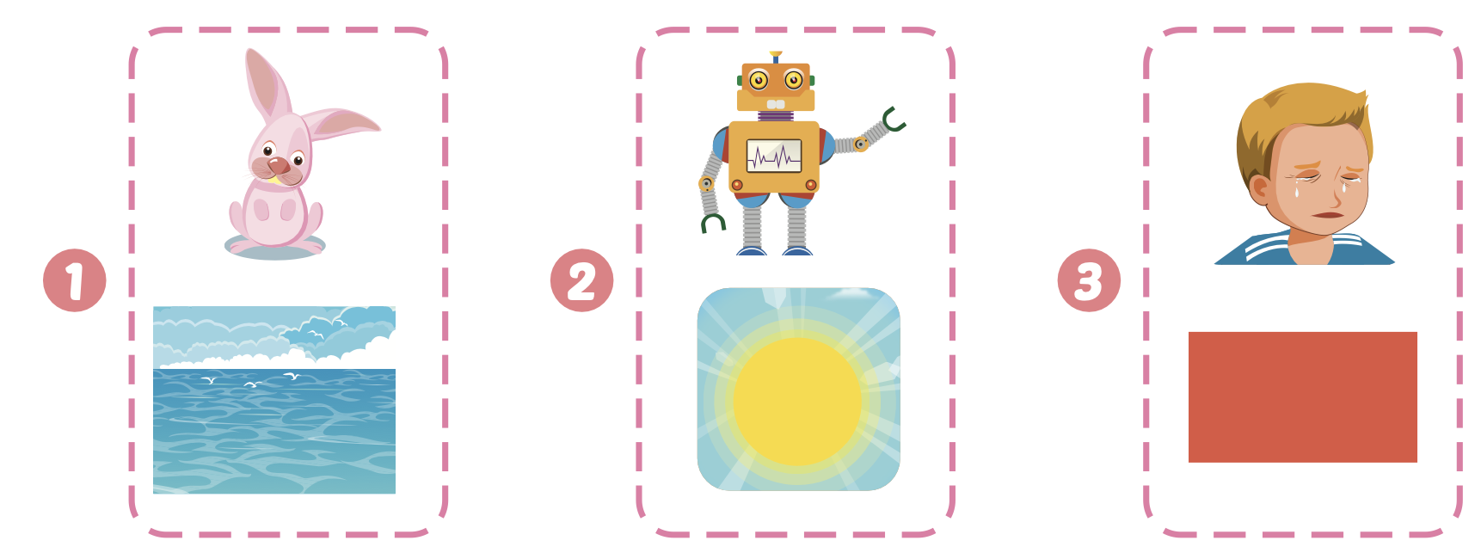
Extra Practice
WB, page 29

Slide 29

WRAP-UP

Slide 30
Lesson 3
Today’s lesson
Vocabularies
Rabbit, robot, sea, sun
Phonics
/r/, /s/

Slide 31
Lesson 3
Homework
Practice the /r/, /s/ sounds
Do the exercises in Tiếng Anh 2 i-Learn Smart Start WB (page 29)
Do the exercises in Tiếng Anh 2 i-Learn Smart Start Notebook (page 27)
Prepare the next lesson (page 32 SB)
Play the consolidation games in Tiếng Anh 2 i-Learn Smart Start DHA App on www.eduhome.com.vn

Slide 32

Enjoy your day!

Slide 33

Have a nice day!

