Slide 1
MsPham
0936082789
Unit 1
All about me
MsPham
0936082789
Lesson 3 – Part 4,5,6

Slide 2
Table of contents
01
Warm-up and review
02
Read and circle.
MsPham
0936082789
03
Let’s write.
04
Project
05
Fun corner and wrap-up
https://www.facebook.com/msphampowerpoint

Slide 3
MsPham
0936082789
1.
MsPham
0936082789
Warm-up
https://www.facebook.com/msphampowerpoint

Slide 5
MsPham
0936082789
2.
Read and circle
MsPham
0936082789
https://www.facebook.com/msphampowerpoint

Slide 6
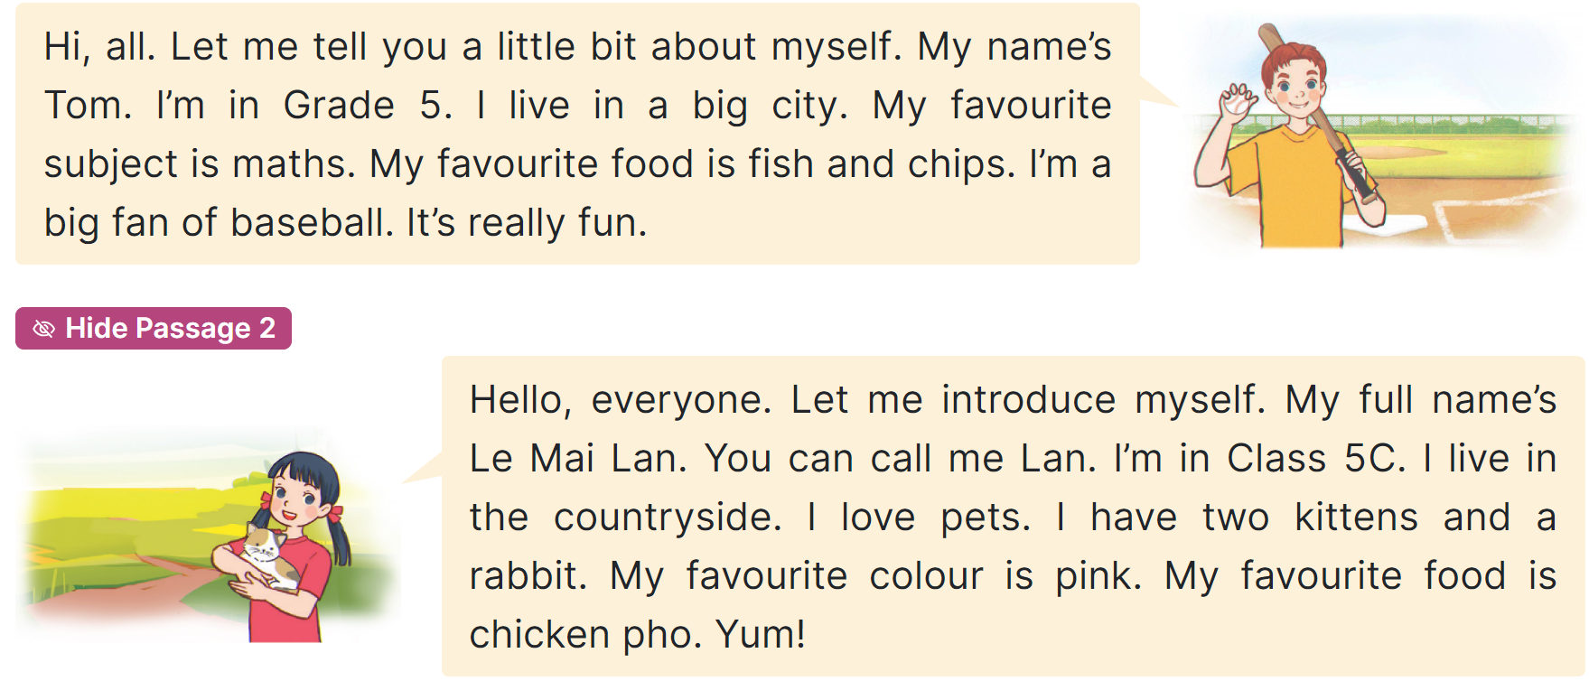
Read
MsPham
0936082789
MsPham
0936082789
https://www.facebook.com/msphampowerpoint

Slide 7
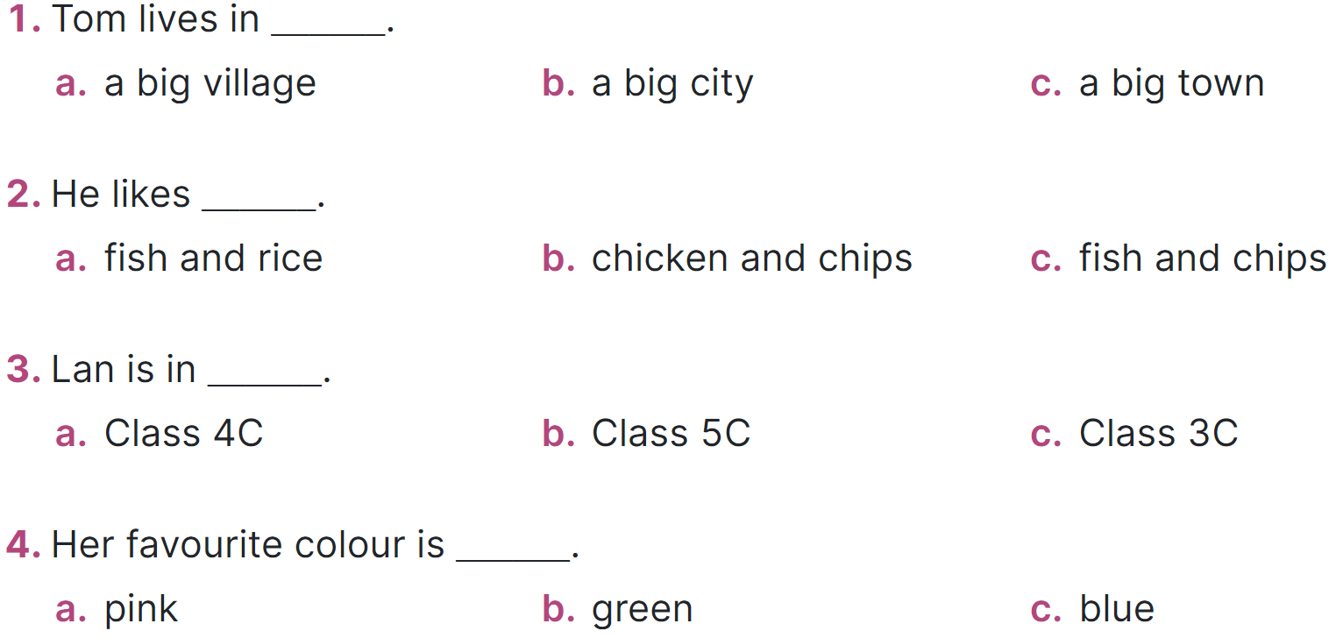
Read and circle
MsPham
0936082789
MsPham
0936082789
https://www.facebook.com/msphampowerpoint

Slide 8
MsPham
0936082789
3.
MsPham
0936082789
Let’s write!
https://www.facebook.com/msphampowerpoint

Slide 9
Let’s write
My name is __________. I live in the _________________.
I am in Class _______. My favourite sport is ___________. My favourite food is _____________. My favourite colour is _____________. My favourite animal is ____________.
What about you? What are your favourite things?
MsPham
0936082789
https://www.facebook.com/msphampowerpoint

Slide 10
MsPham
0936082789
4.
MsPham
0936082789
Project
https://www.facebook.com/msphampowerpoint

Slide 11
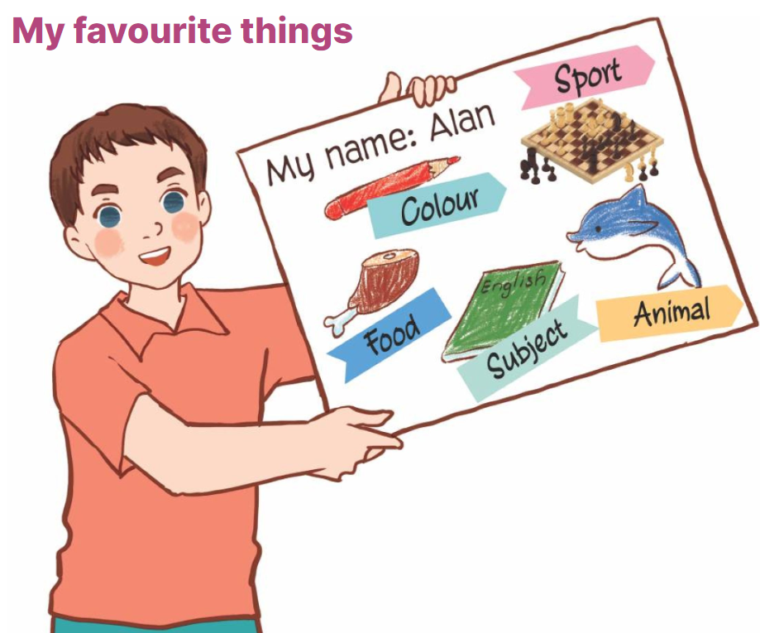
Project
My favourite colour is red.
MsPham
0936082789
https://www.facebook.com/msphampowerpoint

Slide 12
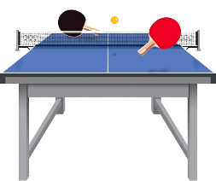
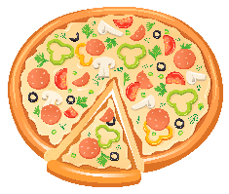
My favourite things
Ms.
HuyenPham
My name is Ms.Huyen.
I am in Class 5A.
My favourite
animal is rabbit.
Hello. Let me tell
you about myself.
I live in
the City.
My favourite
sport is table tennis.
My favourite
subject is English.
My favourite
colour is Green.
My favourite
food is Pizza.

Slide 13
Your favourite things
Ms.
HuyenPham
My name is _______.
I am in Class ___.
My favourite
animal is _______.
Hello. Let me tell
you about myself.
I live in
the _____.
My favourite
sport is _______.
My favourite
subject is _______.
My favourite
colour is _______.
My favourite
food is _______.
What about you? What are your favourite things?

Slide 14
MsPham
0936082789
5.
Fun corner &
Wrap - up
MsPham
0936082789
https://www.facebook.com/msphampowerpoint

Slide 15
Fill the
missing letter

Slide 16
Ms.
HuyenPham
Check
Next
My ______ is Ms.Pham
name
go

Slide 17
Check
Next
My favourite _______ is green.
colour
go

Slide 18
Check
Next
My favourite _______ is English.
subject
go

Slide 19
Check
Next
My favourite _______ is pizza.
food
go

Slide 20
Check
Next
My favourite _______ is table tennis.
sport
go

Slide 21
Check
Next
My favourite _______ is rabbit.
animal
go

Slide 22
Check
Next
I _____ in the city.
live
go

Slide 23
Check
Next
I _____ in Class 5 A.
am
go

Slide 24
You’re welldone!

Slide 25
MsPham
0936082789
Thank you!
MsPham
0936082789
For joining!

