Slide 2
9
Colours
LESSON 2
Period 3

Slide 3
01
Warm-up and review

Slide 4
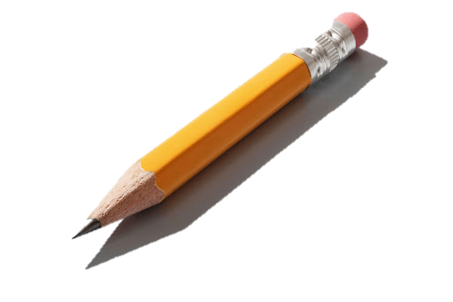
a pencil
pencils

Slide 5
an eraser
erasers

Slide 6
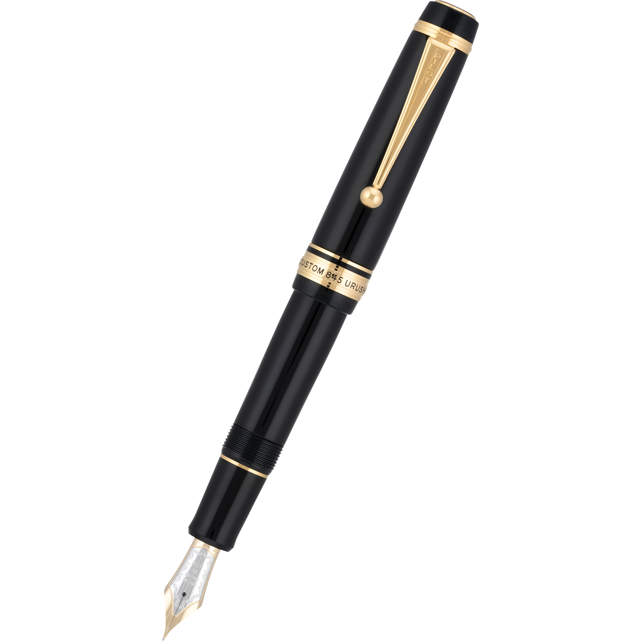
a pen
pens

Slide 7
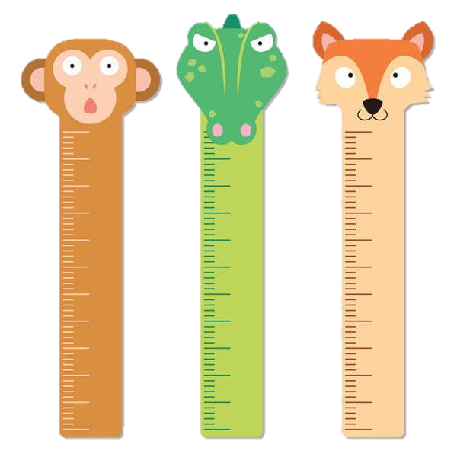
a ruler
rulers

Slide 8
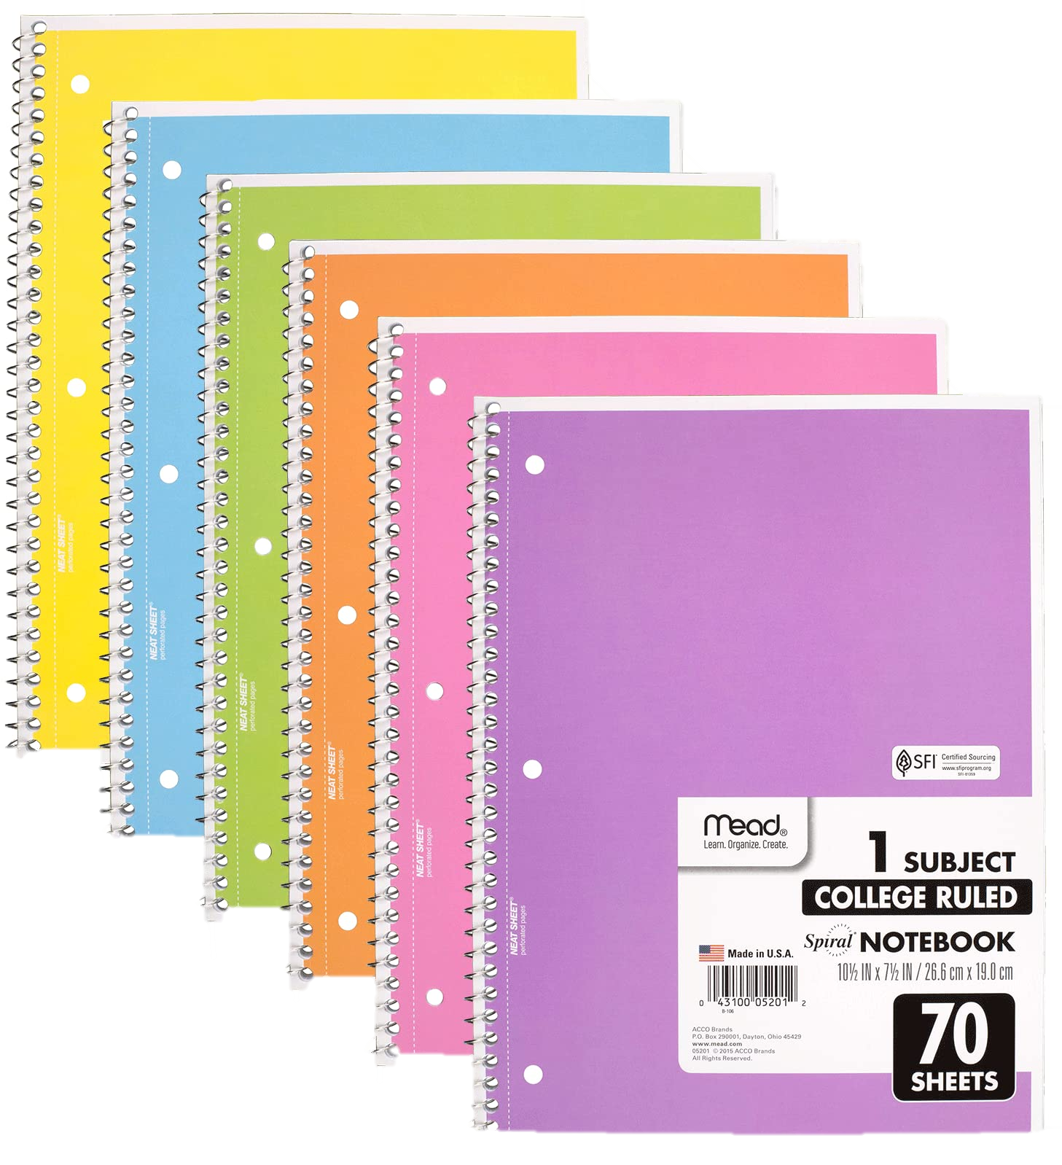
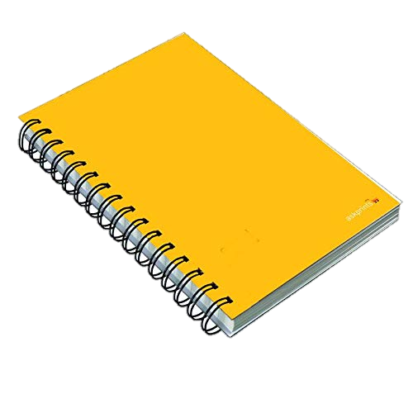
a notebook
notebooks

Slide 9
a book
books

Slide 10
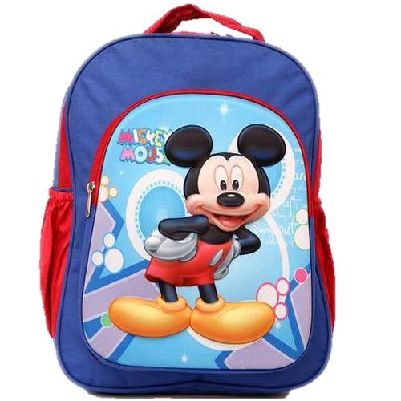
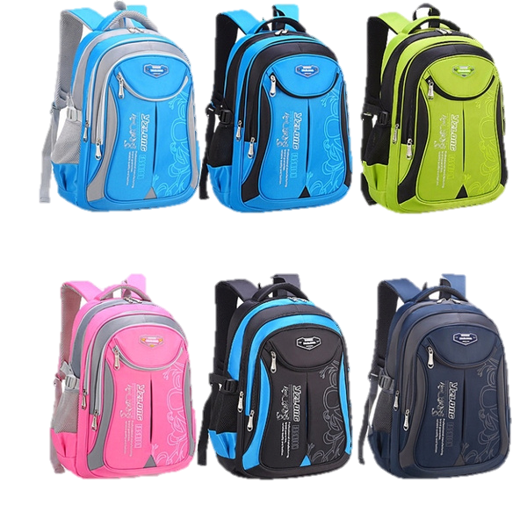
a school bag
school bags

Slide 11
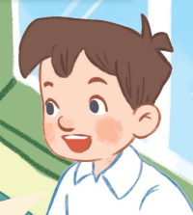
Do you have ......................?
erasers
Yes, I do.

Slide 12
Do you have ......................?
pencils
Yes, I do.

Slide 13
Do you have ......................?
pens
Yes, I do.

Slide 14
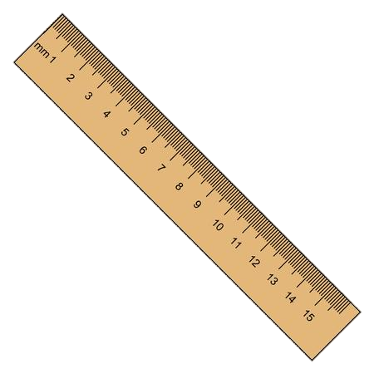
Do you have ......................?
rulers
Yes, I do.

Slide 15
Look, listen and repeat.

Slide 16
What colour are they?
What are these?
They are green.
They are pencils.

Slide 17
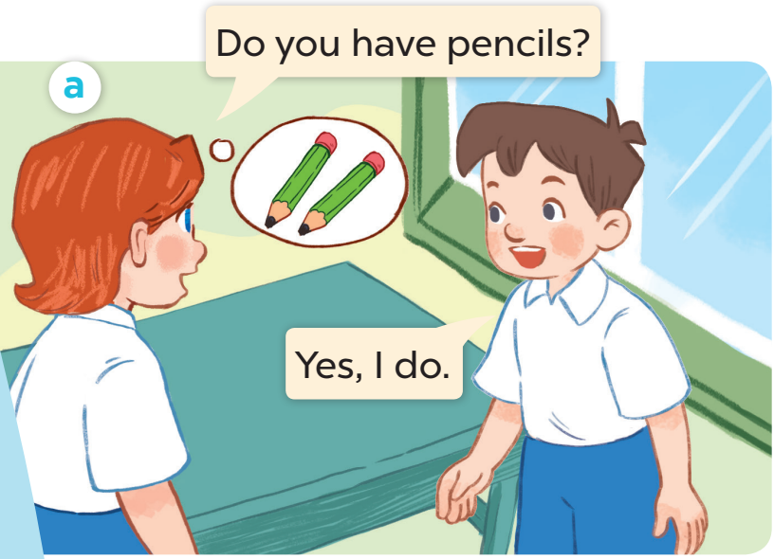
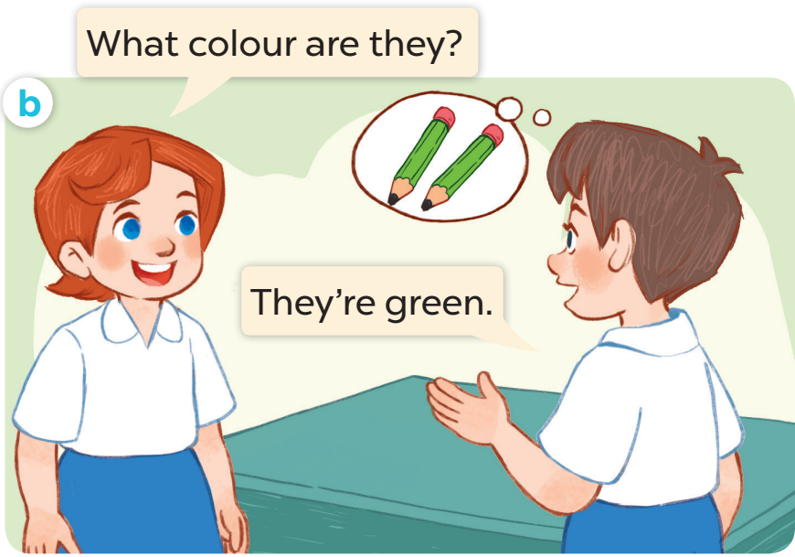

Slide 18
Listen, point and say.

Slide 19
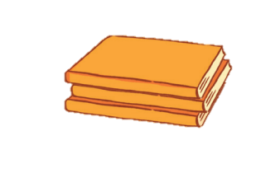
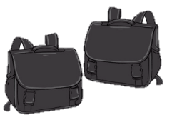
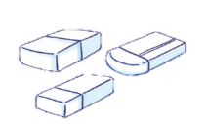
Orange
Green
White
Black

Slide 20
Let’s talk.

Slide 21
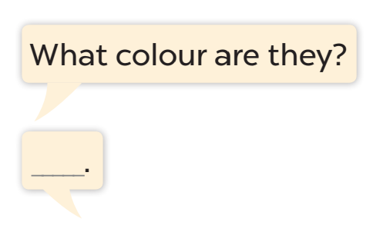
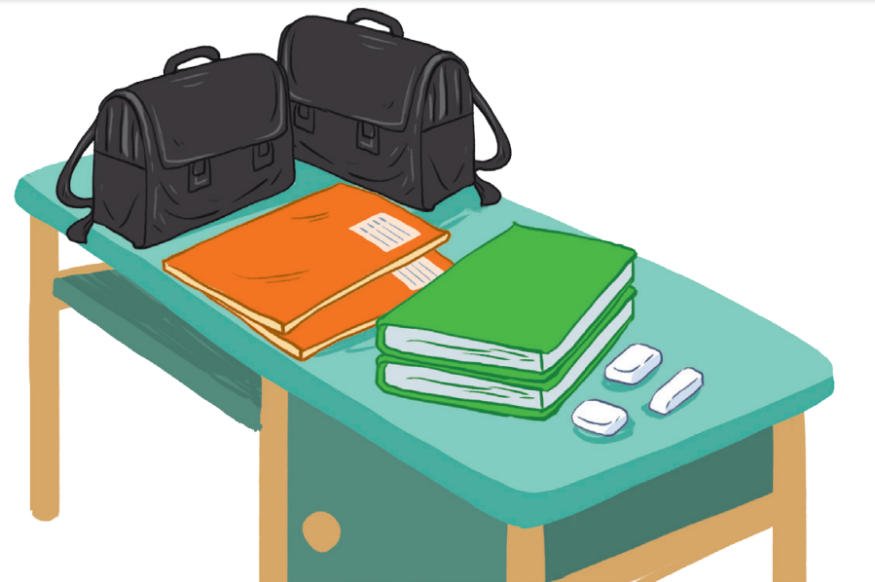

Slide 22
Fun corner and wrap-up

Slide 23
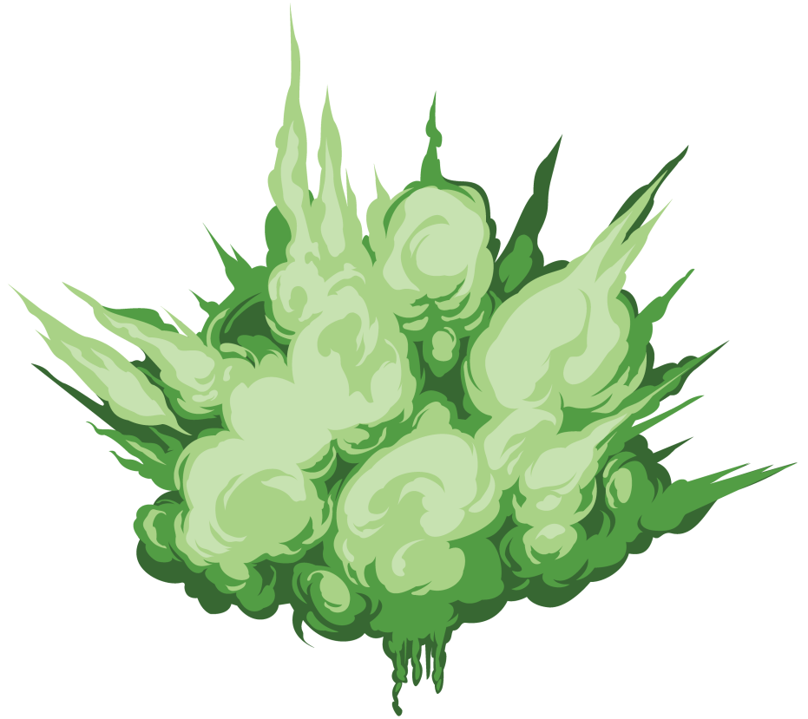
A
B
C
D
1
-1
Choose 1 box to open. Beware of bombs or dynamites.
Green Gem +1pt
Purple Gem +5pts
Trophy +10 pts
Crying face -3 pts
2
-5
3
4
-2
Notes:
Game: Lucky number
Divide the class into groups of 2 (boys and girls).
Each team then chooses a pair of number and letter.
For example: 1 A. Then they must identify the picture number 1 and color A. Two students in the team will have a dialog “what color are the notebooks?” and the answer must be “they are pink”.
The group with more points at the end of the game will be the winner.

