Slide 1
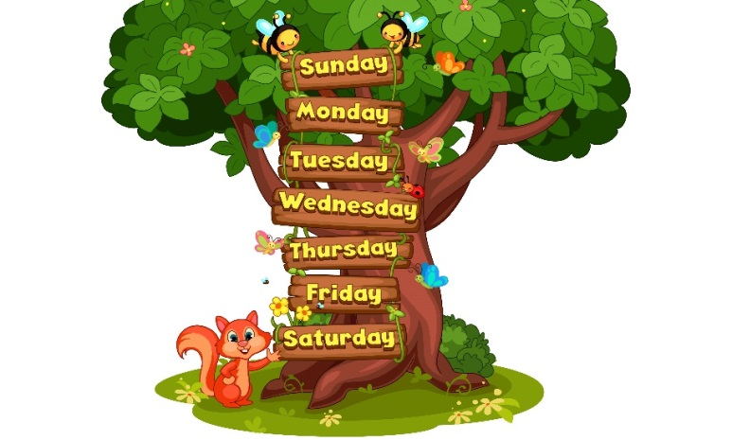
My week
Unit
3
Lesson 1

Slide 2
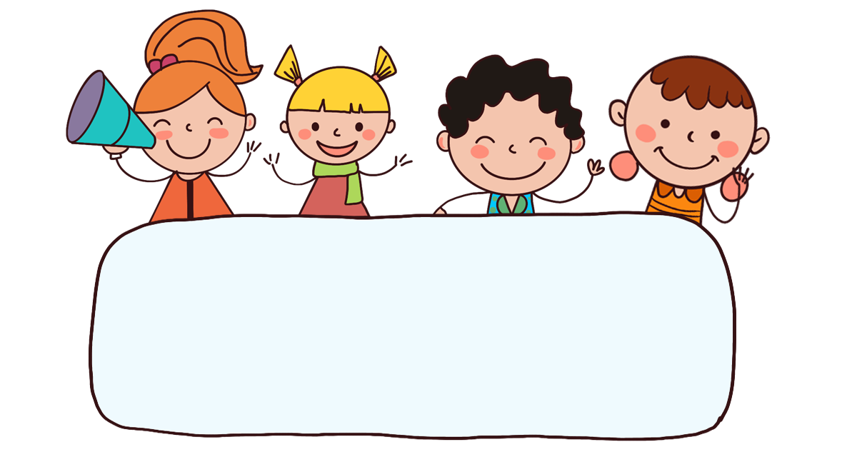
Warm-up

Slide 3
Let’s sing!

Slide 4




Slide 5


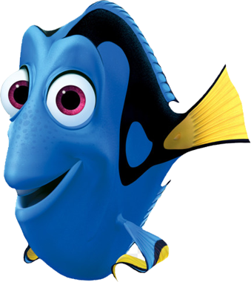




What day is it today?
It’s Thursday
It’s Monday.
It’s Sunday.

Slide 6
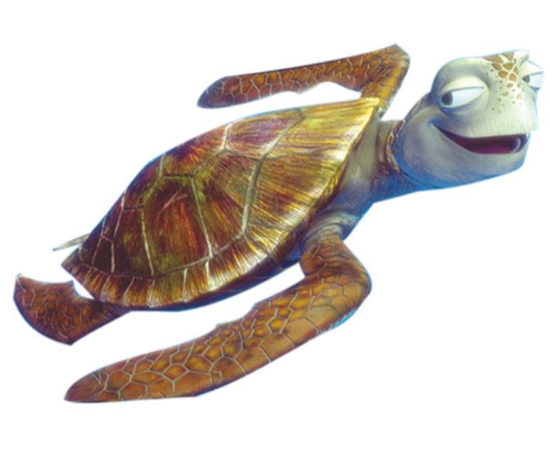
What day is it today?
It’s Wednesday.
It’s Saturday.
It’s Tuesday.

Slide 7
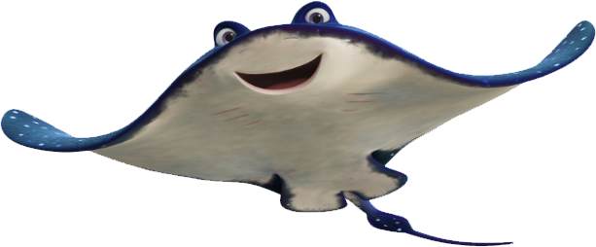
What day is it today?
It’s Sunday.
It’s Wednesday.
It’s Friday.

Slide 8
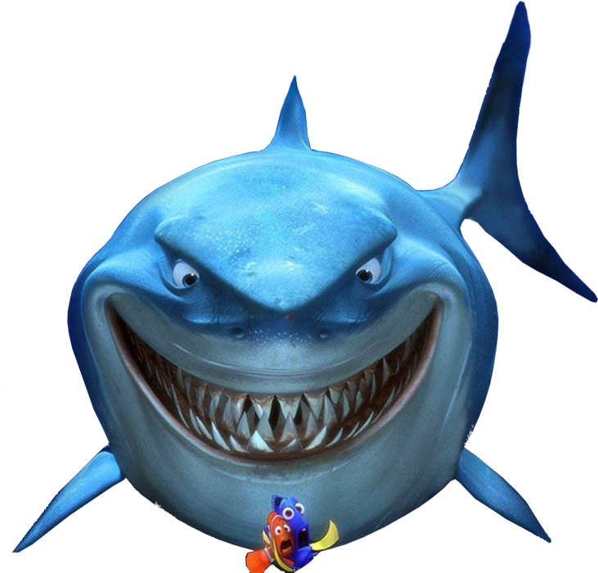
What day is it today?
It’s Monday.
True
False

Slide 9
What day is it today?
It’s Sunday.
Bùi Liễu 0968142780
False
True

Slide 10
It’s ___day.
Fri
Satur
Tues

Slide 11
Wed___day
es
nen
nes

Slide 12
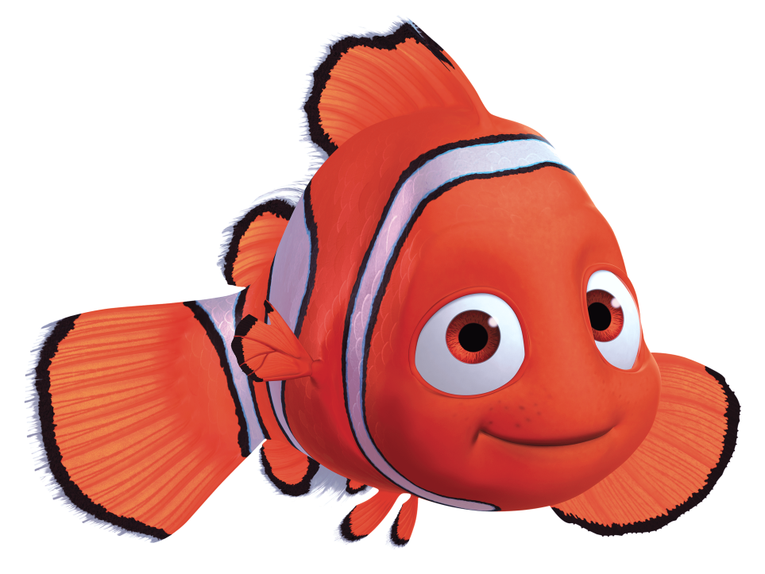
A: ______ day is it today?
B: It’s Saturday.
What
When
Where

Slide 13
Listen and choose:
A: What day is it _______?
B: It’s _________.
today / Monday
today / Thursday
yesterday / Thursday

Slide 14
Listen and choose:
A: What day _____ today?
B: It’s ___________.
is it / Saturday
are there/Wednesday
is it / Wednesday

Slide 15

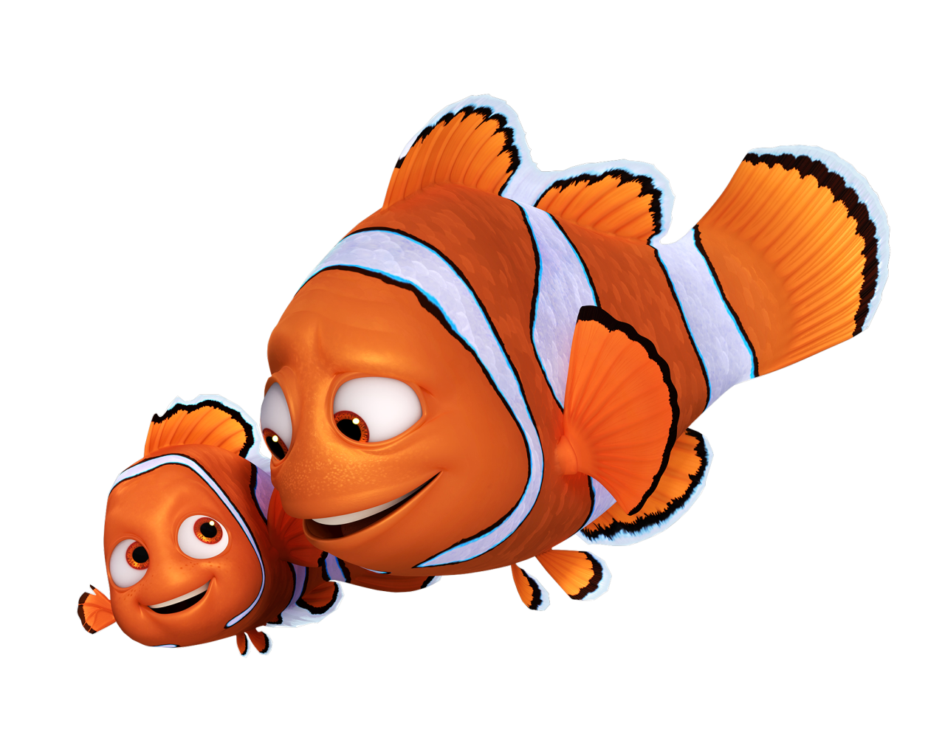

Slide 16

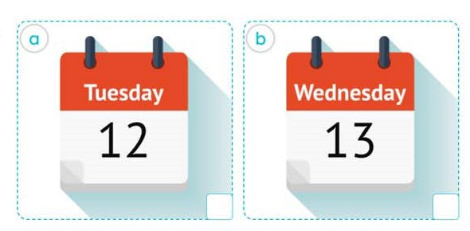
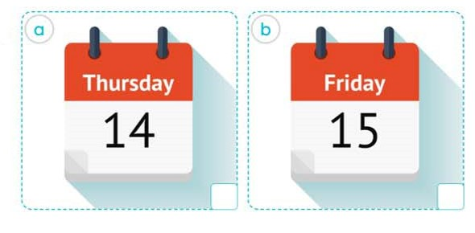



4. Listen and tick.
2.
1.
a
b
a
b
Bùi Liễu 0968142780

Slide 17
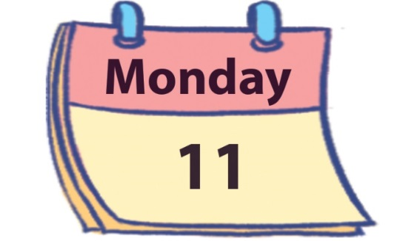
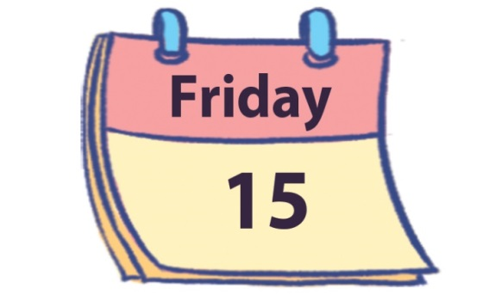
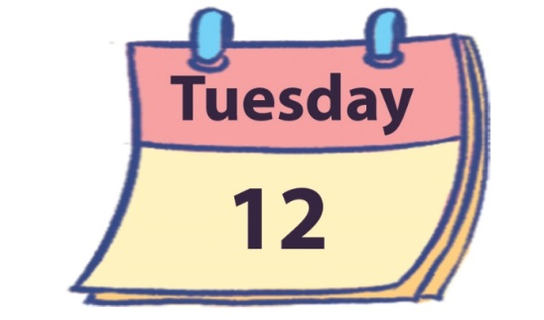
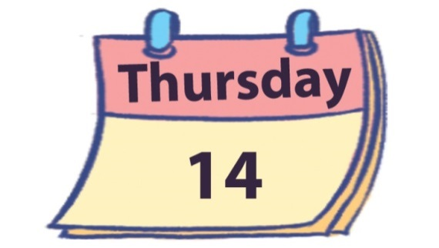
5. Look, complete and read.
1.
A: What day is it today?
B: It’s ________.
2.
A: What day is it today?
B: It’s _________.
Monday
Friday
3.
4.
today
What day
A: What day is it________?
B: _________________.
A: __________ is it today?
B: _______ Tuesday.
It’s
It’s Thursday

Slide 18
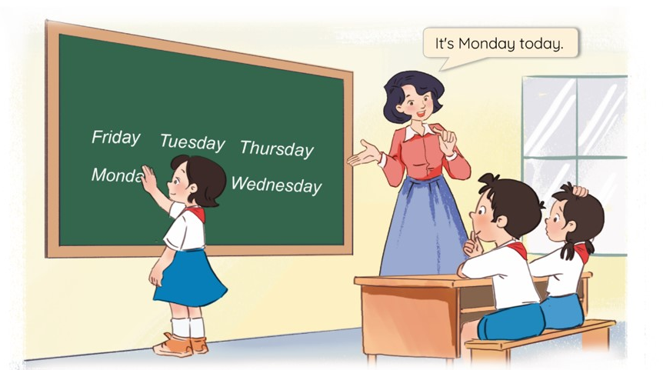
6. Let’s play.
Slap the board

Slide 19
Wrap up

Slide 20
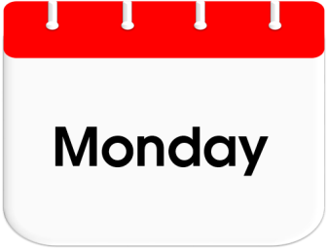
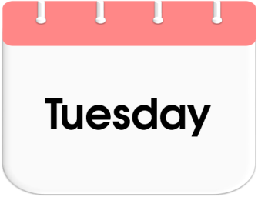
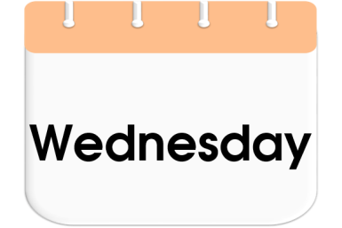
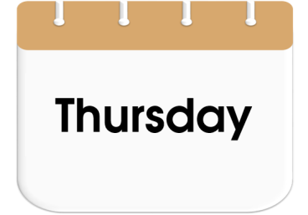
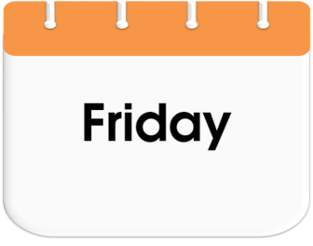
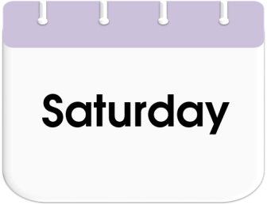
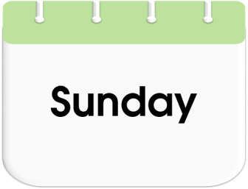
Unit 3 lesson 1
Bùi Liễu 0968142780
What day is it today?
It’s _______.
it’s = it is

Slide 21
Homework
Learn by heart all the new words.
Read again the dialogue in part 1.

Slide 22

Thank you!

