Slide 2
Saturday, November 9th 2024
Unit
6
Our school facilities
Lesson 1 - Part 1,2,3

Slide 3
01
Warm-up

Slide 4
Warm-up

Slide 5
Let’s sing.
Things they can do
She can draw.
She can dance.
She can play the piano,
but she can’t play the guitar.
He can swim.
He can cook.
He can ride a bike,
but he can’t ride a horse.

Slide 6
Guessing game

Slide 7
02
Activity 1
Look, listen and repeat.

Slide 8
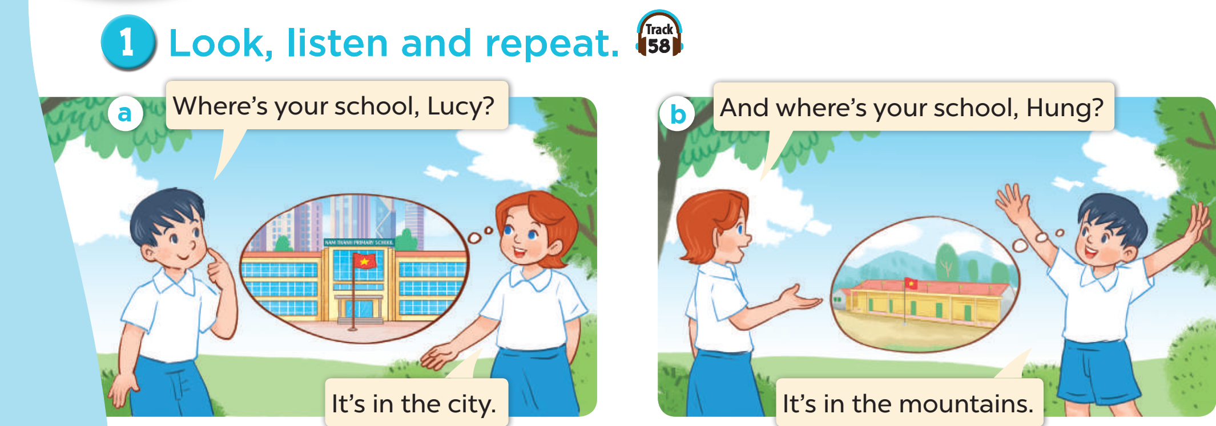
1. Look, listen and repeat.
Where’s your school, Lucy?
And where’s your school, Hung?
It’s in the city.
It’s in the mountains.

Slide 9
03
Activity 2
Listen, point and say.

Slide 10
Vocabulary

Slide 11
Vocabulary
mountains
/ˈmaʊntənz/
vùng núi
Click on “mountains” to hear the sound.

Slide 12
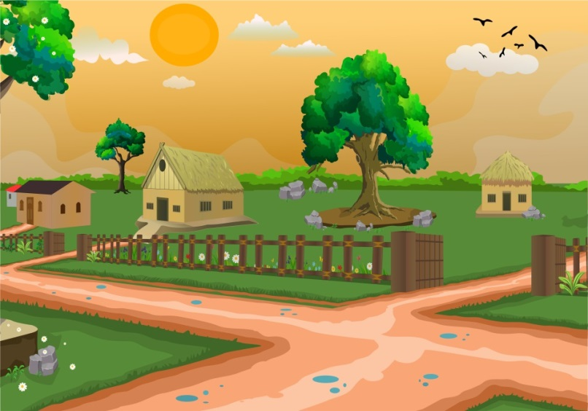
Vocabulary
village
/ˈvɪlɪdʒ/
ngôi làng

Slide 13
Vocabulary
city
/ˈsɪti/
thành phố

Slide 14
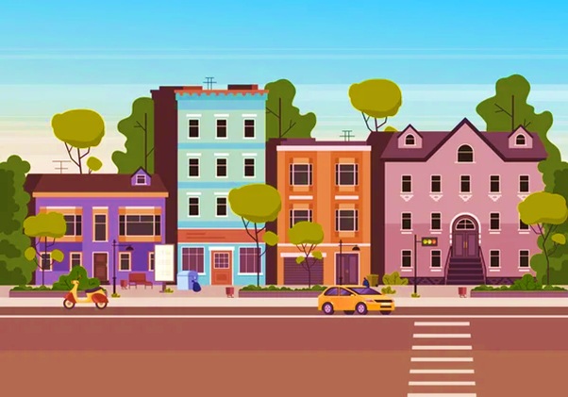
Vocabulary
town
/taʊn/
thị trấn

Slide 15
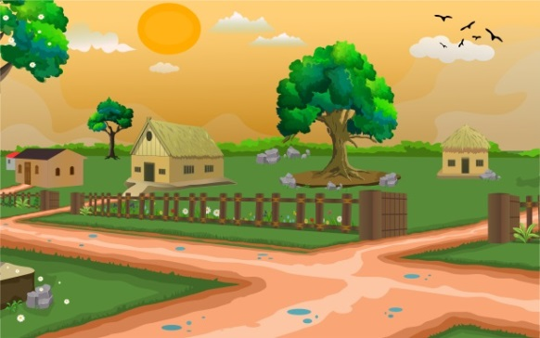
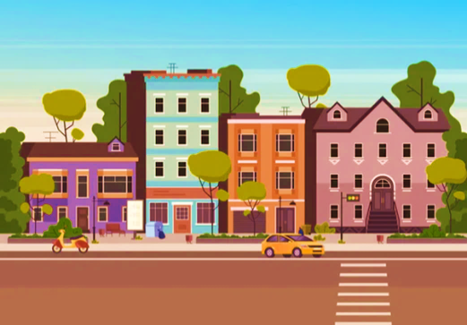
Vocabulary
mountains
village
city
town

Slide 16
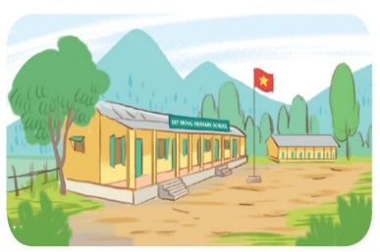
Look, read and tick
1
2
4
3
city

Slide 17
Read and tick
1
2
4
3
mountains

Slide 18
Read and tick
1
2
4
3
village

Slide 19
Read and tick
1
2
4
3
town

Slide 20
Model sentence

Slide 21
Model sentence
B. Model sentence:
Where is your school?
It’s in the
mountains.
mountains.

Slide 22
B. Structure:
Hỏi và trả lời trường của bạn ở đâu:
Where is your school?
It’s in the +_______.
Địa điểm
(Trường bạn ở đâu?)
(Nó ở _______)

Slide 23
Where’s your school?
It’s in the ______.
town
mountains
village
city

Slide 24
2. Listen, point and say.

Slide 25
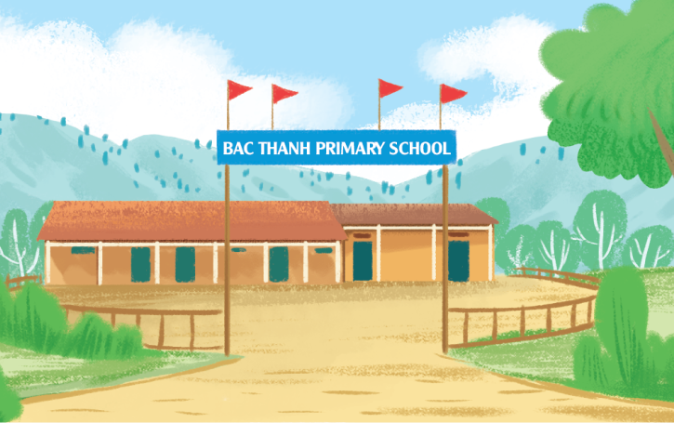
2. Listen, point and say.
mountains
Where’s your school?
It’s in the mountains.
Click on the sentences to hear many times.

Slide 26
2. Listen, point and say.
village
Where’s your school?
It’s in the village.

Slide 27
2. Listen, point and say.
city
Where’s your school?
It’s in the city.

Slide 28
2. Listen, point and say.
town
Where’s your school?
It’s in the town.

Slide 29
04
Activity 3
Let’s talk.

Slide 30
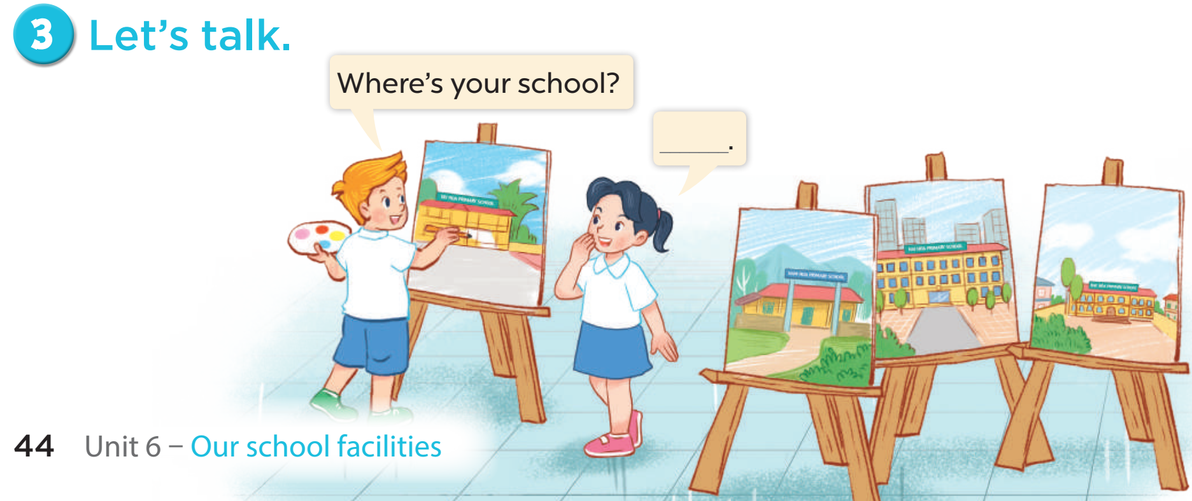
3. Let’s talk.

Slide 31
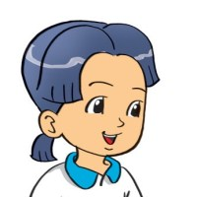
B. Structure:
Hỏi và trả lời trường của bạn ở đâu:
Where is your school?
It’s in the ________.
Địa điểm
(Trường bạn ở đâu?)
(Nó ở _______)

Slide 32
04
Activity 3
Let’s talk.

Slide 33
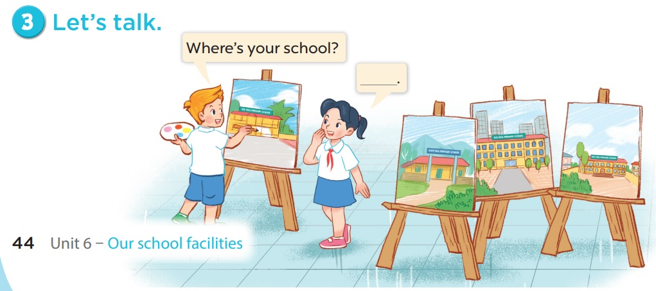

Slide 34
Ms Huyền Phạm
0936.082.789
Notes:
Ms Huyền Phạm - 0936.082.789 – YOUTUBE: MsPham. Facebook: Dạy và học cùng công nghệ.

Slide 35
It’s in the mountains.
Where's your school?
It’s in the village.
Ms Huyền Phạm
0936.082.789
Notes:
Ms Huyền Phạm - 0936.082.789 – YOUTUBE: MsPham. Facebook: Dạy và học cùng công nghệ.

Slide 36
It’s in the city.
Where's your school?
It’s in the town.
Ms Huyền Phạm
0936.082.789
Notes:
Ms Huyền Phạm - 0936.082.789 – YOUTUBE: MsPham. Facebook: Dạy và học cùng công nghệ.

Slide 37
It’s in the mountains
Where's your school?
It’s in the village.
Ms Huyền Phạm
0936.082.789
Notes:
Ms Huyền Phạm - 0936.082.789 – YOUTUBE: MsPham. Facebook: Dạy và học cùng công nghệ.

Slide 38
It’s in the mountains.
Where's your school?
It’s in the town.
Ms Huyền Phạm
0936.082.789
Notes:
Ms Huyền Phạm - 0936.082.789 – YOUTUBE: MsPham. Facebook: Dạy và học cùng công nghệ.

Slide 39
Where’s
_______ your school?
What’s
Ms Huyền Phạm
0936.082.789
Notes:
Ms Huyền Phạm - 0936.082.789 – YOUTUBE: MsPham. Facebook: Dạy và học cùng công nghệ.

Slide 40
They’re
Where's your school?
_____ in the village.
It’s
Ms Huyền Phạm
0936.082.789
Notes:
Ms Huyền Phạm - 0936.082.789 – YOUTUBE: MsPham. Facebook: Dạy và học cùng công nghệ.

Slide 41
Good job!
Ms Huyền Phạm
0936.082.789
Notes:
Ms Huyền Phạm - 0936.082.789 – YOUTUBE: MsPham. Facebook: Dạy và học cùng công nghệ.

Slide 42
Homework
Learn by heart the vocabulary and the model sentence.
Read again the dialogue in part 1.
Prepare Unit 6 -Lesson 1(4,5,6)

Slide 43
Facebook : Bùi Liễu
0968142780
Thank you!

Slide 44
2. Listen, point and say
Where's your school?
It’s in the _________.
a
d
b
c
mountains
town
village
city

