Slide 1





Slide 2



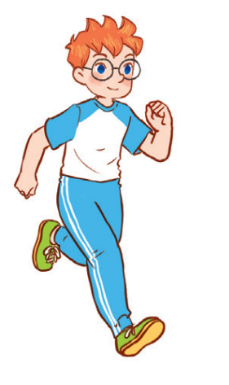
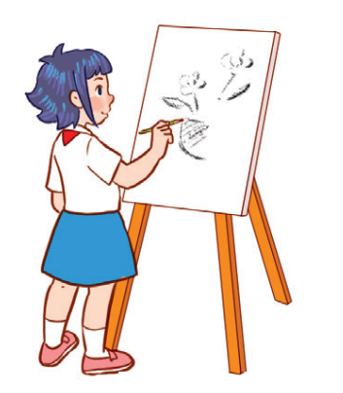

Unit 8
Period 5

Slide 3
Contents
1
Warm-up and review
2
Listen and repeat.
3
Listen and circle.
4
Let’s chant.
5
Fun corner and wrap-up

Slide 4
Warm-up and review
1
1
Game: Make sentences

Slide 5




Notes:
Make sentences with these pictures.
Example: Why do you like science? – Because I want to be a science teacher.

Slide 6
Listen and repeat.
2
2

Slide 7



Slide 8
Listen and circle.
3
3

Slide 9
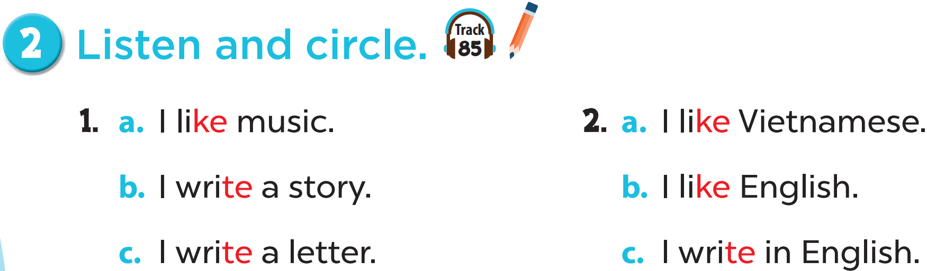

Slide 11

Let’s chant.
4
4

Slide 12
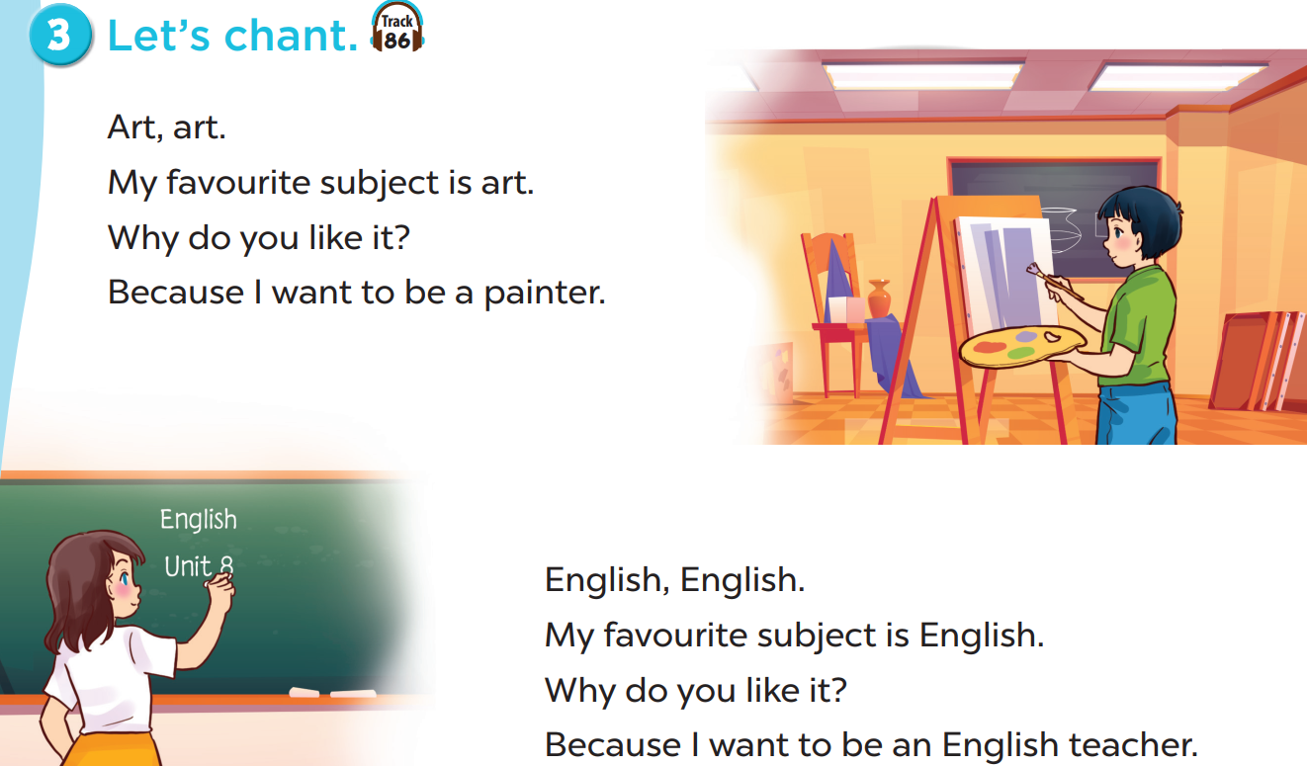

Slide 14
Fun corner and wrap-up
5
5

Slide 15

Singing contest
Notes:
play the track 86.
Teach pupils to stomp their feet or clap their hands to feel the rhythm.
Write down or use the unit flashcards to help pupils sing sentence by sentence.
Practise sereral times until they can remember and chant the whole song.
Call some volunteers to sing and vote for THE BEST VOICE OF THE CLASS.
Prepare some small gifts for them.

Slide 16

Facebook : Bùi Liễu
0968142780
Thank you!

