Slide 2
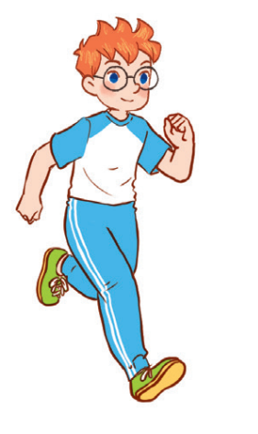
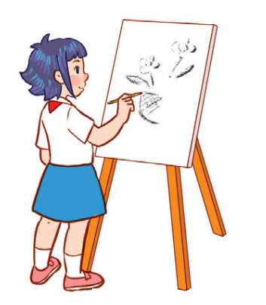
Unit 8
Period 6

Slide 3
Contents
1
Warm-up and review
2
Read and tick True or False.
3
Let’s write.
Project
4
5
Fun corner and wrap-up

Slide 4
Warm-up and review
1
1
Game: Camping trip
4
4

Slide 5
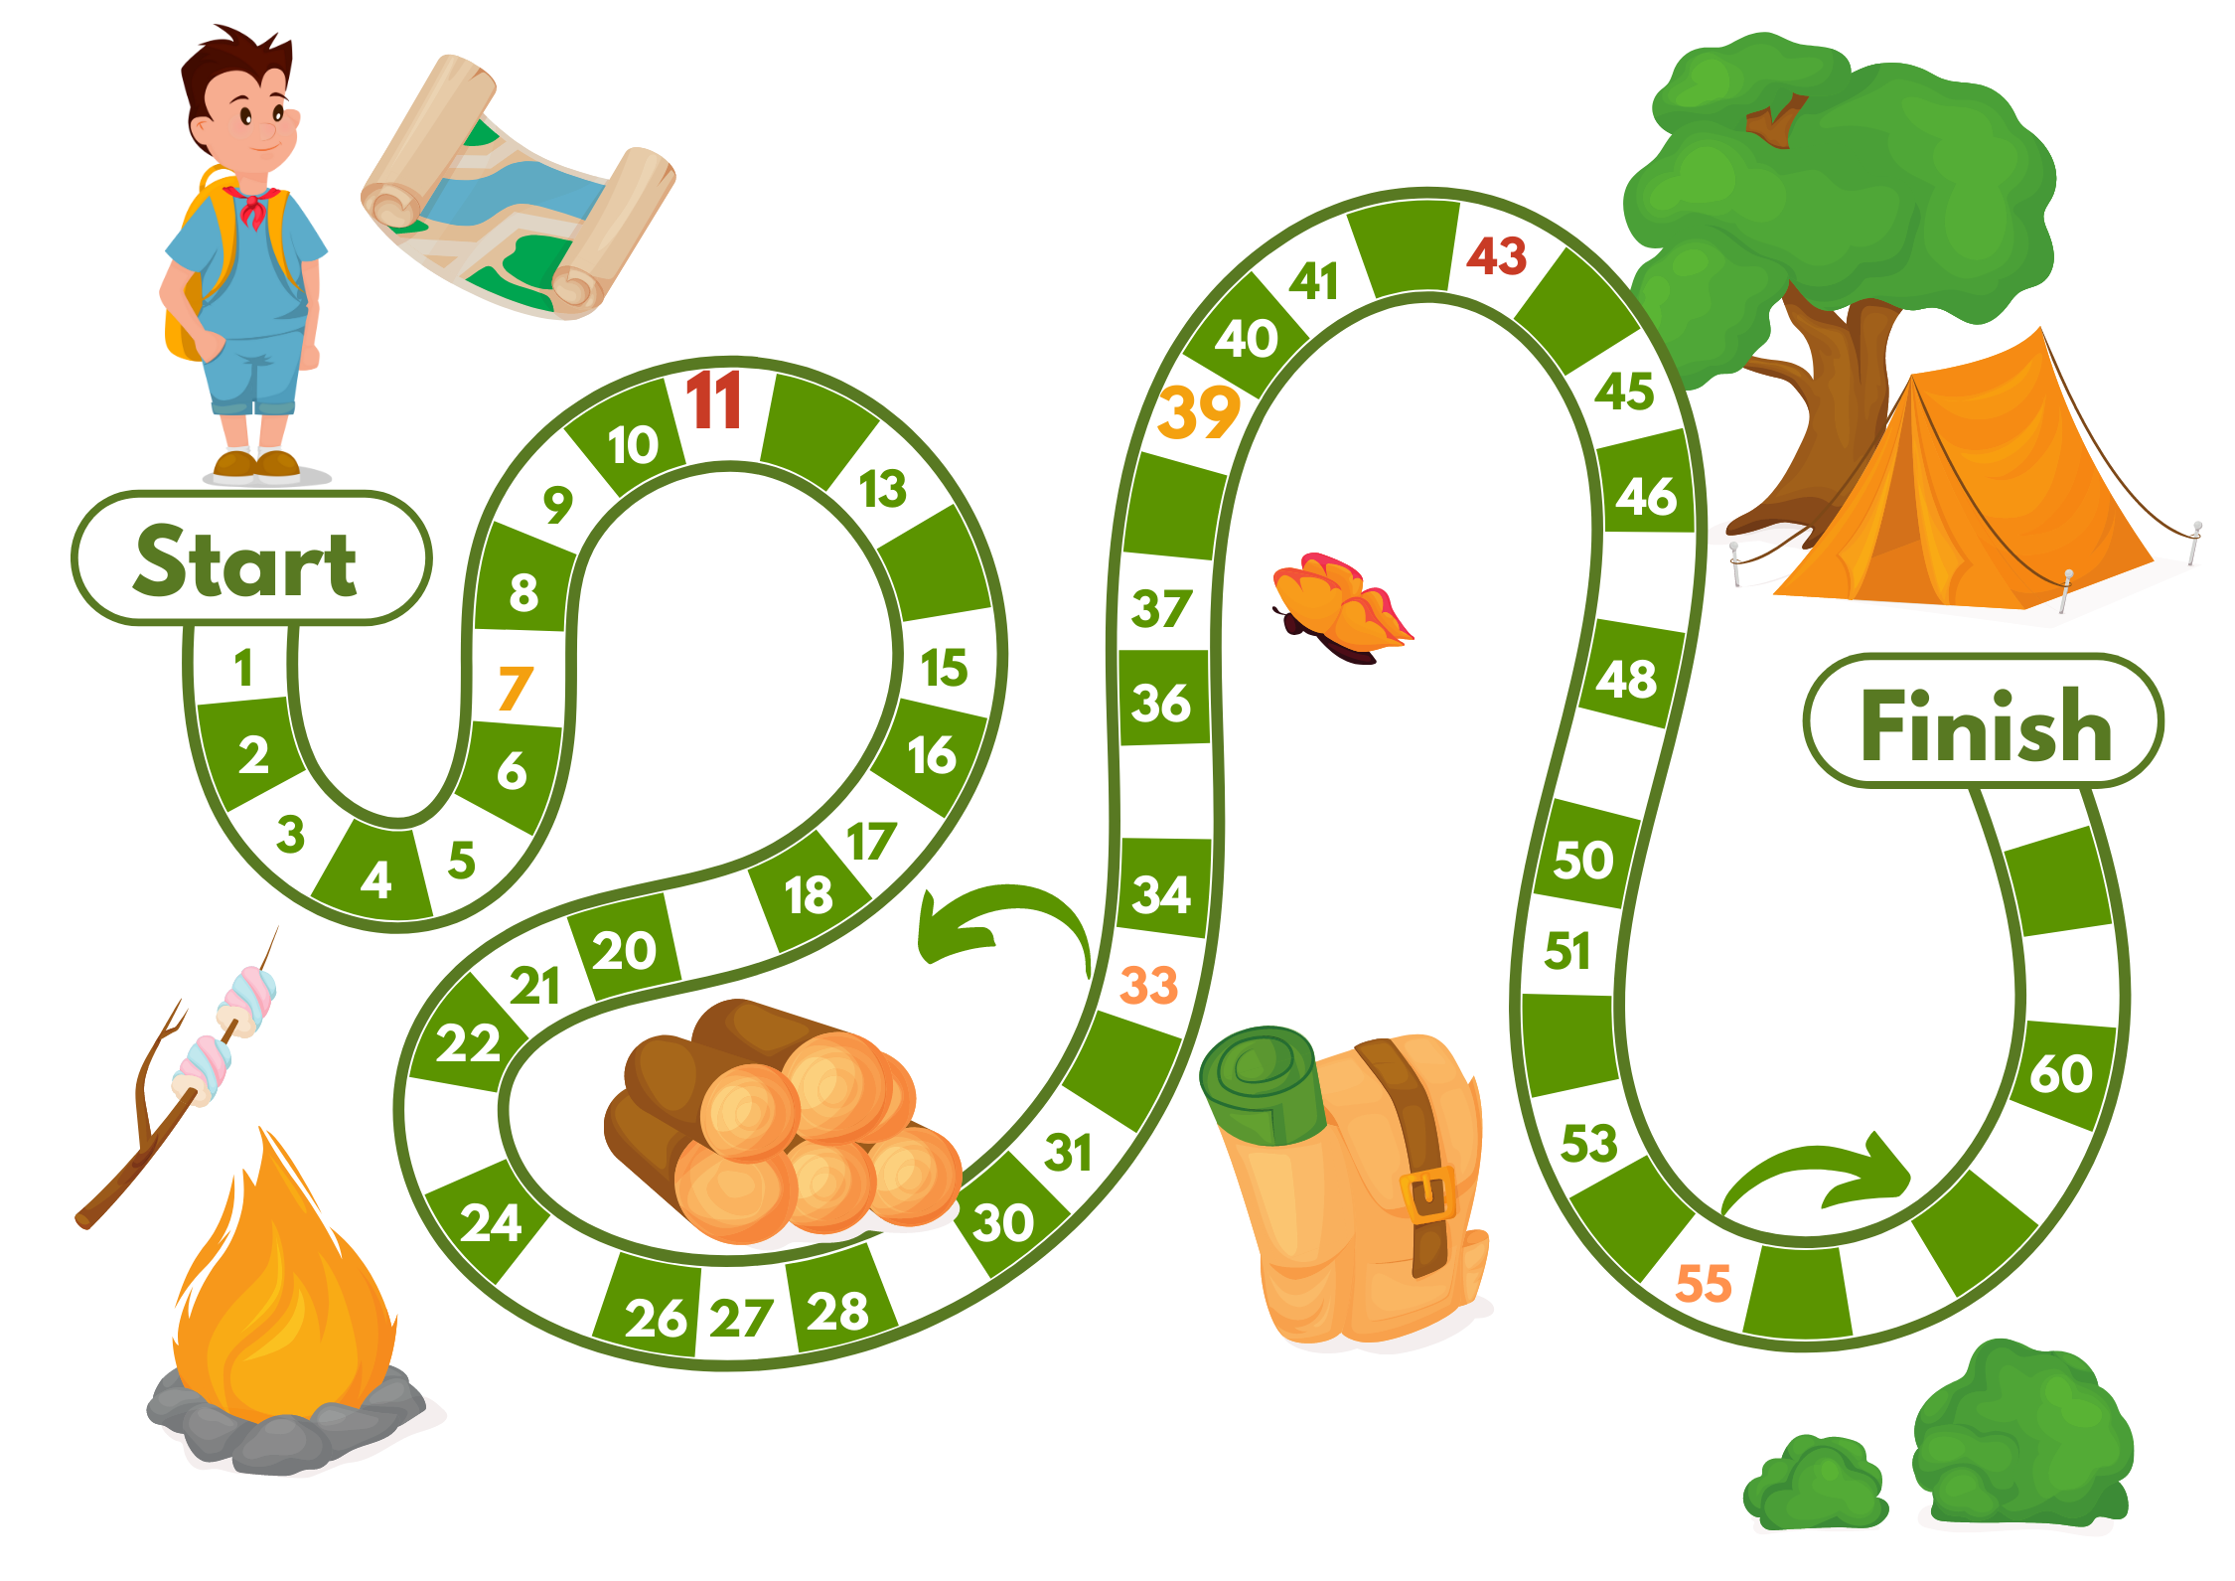
Notes:
Camping trip game
Roll a dice.
red space: back 5 spaces
orange space: forward 3 spaces
the rest: answer questions. For example: what subject do you use a ruler/ a crayon?... (Teacher prepares more questions)

Slide 6
Read and tick True or False.
2
2

Slide 7
✓
✓
✓
✓

Slide 8
Let’s write.
3
3

Slide 10
Project
4
4

Slide 11
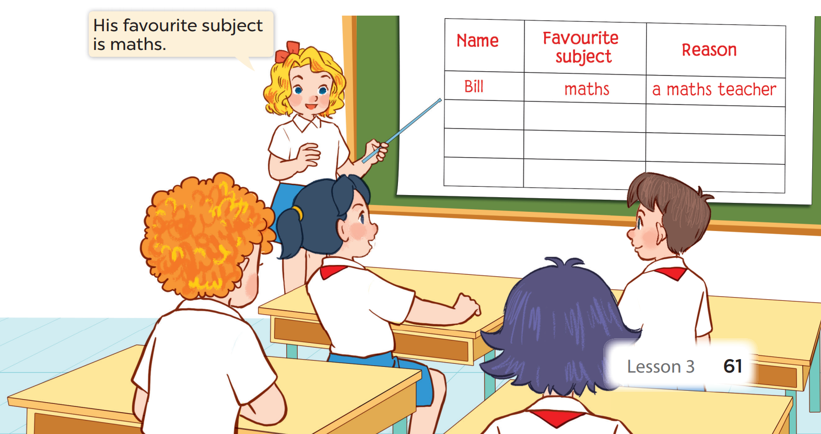

Slide 12
NAME | FAVOURITE SUBJECT | REASON
Notes:
Divide pupils into groups, ask them to interview their friends to complete a survery on their favourite subjects, give help if necessary.
Request each group to present.

Slide 13
Fun corner and wrap-up
5
5

Slide 14
Notes:
Put all boxes in the middle of the room
Pupils have 5 pieces of paper with 5 colours (purple, green, brown, red, orange)
All pupils sit with their back toward the boxes.
Pupils take turns to put the colour piece of paper into the corresponding colour box.
The piece of paper is their favourite subject at school.
They can put paper pieces into more than one box.
The teacher and the whole class check the number of paper pieces in each box and give a summary.

Slide 15
Facebook : Bùi Liễu
0968142780
Thank you!

