Slide 1
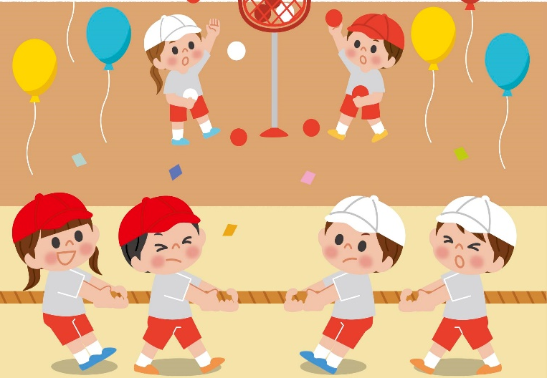
Wednesday, December 18th, 2024
Unit
9
Our sports day
Lesson 2 – Part 4,5,6

Slide 2
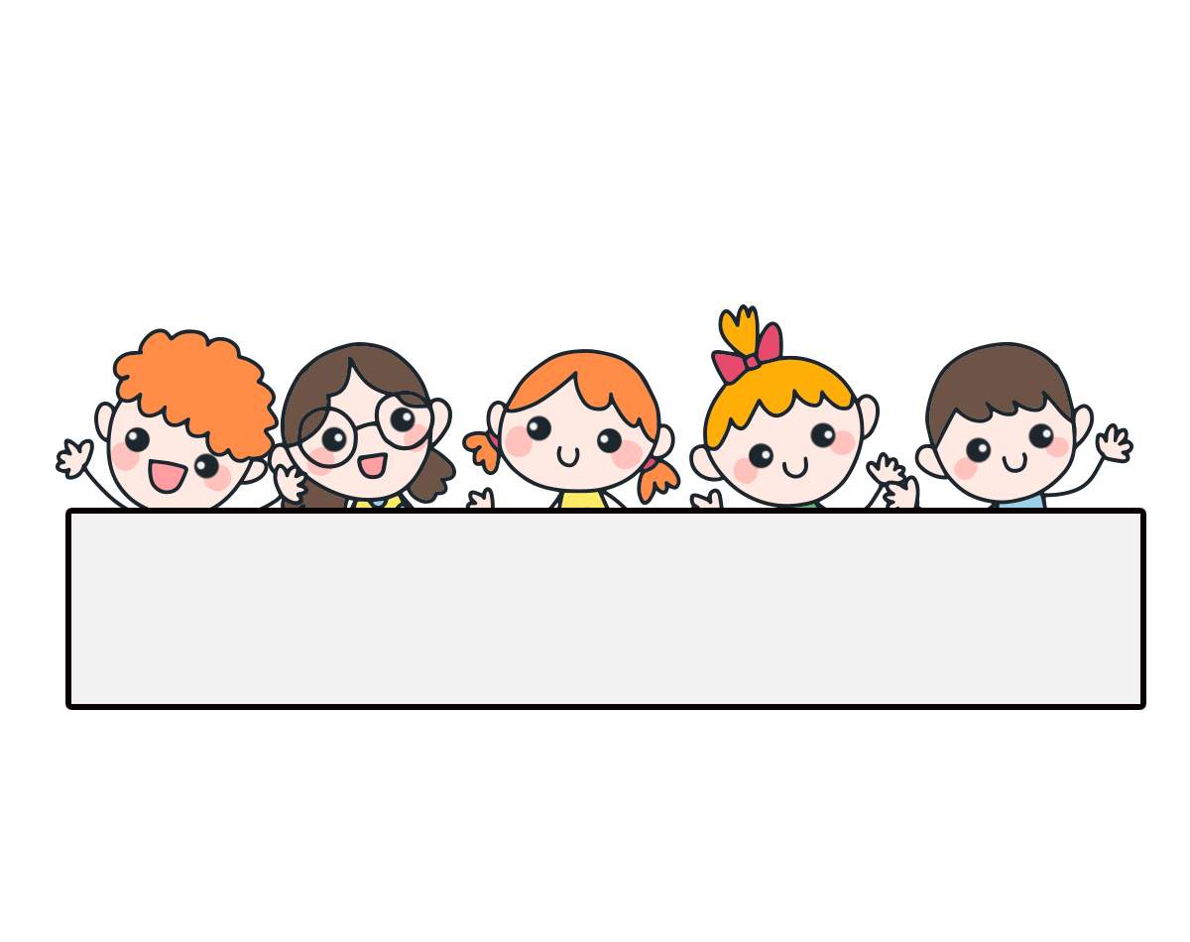
Warm-up

Slide 3
Contents
02
03
04
Listen and tick.
Look, complete and read.
Let’s play.

Slide 4
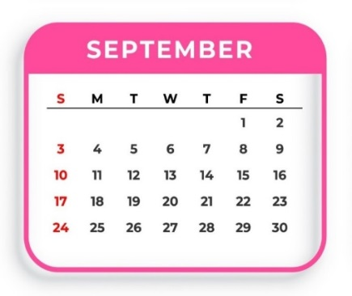
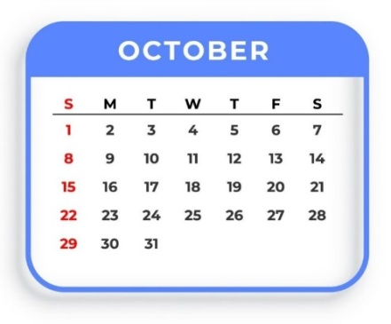
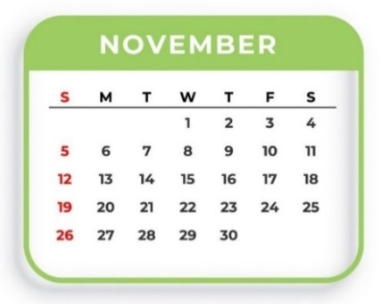
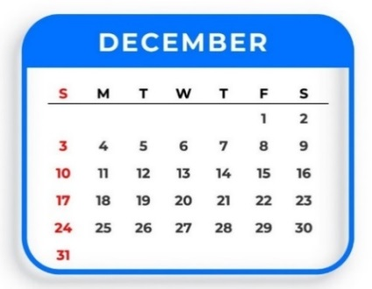
Review
September
October
November
December

Slide 5
Play
a game

Slide 7
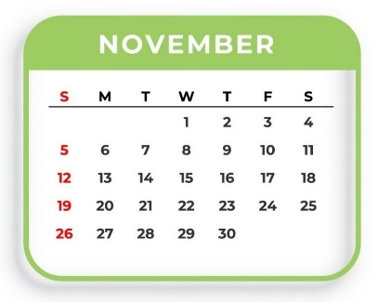
Question 1
10
9
8
7
6
5
4
3
2
1
0
When’s your sports day?
A. It’s in October.
B. It’s in November.
C. It’s in December.

Slide 8
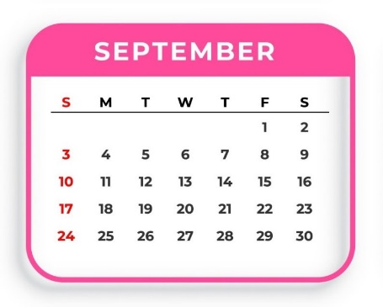
Question 2
10
9
8
7
6
5
4
3
2
1
0
When’s your sports day?
A. It’s in December.
B. It’s in November.
C. It’s in September.

Slide 9
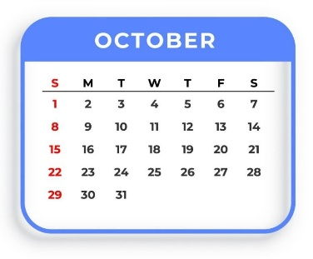
Question 3
10
9
8
7
6
5
4
3
2
1
0
When’s your sports day?
A. It’s in August.
B. It’s in November.
C. It’s in October.

Slide 10
Question 4
10
9
8
7
6
5
4
3
2
1
0
A. tháng mười
The meaning of “December” in Vietnamese:
B. tháng mười hai
C. tháng tám

Slide 11
Question 5
10
9
8
7
6
5
4
3
2
1
0
A. tháng chín
The meaning of “November” in Vietnamese:
B. tháng mười một
C. tháng mười

Slide 12
Question 6
10
9
8
7
6
5
4
3
2
1
0
A. tháng mười một
The meaning of “October” in Vietnamese:
B. tháng mười
C. tháng chín

Slide 13
Question 7
10
9
8
7
6
5
4
3
2
1
0
A. tháng chín
The meaning of “September” in Vietnamese:
B. tháng tư
C. tháng năm

Slide 14
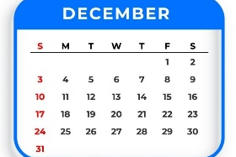
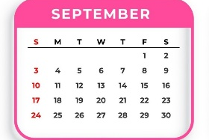
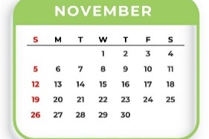
Question 8
10
9
8
7
6
5
4
3
2
1
0
A.
B.
C.

Slide 15
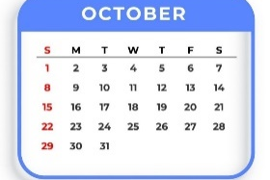
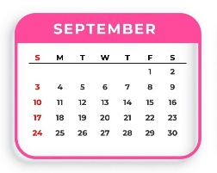
Question 9
10
9
8
7
6
5
4
3
2
1
0
A.
B.
C.

Slide 16
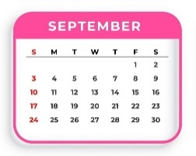
Question 10
10
9
8
7
6
5
4
3
2
1
0
A.
B.
C.

Slide 17
Facebook : Bùi Liễu
0968142780
Good job!

Slide 18
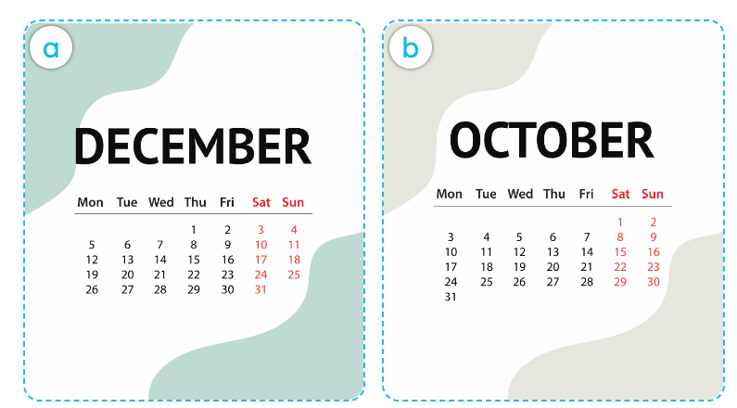
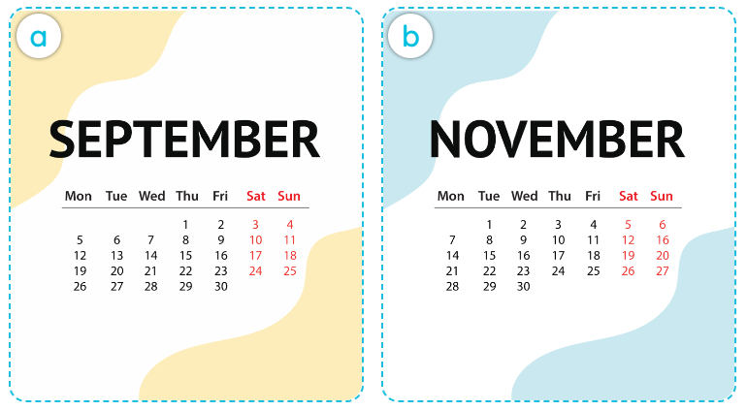
4. Listen and tick.
1.
2.
a
b
a
b

Slide 19
Audio script:
1. A: Is your sports day in December?
B: No, it isn’t.
A: When’s your sports day?
B: It’s in October.
2. A: When’s your sports day? In November?
B: No, it isn’t. It’s in September.
A: Oh, it’s soon.

Slide 20
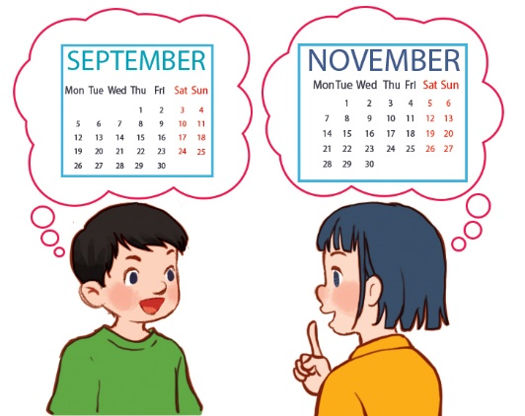
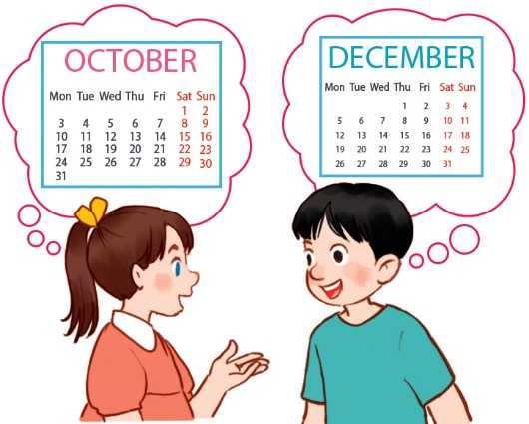
5. Look, complete and read.
1.
A: Is your sports day in September?
B:________, it is. When’s your sports day?
A: It’s in ___________.
Yes
November
2.
A: Our sports day is in October. ____ your sports day in October too?
B: No, it isn’t.
A: _________ your sports day?
B: It’s in __________.
Is
When’s
December

Slide 21
6. Let’s play.

Slide 22
6. Let’s play.
Who’s faster?
October
December
October
Our sports day is in ________ .
Our sports day is in December.

Slide 23
6. Let’s play.

Slide 24
Wrap up

Slide 25
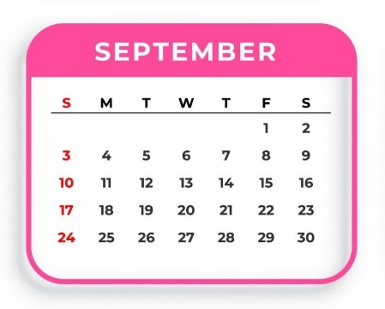
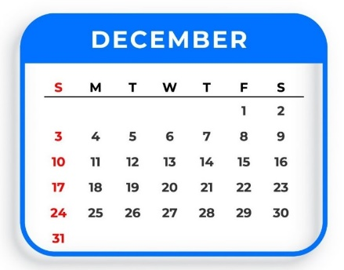
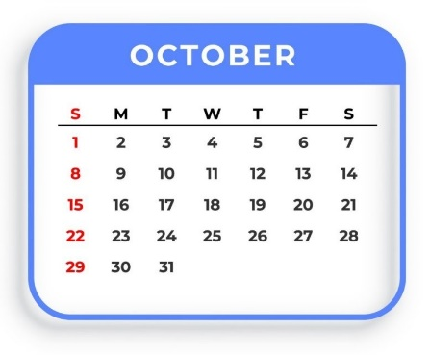
Unit 9.2
When’s your sports day?
It’s in _________.
September
December
October
November

Slide 26
Homelink
Review the months of a year and structure.
Do exercises in workbook.
Prepare Unit 9: Lesson 3- Part 1,2,3

Slide 27
Thank you!

