Slide 1

Shapes
Lesson 2.1: Vocabulary & Phonics
Page: 18

Slide 2
Lesson Outline
Warm-up
Vocabulary
Structure
Practice
Consolidation
Wrap-up

Slide 3
Objectives
By the end of this lesson, students will be able to gain the following:
Phonics: /n/
Vocabulary:
nut, nose
Sentence pattern:
Revise “This is …."
Skills:
Recognize the letter P/p and make the /p/ sound.

Slide 4

WARM UP

Slide 5


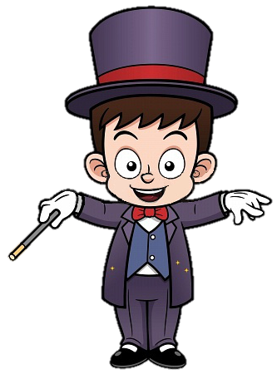
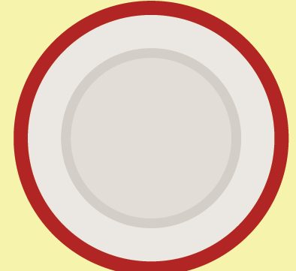

What shape is it?
It’s a circle.

Slide 6
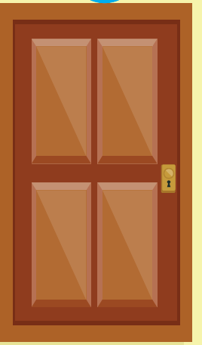
What shape is it?
It’s a rectangle.

Slide 7
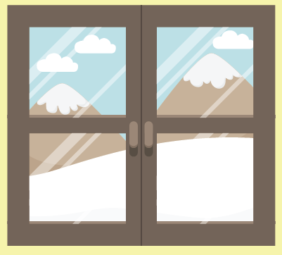
What shape is it?
It’s a square.

Slide 8

What shape is it?
It’s a triangle.

Slide 9

What shape is it?
It’s a circle.

Slide 10

What shape is it?
It’s a rectangle.

Slide 11

What shape is it?
It’s a triangle.

Slide 12
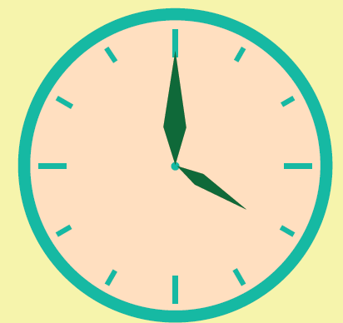
What shape is it?
It’s a circle.

Slide 13
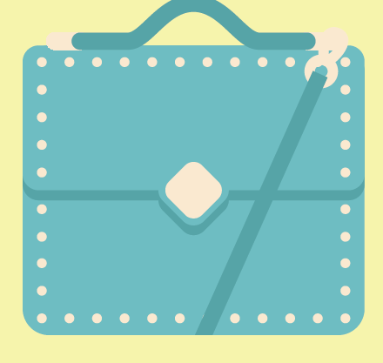
What shape is it?
It’s a square.

Slide 14
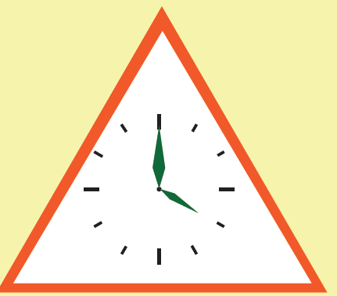
What shape is it?
It’s a rectangle.

Slide 15

It’s time to learn …

Slide 16
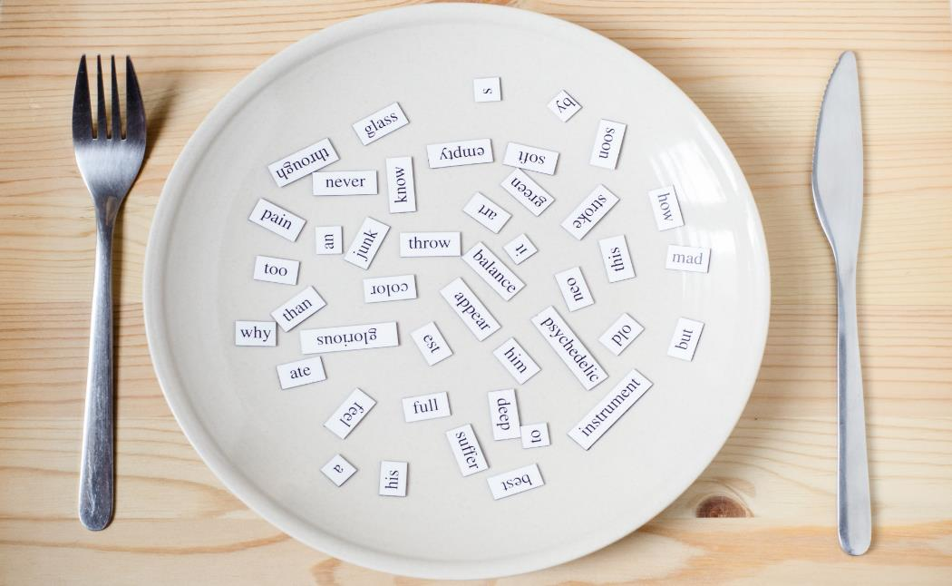
Phonics
/p/

Slide 17
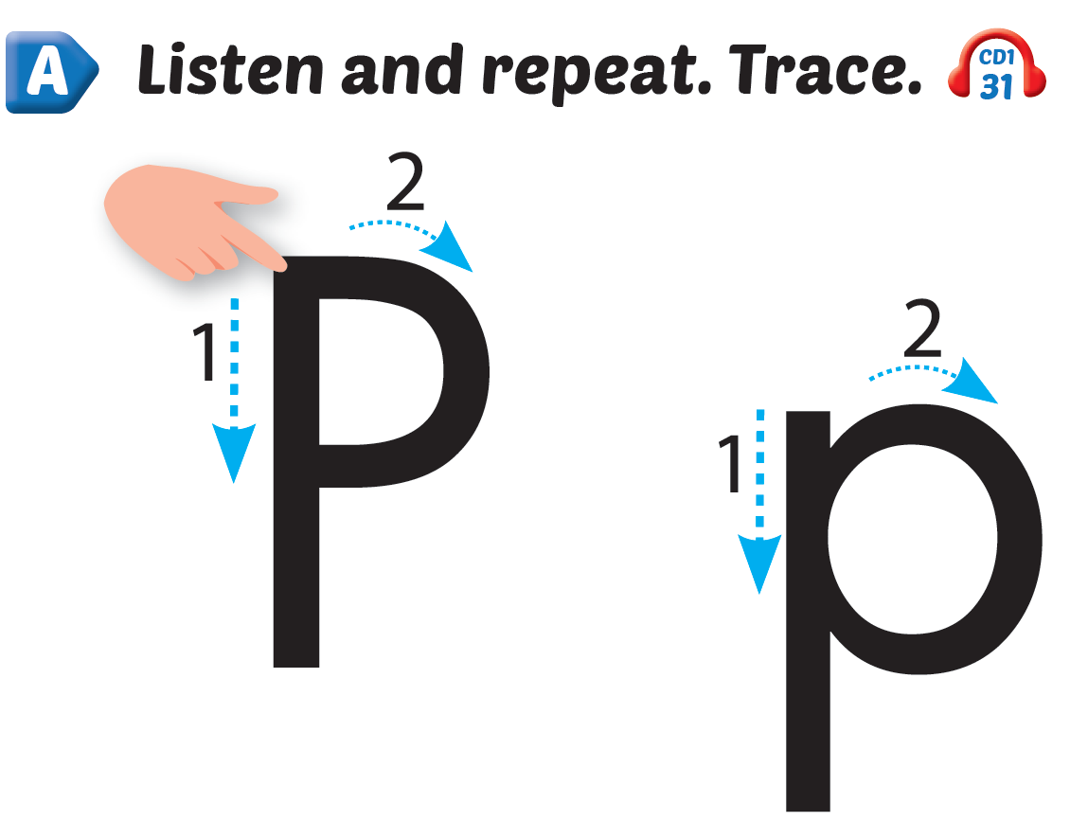
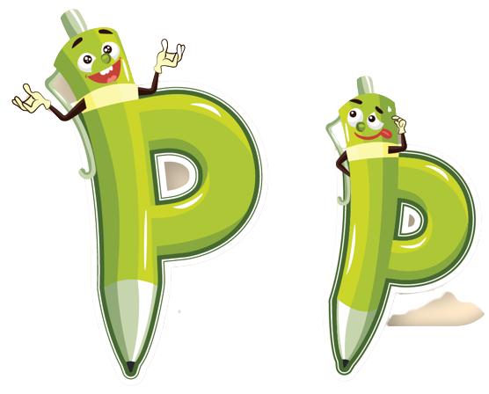
Click Alphabet to hear the sound
Notes:
Click vào hình A. 1. Listen and point. Repeat để cho cả audio full chạy

Slide 18
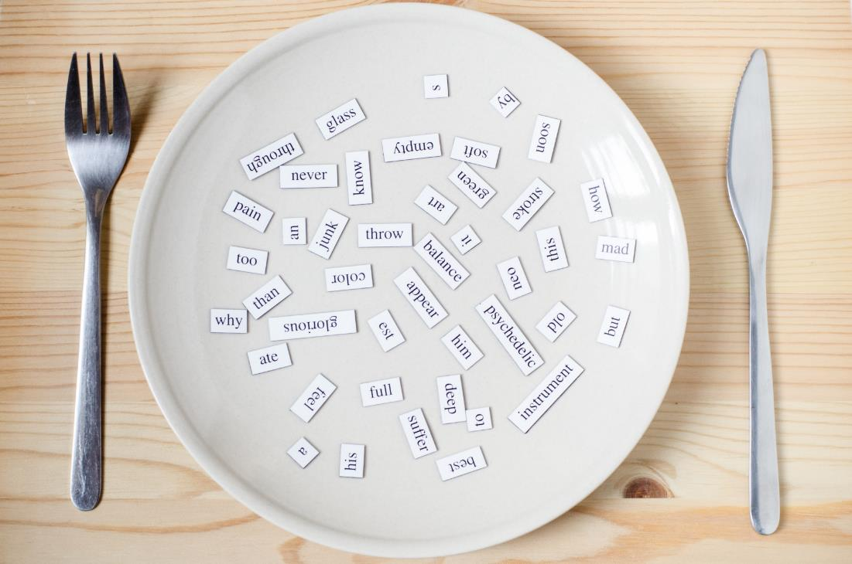
New words
pen, penguin

Slide 19
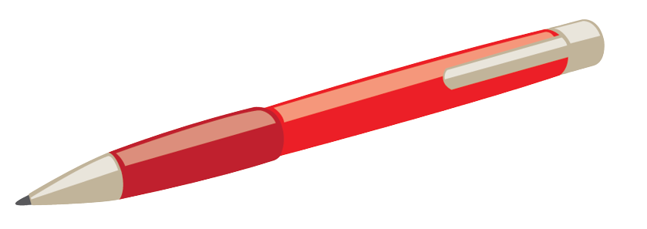

/pen/
bút mực
Notes:
Click vào hình A. 1. Listen and point. Repeat để cho cả audio full chạy

Slide 20

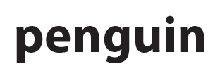
/ˈpeŋɡwɪn/
con chim cánh cụt
Notes:
Click vào hình A. 1. Listen and point. Repeat để cho cả audio full chạy

Slide 21
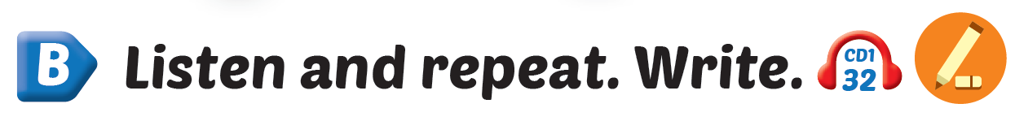

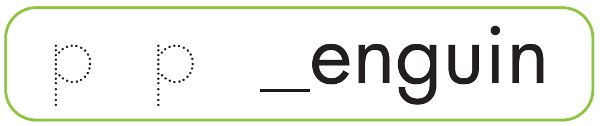
p
p
Notes:
Click vào hình A. 1. Listen and point. Repeat để cho cả audio full chạy

Slide 22
It’s time to play …

Slide 23




What’s next?
?
pen
penguin

Slide 24


What’s next?
?
pen
penguin

Slide 25


What’s next?
?
penguin
pen

Slide 26

What’s next?
?
pen
penguin

Slide 27

Practice

Slide 28



I have a ,
p, p, .
I have a ,
p, p, p.
Notes:
Click vào hình A. 1. Listen and point. Repeat để cho cả audio full chạy

Slide 29

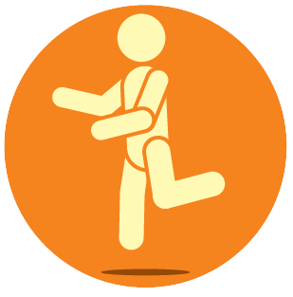
Notes:
Click vào hình A. 1. Listen and point. Repeat để cho cả audio full chạy

Slide 30

Further Practice

Slide 31

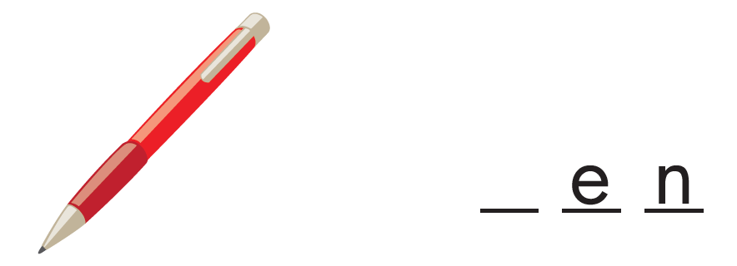

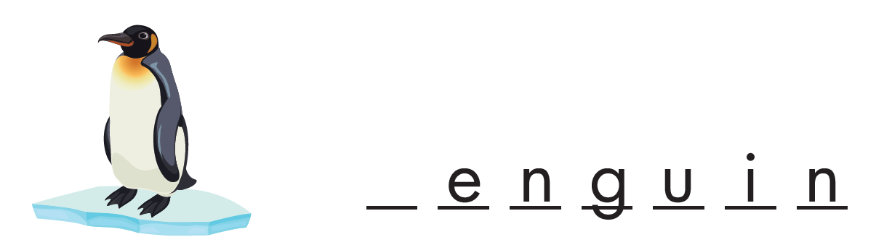

p
p

Slide 32

CONSOLIDATION

Slide 33
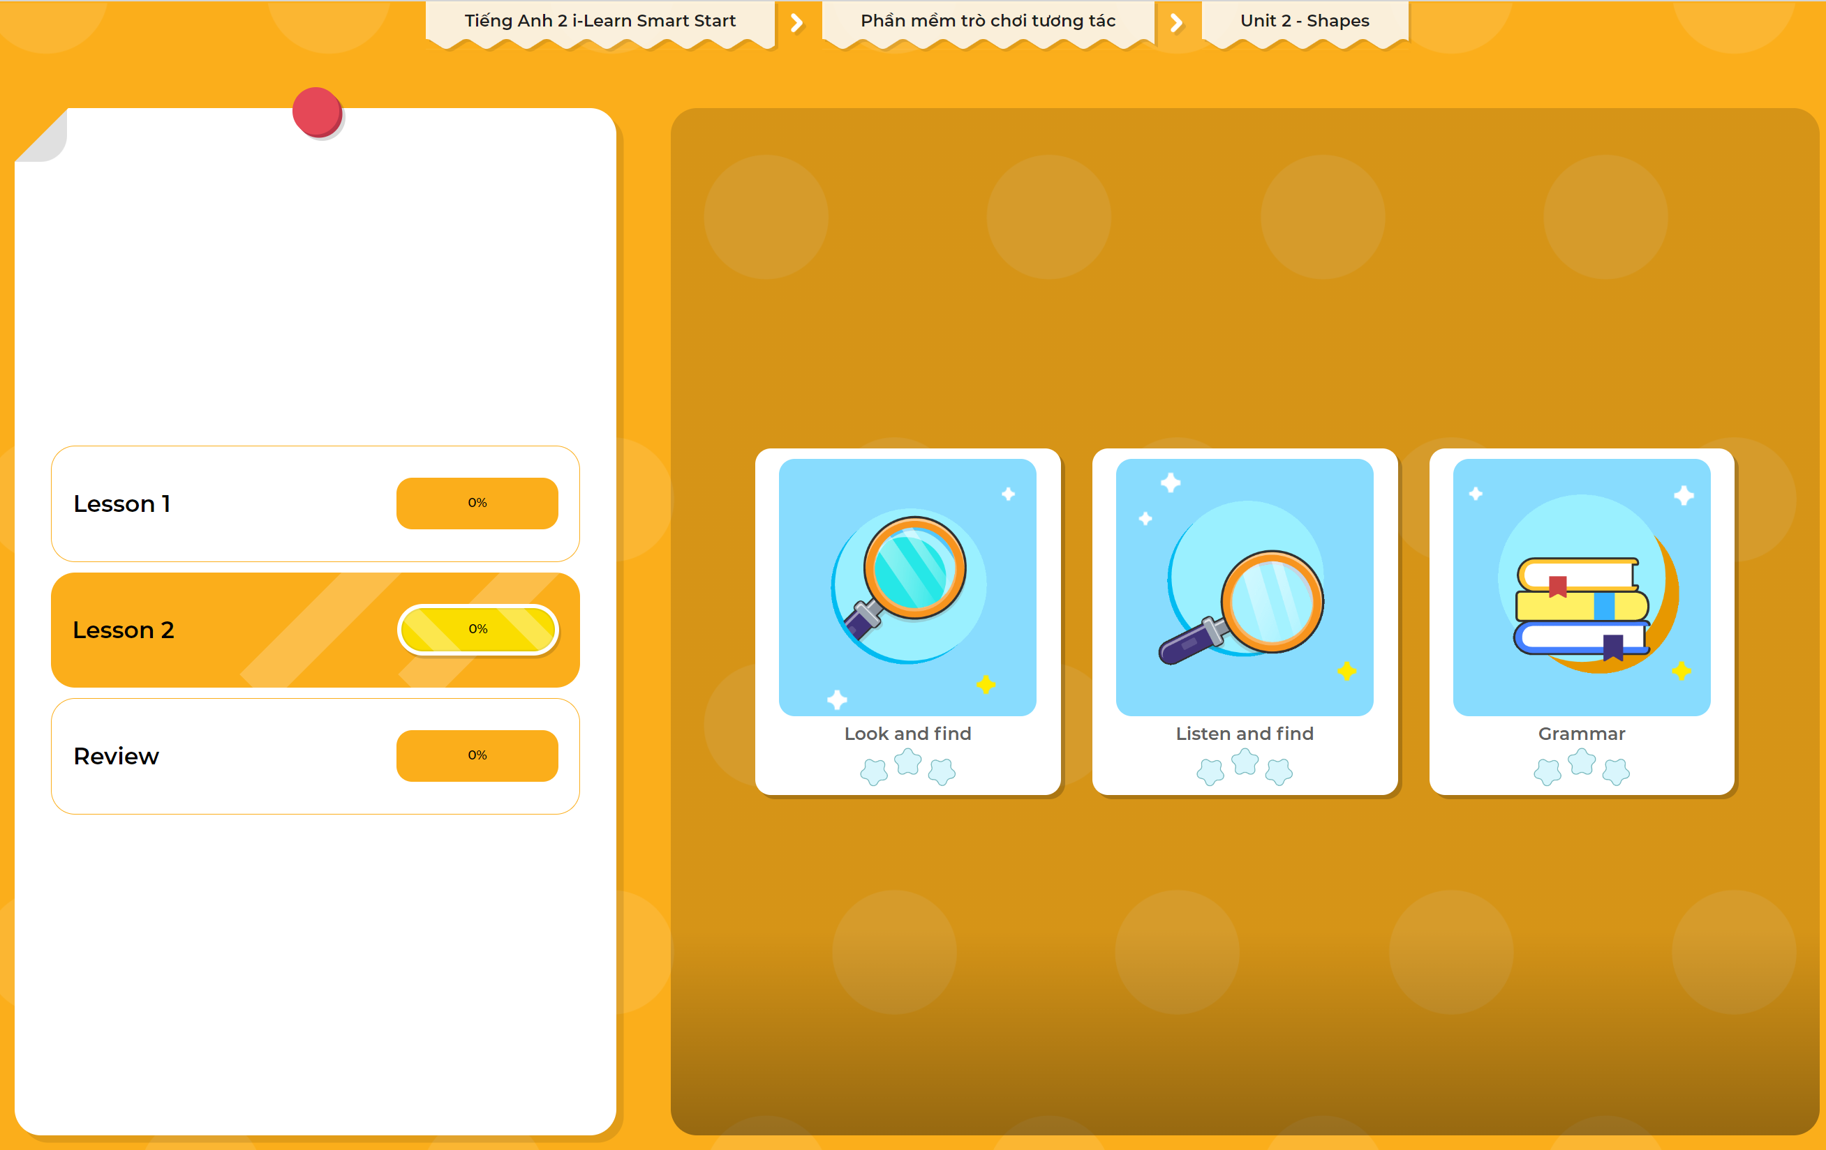
Extra Practice
DHA App
LET’S PLAY!
Click here to play the games

Slide 34

WRAP-UP

Slide 35
Today’s lesson
Structures/ Sentence patterns
I have a pen.
Vocabulary
pen, penguin

Slide 36
Homework
Practice vocabularies and phonics. Practice saying them.
Practice the vocabulary and phonics in Tiếng Anh 2 i-Learn Smart Start Notebook (page 16)
Do the exercises in Tiếng Anh 2 i-Learn Smart Start Workbook (page 16)
Play the consolidation games in Tiếng Anh 2 i-Learn Smart Start DHA App on www.eduhome.com.vn
Prepare the next lesson (page 19)

Slide 37

Enjoy your day!

