Slide 1

Shapes
Lesson 2.2: Vocabulary & Phonics
Page: 19

Slide 2
Lesson Outline
Warm-up
Vocabulary
Structure
Practice
Consolidation
Wrap-up

Slide 3
Objectives
By the end of this lesson, students will be able to gain the following:
Phonics: /q/
Vocabulary:
queen, question
Sentence pattern:
Revise “This is …."
Skills:
Recognize the letter Q/q and make the /q/ sound.

Slide 4

WARM UP

Slide 5
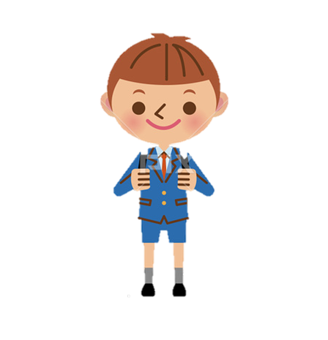

I have a penguin.
What is in the picture?
T
I
M
E
I
S
U
P
CHECK
NEXT
Click on the coloured boxes to turn them around

Slide 6

I have a pen.
What is in the picture?
T
I
M
E
I
S
U
P
CHECK
NEXT
Click on the coloured boxes to turn them around

Slide 7

It’s time to learn …

Slide 8
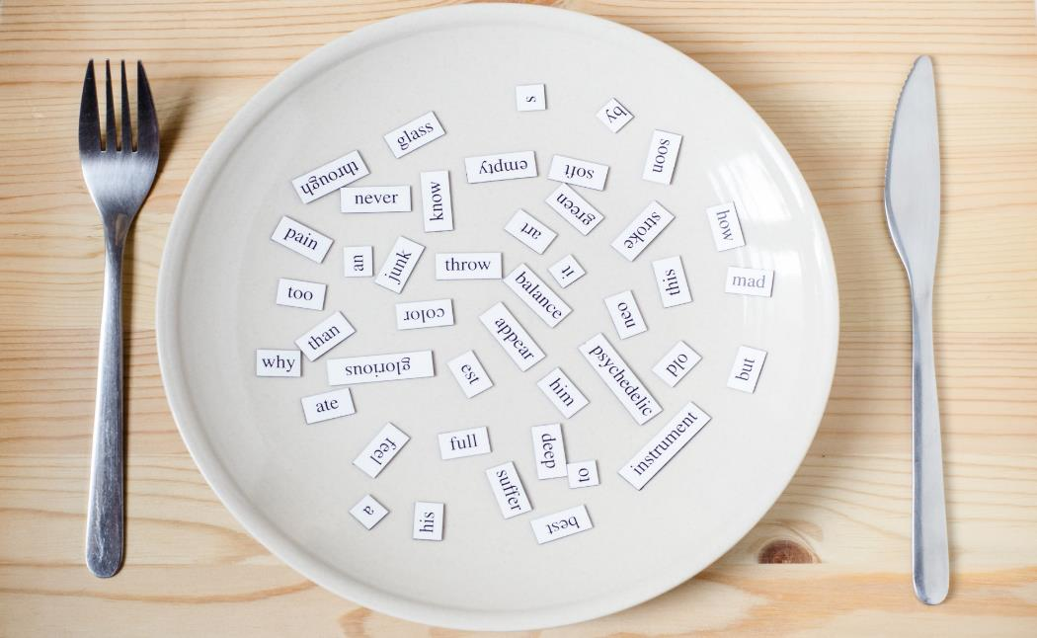
Phonics
/q/

Slide 9
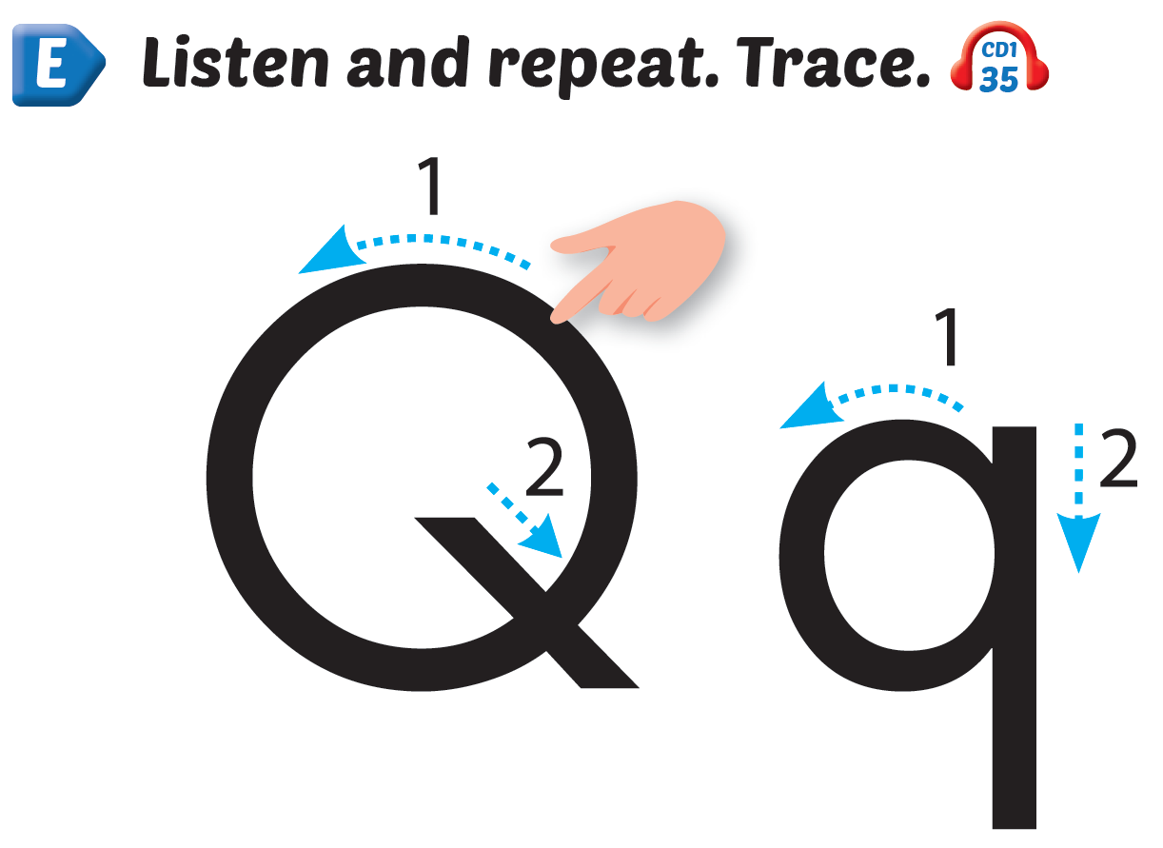
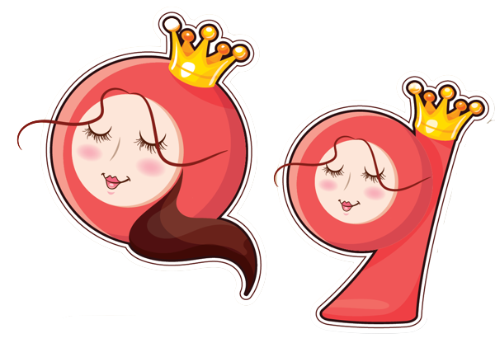
Click Alphabet to hear the sound
Notes:
Click vào hình A. 1. Listen and point. Repeat để cho cả audio full chạy

Slide 10
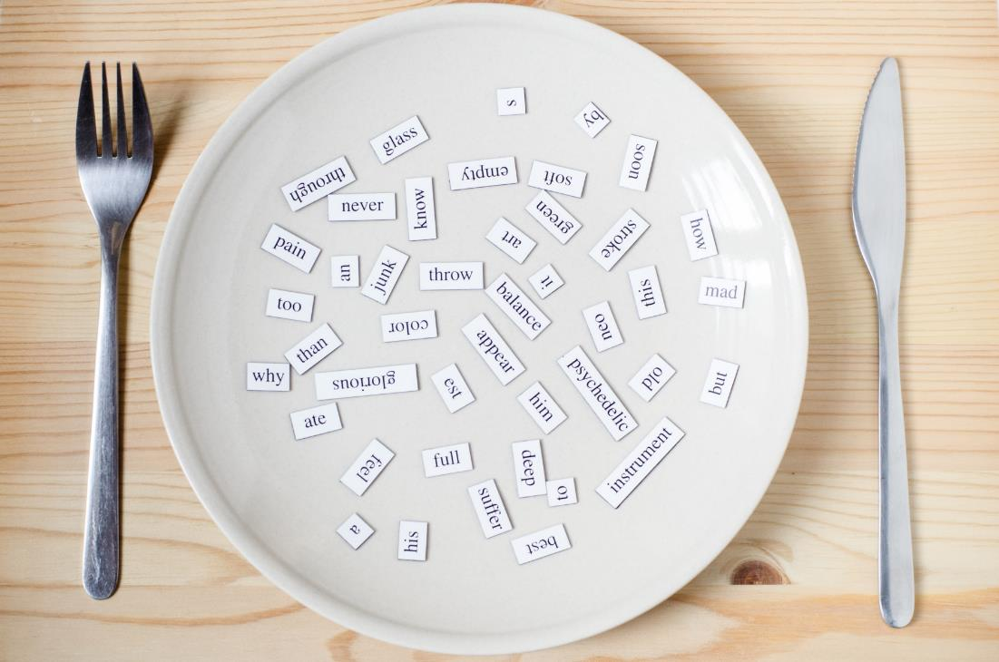
New words
queen, question

Slide 11
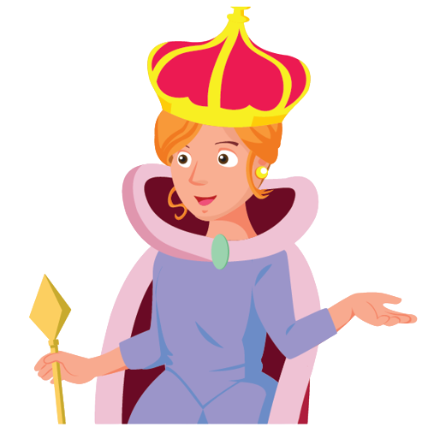

/kwiːn/
nữ hoàng
Notes:
Click vào hình A. 1. Listen and point. Repeat để cho cả audio full chạy

Slide 12


/ˈkwestʃən/
câu hỏi
Notes:
Click vào hình A. 1. Listen and point. Repeat để cho cả audio full chạy

Slide 13



q
q
Notes:
Click vào hình A. 1. Listen and point. Repeat để cho cả audio full chạy

Slide 14
It’s time to play …

Slide 15
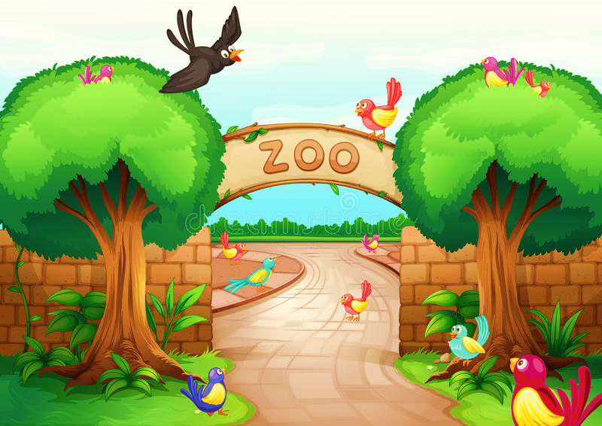

Excellent!
Letter Qq
Letter Pp
(_____________)

Slide 16
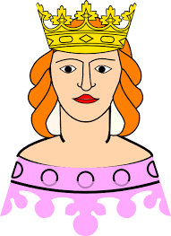
Excellent!
queen
penguin
(_____________)

Slide 17
Excellent!
queen
pen
(_____________)

Slide 18
Excellent!
queen
question
(_____________)

Slide 19
Excellent!
pen
penguin
(_____________)

Slide 20

Excellent!
Letter Qq
Letter Pp
(_____________)

Slide 21

Excellent!
queen
penguin
(_____________)

Slide 22
Excellent!
Letter Pp
Letter Qq
What’s your name?
(_____________)

Slide 23

Practice

Slide 24

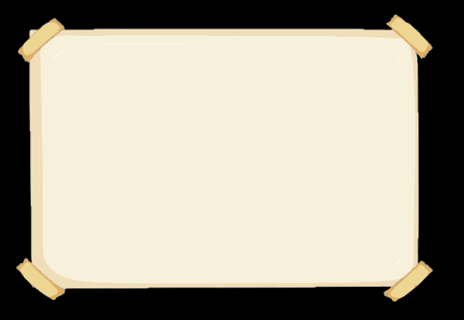

This is a ,
q, q, .
This is a ,
q, q, q.
Notes:
Click vào hình A. 1. Listen and point. Repeat để cho cả audio full chạy

Slide 25


Notes:
Click vào hình A. 1. Listen and point. Repeat để cho cả audio full chạy

Slide 26

Further Practice

Slide 27

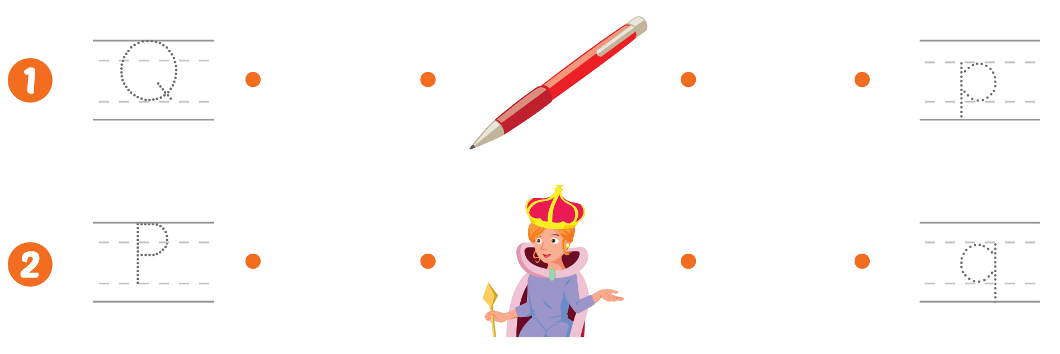

Slide 28

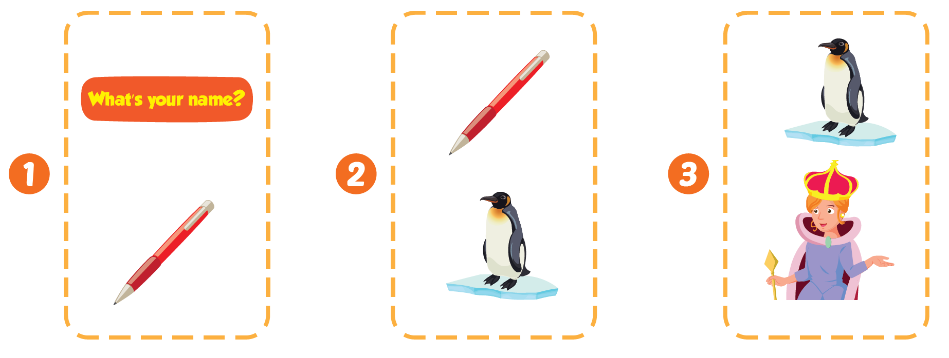





Slide 29

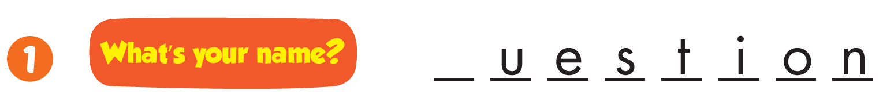
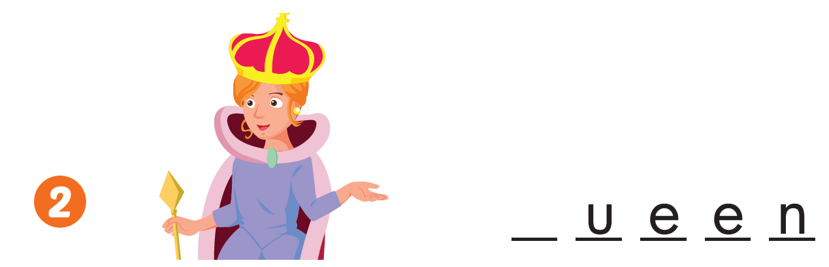
q
q

Slide 30

CONSOLIDATION

Slide 31
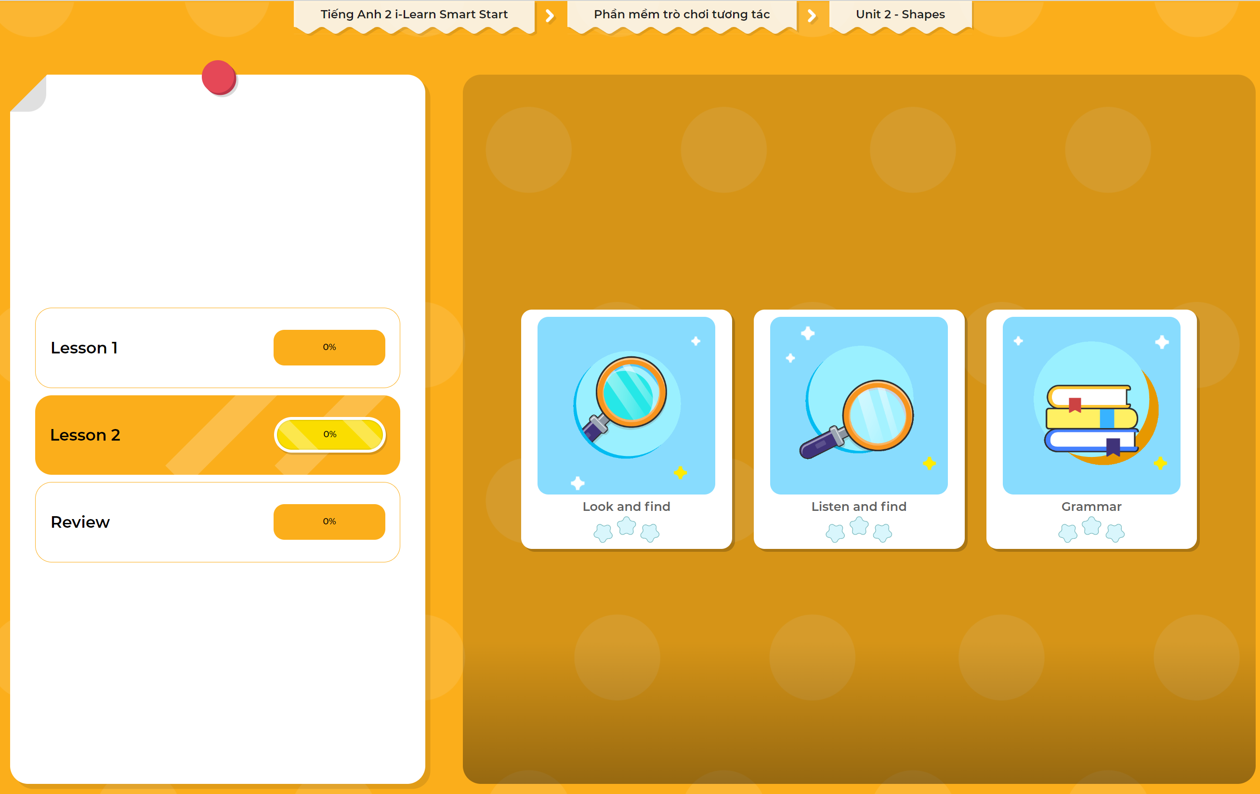
Extra Practice
DHA App
LET’S PLAY!
Click here to play the games

Slide 32

WRAP-UP

Slide 33
Today’s lesson
Structures/ Sentence patterns
This is a question.
This is a queen.
Vocabulary
queen, question

Slide 34
Homework
Review the vocabularies and phonics. Practice saying them.
Practice the vocabulary and phonics in Tiếng Anh 2 i-Learn Smart Start Notebook (page 17)
Do the exercises in Tiếng Anh 2 i-Learn Smart Start Workbook (pages 16,17)
Play the consolidation games in Tiếng Anh 2 i-Learn Smart Start DHA App on www.eduhome.com.vn
Prepare the next lesson (page 20)

Slide 35
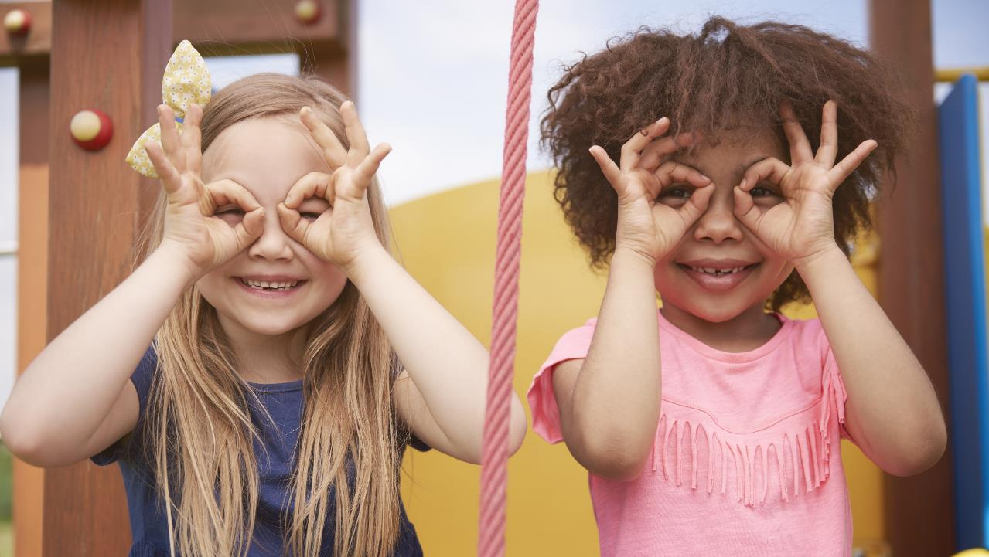
Enjoy your day!

