Slide 1

UNIT 5: FREE TIME ACTIVITIES Lesson 2.1
Page 36

Slide 2
Lesson Outline
Warm-up
Phonics
Practice
Consolidation
Wrap-up

Slide 3
Objectives
By the end of this lesson, students will be able to recognize the /t/ sound.
Phonics: /t/
Vocabulary: tiger, top.
Sentence pattern:
Revise “I can see a (an)…."
Skills: Recognize the letter T/t and make the /t/ sound.

Slide 4

WARM UP

Slide 5


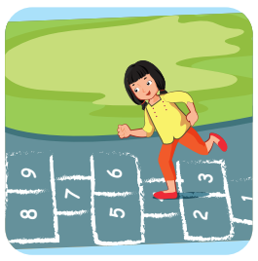

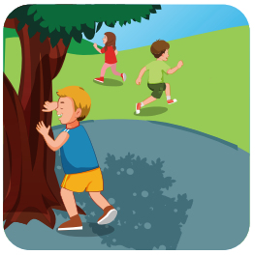
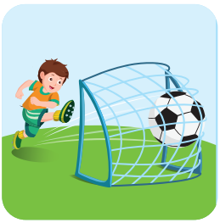
Look at the word and say the right number.
4
3
2
1
hide and seek

Slide 6
Look at the word and say the right number.
4
3
2
1
hopscotch

Slide 7
Look at the word and say the right number.
4
3
2
1
soccer

Slide 8
Look at the word and say the right number.
4
3
2
1
tag

Slide 9

It’s time to learn …

Slide 10
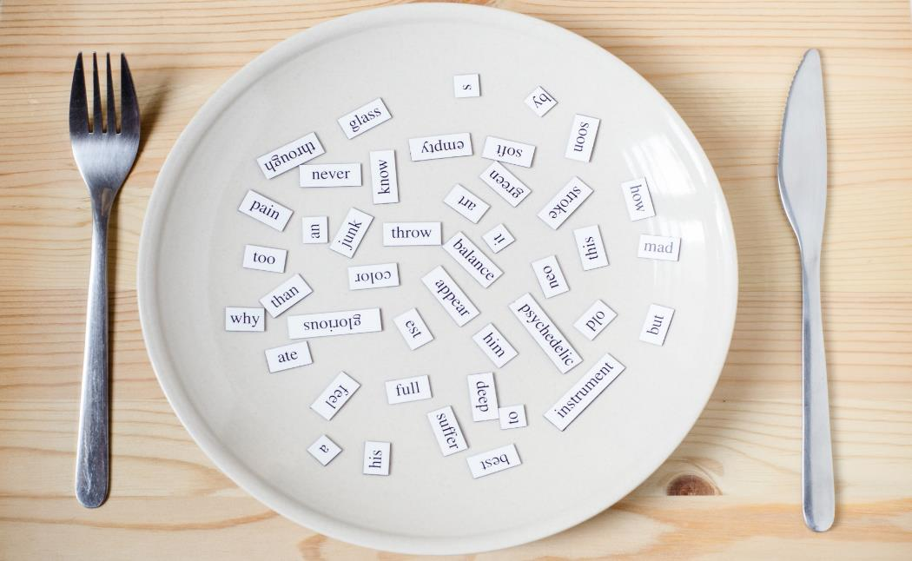
Phonics
/t/
New words
tiger, top

Slide 11
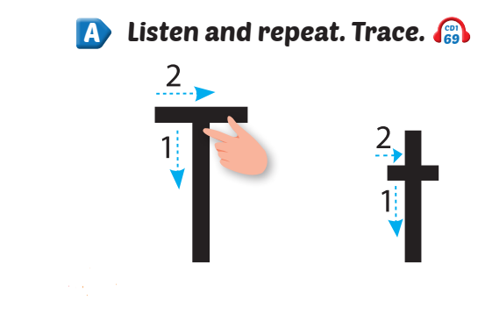


Click Alphabet to hear the sound

Slide 12
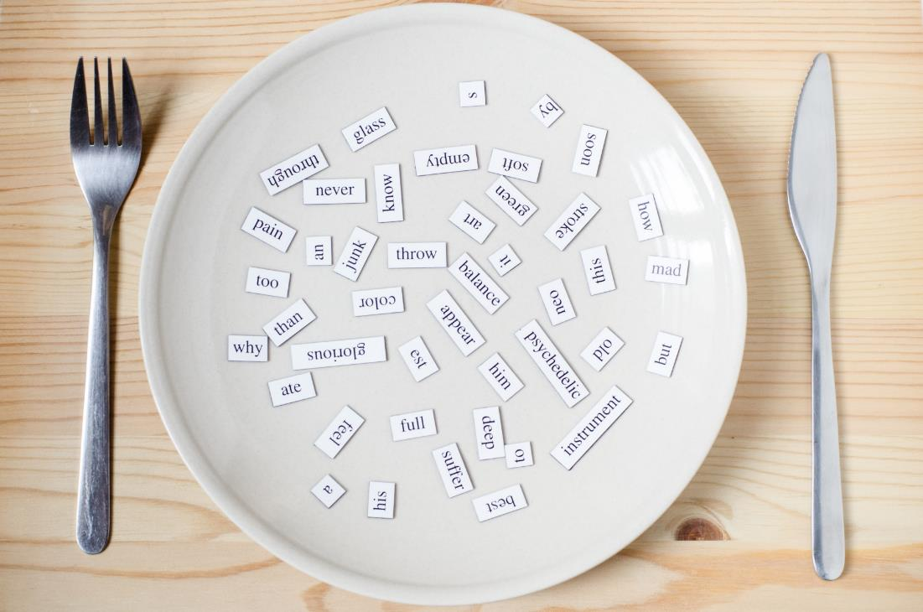
New words
tiger,
top

Slide 13
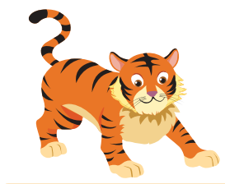
Click the picture to hear the sound.
/t/ /t/
tiger
/ˈtaɪɡər/
con hổ

Slide 14

Click the picture to hear the sound.
/t/ /t/
top
/tɒp/
con quay

Slide 15

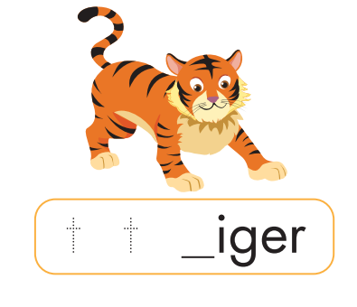
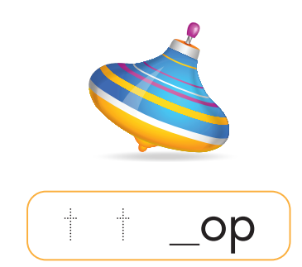
Click the picture to hear the sound.
t
t

Slide 16


tiger
two
tag
top

Slide 17
HIDDEN PICTURE

Slide 18



tiger
Answer

Slide 19
top
Answer

Slide 20
two
Answer

Slide 21
tag
Answer

Slide 22

Practice

Slide 23


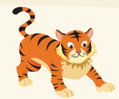
I can see a ,
t, t, .
I can see a ,
t, t, t.
Notes:
Click vào hình A. 1. Listen and point. Repeat để cho cả audio full chạy

Slide 24



Slide 25

Further Practice

Slide 26

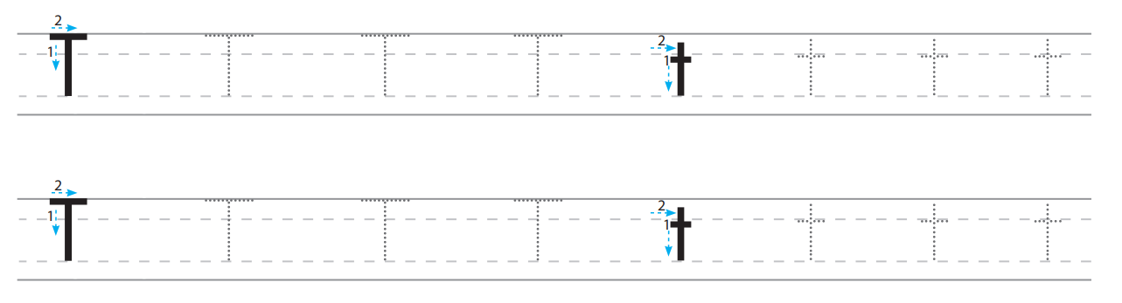

Slide 27

CONSOLIDATION

Slide 28

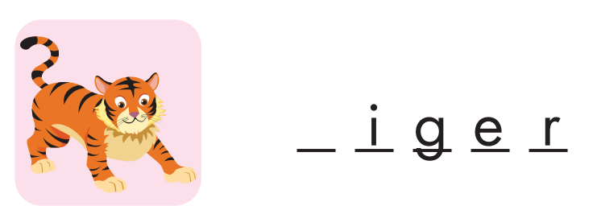

t
t

Slide 29
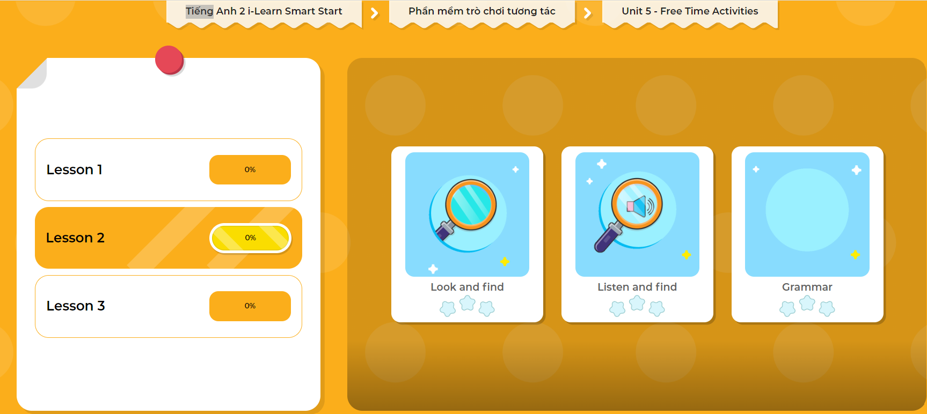
Extra Practice
DHA App
LET’S PLAY!
Click here to play the games

Slide 30

WRAP-UP

Slide 31
Today’s lesson
Structures/ Sentence patterns
I can see a…….
Vocabulary
tiger, top

Slide 32
Homework
Practice saying the sound.
Do the exercise in Tiếng Anh 2 i-Learn Smart Start Notebook (page 30).
Do the exercises in Tiếng Anh 2 i-Learn Smart Start Workbook (page 34).
Play the consolidation games in Tiếng Anh 2 i-Learn Smart Start DHA App on www.eduhome.com.vn
Prepare the next lesson (page 37).

Slide 33

Enjoy your day!

