Slide 1

UNIT 5: FREE TIME ACTIVITIES Lesson 3.1
Page 38

Slide 2
Lesson Outline
Warm-up
Vocabulary
Structure
Practice
Consolidation
Wrap-up

Slide 3
Objectives
By the end of this lesson, students will be able to talk about activities they do and say “ Happy…/Merry…..” on special occasions.
Vocabulary: ride my bike, read books, listen to music, eat snacks.
Sentence pattern: I (read books).

Slide 4

WARM UP

Slide 5

Letter QUIZ

Slide 6






Letter t

Slide 7


Letter t

Slide 8


Letter u

Slide 9


Letter u

Slide 10

It’s time to learn …

Slide 11
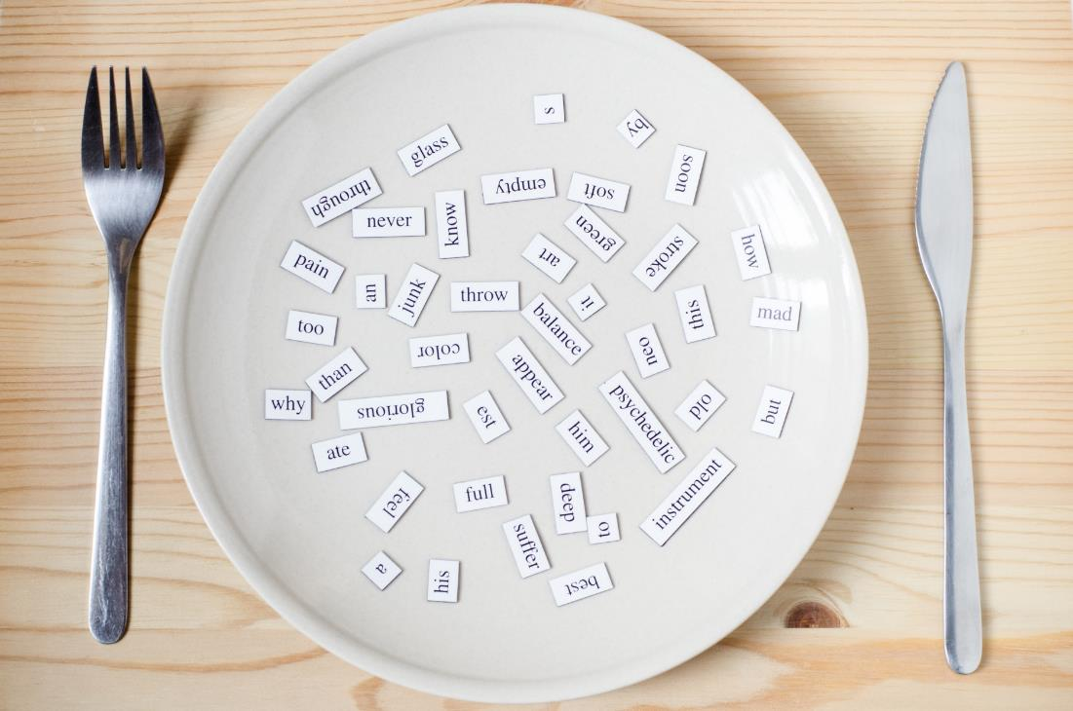
New words
ride my bike,
read books,
listen to music,
eat snacks.

Slide 12




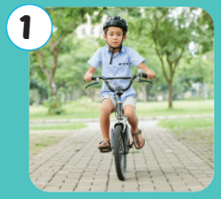

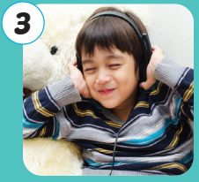
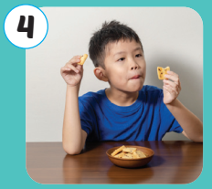
Click A to hear the sound
Notes:
Click vào hình A. 1. Listen and point. Repeat để cho cả audio full chạy

Slide 13




Click pictures to hear the sound
/raɪd mai baɪk/
đi xe đạp
/riːd bʊk/
đọc sách
/ˈlɪsn to ˈmjuːzɪk/
nghe nhạc
/iːt snæk/
ăn nhẹ
Notes:
Click vào hình A. 1. Listen and point. Repeat để cho cả audio full chạy

Slide 14
Click pictures to hear the sound
/raɪd mai baɪk/
đi xe đạp
Notes:
Click vào hình A. 1. Listen and point. Repeat để cho cả audio full chạy

Slide 15
Click pictures to hear the sound
/riːd bʊk/
đọc sách
Notes:
Click vào hình A. 1. Listen and point. Repeat để cho cả audio full chạy

Slide 16
Click pictures to hear the sound
/ˈlɪsn to ˈmjuːzɪk/
nghe nhạc
Notes:
Click vào hình A. 1. Listen and point. Repeat để cho cả audio full chạy

Slide 17
Click pictures to hear the sound
/iːt snæk/
ăn nhẹ
Notes:
Click vào hình A. 1. Listen and point. Repeat để cho cả audio full chạy

Slide 18
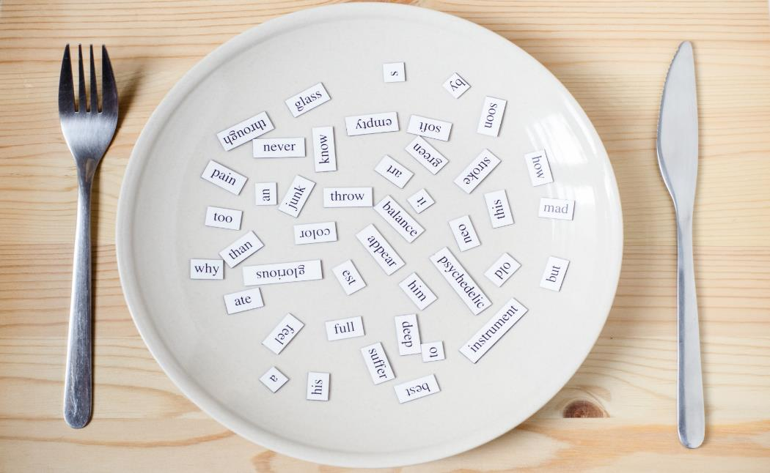
Structures
I (read books).

Slide 19

Practice

Slide 20

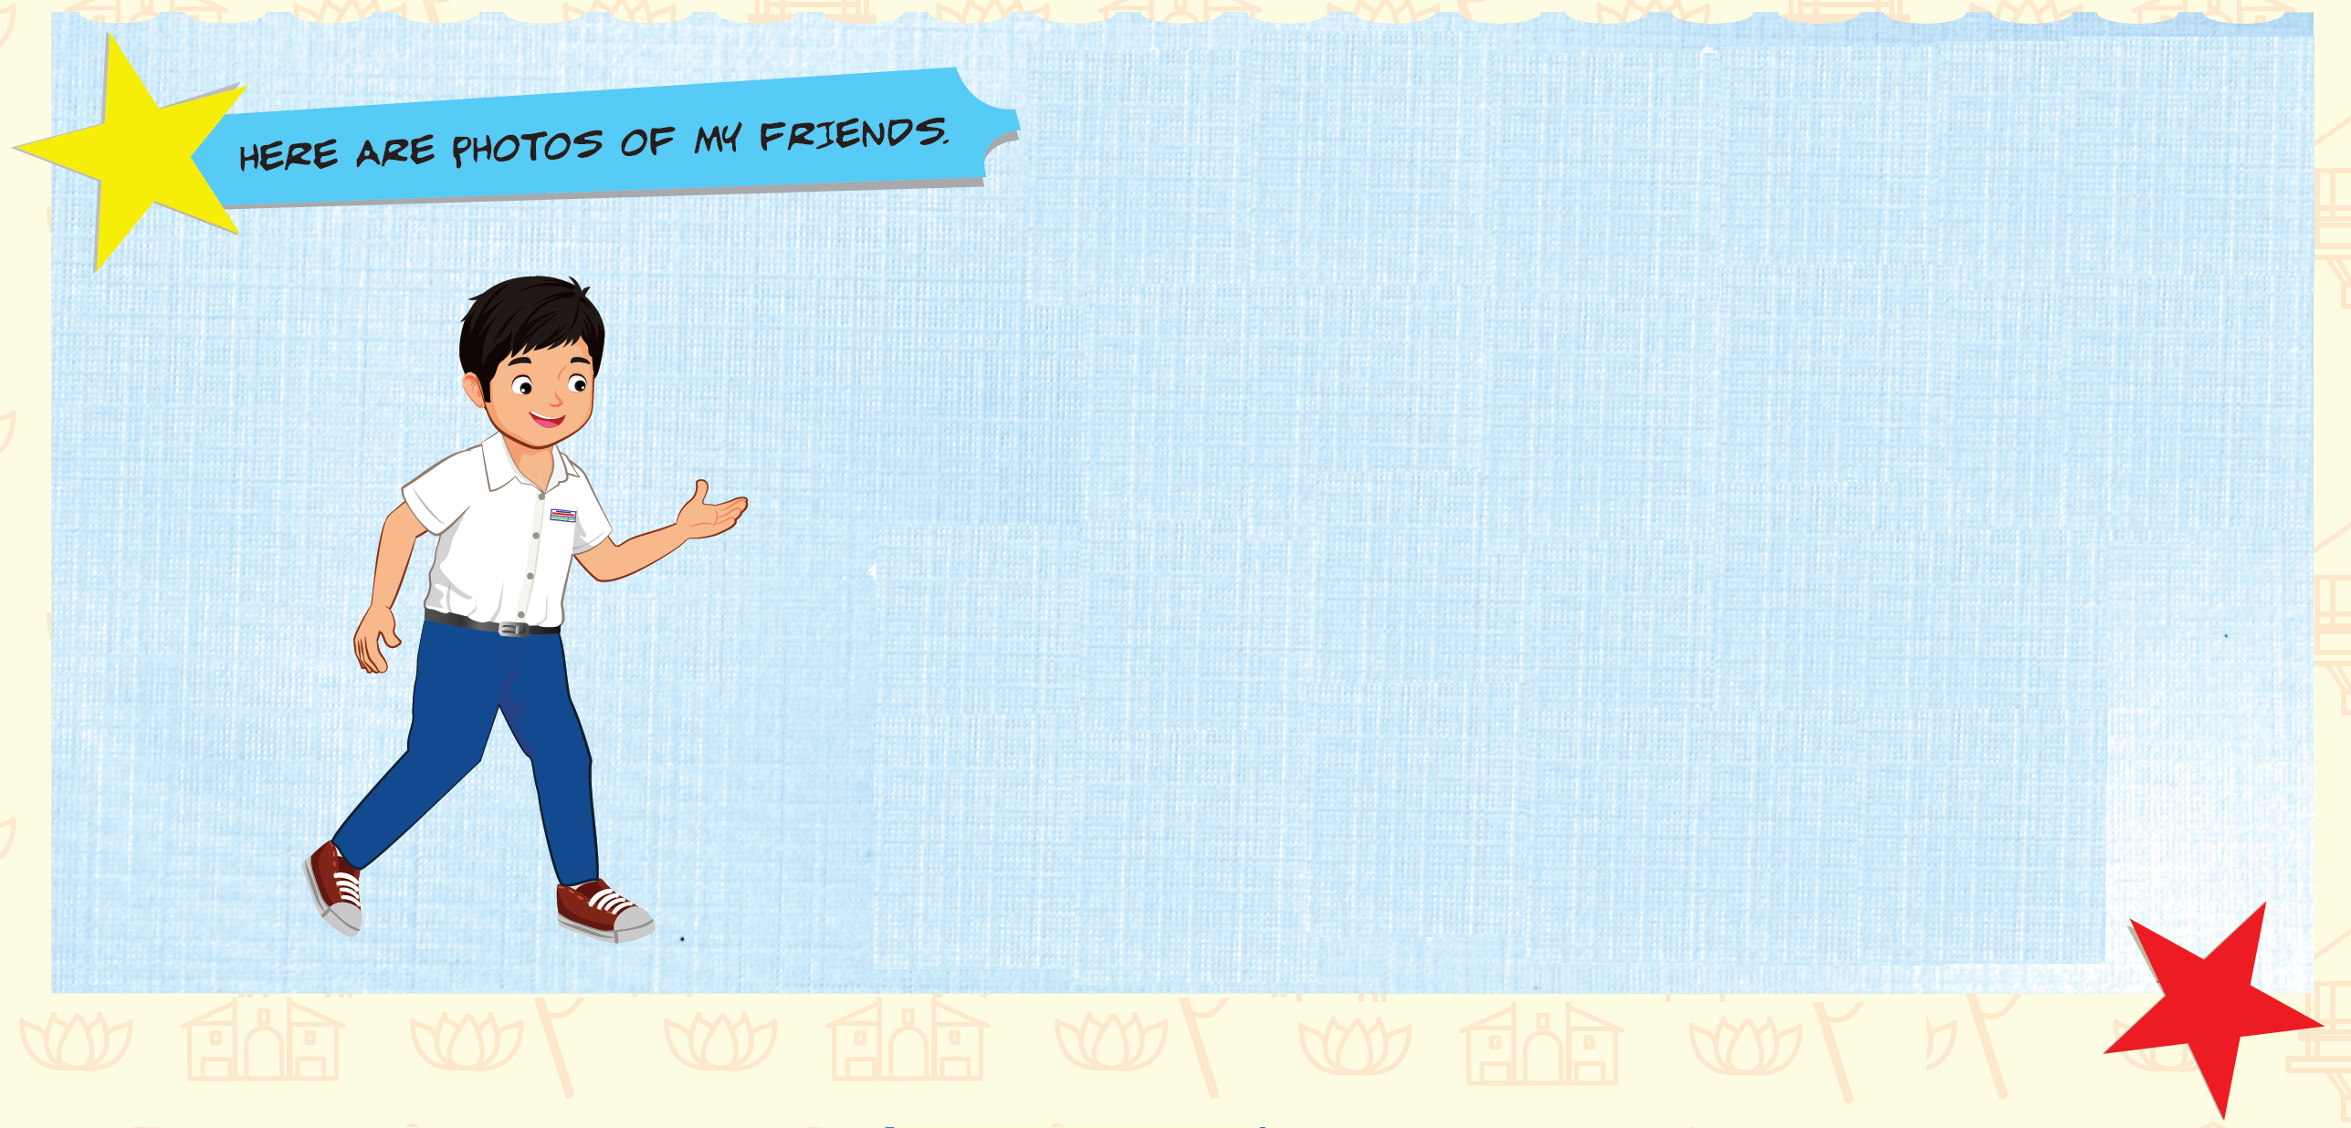


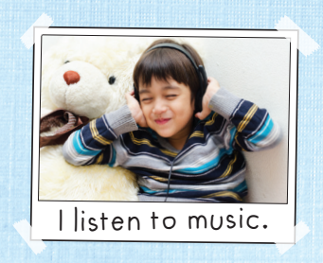
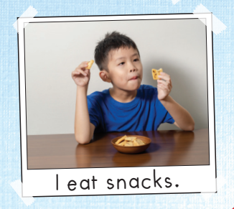
One weekend...
Click B and pictures to hear the sound
Notes:
B. Listen and point. Repeat. Role-play. (CD1 Track 03)
Have students call out the things they can see in each picture.
Play the audio and have them point to the characters.
Play the audio again and have them repeat the new words.
Divide the class into pairs to role-play the dialogue.
Swap roles and repeat.
Invite some pairs to demonstrate the activity in front of the whole class.
Go around the class and support them if necessary.

Slide 21

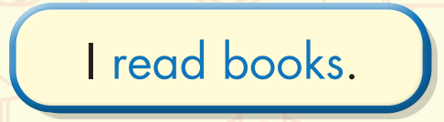
Click 2 to hear the sound
Notes:
B. Listen and point. Repeat. Role-play. (CD1 Track 03)
Have students call out the things they can see in each picture.
Play the audio and have them point to the characters.
Play the audio again and have them repeat the new words.
Divide the class into pairs to role-play the dialogue.
Swap roles and repeat.
Invite some pairs to demonstrate the activity in front of the whole class.
Go around the class and support them if necessary.

Slide 22

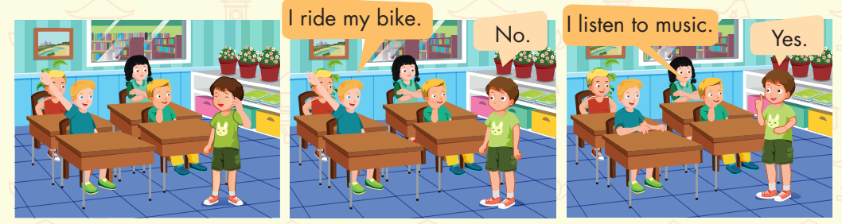
Notes:
B. Listen and point. Repeat. Role-play. (CD1 Track 03)
Have students call out the things they can see in each picture.
Play the audio and have them point to the characters.
Play the audio again and have them repeat the new words.
Divide the class into pairs to role-play the dialogue.
Swap roles and repeat.
Invite some pairs to demonstrate the activity in front of the whole class.
Go around the class and support them if necessary.

Slide 23
It’s time to play …

Slide 24




Click on the right word
read books
listen to music
ride my bike

Slide 25

Click on the right word
listen to music
read books
eat snacks

Slide 26

Click on the right word
eat snacks
read books
listen to music

Slide 27

Click on the right word
ride my bike
listen to music
read books

Slide 28

Further Practice

Slide 29

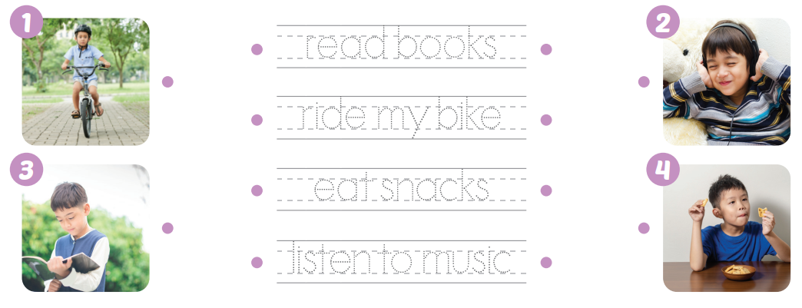

Slide 30

CONSOLIDATION

Slide 31

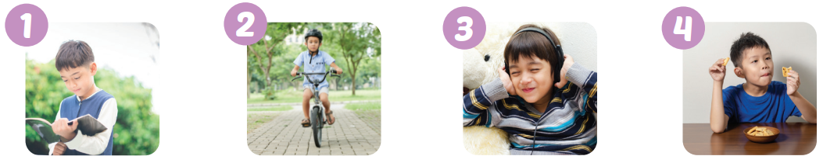

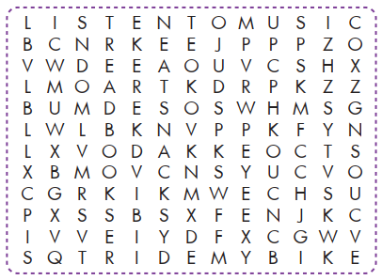

Slide 32
Extra Practice
DHA App
LET’S PLAY!
Click here to play the games

Slide 33
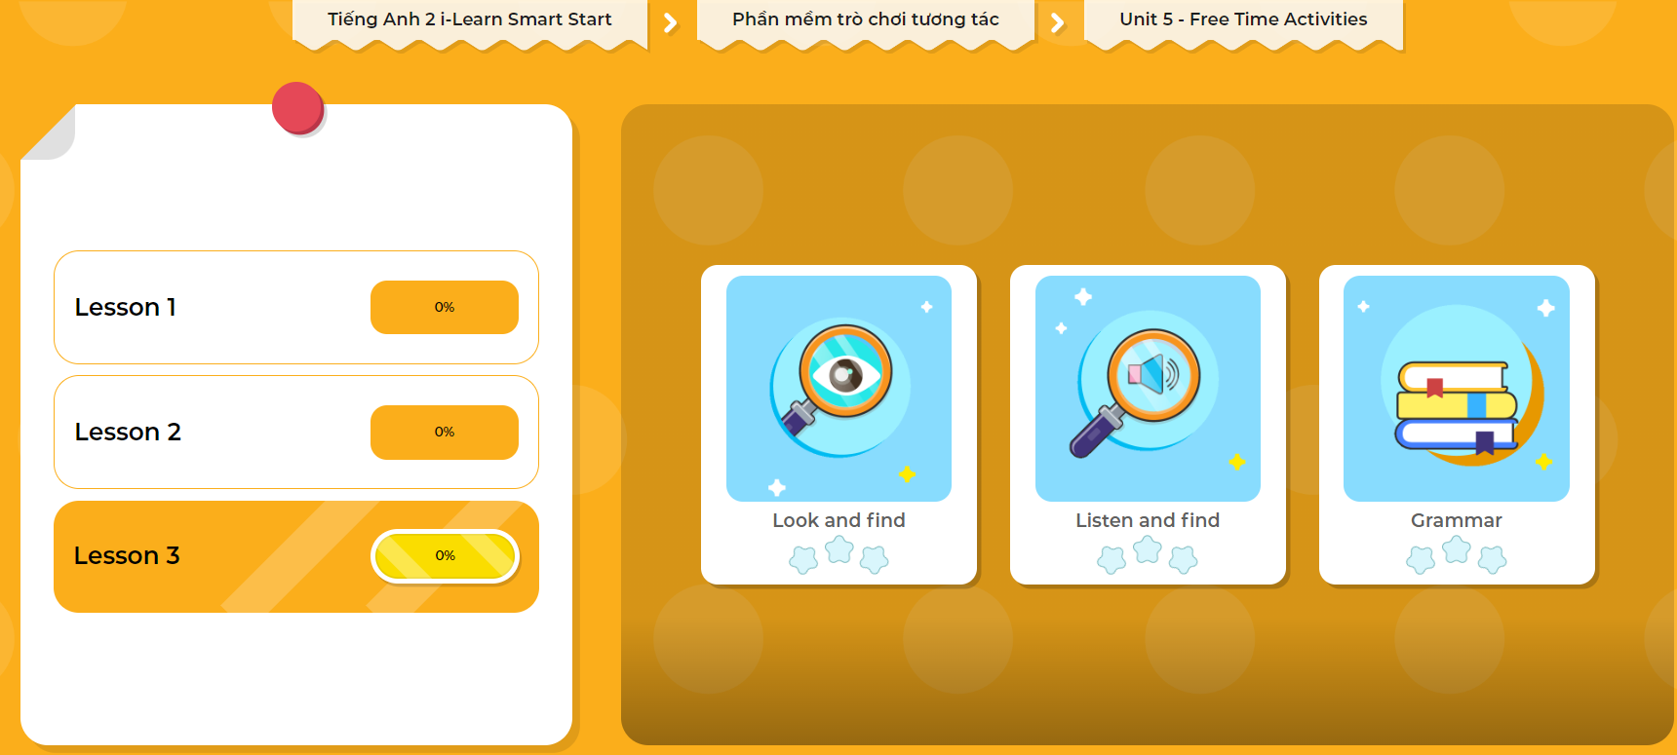
Extra Practice
DHA App
LET’S PLAY!
Click here to play the games

Slide 34

WRAP-UP

Slide 35
Today’s lesson
Vocabulary
ride my bike,
read books,
listen to music,
eat snacks
Structures/ Sentence patterns
I (read books).

Slide 36
Homework
Review the vocabularies and structure. Make sentences using them.
Practice the vocabulary and structure in Tiếng Anh 2 i-Learn Smart Start Notebook (page 32).
Do the exercises in Tiếng Anh 2 i-Learn Smart Start Workbook (page 36).
Play the consolidation games in Tiếng Anh 2 i-Learn Smart Start DHA App on www.eduhome.com.vn
Prepare the next lesson (page 39).

Slide 37

Enjoy your day!

