Slide 2
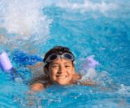
5
My hobbies
LESSON 1
Period 1

Slide 3
Contents
03
Listen, point and say.
01
Warm-up
04
Let’s talk.
02
Look, listen and repeat.
05
Fun corner and wrap-up

Slide 4
1 Warm-up
Let’s play a game.

Slide 6
2 Look, listen and repeat.

Slide 7
Notes:
Step 1: Ask pupils to look at context a. Play the recording for them to listen. Play the recording again, sentence by sentence, for them to listen and repeat. Correct pronunciation if necessary.
Step 2: Do the same with context b.
Step 4: Work in pair - role play.
Step 5: Invite few pairs to the front of the class and act.

Slide 8
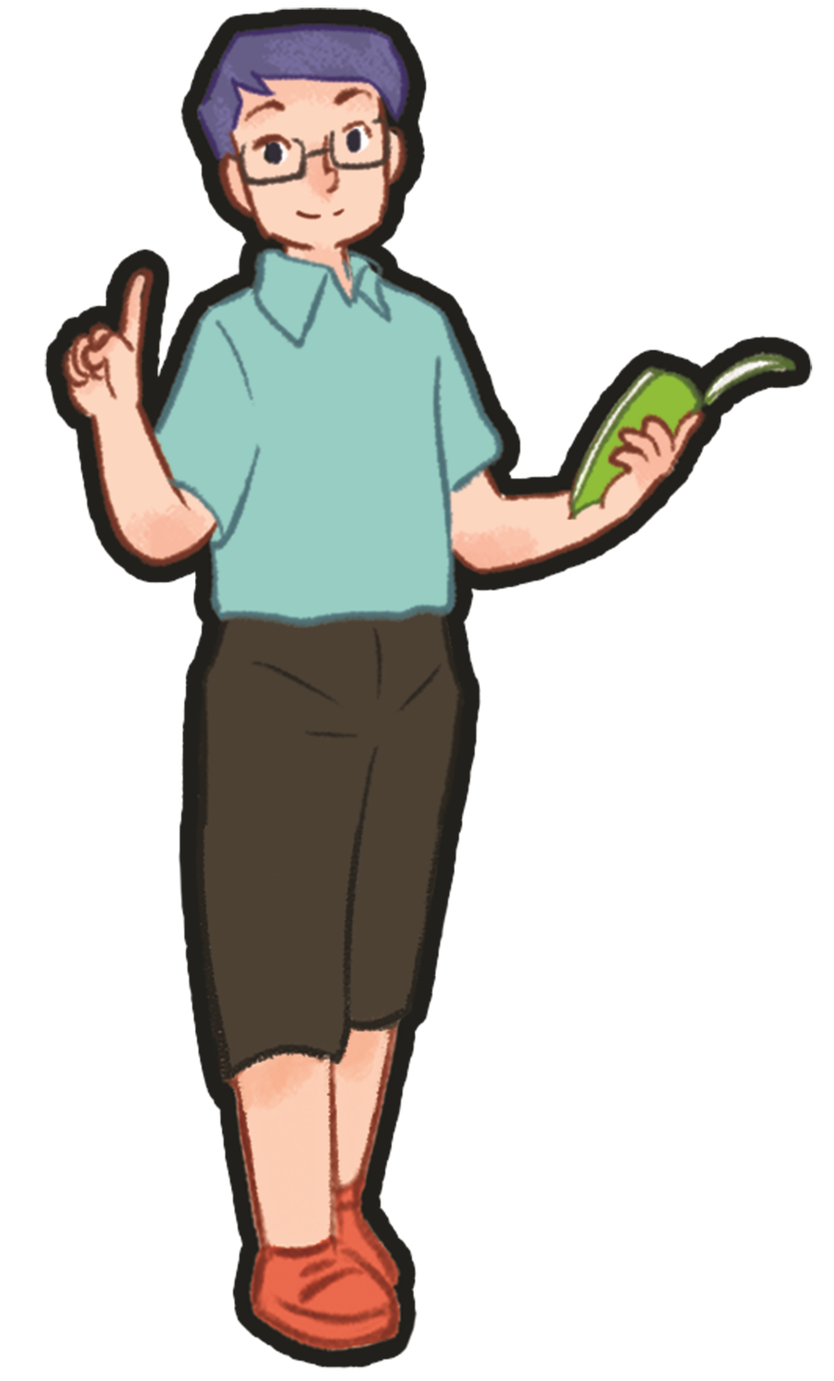
2 Listen, point and say.

Slide 9
Notes:
Step 1: Have pupils look at the pictures and elicit the names of the pupils. Have the class repeat the words a few time.
Step 2: Ask 2 pupils to do as an example.
Step 4: Ask pupils to work in pairs, pointing to the questions and pictures and giving the answers.
Step 5: Invite few pairs to the front of the class and make questions and answers.

Slide 10
singing

Slide 11
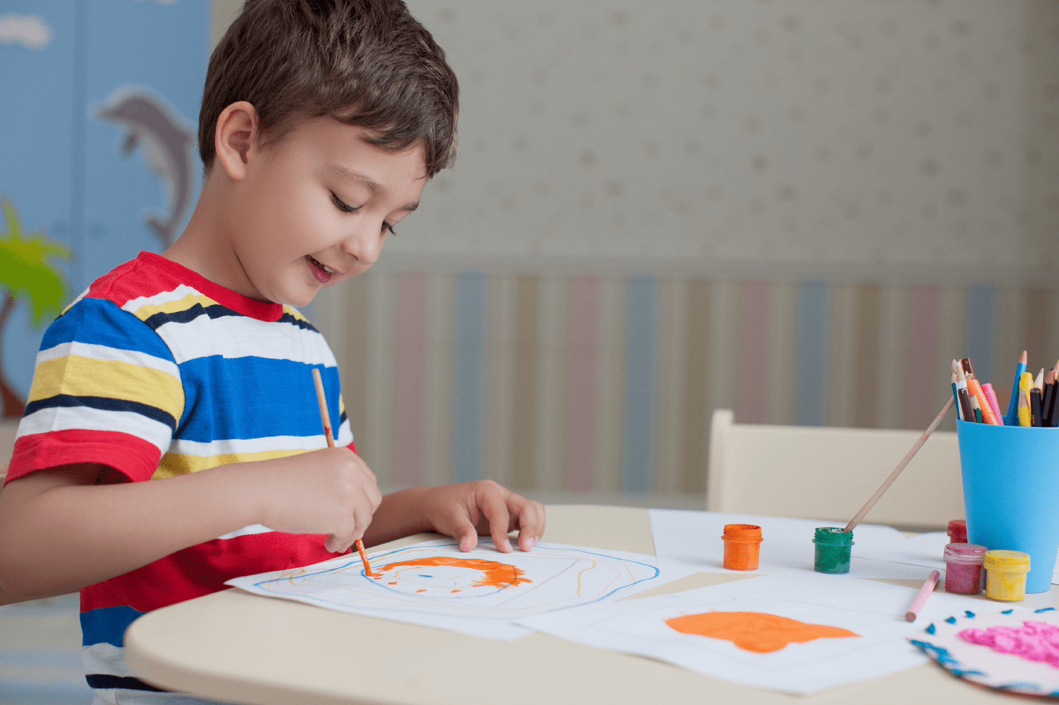
drawing

Slide 12
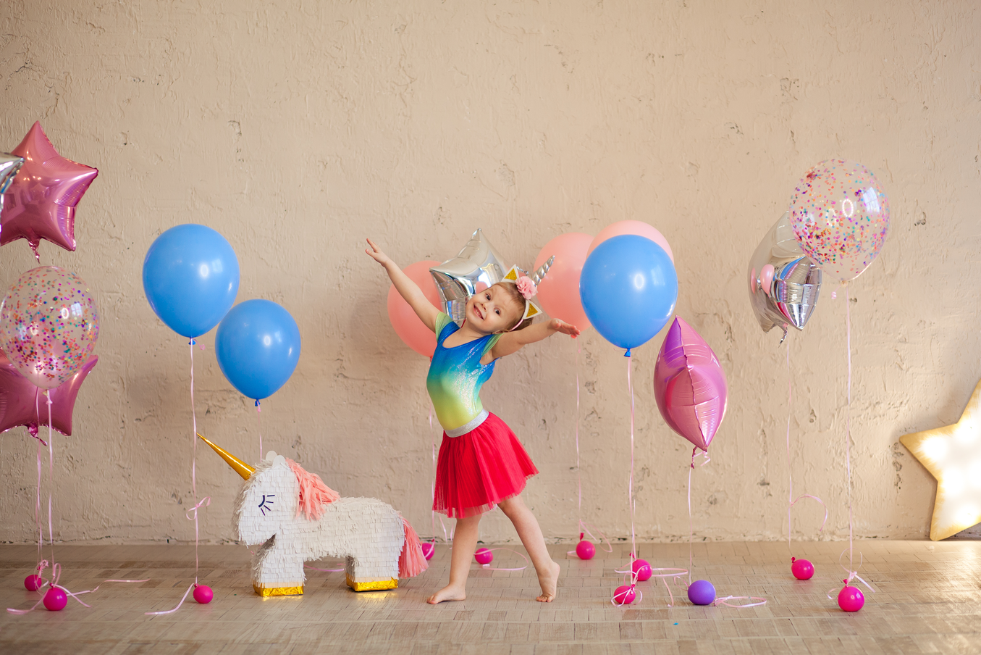
dancing

Slide 13
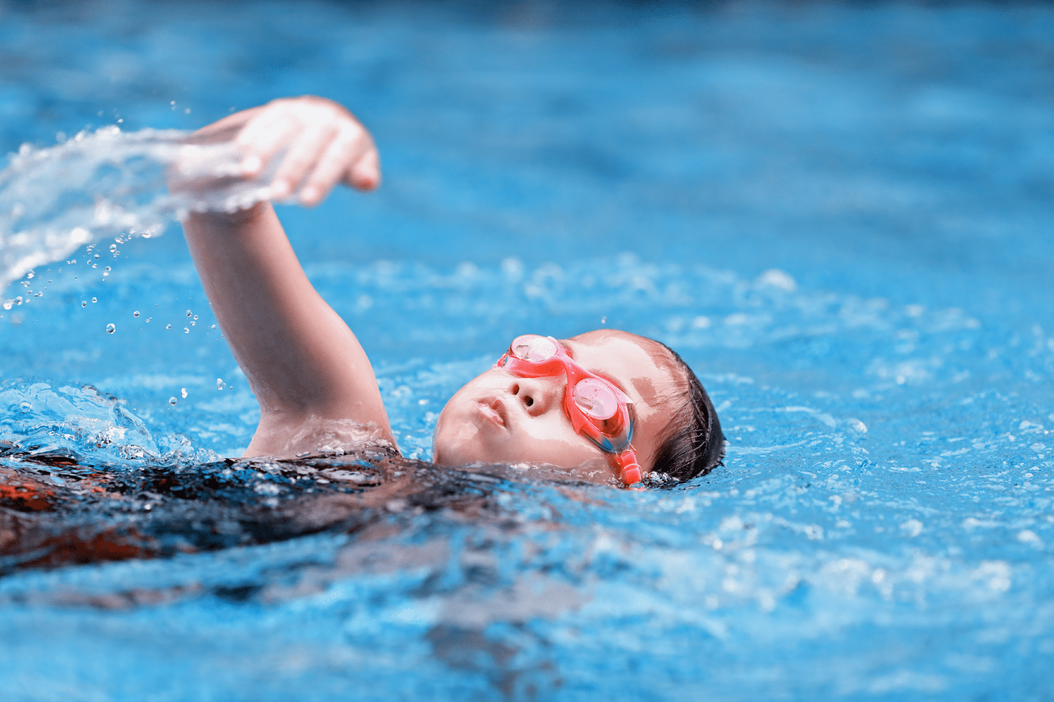
swimming

Slide 14
Notes:
Step 1: Have pupils look at the pictures and elicit the names of the pupils. Have the class repeat the words a few time.
Step 2: Ask 2 pupils to do as an example.
Step 4: Ask pupils to work in pairs, pointing to the questions and pictures and giving the answers.
Step 5: Invite few pairs to the front of the class and make questions and answers.

Slide 15
What’s missing?
Notes:
Game: What’s missing?
Divide the class into 4 groups.
A pupil from each group comes to the front, look at the pictures and say which is missing.
Who say it fast will get points.

Slide 16
What’s missing?

Slide 17
What’s missing?

Slide 18
What’s missing?

Slide 19
What’s missing?

Slide 20
4 Let’s talk.

Slide 22
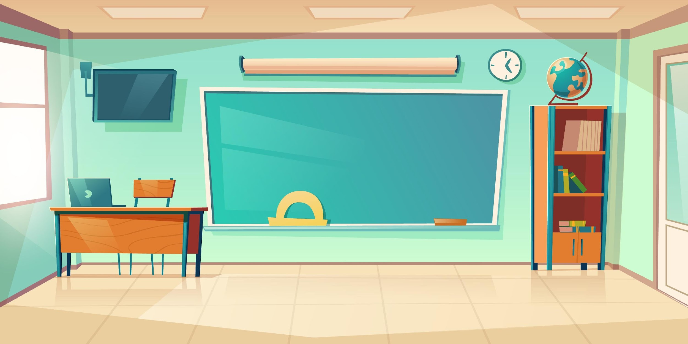
It’s ____.
What’s your hobby?
Notes:
- T asks pupils to practise in pairs asking and answering.
- T asks some pairs to present in front of class.

Slide 23
Matching game

Slide 24
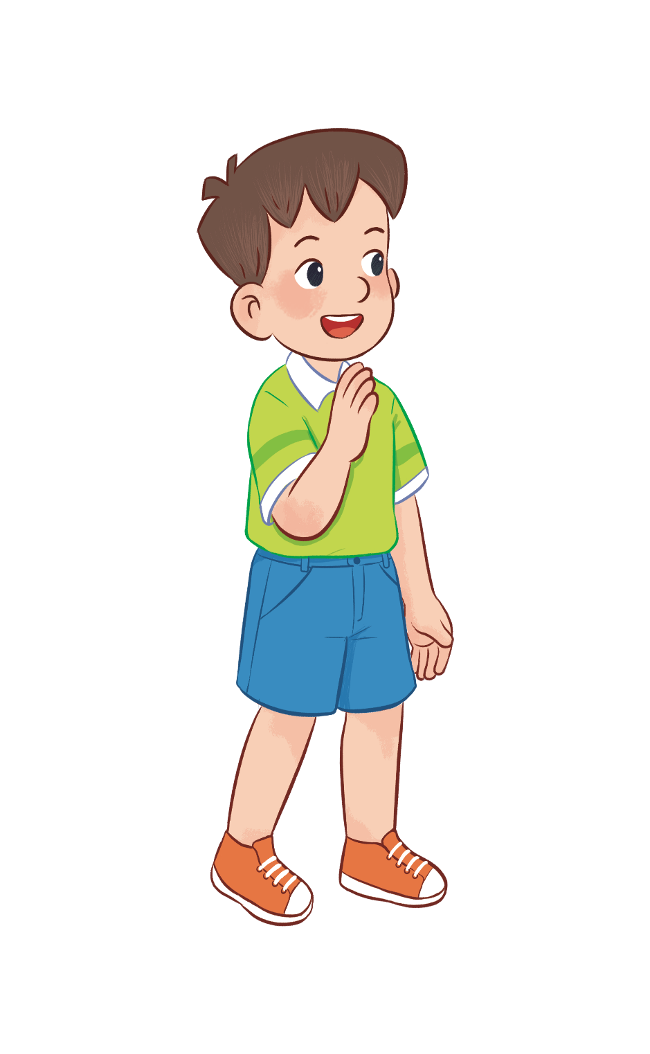
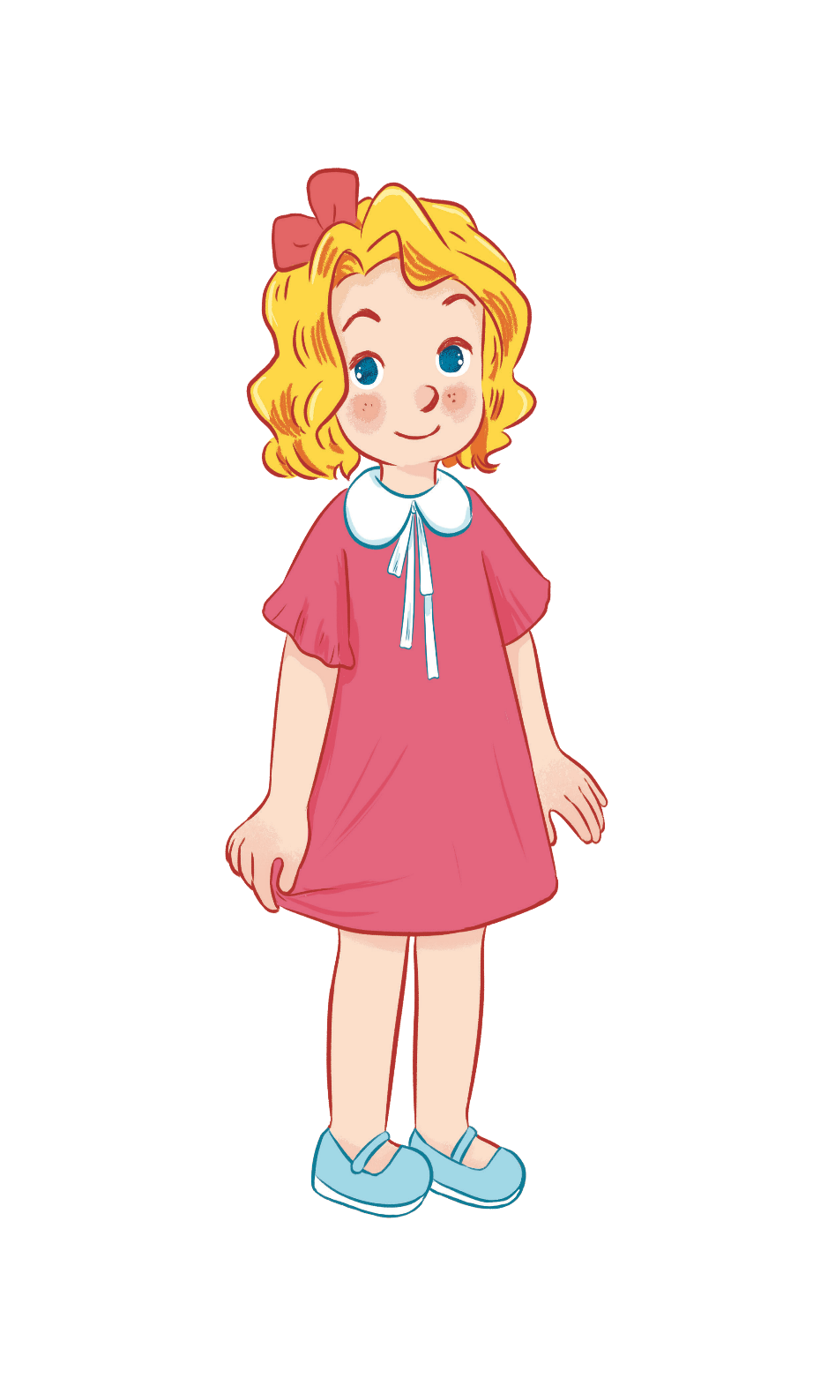
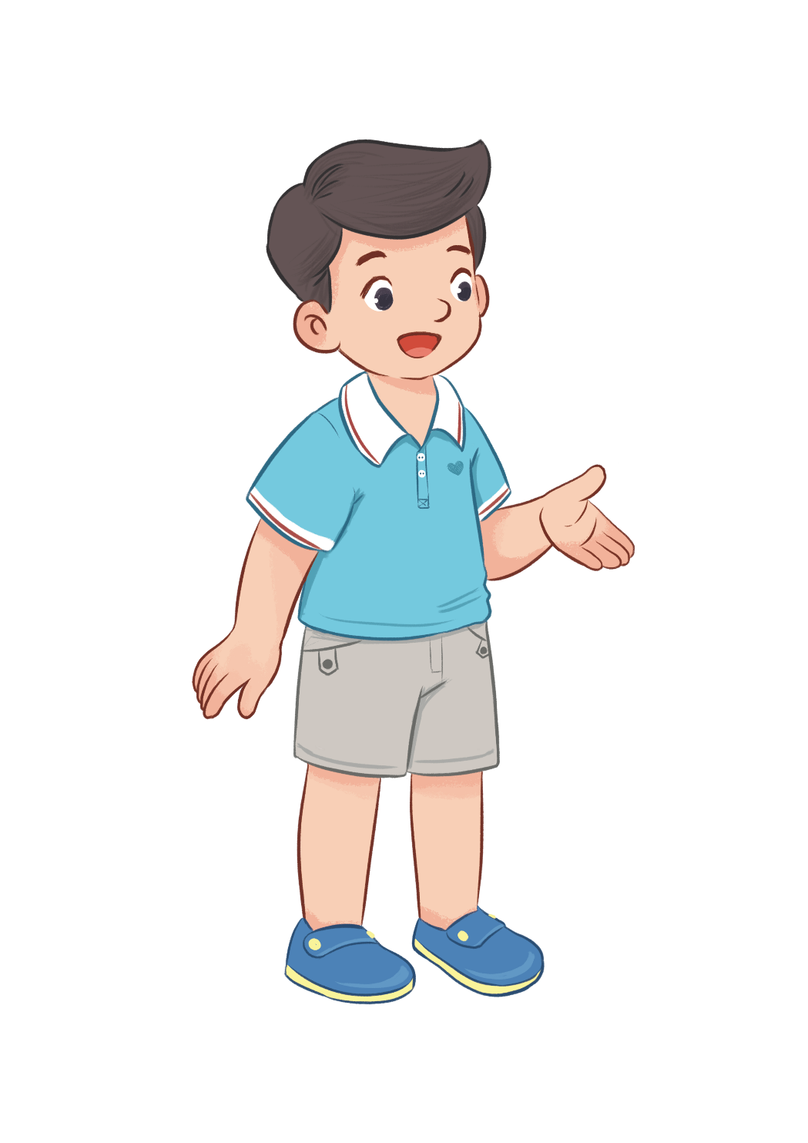
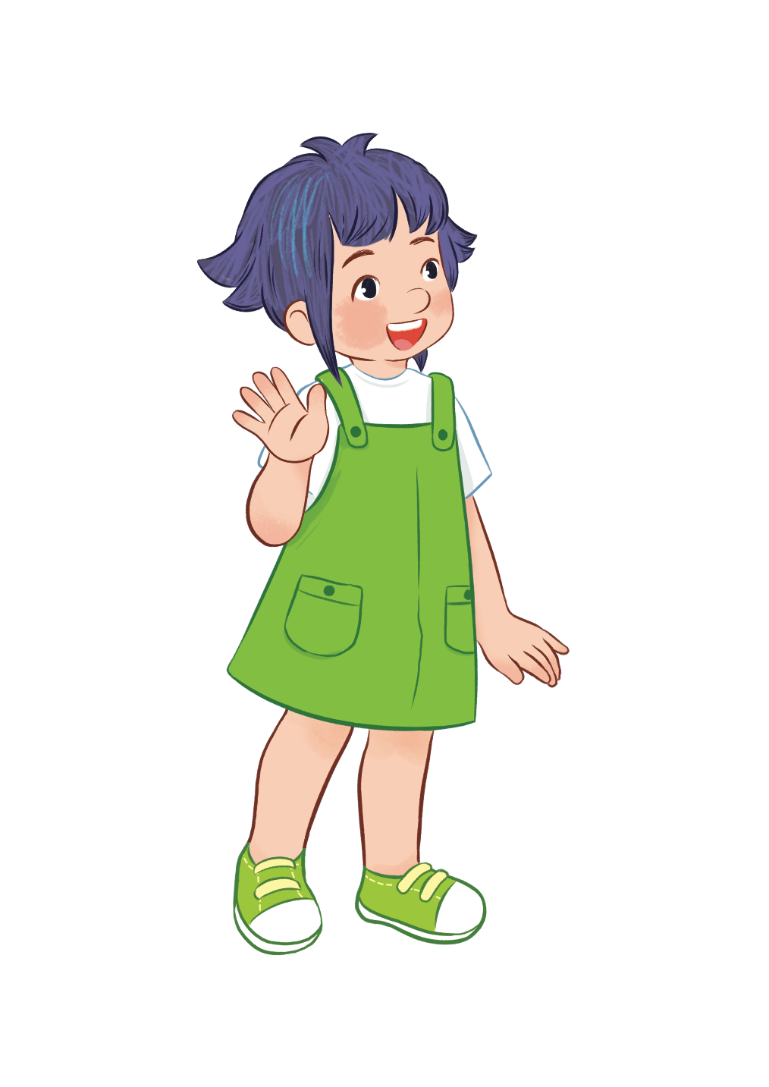
HOBBIES
drawing
swimming
dancing
singing
Notes:
- T writes 4 new words on the board and asks pupils to read (whole class).
- T asks 4 pupils to come to the board and write their hobbies in the pieces of paper and keep them in secret.

Slide 25
swimming/ drawing, ..?
dancing/ singing, ..?
dancing/ singing, ...?
swimming/ drawing, ...?
HOBBIES
drawing
swimming
dancing
singing
Notes:
T asks 1 pupil come to the board and guess their hobbies written in the paper (He has to write the answers in the small pieces of paper and stick to 4 pupils).

Slide 26
It’s swimming.
HOBBIES
drawing
swimming
dancing
singing
What’s your hobby?
swimming
singing
dancing
drawing
Notes:
T asks the pupil to ask the question to find the answers and gives him or her point if correct (repeat the activities depending the time).

Slide 27
5 Fun corner and Wrap-up

Slide 28
Notes:
- T asks 1 student come to the board and face to the class.
- T shows 1 picture of 4 hobbies and lets the others act so that the pupil on the board can guess the name of the hobby in the picture (1 pupil will guess 3 pictures).

Slide 29
What’s your hobby?
Notes:
T shows 4 pictures on the board and asks pupils to repeat -> Wrap up.

Slide 30
Website: hoclieu.vn
Fanpage: facebook.com/www.tienganhglobalsuccess.vn

