Slide 2
6
Our school
LESSON 1 PERIOD 1

Slide 3
Contents
Warm-up
Activity 1
01
02
Activity 2
Activity 3
03
04
Sing a song
Look, listen and repeat.
Listen, point and say.
Let’s talk.
Fun corner
05
Game

Slide 4
Warm-up

Slide 6
Look, listen and repeat.

Slide 7
Look and answer the questions.
Where are they?
Who are they?
What are they doing?

Slide 10
Work in pairs. Practise.
Listen and repeat.

Slide 11
Listen, point and say.

Slide 12
New words

Slide 13
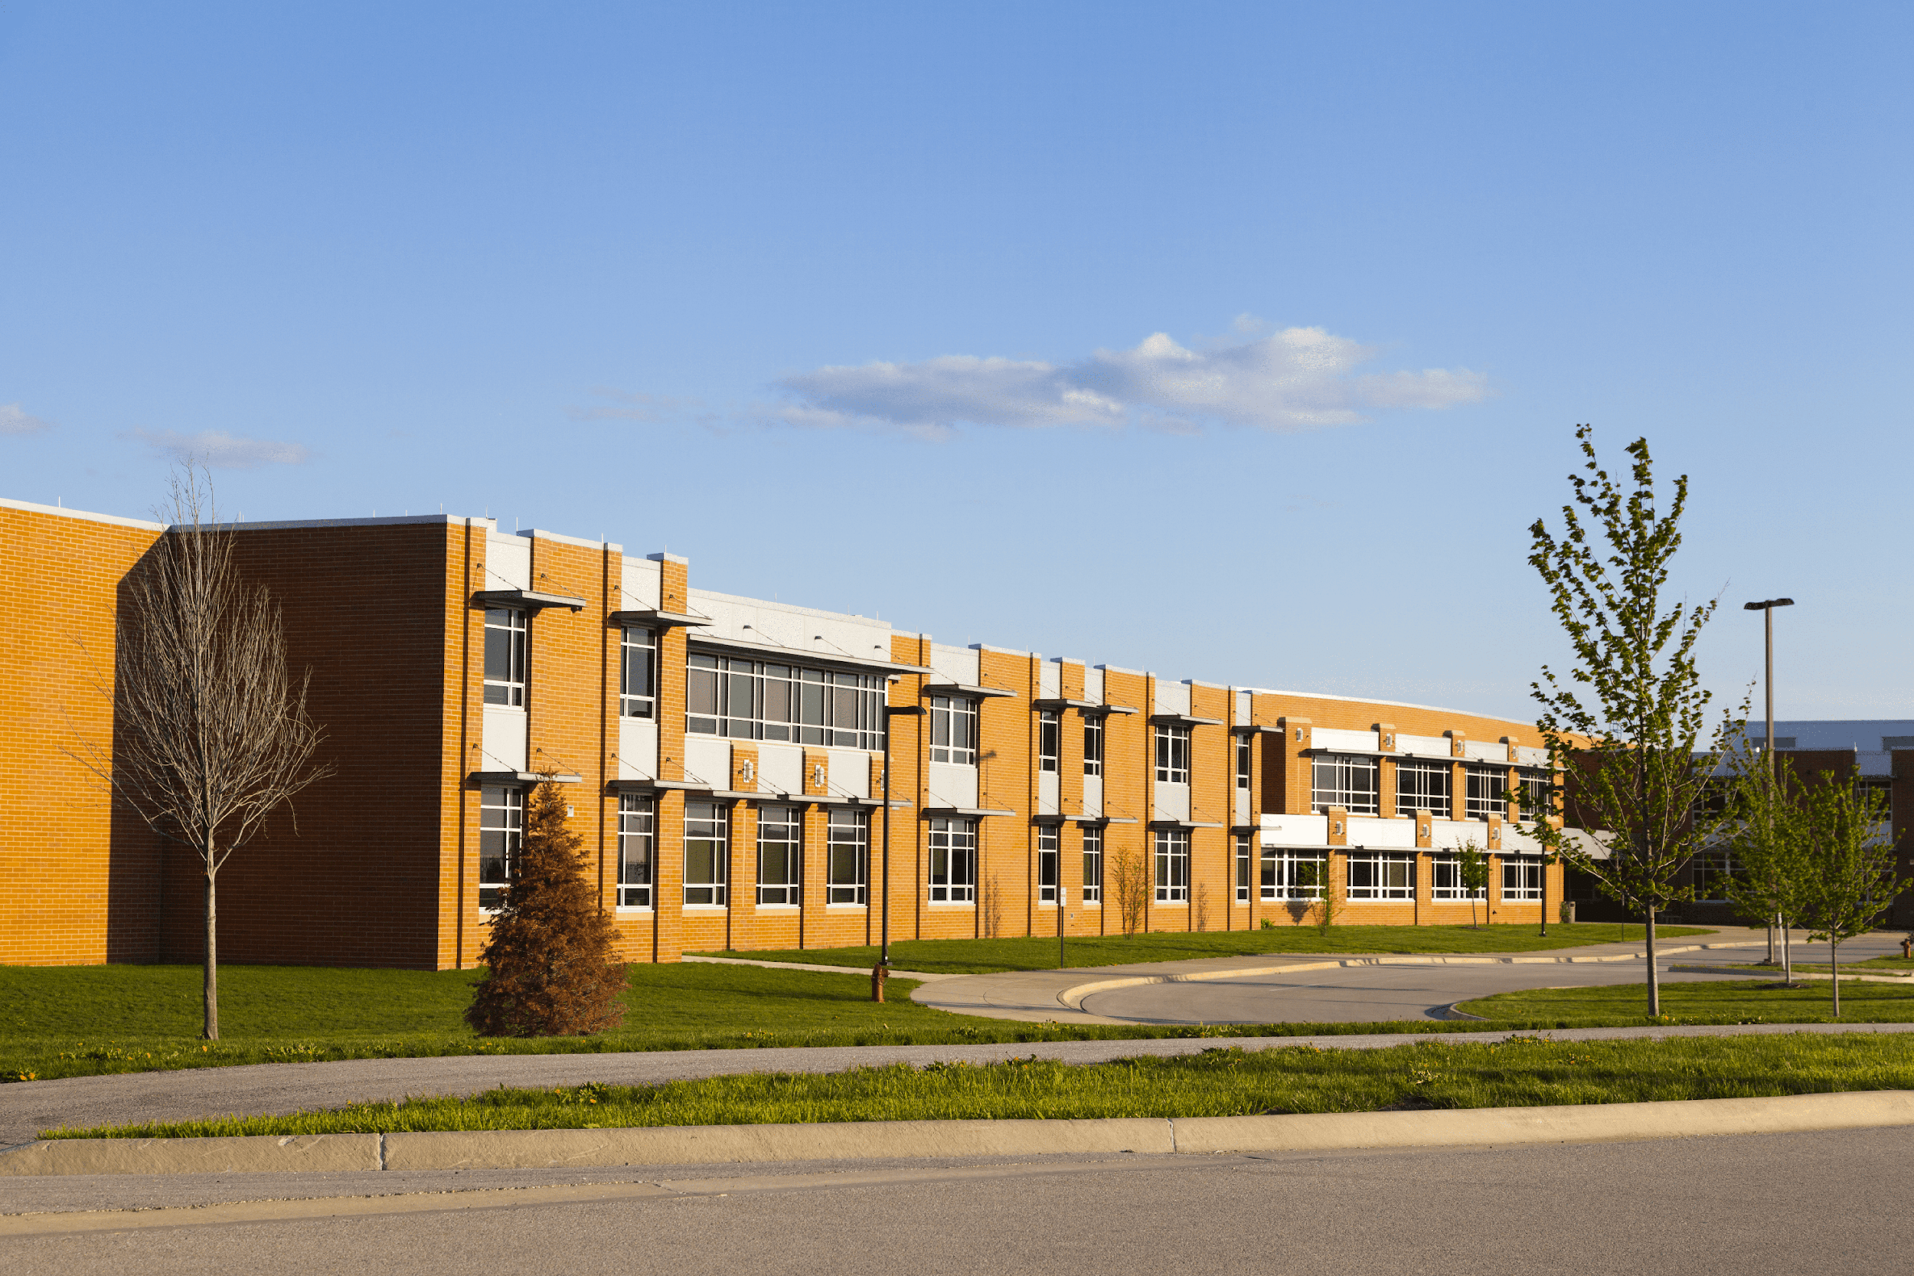
school

Slide 14
classroom

Slide 15
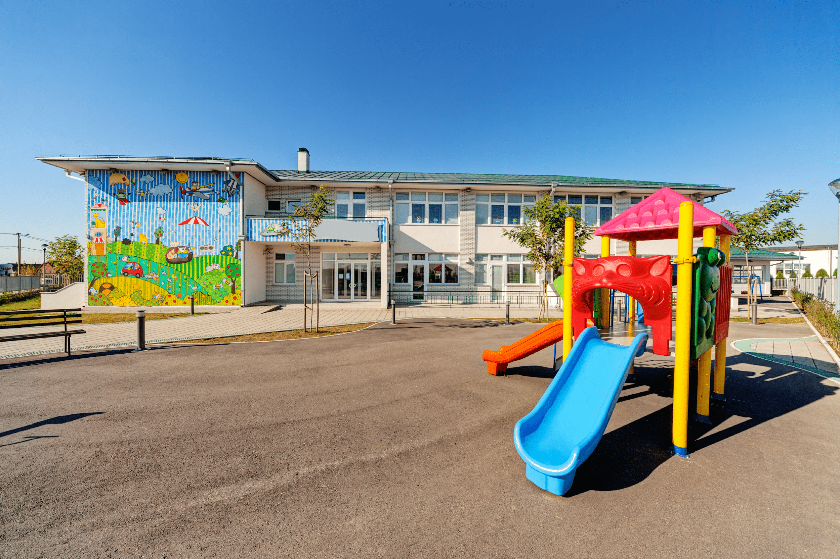
playground

Slide 16
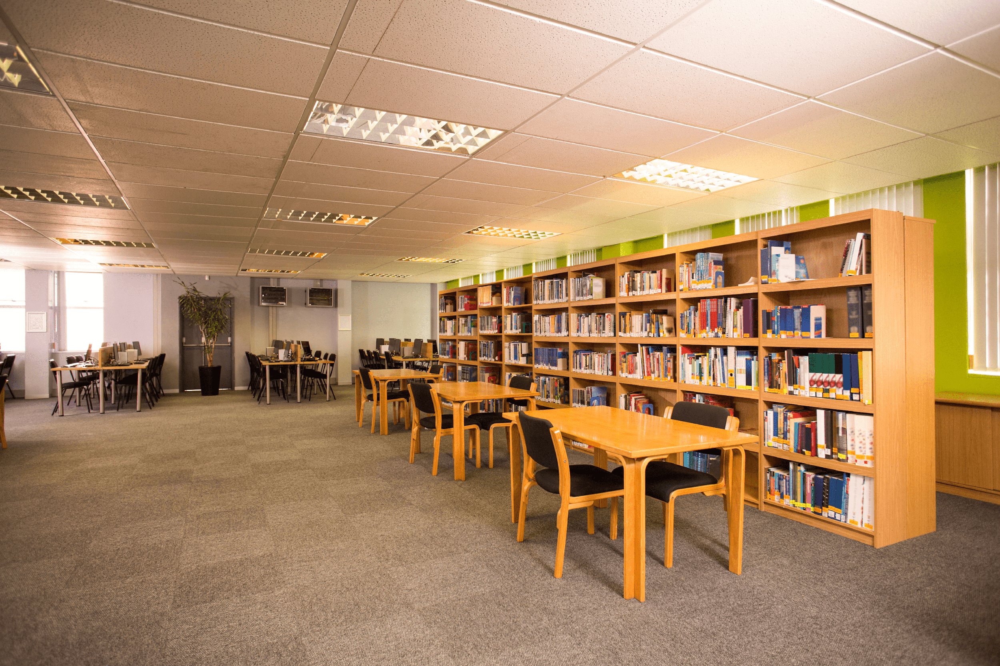
library

Slide 17
Look and guess.

Slide 18
playground

Slide 19
classroom

Slide 20
library

Slide 21
school

Slide 22
Is this our classroom?
No, it isn’t.
Yes, it is.

Slide 23
Is this our library?
Yes, it is.
No, it isn’t.

Slide 24
Is this our playground?
Yes, it is.
No, it isn’t.

Slide 25
Work in pairs. Practise.

Slide 26
Let’s talk.

Slide 28
Fun corner

Slide 29
Let’s play a game!
3 points
10 points
No
Yes
classroom
library
4
bomb
playground
No
school
3
2
1
Yes
5
10 points
8
school
library
7
classroom
- 3 points
6
Yes
Yes
playground
1 point
No
Yes
4 points
Notes:
Gv chia 2 đội.
Hs chọn số, 1 bạn đặt câu hỏi, 1 bạn trả lời với từ cho sẵn và nhận điểm

Slide 30
Website: hoclieu.vn
Fanpage: facebook.com/www.tienganhglobalsuccess.vn

