Slide 1




Slide 2



6
Our school
LESSON 1 - PERIOD 2

Slide 3
Contents
Warm-up and review
Activity 4
01
02
Activity 5
Activity 6
03
04
Listen and tick.
Look, complete and read.
Let’s sing.
Fun corner
05
Game

Slide 4
Hello, boys and girls. Welcome to our lesson today.

Slide 5

WARM-UP AND REVIEW

Slide 6
Warm-up

Slide 7
Is this our…….?
1
2
3
Notes:
Divide the class into 3 teams.
Each team has 1 sticky ball.
Play the music. Pupils in each team take turns to pass the ball. After the music ends, 3 pupils who have the ball stand up and say the words school, classroom, library, playground, then make sentences using the sentence model.

Slide 8

LISTEN AND TICK.

Slide 9


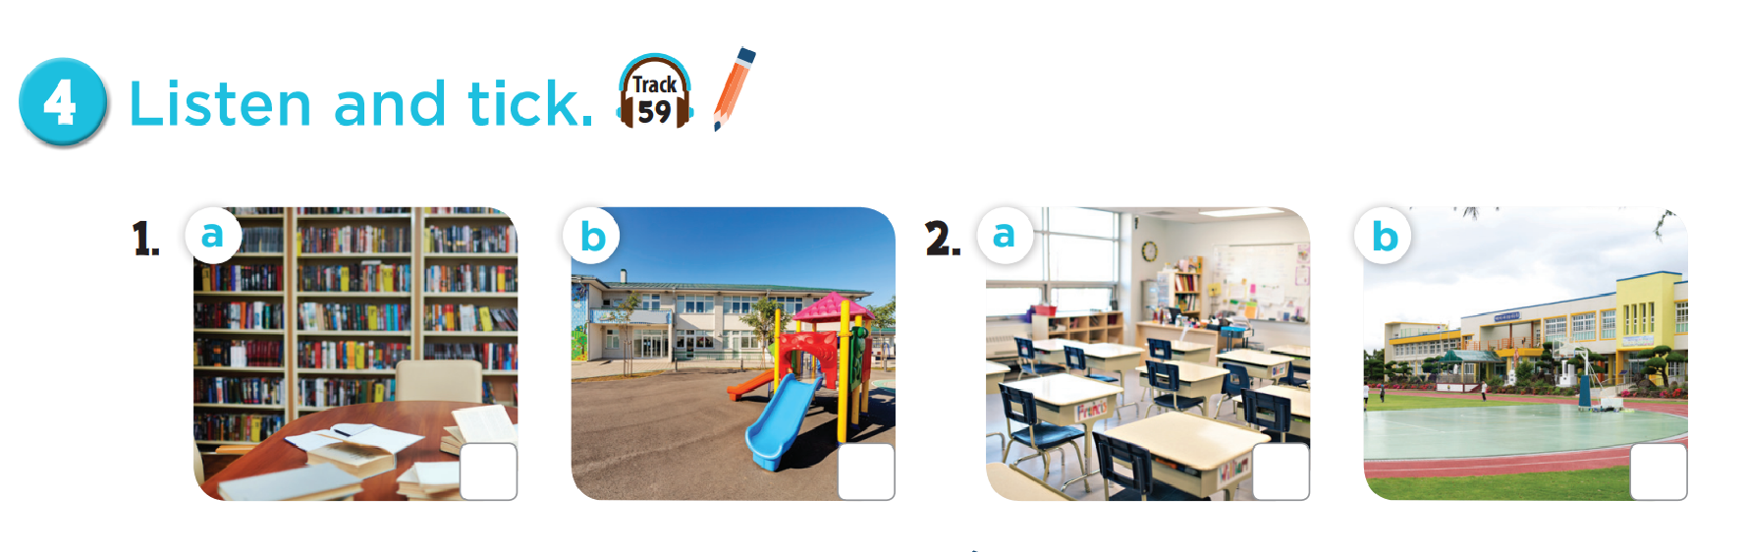

Slide 10

LOOK, COMPLETE
AND READ.

Slide 11
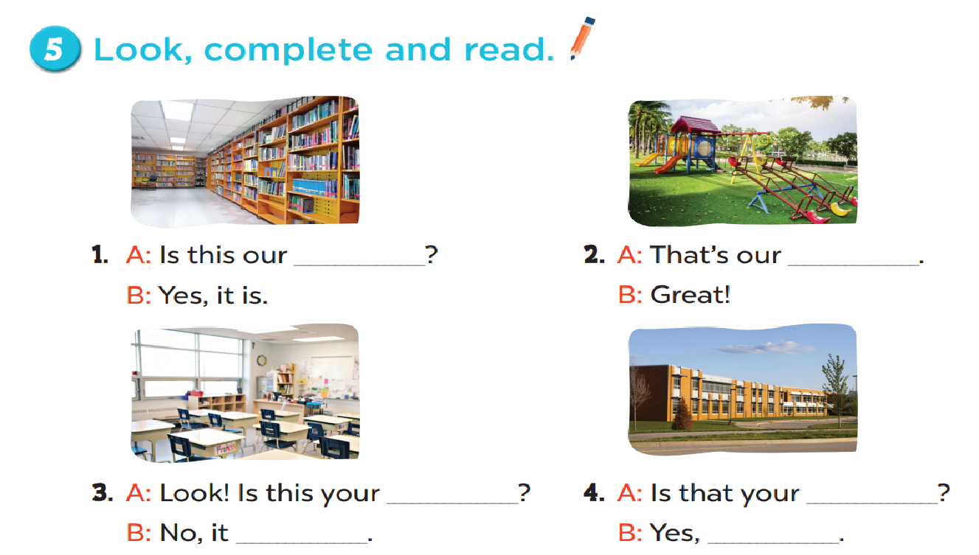
library
playground
classroom
school
isn’t
it is

Slide 12

LET’S SING.

Slide 13
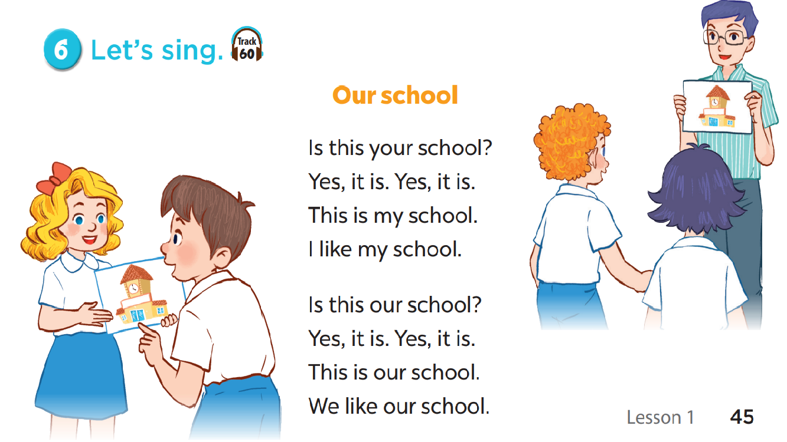

Slide 14

FUN CORNER

Slide 15







5
10
15
20
15
25
10
🡪

Slide 16
Read and choose.
………… this your classroom?
Is
Is
Are

Slide 17
Read and choose.
That is our…………………………
playground
playground
classroom

Slide 18
Read and choose.
Is ……….your classroom?
they
that
that

Slide 19
Read and choose.
Is that your library?
Yes, it isn’t.
Yes, it is.

Slide 20
Read and choose.
Is that ………….school?
look
your
your

Slide 21
Read and choose.
Is this our playground?
No, it isn’t.
No, it is.

Slide 22
Read and choose.
Is that your……………..?
library
school
school

Slide 23

Website: hoclieu.vn
Fanpage: facebook.com/www.tienganhglobalsuccess.vn

