Slide 2
8
Period 1

Slide 3
①
Warm-up and review
Contents
②
Look, listen and repeat.
③
Listen, point and say.
④
Let’s talk.
⑤
Fun corner and wrap-up

Slide 4
①
Warm-up and review

Slide 5
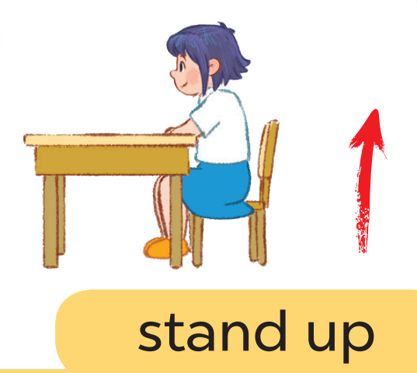
Game: Listen and choose

Slide 6
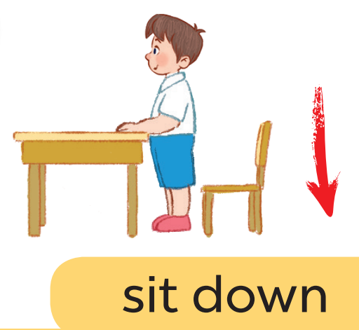
Game: Listen and choose

Slide 7
Game: Listen and choose

Slide 8
Game: Listen and choose

Slide 9
Game: Listen and choose

Slide 10
Game: Listen and choose

Slide 11
Game: Listen and choose

Slide 12
Game: Listen and choose

Slide 13
②
Look, listen and repeat.

Slide 14
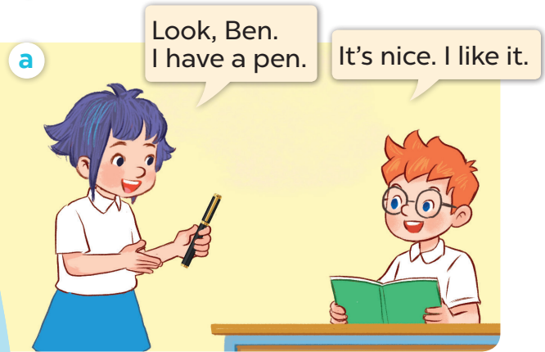
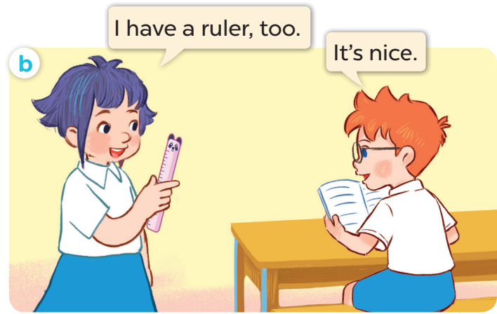

Slide 15
③
Listen, point and say.

Slide 18
Game:
Notes:
Game: Slap the board.
- Divide the class into four teams.
- Stick the pictures of activities on the board.
- T says a sentence, a pupil from each team has to point/slap the right picture and says the sentence again. The faster pupil will get points for their team.

Slide 19
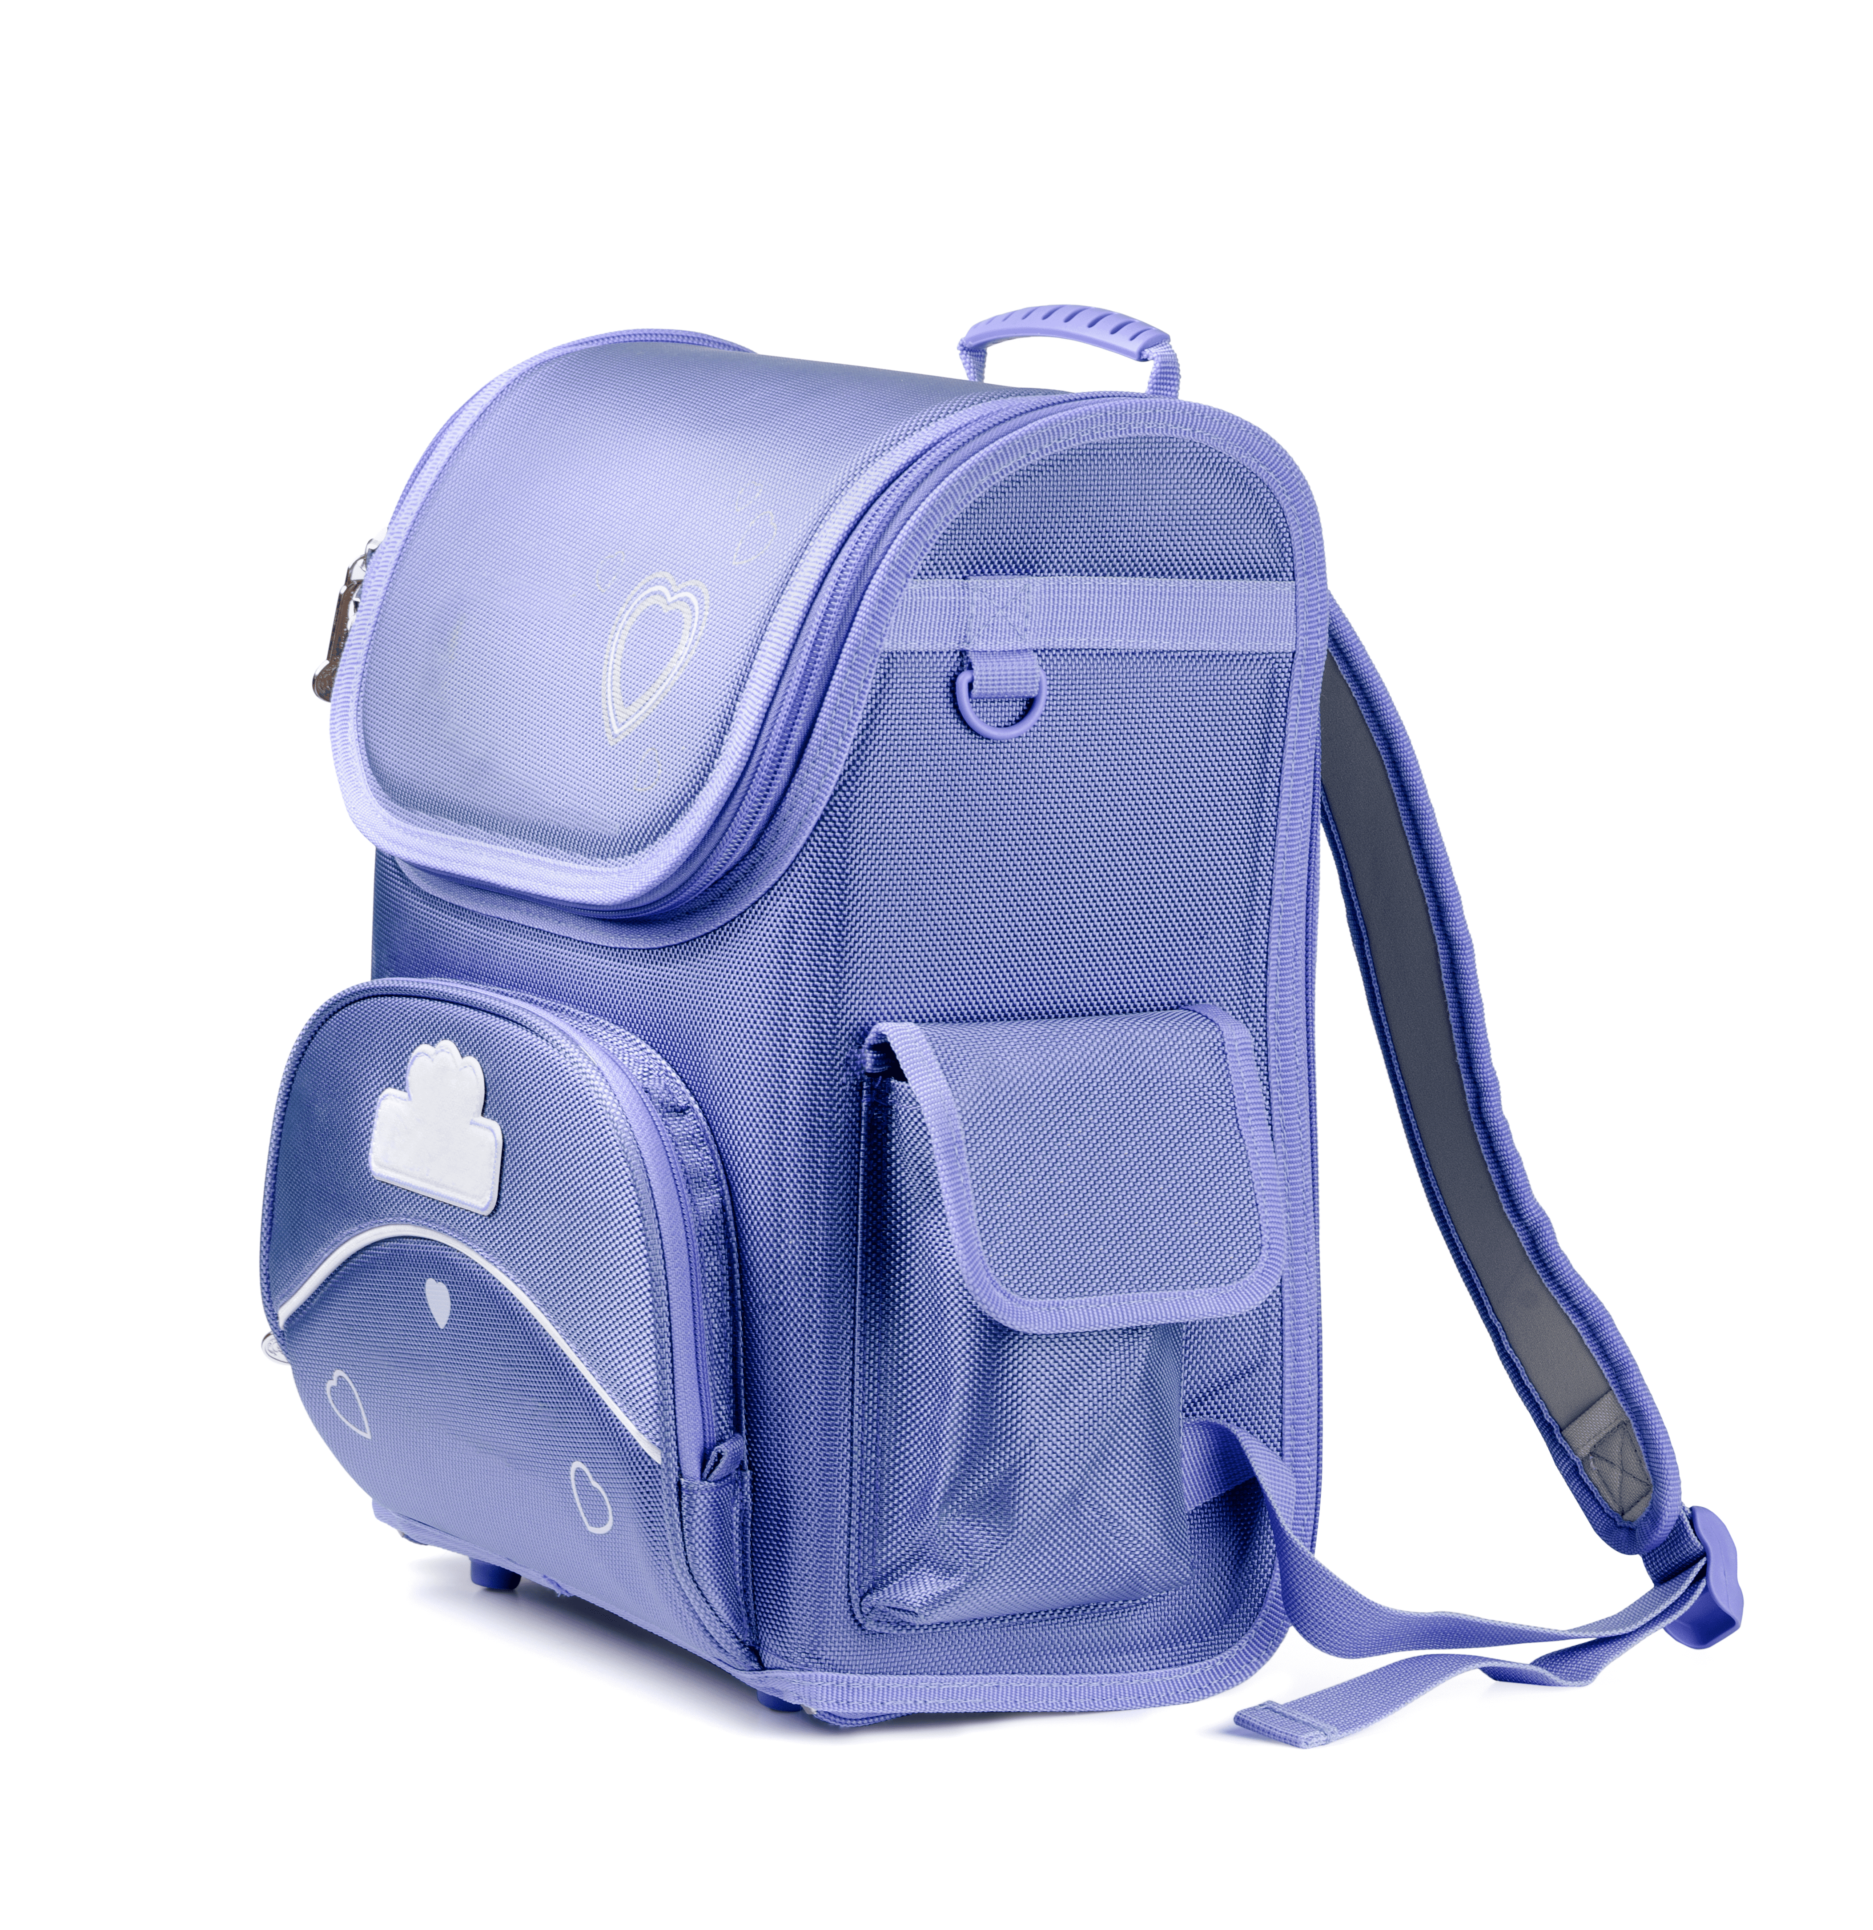
I have a ruler!
I have a ruler!
Notes:
Game: Slap the board.
- Divide the class into four teams.
- Stick the pictures of school things on the board.
- T says a sentence, a pupil from each team has to point/slap the right picture and says the sentence again. The faster pupil will get points for their team.

Slide 20
④
Let’s talk.

Slide 21
I have a school bag!
I have a book!

Slide 22
Game: Let’s move and say!

Slide 23
I have a pencil!
Go back 1 space
Go back 1 space
Go forward 1 space
Back to
start!
Notes:
Let’s move and say!
- Get 2-3 pupils to play at the same time.
- Each pupil tosses a dice then moves accordingly.
- When he/she gets to the space, they have to do the requirements. Whoever gets to the last place first is the winner.

Slide 24
⑤
Fun corner and wrap-up
Notes:
Preparation for the project:
Tell pupils about the project on page 61. Ask them to prepare three school things at home and the language to present about them. Tell students to bring their school things to the classroom at the project time to talk with their classmates. Guide them with the presentation language.

Slide 25
Website: sachmem.vn
Fanpage: www.facebook.com/sachmem.vn

