Slide 1



Slide 2





8
Period 2

Slide 3



①
Warm-up and review
Contents
②
Listen and tick.
③
Look, complete and read.
④
Let’s sing.
⑤
Fun corner and wrap-up

Slide 4


①
Warm-up and review
Notes:
Sentence Puzzle
- Divide the class into groups of four.
- Give each group a sentence that is broken/cut into pieces.
- Ask them to arrange the words to make a complete sentence, then read it aloud.
- The group that makes it first will be the winner.

Slide 5


Game: Sentence puzzle
pen.
have
I
a
I
have
a
pen.
Notes:
Wait for the clock to count down.
Click anywhere to show the answer.

Slide 6

Game: Sentence puzzle
book.
have
a
I
I
have
a
book.
Notes:
Wait for the clock to count down.
Click anywhere to show the answer.

Slide 7

Game: Sentence puzzle
I
have
a
ruler.
I
have
a
ruler.
Notes:
Wait for the clock to count down.
Click anywhere to show the answer.

Slide 8
②
Listen and tick.

Slide 9
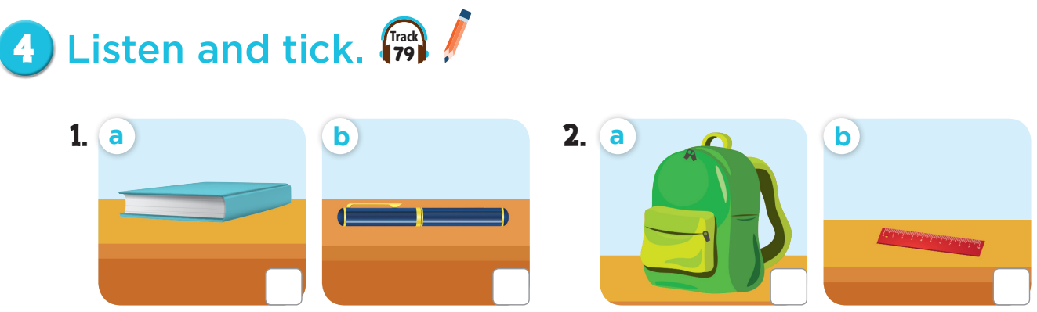


Slide 10
✓
✓

Slide 11

Let’s play:
Who says fast?
I have a book!
Notes:
Game: Who says fast? Teacher points to the picture, pupils say it as fast as they can. This can be played individually or in teams.

Slide 12
③
Look, complete and read.

Slide 13
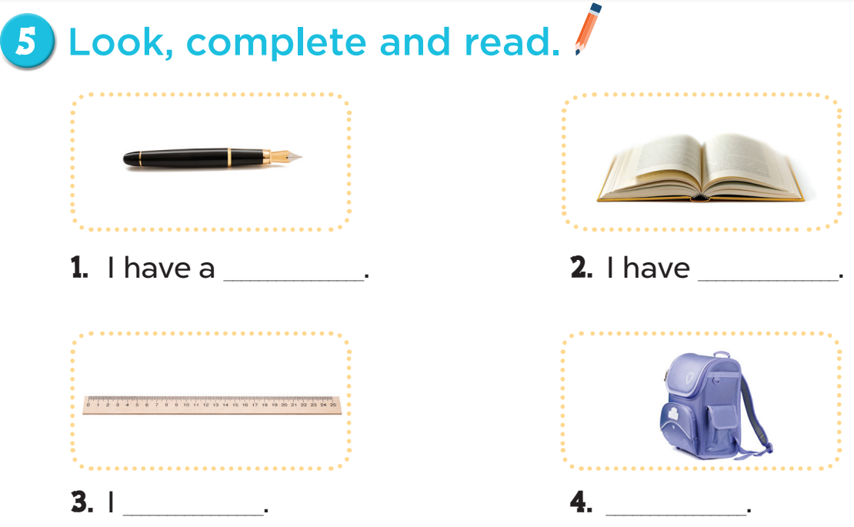
pen
a book
have a ruler
I have a school bag

Slide 14
Game: Choose the right pairs!
Notes:
Game: Choose the right pairs!
- Divide the class into two teams.
- Each pupil from each team comes to the board, choose a card from the left, then choose one from the right. If they match, he/she gets points for their team.

Slide 15






1
2
a
b
I have a ruler.
I have a pen.
3
4
c
d
I have a pencil.
I have a bag.
Notes:
Click the red circle to turn the cards face down again.

Slide 16
④
Let’s sing.

Slide 17


Slide 18
⑤
Fun corner and wrap-up

Slide 19
Game: Let’s sing and move!
Notes:
Play music – audio track 80, then ask pupil to sing and dance along with the song, when the music stops, every body has to stop moving. Who can make it is the winner.

Slide 20
stop
Notes:
Play the song, ask pupils to sing and dance along the song. When the music stops, everybody has to stop moving. Pupils who can’t stop in time will be eliminated.

Slide 21
music

Slide 22

Website: sachmem.vn
Fanpage: www.facebook.com/sachmem.vn

