Slide 1


Unit 6: Activities
Lesson 2.2
Page 41

Slide 2
Objectives
By the end of this lesson, students will review the /g/ and /h/ sounds and pronounce them correctly.
Vocabulary: girl, hop
Phonic: /g /, / h /

Slide 3
Lesson Outline
Warm-up
Listening
Consolidation
Wrap-up

Slide 4

WARM UP

Slide 5
Let’s sing!

Slide 6

Click the icon to hear the sound.

Slide 7

It’s time to learn …

Slide 8

Let’s play!
Magic finger
Notes:
Divide the class into pairs.
Have student A write a letter with their finger on student B’s back.
Have the student B guess which letter it is.

Slide 9

Review

Slide 10

Phonics
/ g /,
/ h /

Slide 11



Click the icon to hear the sound.
G, g
H, h
/ h /
/ g /

Slide 12

Click the icon to hear the sound.
G, g
H, h
/ h /
/ g /

Slide 13

Practice

Slide 14

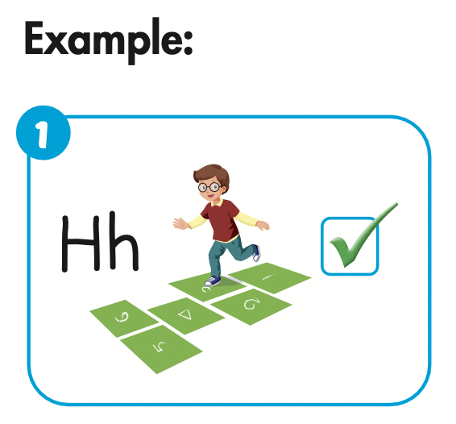

Slide 15
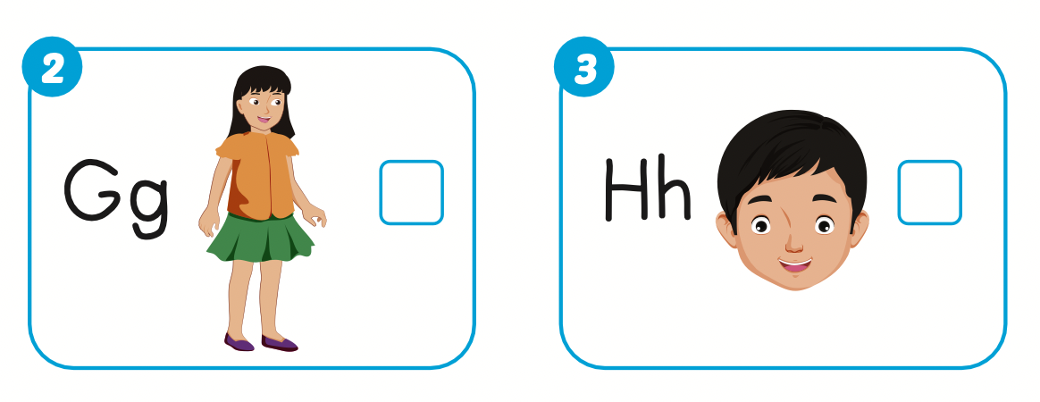



Slide 16

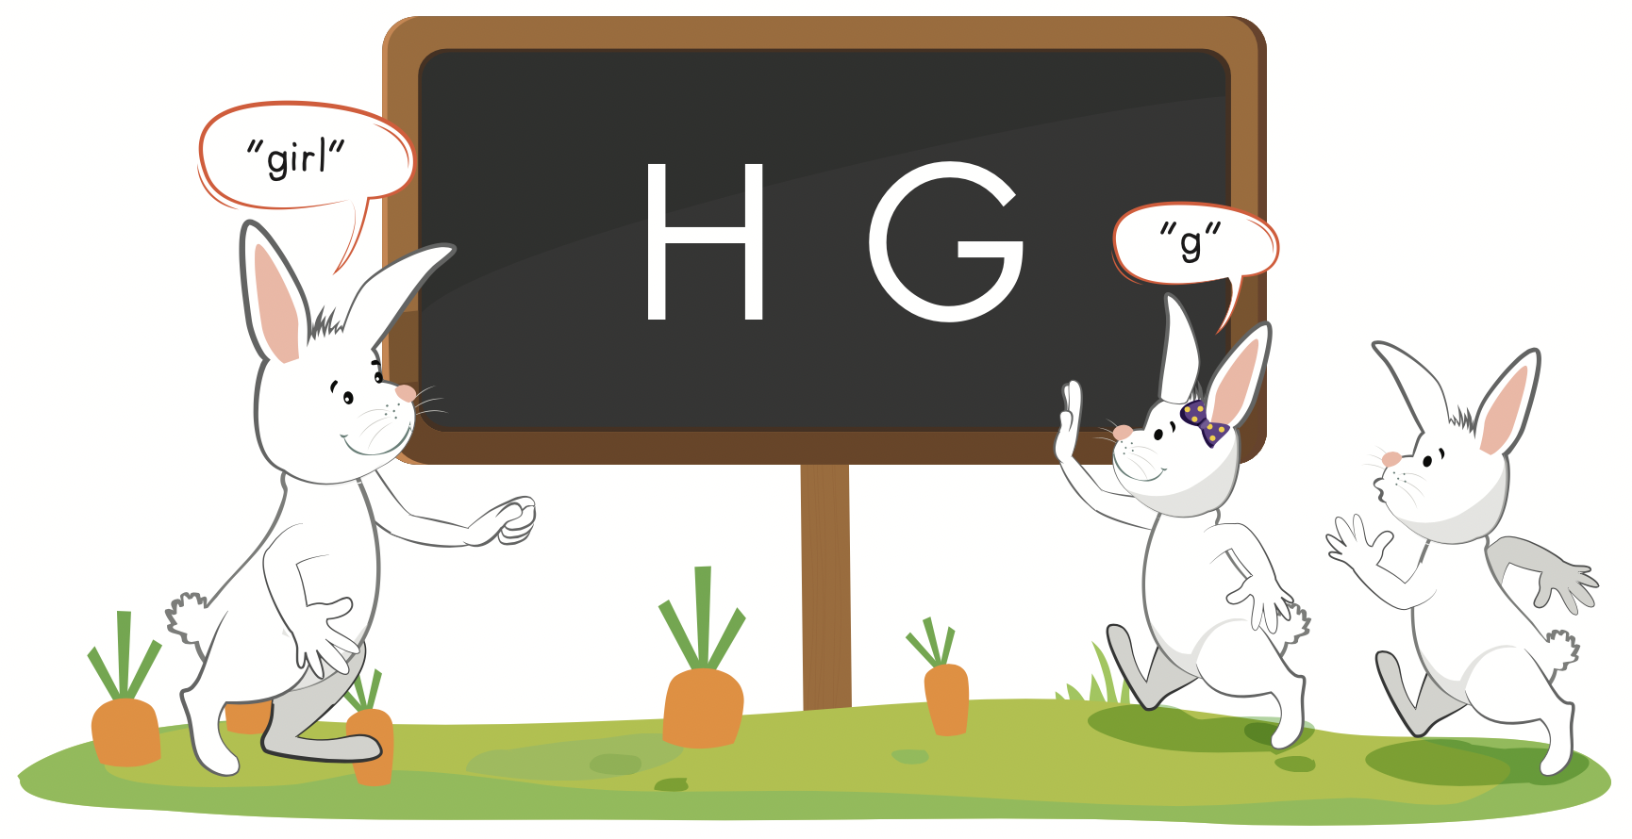

Slide 17

Production

Slide 18
Let’s play!

Slide 19

Let’s Dance Game

Slide 20
How To Play
Students must take turns reading the words in order.
Each time a student can choose to say the words in 1 square, 2 squares or a maximum of 3 squares.
The student who says the red word must dance!

Slide 21

elephant
father
hop
food
ant
a
b
g
e
f
h
boy
cat
door
girl

Slide 22


Slide 23

CONSOLIDATION

Slide 24
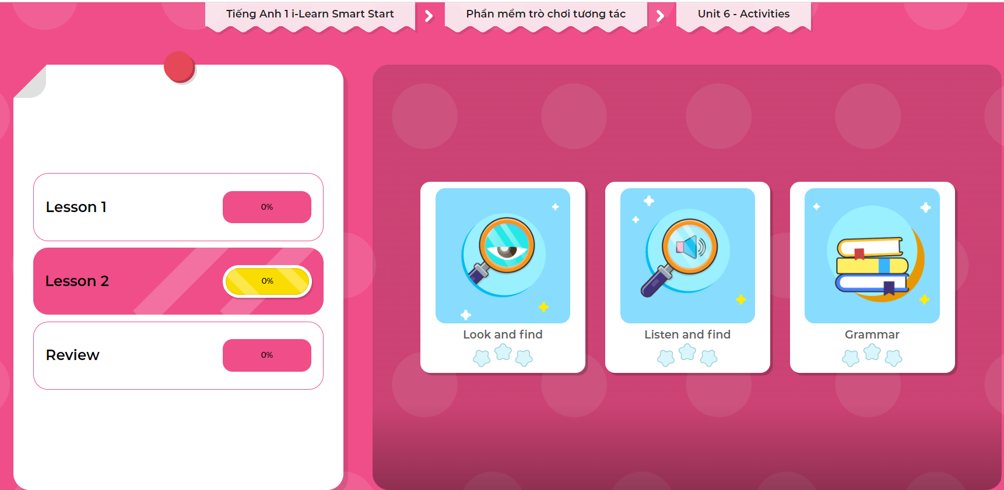
Extra Practice
DHA on Eduhome
LET’S PLAY!
Click on the picture below to play the games.

Slide 25

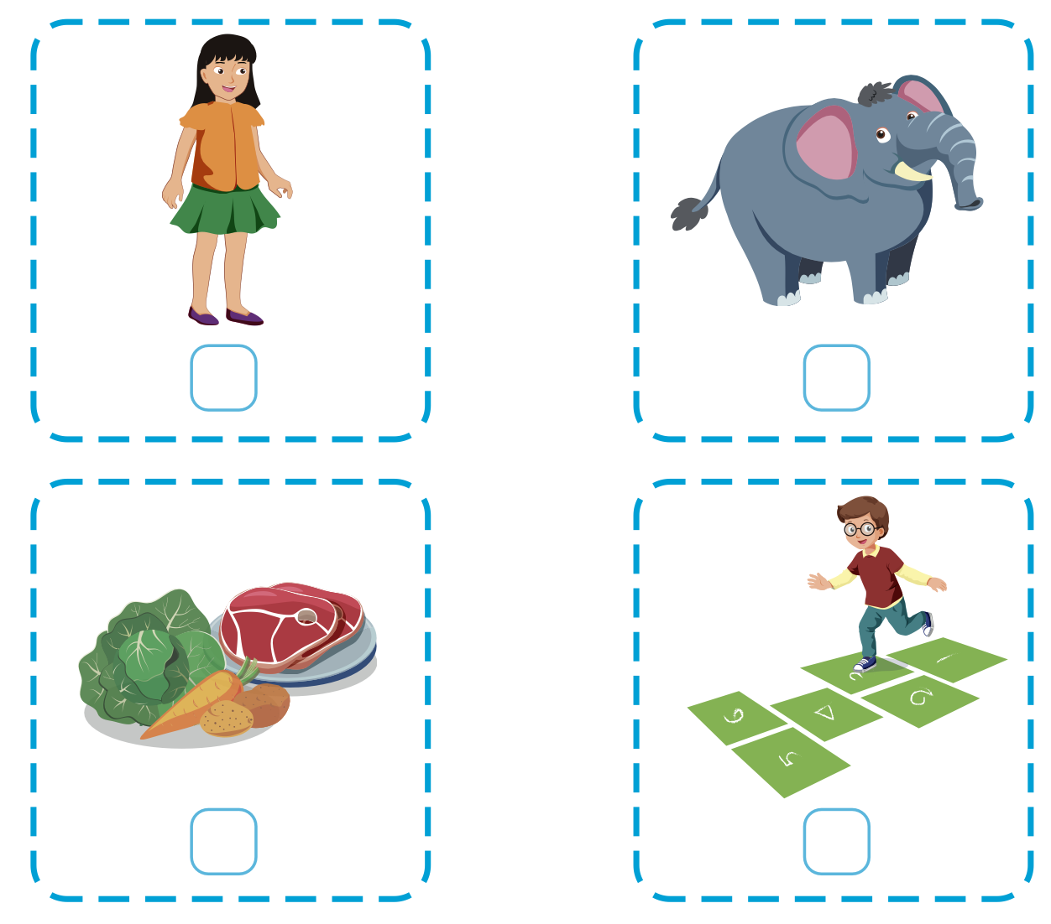
Extra Practice
WB, page 39
Click the icon to hear the sound.
2
1
4
3

Slide 26

WRAP-UP

Slide 27
Lesson 3
Today’s lesson
Vocabularies
Girl,
Hop
Phonics
/ g /, / h /

Slide 28
Lesson 3
Homework
Practice pronouncing the sound /g/ and /h/
Do the exercises in Tiếng Anh 1 i-Learn Smart Start WB (page 39).
Do the exercises in Tiếng Anh 1 i-Learn Smart Start Notebook (page 41).
Prepare the next lesson (page 42 SB)
Play the consolidation games in Tiếng Anh 1 i-Learn Smart Start DHA App on www.eduhome.com.vn

Slide 29
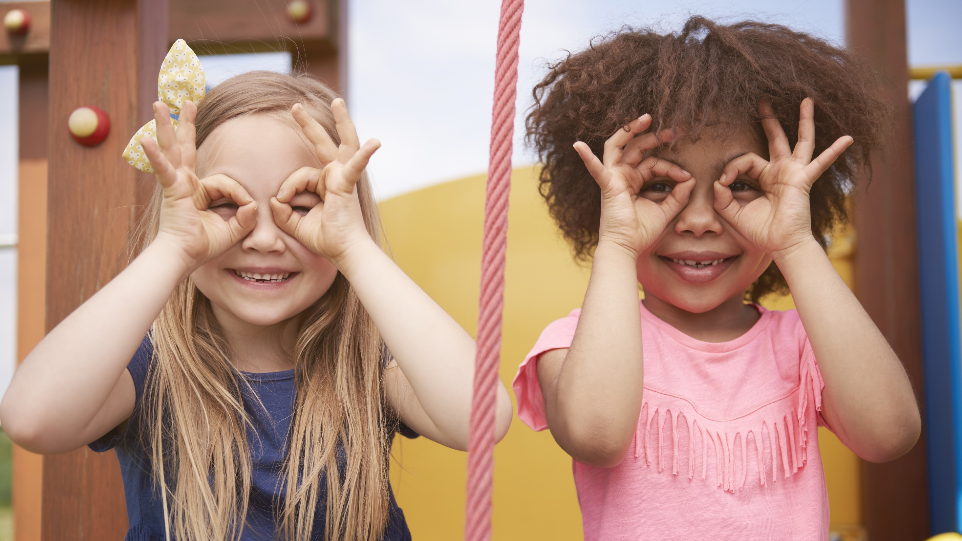
Enjoy your day!

Slide 30
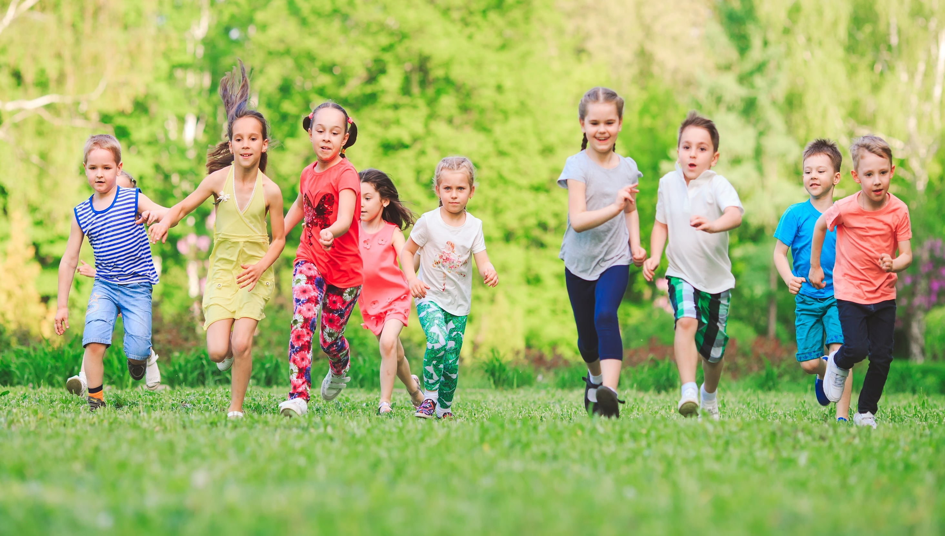
Have a nice day!

