Slide 1


Unit 6: Activities
Review 5
Page 42

Slide 2
Objectives
By the end of this lesson, students will review identifying animals and saying what animals they like.
Vocabulary: cat, dog, bird, snake, bear, monkey,..
Structure: I like (cats).

Slide 3
Lesson Outline
Warm-up
Practice
Production
Consolidation
Wrap-up

Slide 4

WARM UP

Slide 5
Let’s play!
What animal is it?

Slide 6
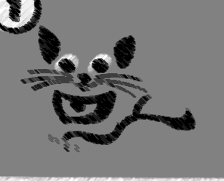
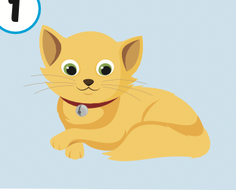

This is a cat.

Slide 7
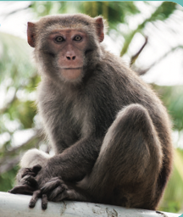
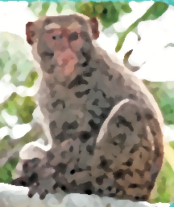
This is a monkey.

Slide 8
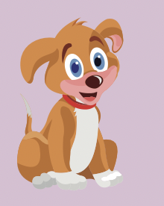
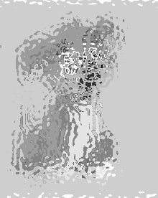
This is a dog.

Slide 9
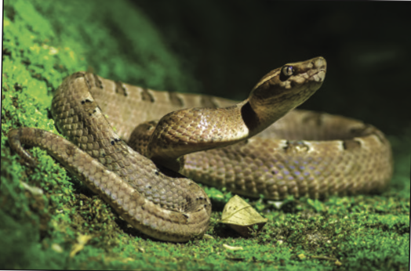
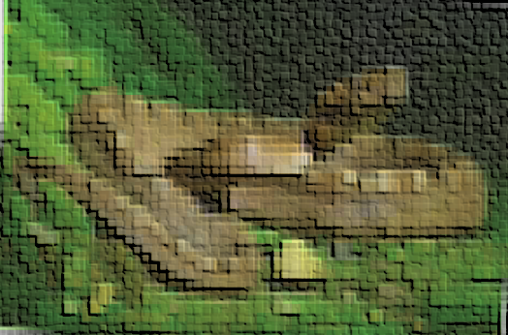
This is a snake.

Slide 10
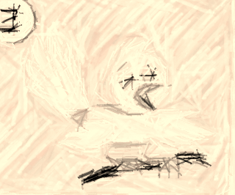
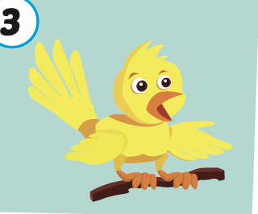
This is a bird.

Slide 11
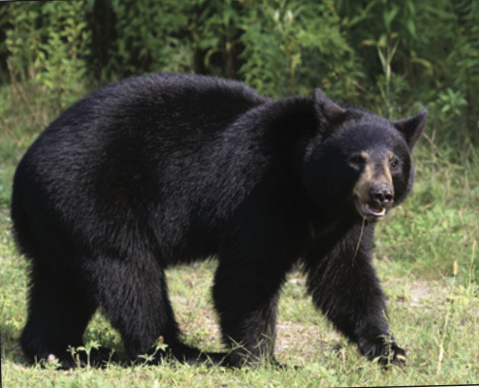
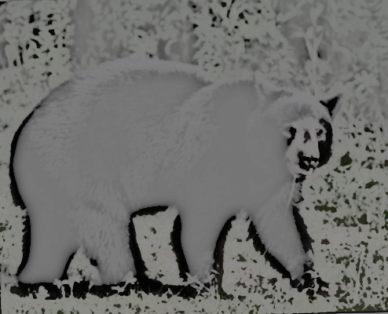
This is a bear.

Slide 12

It’s time to learn …

Slide 13

New words
Cat,
dog,
bird,
monkey,
snake,
bear

Slide 14
Structures
I like (cats).

Slide 15

Review

Slide 16
Let’s say!
I like cats.

Slide 17
Let’s say!
I like dogs.

Slide 18
Let’s say!
I like birds.

Slide 19
Let’s say!
I like monkeys.

Slide 20
Let’s say!
I like snakes.

Slide 21
Let’s say!
I like bears.

Slide 22

Practice

Slide 23

Listening

Slide 24
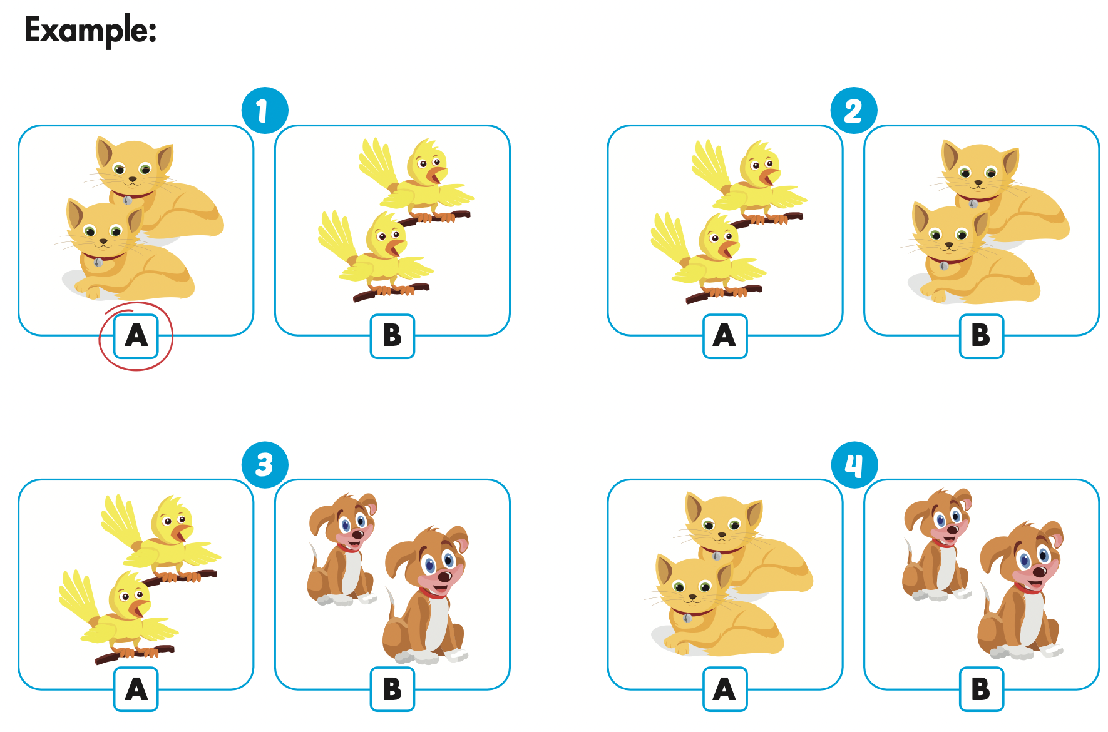
Click the icon to hear the sound.

Slide 25
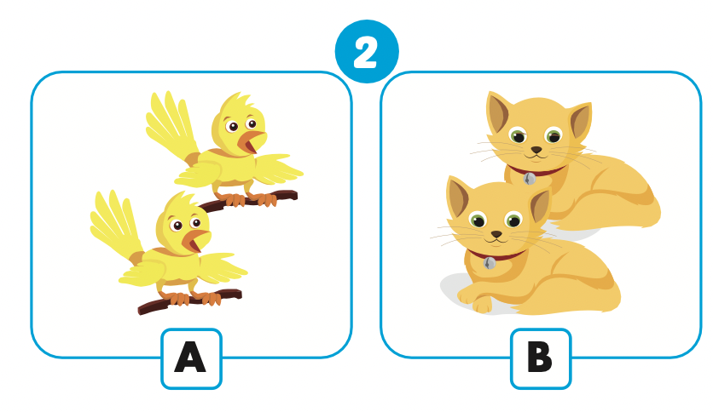
Let’s check!

Slide 26
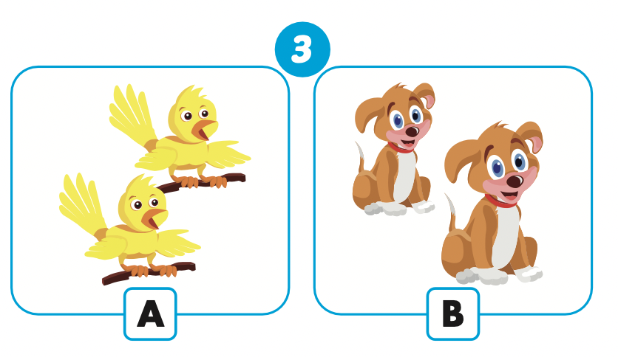
Let’s check!

Slide 27
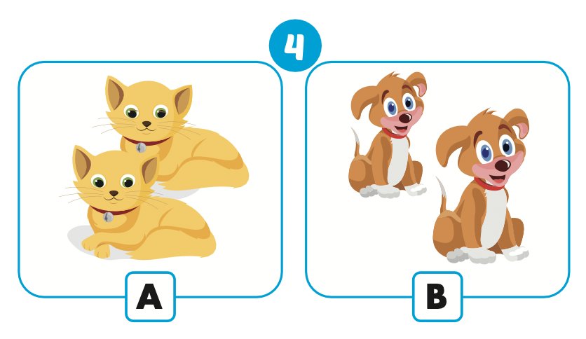
Let’s check!

Slide 28
Let’s sing!

Slide 29


Slide 30

Production

Slide 31

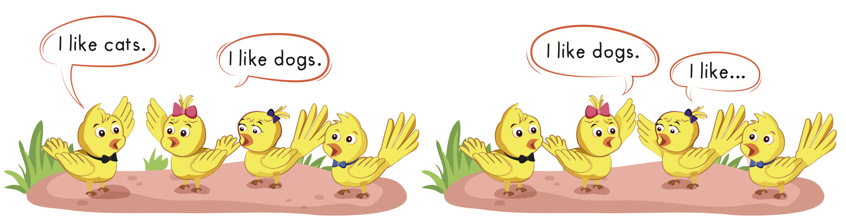

Slide 32

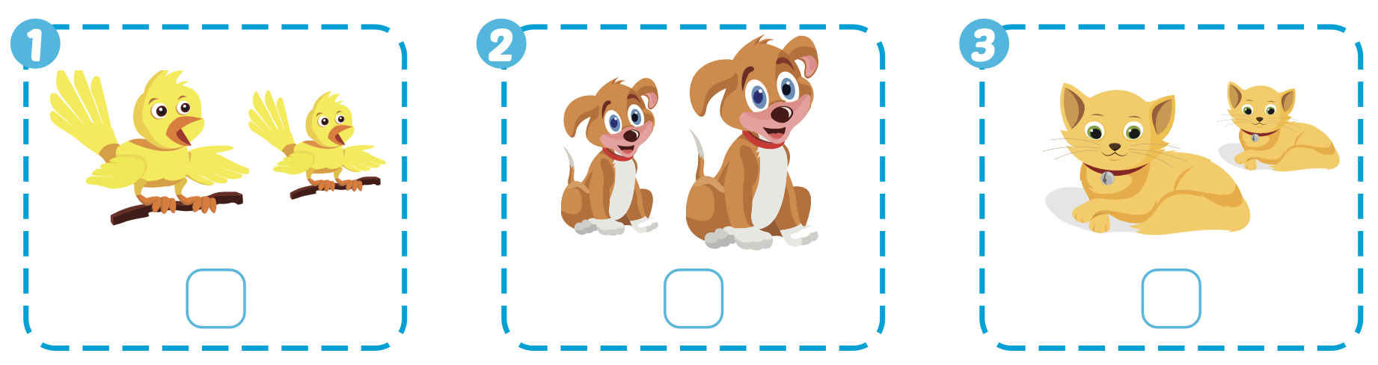


Extra Practice
WB, page 40

Slide 33
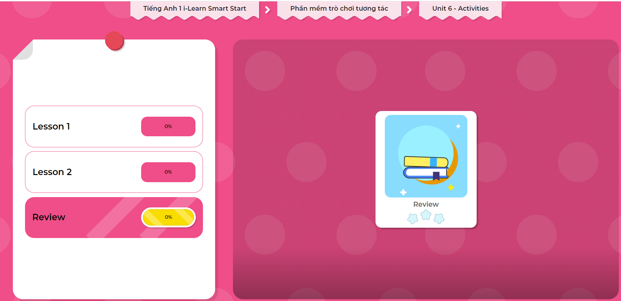
Extra Practice
DHA on Eduhome
LET’S PLAY!
Click on the picture below to play the games.

Slide 34

CONSOLIDATION

Slide 35
Let’s play!
Bingo
B | I | N | G | O
Notes:
Have students choose 5 animals and write them down on their piece of paper.
Read the animals aloud.
Students listen and cross out the words.
When the students have crossed out all their words, they shout “Bingo!”

Slide 36

WRAP-UP

Slide 37
Today’s lesson
Vocabularies
Bird,
Cat,
Dog,
Monkey,
Bear,
Snake
Structures/ Sentence patterns
I like (cats).

Slide 38
Homework
Review the vocabularies and structure; and make sentences using them.
Do the exercises in Tiếng Anh 1 i-Learn Smart Start WB (page 40)
Prepare the next lesson (page 42 SB)
Play the consolidation games in Tiếng Anh 1 i-Learn Smart Start DHA App on www.eduhome.com.vn

Slide 39
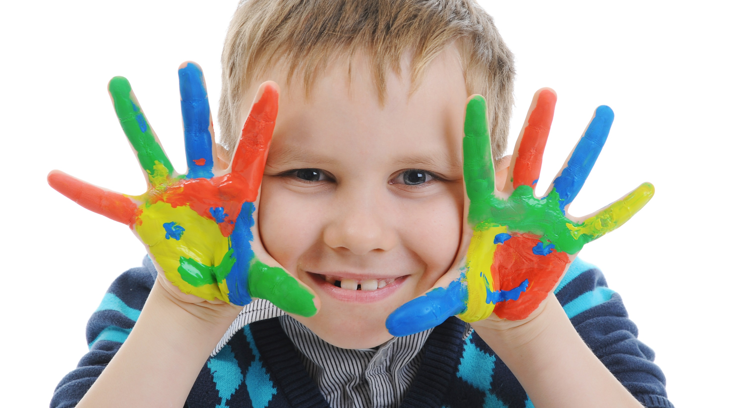
Enjoy your day!

