Slide 1


Unit 6: Activities
Review 6
Page 43

Slide 2
Objectives
By the end of this lesson, students will review talking about their abilities.
Vocabulary: run, swim, sing,..
Structure: I can (run).

Slide 3
Lesson Outline
Warm-up
Practice
Production
Consolidation
Wrap-up

Slide 4

WARM UP

Slide 5
Let’s play!
Look and guess

Slide 6

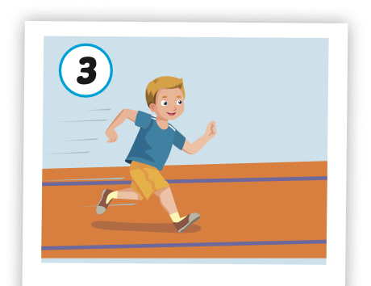

Start
Check

Slide 7

Start
Check

Slide 8
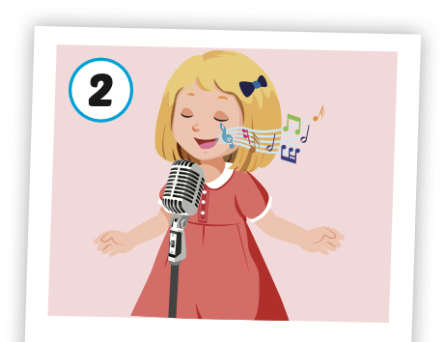
Start
Check

Slide 9


Slide 10

It’s time to learn …

Slide 11

New words
Run,
sing,
swim

Slide 12
Structures
I can (run).

Slide 13

Review

Slide 14
Let’s say!
I can swim.

Slide 15
Let’s say!
I can sing

Slide 16
Let’s say!
I can run.

Slide 17

Practice

Slide 18

Listening

Slide 19

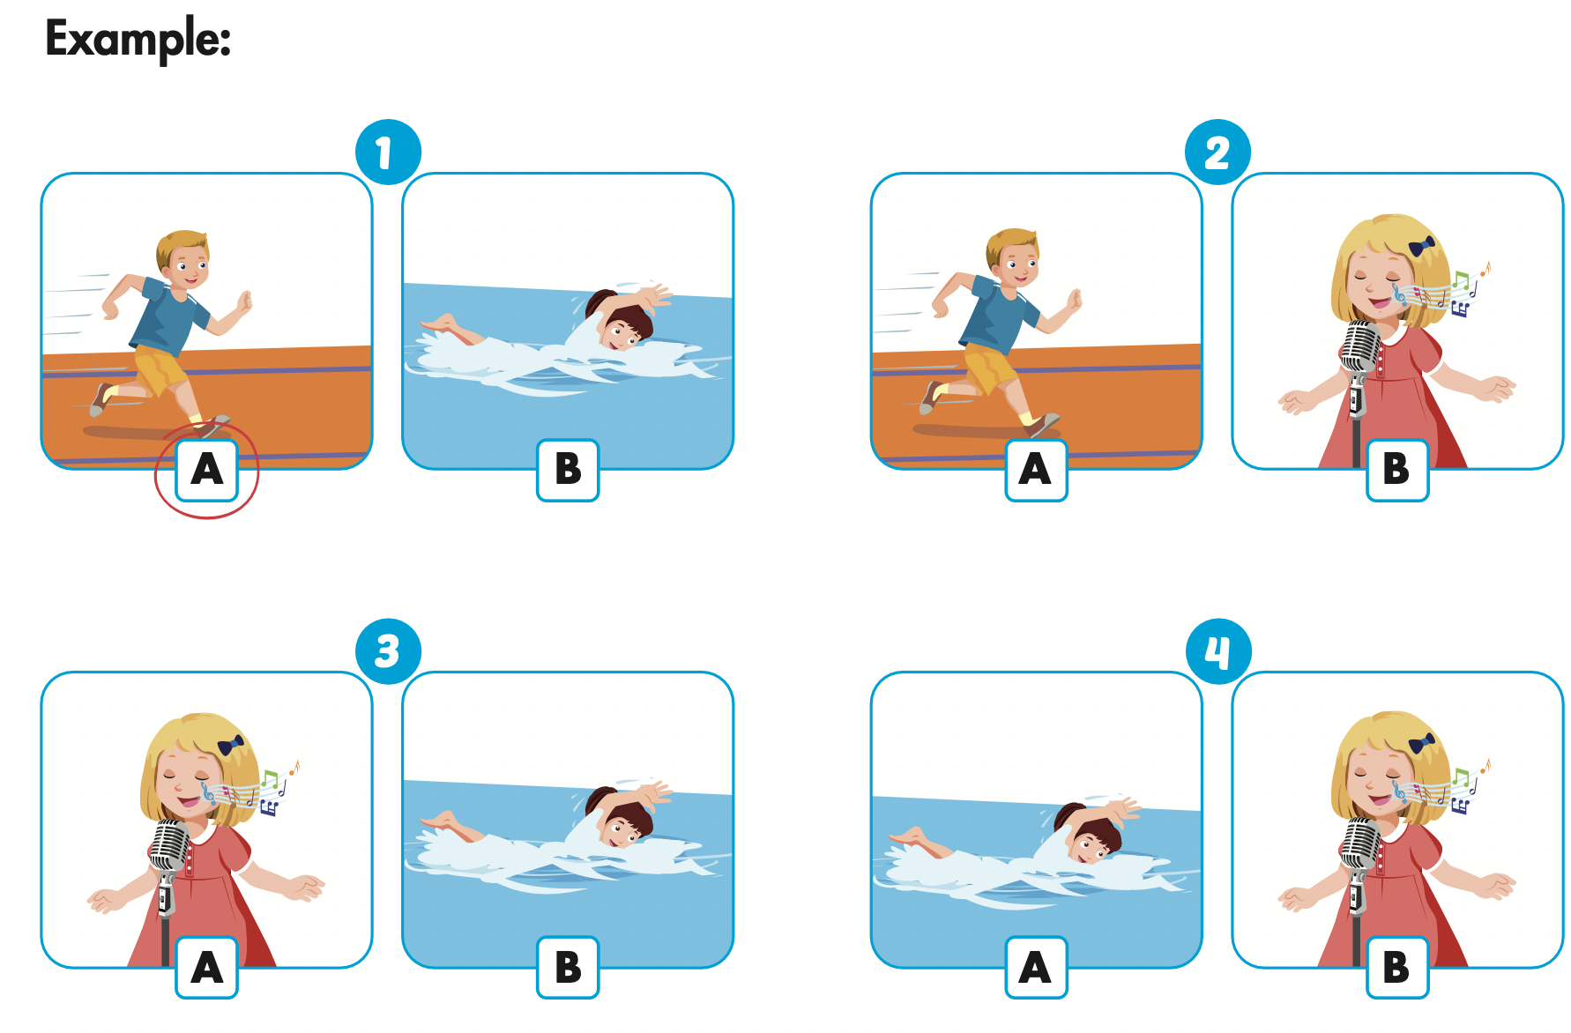
Click the icon to hear the sound.

Slide 20
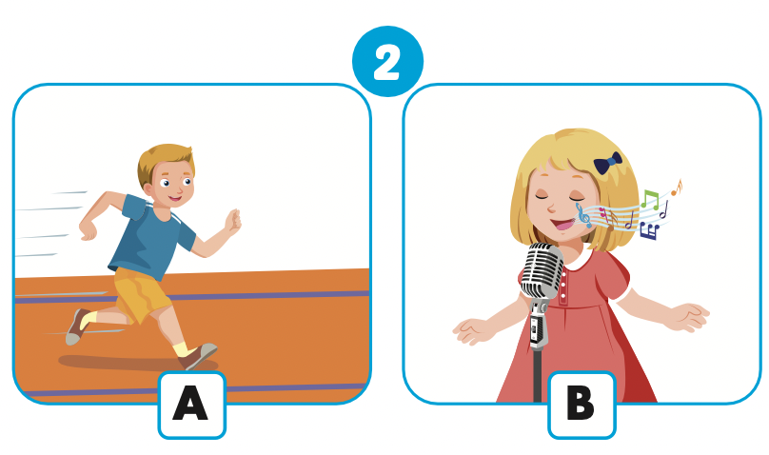
Let’s check!

Slide 21
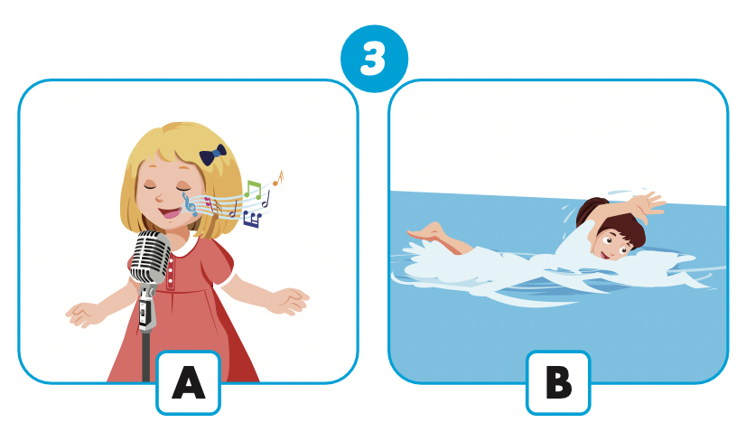
Let’s check!

Slide 22
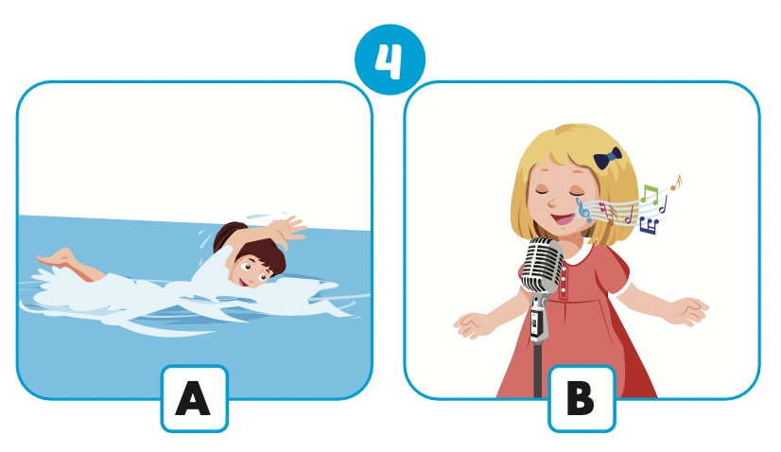
Let’s check!

Slide 23
Let’s sing!

Slide 24


Slide 25

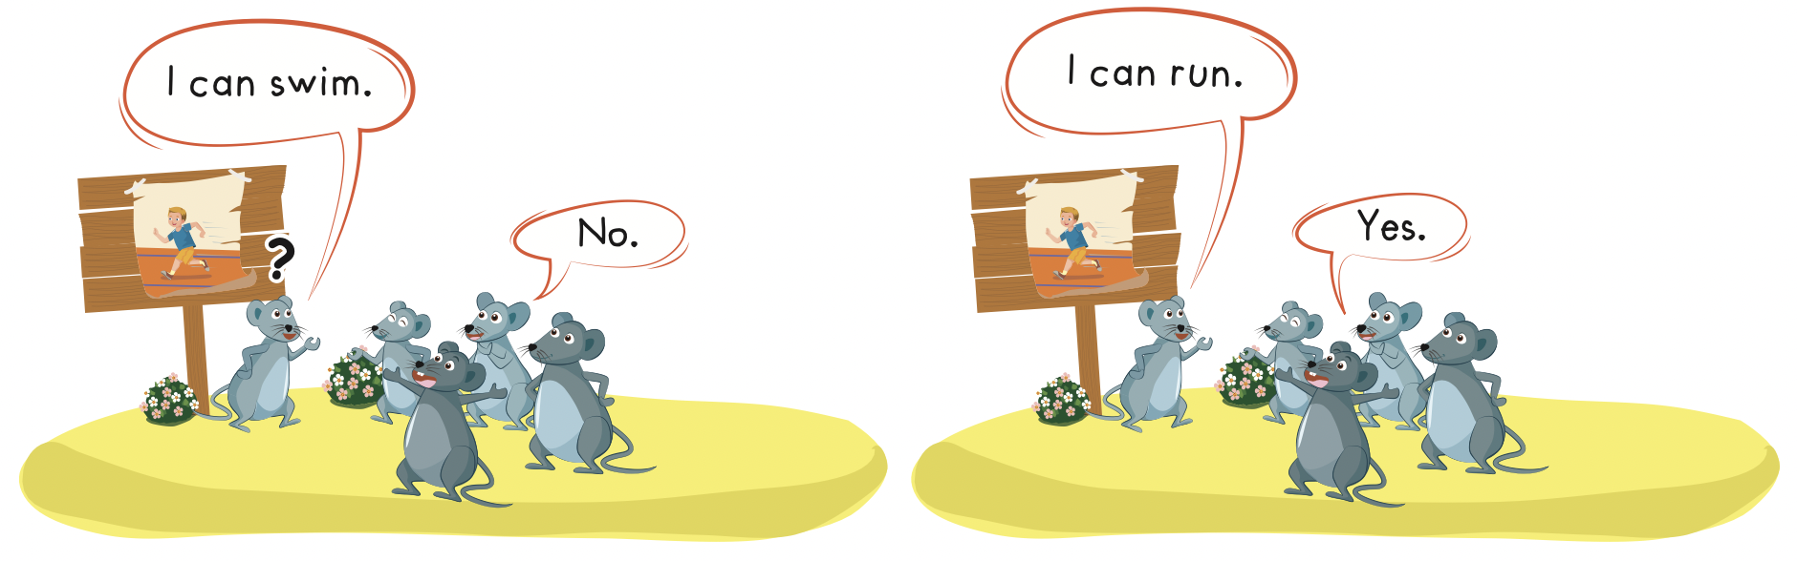

Slide 26

Production

Slide 27
Matching Game
Let’s play!

Slide 28
How to Play
Divide the class into two teams.
Each team takes turns in choosing TWO squares.
If the two squares are the same word / picture, then the team gets a point.
If the two squares are different, then click on the green circle to hide the picture again.

Slide 29
1
2
run | sing
swim | sing
swim | run
3
4
5
6

Slide 30

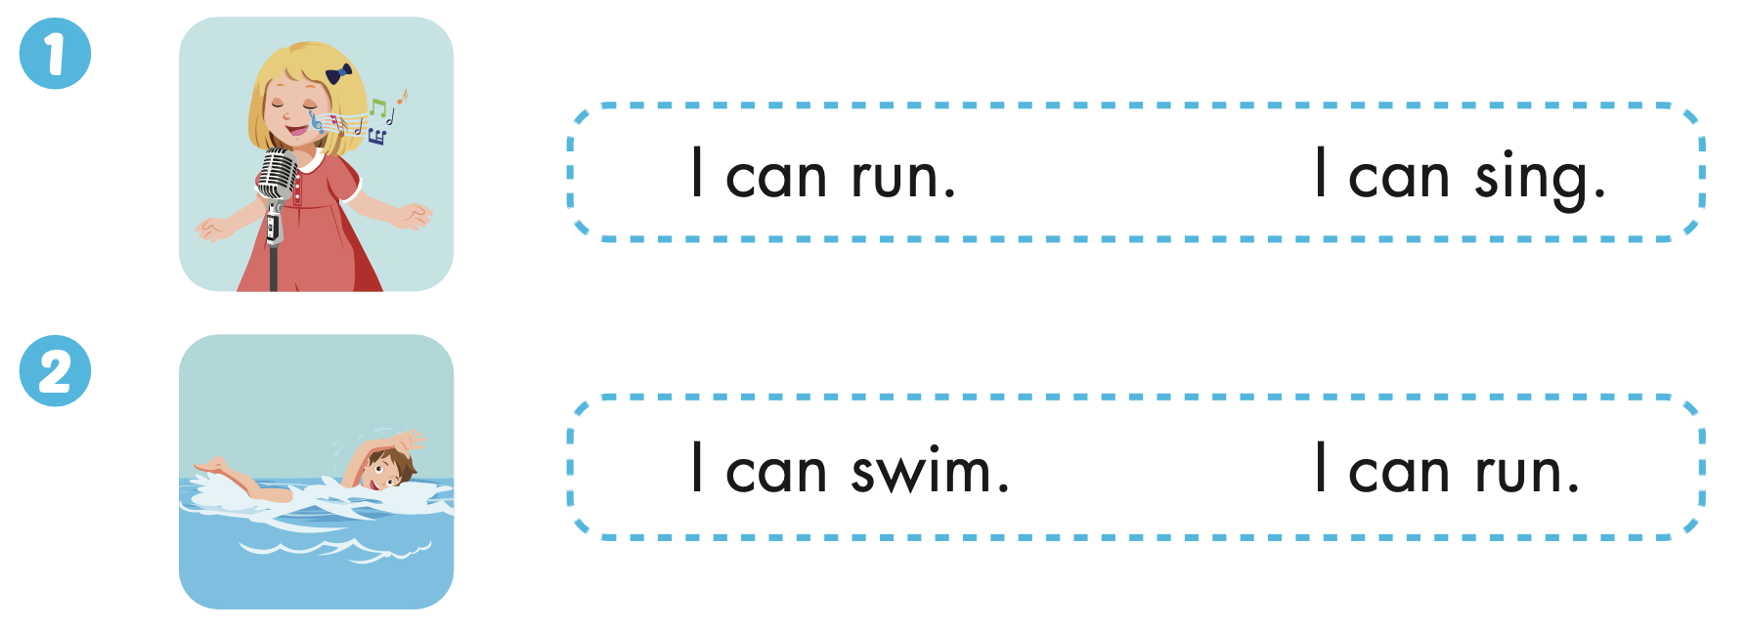
Extra Practice
WB, page 41

Slide 31

CONSOLIDATION

Slide 32
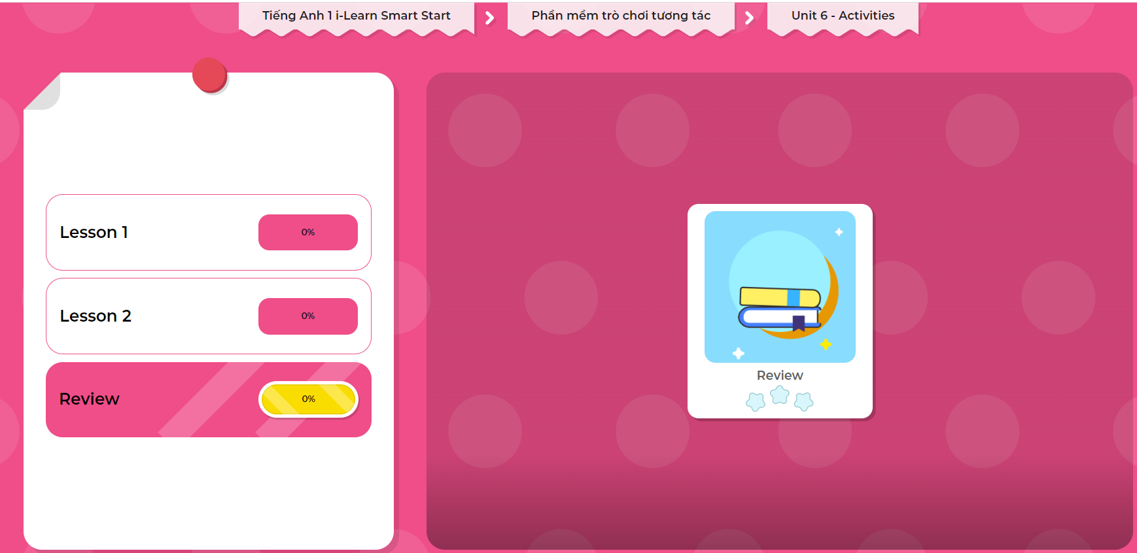
Extra Practice
DHA on Eduhome
LET’S PLAY!
Click on the picture below to play the games.

Slide 33
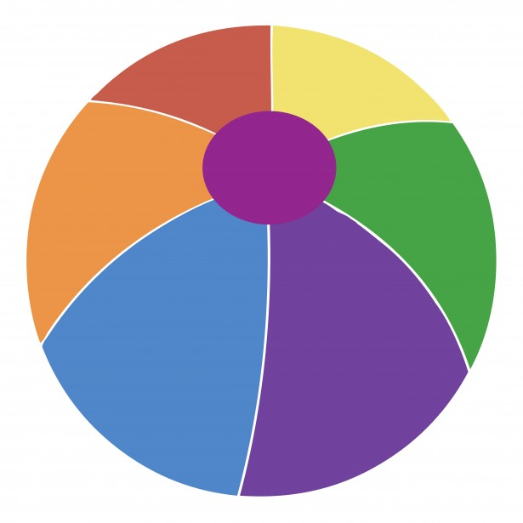
Let’s play!
Pass the ball game
Notes:
Choose a small soft ball. Play a song. When the music is playing, students must pass the ball. When the music stops, the student with the ball must stand up, everyone says: ”I can (run.)”

Slide 34

WRAP-UP

Slide 35
Today’s lesson
Vocabularies
Swim,
Sing,
Run
Structures/ Sentence patterns
I can (run).

Slide 36
Homework
Review the vocabularies and structure; and make sentences using them.
Do the exercises in Tiếng Anh 1 i-Learn Smart Start WB (page 41)
Prepare the next lesson (page 43 SB)
Play the consolidation games in Tiếng Anh 1 i-Learn Smart Start DHA App on www.eduhome.com.vn

Slide 37

Enjoy your day!

